Slide 1

Introduction to Software Engineering BY Dr. Rani Choudhary

Slide 2
What is Software Engineering ?
The term software engineering is the product of two words, software, and engineering.
The software is a collection of integrated programs.
Engineering is the application of scientific and practical
knowledge to invent, design, build, maintain, and improve
frameworks, processes, etc.

Slide 3
Software engineering is the establishment and use of sound engineering principles in order to obtain economical software that is reliable and works efficiently on real machines.
According to Fritz Bauer(1969)……..
Software Engineering is an engineering branch related to the evolution of software product using well-defined scientific principles, techniques, and procedures. The result of software engineering is an effective and reliable software product.

Slide 4
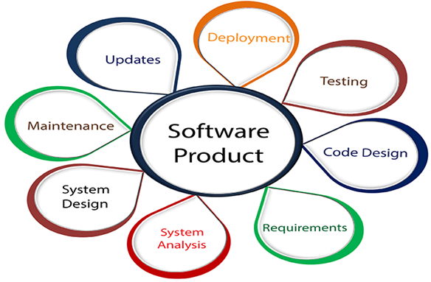

Slide 5
Characteristics of software in software engineering:
Software is developed or engineered; it is not manufactured in the classical sense:
Although some similarities exist between software development and hardware manufacturing, few activities are fundamentally different.
The software doesn’t “wear out.”:
There are no software spare parts.
When a hardware component wears out, it is replaced by a spare part.
The Software is flexible.
Reusability of Components.
The software continues to be custom-built:
A software part should be planned and carried out with the goal that it tends to be reused in various projects.

Slide 6
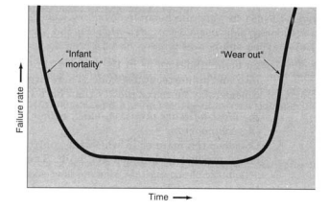
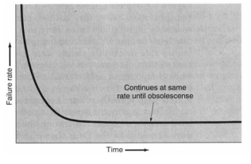
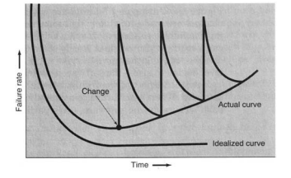
Software is deteriorating due to change

Slide 7
THE EVOLVING ROLE OF SOFTWARE
Today, software takes on a dual role.
It is a product and, at the same time, the vehicle for delivering a product.
As a product, it delivers the computing potential embodied by computer hardware. Whether it resides within a mobile phone or operates inside a mainframe computer, software is an information transformer.
As the vehicle used to deliver the product, software acts as the basis for the control of the computer (operating systems), the communication of information (networks), and the creation and control other programs (software tools and environments).

Slide 8
Changing Nature of Software:
The nature of software has changed a lot over the years.
System software: Infrastructure software come under this category like compilers, operating systems, editors, drivers, etc. Basically system software is a collection of programs to provide service to other programs.
Real time software: These software are used to monitor, control and analyze real world events as they occur. An example may be software required for weather forecasting. Such software will gather and process the status of temperature, humidity and other environmental parameters to forecast the weather.

Slide 9
3. Embedded software: This type of software is placed in “Read-Only- Memory (ROM)” of the product and control the various functions of the product. The product could be an aircraft, automobile, security system, signaling system, control unit of power plants, etc. The embedded software handles hardware components and is also termed as intelligent software .
4. Business software : This is the largest application area. The software designed to process business applications is called business software. Business software could be payroll, file monitoring system, employee management, account management. It may also be a data warehousing tool which helps us to take decisions based on available data. Management information system, enterprise resource planning (ERP) and such other software are popular examples of business software.

Slide 10
5. Personal computer software: The software used in personal computers are covered in this category. Examples are word processors, computer graphics, multimedia and animating tools, database management, computer games etc. This is a very upcoming area and many big organizations are concentrating their effort here due to large customer base.
6. Artificial intelligence software: Artificial Intelligence software makes use of non numerical algorithms to solve complex problems that are not amenable to computation or straight forward analysis. Examples are expert systems, artificial neural network, signal processing software etc.
7. Web based software: The software related to web applications come under this category. Examples are HTML, Java, Perl, DHTML etc.

Slide 11
Importance of Software Engineering
Reduces Complexity
To minimize Software Cost
To decrease time
Handling big Projects
Reliable Software
Effectiveness
Productivity

Slide 12
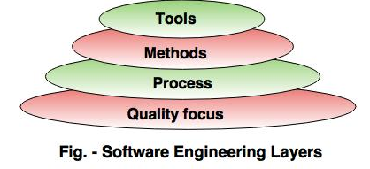
Software engineering - Layered technology
Software engineering is a fully layered technology.
To develop a software, we need to go from one layer to another.
All these layers are related to each other and each layer demands the fulfillment of the previous layer.

Slide 13
1. Quality focus: The characteristics of good quality software are
a. Correctness of the functions .
b. Maintainability of the software
c. Integrity i.e. providing security
d. Usability
2. Process:- It is the base layer or foundation layer for the software engineering.
The software process is the key to keep all levels together. It covers all activities, actions and tasks required to be carried out for software development.
3. Methods:- The method provides the answers of all 'how-to' that are asked during the process.
It provides the technical way to implement the software. It includes collection of tasks starting from communication, requirement analysis, analysis and design modelling, program construction, testing and support.
4. Tools:- The software engineering tool is an automated support for the software development. The tools are integrated i.e the information created by one tool can be used by the other tool.
For example: The Microsoft publisher can be used as a web designing tool.

Slide 14
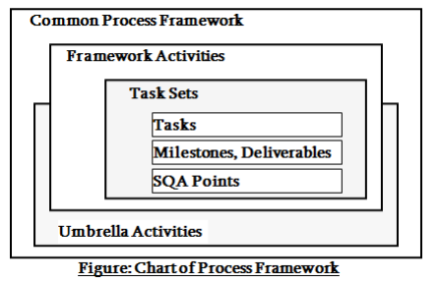
Software Process Framework
A process framework establishes the foundation for a complete software process by identifying a small number of framework activities that are applicable to all software projects, regardless of size or complexity. It also includes a set of umbrella activities that are applicable across the entire software process. Some most applicable framework activities are described below

Slide 15
Software Process
A software process (also knows as software methodology) is a set of related activities that leads to the production of the software. These activities may involve the development of the software from the scratch, or, modifying an existing system.
Communication
Planning
Modeling
Construction
Deployment

Slide 16
Process Models/SDLC Models
A framework that describes the activities performed at each stage of a software development project.
Waterfall Model
V-Shaped Model
Iterative Model
Spiral Model
Bigbang Model
Agile Model

Slide 17
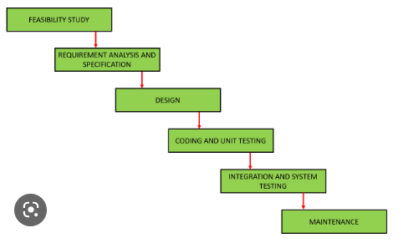
Waterfall Model
Requirements – defines needed information, function, behavior, performance and interfaces.
Design – data structures, software architecture, interface representations, algorithmic details.
Implementation – source code, database, user documentation, testing.

Slide 18
Feasibility Study-
Abstract definition of the problem
Formulation of the different solution strategies
Examination of alternate solution strategies and their benefits
A cost/benefit analysis is performed to determine which solution is the best
2. Requirement Analysis and Specification;- to understand the exact requirement of the customer and document them properly.
a. Requirement Analysis
b. Requirement Specification
3. Design- Translate the SRS document in to design document
a. Traditional Design approach- structural analysis and software design
b. Object-oriented design
4. Coding and unit testing::- each component of the design is implemented as a program module. Module is unit tested ,debugged and documented.
5. Integration and system testing:-
alpha testing
Beta testing
Acceptance testing
6. Maintenance:-
Corrective Maintenance
Perfective Maintenance
Adaptive maintenance

Slide 19
When to use SDLC Waterfall Model?
Waterfall Methodology can be used when:
Requirements are not changing frequently
Application is not complicated and big
Project is short
Requirement is clear
Environment is stable
Technology and tools used are not dynamic and is stable
Resources are available and trained

Slide 20
Waterfall Strengths
Easy to understand, easy to use
Provides structure to inexperienced staff
Milestones are well understood
Sets requirements stability
Good for management control (plan, staff, track)
Works well when quality is more important than cost or schedule

Slide 21
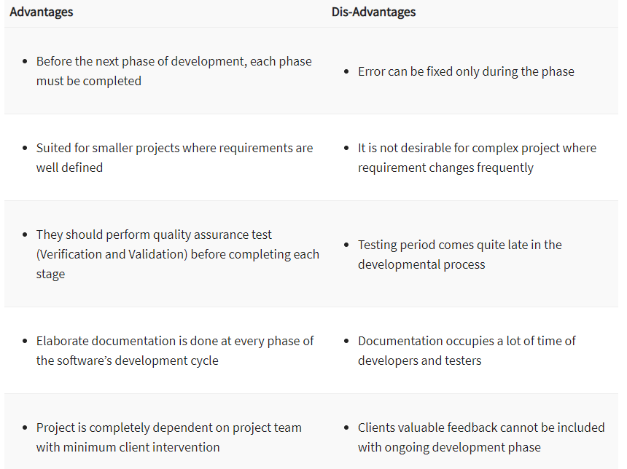


Slide 22
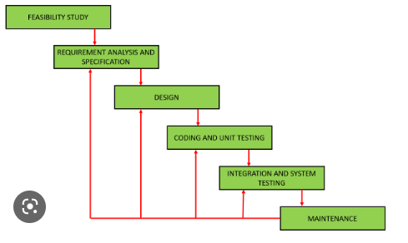
Iterative Waterfall Model

Slide 23
Prototype model
The Prototype model is one of the software development life cycle models in which a prototype is built with minimal requirements. This prototype is then tested and modified based on the feedback received from the client until a final prototype with desired functionalities gets created. This final prototype also acts as a base for the final product.
Phases of Prototype Model
The following are the primary phases involved in the development cycle of any prototype model.
Initial Communication – In this phase, business analysts and other individuals responsible for collecting the requirements and discussing the need for the product, meet the stakeholders or clients.
Quick Plan – Once basic requirements have been discussed, a quick plan of the initial prototype is made.

Slide 24
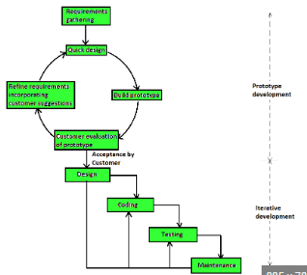

Slide 25
Modeling Quick Design – User interface part i.e. designing part of the prototype is carried out in this phase.
Development of the Prototype – In this phase, the designed prototype is coded and developed.
Deployment, Delivery, and Feedback of the Prototype – In this phase, the initial prototype is deployed and is accessible to clients for its use. Clients review or evaluate the prototype and they provide their feedback to the requirements gathering and development teams. Above mentioned phases keep repeating until the replica of the final product is deployed.
Final Product Design, Implementation, Testing, Deployment, and Maintenance – Once the client finalizes a prototype, on the basis of the prototype, the final product is designed and developed. This developed product is tested by the testing team and if it is ready to go LIVE, the product is deployed and is available for end-user.

Slide 26
Types of Prototype Model
Developers can choose from available prototype model types based on the product’s requirements –
Rapid Throwaway Prototyping
Evolutionary Prototyping
Incremental Prototyping
Extreme Prototyping

Slide 27
Advantages of Prototype Model
Quick client feedback is received which speeds up the development process. Also, it helps the development team to understand the client’s needs.
Developed prototypes can be used later for any similar projects.
Any missing functionality and any error can be detected early.
It is useful when requirements are not clear from the client’s end, even with limited requirements, the development team can start the development process.

Slide 28
Disadvantages of Prototype Model
It is a time-consuming process or method as multiple prototypes might be needed until the client reaches the final requirements. The Client may not have an explicit idea about what they want.
This method involves too much client interaction and involvement, which can be done only with a committed client.
In the beginning, it is a bit difficult to predict the exact amount of time needed to reach the final product.
While coding, developers do not have a broad perspective of what is coming, because of which they might use an underlying architecture that is not suitable for a final product.
To produce the quick prototype, developers might make weak decisions during the development process (especially implementation decisions), and compromise on quality which might eventually affect the product.

Slide 29
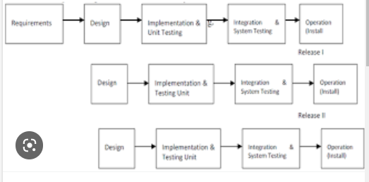
Iterative Enhancement Model

Slide 30
The iterative enhancement model in software engineering combines elements of the linear sequential model with the iterative philosophy of prototyping. In this model, the software is broken down into several modules which are incrementally developed and delivered. Firstly, the development team develops the core module of the system. After that, it is refined into increasing levels of capacity of adding new functionalities in successive versions.
When to Use Iterative Model:
Model is used where risk of long project can not be taken.
This model is for businesses where time is of essence.

Slide 31
Advantages of Iterative Enhancement Model:
The feedback from early increment improves the later stages.
The possibility of changes in requirement is reduced due to the shorter time span between the design component and its delivery.
Users get benefits earlier than the conventional approach.
Smaller sub-projects are easier to control and manages.
File priority features are incorporated in early deliverables.

Slide 32
Disadvantage of Model:
Programmers may have more productive working on one large system than on the series.
The development cost of the total product is higher.
The time period for the delivery of the entire functionality is higher.
Planning of delivery increments is critical to success.
Wrong planning results to disaster.

Slide 33
Evolutionary Model
Evolutionary model is also referred to as the successive versions model and sometimes as the incremental model. In Evolutionary model, the software requirement is first broken down into several modules (or functional units) that can be incrementally constructed and delivered (see Figure 5).
The development first develops the core modules of the system. The core modules are those that do not need services from the other modules. The initial product skeleton is refined into increasing levels of capability by adding new functionalities in successive versions. Each evolutionary model may be developed using an iterative waterfall model of development.

Slide 34
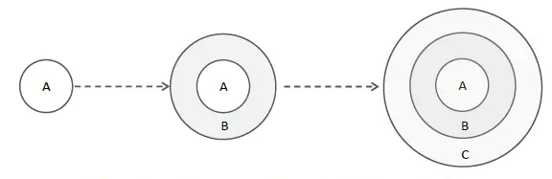

Slide 35
Advantage of the Model:
Risk analysis is better.
It supports changing environment.
Initial operating time is less.
Better suited for large mission-critical projects.
During the life cycle software is produced early which facilitates customer evaluation and feedxback.

Slide 36
Disadvantage of the Model:
Management complexity is more.
Not suitable for smaller projects.
Can be costly to use.
Highly skilled resources are required for risk analysis.
Where to use Evolutionary Model:
Very useful for large projects.
Well suited for projects using object-oriented development.
When a client prefers to have the product in increments so that he can began using the specific characteristics as they are provided rather than waiting for the entire thing to be manufactured and delivered, this model is frequently adopted.

Slide 37
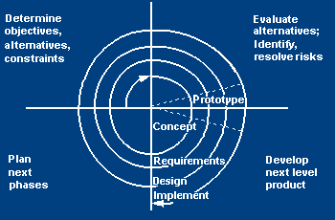
Spiral Model

Slide 38
Spiral model is one of the most important Software Development Life Cycle models, which provides support for Risk Handling. In its diagrammatic representation, it looks like a spiral with many loops. The exact number of loops of the spiral is unknown and can vary from project to project. Each loop of the spiral is called a Phase of the software development process. The exact number of phases needed to develop the product can be varied by the project manager depending upon the project risks. As the project manager dynamically determines the number of phases, so the project manager has an important role to develop a product using the spiral model.
Each cycle involves the same sequence of steps as the waterfall process model

Slide 39
Spiral Quadrant Determine objectives, alternatives and constraints
Objectives: functionality, performance, hardware/software interface, critical success factors, etc.
Alternatives: build, reuse, buy, sub-contract, etc.
Constraints: cost, schedule, interface, etc.
Requirements are gathered from the customers and the objectives are identified, elaborated, and analyzed at the start of every phase. Then alternative solutions possible for the phase are proposed in this quadrant.

Slide 40
Spiral Quadrant Evaluate alternatives, identify and resolve risks
Study alternatives relative to objectives and constraints
Identify risks (lack of experience, new technology, tight schedules, poor process, etc.
Resolve risks (evaluate if money could be lost by continuing system development
During the second quadrant, all the possible solutions are evaluated to select the best possible solution. Then the risks associated with that solution are identified and the risks are resolved using the best possible strategy. At the end of this quadrant, the Prototype is built for the best possible solution.

Slide 41
Spiral Quadrant Develop next-level product
Typical activites:
Create a design
Review design
Develop code
Inspect code
Test product
During the third quadrant, the identified features are developed and verified through testing. At the end of the third quadrant, the next version of the software is available

Slide 42
Spiral Quadrant Plan next phase
Typical activities
Develop project plan
Develop configuration management plan
Develop a test plan
Develop an installation plan
In the fourth quadrant, the Customers evaluate the so far developed version of the software. In the end, planning for the next phase is started.

Slide 43
Spiral Model Strengths
Provides early indication of insurmountable risks, without much cost
Users see the system early because of rapid prototyping tools
Critical high-risk functions are developed first
The design does not have to be perfect
Users can be closely tied to all lifecycle steps
Early and frequent feedback from users
Cumulative costs assessed frequently

Slide 44
Spiral Model Weaknesses
Time spent for evaluating risks too large for small or low-risk projects
Time spent planning, resetting objectives, doing risk analysis and prototyping may be excessive
The model is complex
Risk assessment expertise is required
Spiral may continue indefinitely
May be hard to define objective, verifiable milestones that indicate readiness to proceed through the next iteration

Slide 45
When to use Spiral Model
When creation of a prototype is appropriate
When costs and risk evaluation is important
For medium to high-risk projects
Long-term project commitment unwise because of potential changes to economic priorities
Users are unsure of their needs
Requirements are complex
New product line
Significant changes are expected (research and exploration)

Slide 46
Advantages of Spiral Model:
Risk Handling
Good for large projects
Flexibility in Requirements
Customer Satisfaction
Iterative and Incremental Approach
Emphasis on Risk Management
Improved Communication
Improved Quality

Slide 47
Disadvantages of Spiral Model:
Complex: The Spiral Model is much more complex than other SDLC models.
Expensive: Spiral Model is not suitable for small projects as it is expensive.
Too much dependability on Risk Analysis
Difficulty in time management
Complexity: The Spiral Model can be complex, as it involves multiple iterations of the software development process.
Time-Consuming: The Spiral Model can be time-consuming, as it requires multiple evaluations and reviews.
Resource Intensive: The Spiral Model can be resource-intensive, as it requires a significant investment in planning, risk analysis, and evaluations.

Slide 48
RAD Model
RAD model refers to Rapid Application Development and it is a type of Incremental Model. The components or functions are developed in parallel and it can handle small projects as well as medium projects. In this model, any changes can be made at any stage. It has high productivity due to less number of people.
It focuses on input-output source and destination of the information. It emphasizes on delivering projects in small pieces; the larger projects are divided into a series of smaller projects. The main features of RAD modeling are that it focuses on the reuse of templates, tools, processes, and code.

Slide 49
RAD (Rapid Application Development) is a concept that products can be developed faster and of higher quality through:
Gathering requirements using workshops or focus groups
Prototyping and early, reiterative user testing of designs
The re-use of software components
A rigidly paced schedule that refers design improvements to the next product version
Less formality in reviews and other team communication

Slide 50
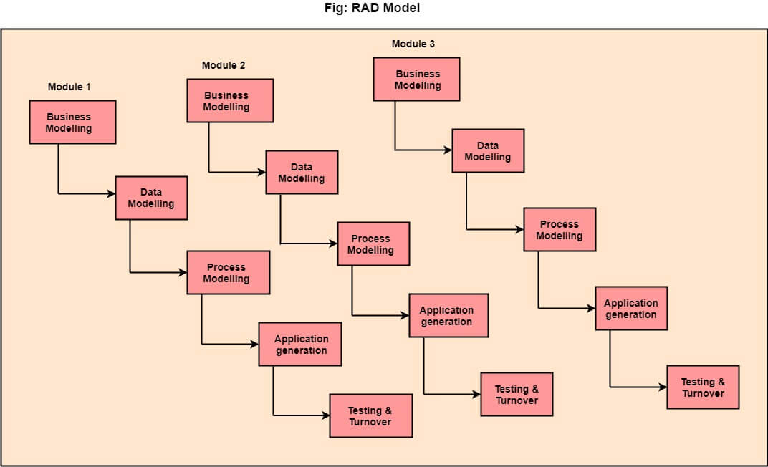

Slide 51
The various phases of RAD are as follows:
1.Business Modelling: The information flow among business functions is defined by answering questions like what data drives the business process, what data is generated, who generates it, where does the information go, who process it and so on.
2. Data Modelling: The data collected from business modeling is refined into a set of data objects (entities) that are needed to support the business. The attributes (character of each entity) are identified, and the relation between these data objects (entities) is defined.
3. Process Modelling: The information object defined in the data modeling phase are transformed to achieve the data flow necessary to implement a business function. Processing descriptions are created for adding, modifying, deleting, or retrieving a data object.
4. Application Generation: Automated tools are used to facilitate construction of the software; even they use the 4th GL techniques.
5. Testing & Turnover: Many of the programming components have already been tested since RAD emphasis reuse. This reduces the overall testing time. But the new part must be tested, and all interfaces must be fully exercised.

Slide 52
When to use RAD Methodology?
When a system needs to be produced in a short span of time (2-3 months)
When the requirements are known
When the user will be involved all through the life cycle
When technical risk is less
When there is a necessity to create a system that can be modularized in 2-3 months of time
When a budget is high enough to afford designers for modeling along with the cost of automated tools for code generation

Slide 53
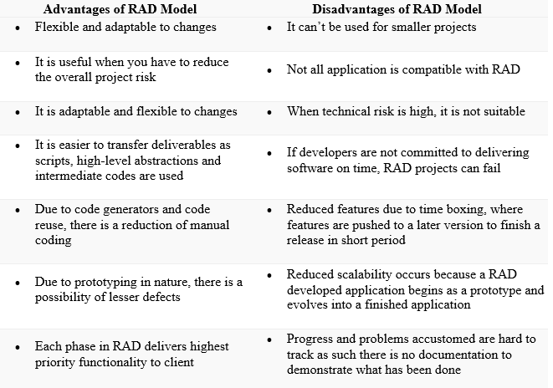

Slide 54
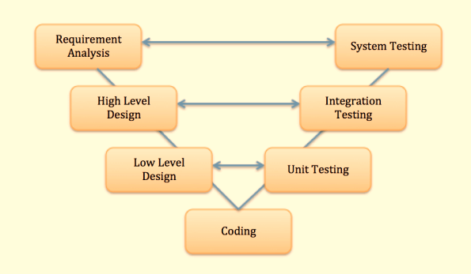
V-Model

Slide 55
V Model is a highly disciplined SDLC model which has a testing phase parallel to each development phase. The V model is an extension of the waterfall model wherein software development and testing is executed in a sequential way. It is known as the Validation or Verification Model.
SDLC- Software Development Life Cycle (Left Side )
STLC- Software Testing life Cycle(Right Side)

Slide 56
Agile Process: Agility is defined as the ability of a project team to respond rapidly to a change.
12 Principles of Agile process:-
The highest priority of this process is to satisfy the customer.
Acceptance of changing requirement even late in development.
Frequently deliver a working software in small time span.
Throughout the project business people and developers work together on daily basis.
Projects are created around motivated people if they are given the proper environment and support.
Face to face interaction is the most efficient method of moving information in the development team.
Primary measure of progress is a working software.
Agile process helps in sustainable development.
Continuous attention to technical excellence and good design increases agility.
From self organizing teams the best architecture, design and requirements are emerged.
Simplicity is necessary in development.

Slide 57
Agile process model
The meaning of Agile is swift or versatile."Agile process model" refers to a software development approach based on iterative development. Agile methods break tasks into smaller iterations, or parts do not directly involve long term planning. The project scope and requirements are laid down at the beginning of the development process. Plans regarding the number of iterations, the duration and the scope of each iteration are clearly defined in advance.
Each iteration is considered as a short time "frame" in the Agile process model, which typically lasts from one to four weeks. The division of the entire project into smaller parts helps to minimize the project risk and to reduce the overall project delivery time requirements. Each iteration involves a team working through a full software development life cycle including planning, requirements analysis, design, coding, and testing before a working product is demonstrated to the client.

Slide 58
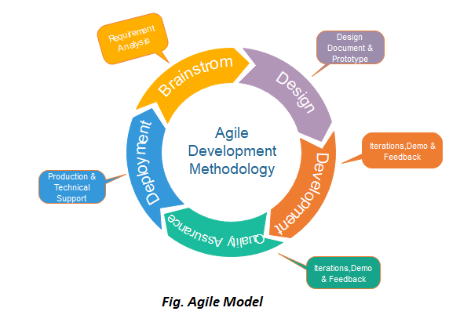

Slide 59
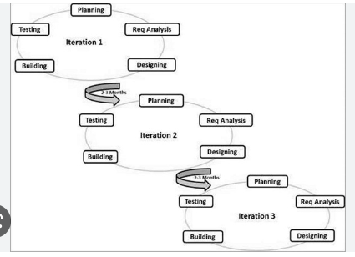

Slide 60
Who Uses Agile?
Any of these project teams can benefit from using Agile:
Teams handling fast-changing deliverables, such as technology products
Teams working on projects that evolve or do not have clear scope and requirements at the beginning
Teams working closely with customers and other external parties throughout a project
Teams that emphasize process and product improvement and need a method for continual advancement
Teams with numerous interdependent tasks needing to work closely together and frequently communicate to ensure success
Teams creating prototypes before building the final project outcome
Teams that must have rapid feedback from each product iteration before creating the next draft

Slide 61
Agile Process Models
Extreme Programming (XP)
Adaptive Software Development (ASD)
Dynamic Systems Development Method (DSDM)
Scrum.
Crystal.
Feature Driven Development (FDD)
Agile Modeling (AM)

Slide 62
Extreme Programming (XP)
The Extreme Programming is commonly used agile process model.
It uses the concept of object-oriented programming.
A developer focuses on the framework activities like planning, design, coding and testing. XP has a set of rules and practices.
Extreme Programming (XP) is an agile software development framework that aims to produce higher quality software, and higher quality of life for the development team. XP is the most specific of the agile frameworks regarding appropriate engineering practices for software development.

Slide 63
The XP process comprises four framework activities:
1. Planning:- Planning starts with the requirements gathering which enables XP team to understand the rules for the software. The customer and developer work together for the final requirements.
2. Design:- The XP design follows the 'keep it simple' principle. A simple design always prefers the more difficult representation.
3. Coding:-The coding is started after the initial design work is over. After the initial design work is done, the team creates a set of unit tests which can test each situation that should be a part of the release. The developer is focused on what must be implemented to pass the test.
Two people are assigned to create the code. It is an important concept in coding activity.
4. Testing:- Validation testing of the system occurs on a daily basis. It gives the XP team a regular indication of the progress. 'XP acceptance tests' are known as the customer test.

Slide 64
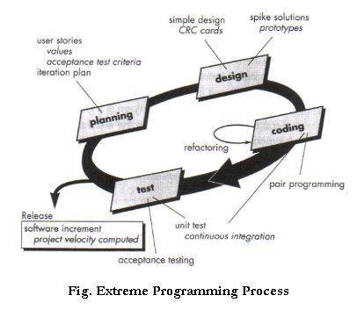

Slide 65
What is Scrum?
Scrum is a framework that helps agile teams to work together. Using it, the team members can deliver and sustain the complex product. It encourages the team to learn through practice, self-organize while working on the problem. Scum is a work done through the framework and continuously shipping values to customers.
It is the most frequent software that is used by the development team. Its principle and lessons can be applied to all kinds of teamwork. Its policy and experiences is a reason of popularity of Scrum framework. The Scrum describes a set of tools, meetings, and roles that help the teams structure. It also manages the work done by the team
The framework
Scrum and agile are not the same thing because Scrum focused on continuous improvement, which is a core foundation of agile. Scrum framework focuses on ongoing getting work done.
What are sprints?
With scrum, a product is built in a series of repetition called sprints. It breaks down big complex projects into bite-size pieces. It makes projects more manageable, allows teams to ship high quality, work faster, and more frequently. The sprints give them more flexibility to adapt to the changes.

Slide 66
Sprints are a short, time-boxed period for Scrum team that works to complete a set amount of work. Sprints are the core component of Scrum and agile methodology. The right sprints will help our agile team to ship better software.
What is sprint plan?
Sprint plan is an action in Scrum that kicks off the sprint. The primary purpose of sprint plan is to define what can deliver in the sprint. It also focuses on how the work will be achieved. It is done in combination with the whole Scrum team members.
The sprint is a set of the period where all the work to be done. Before we start the development, we have to set up the sprint. We need to describe how long time is required to achieve the sprint goal and where we are going to start.
Factors affecting Sprint planning
The What: The product owner describes the goal of the sprint and the backlog items which contribute to achieve that goal.
The How: Agile development team plans its necessary work on how to achieve and deliver the sprint goal.
The Who: The product owner defines the goal based on the value that the customers seek. And the developer needs to understand how they can or cannot deliver that goal.
The Inputs: The product backlog provides the list of input stuff that could potentially be part of the current sprint. The team looks over the existing work done in incremental ways.
The Outputs: The critical outcome of sprint planning is to meet described team goal. The product set the goal of sprint and how they will start working towards the goal.

Slide 67
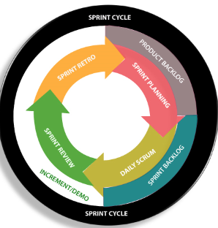

Slide 68
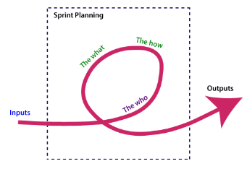

Slide 69
What is the product backlog?
A product backlog is a registered list of work for the development team. It is driven from the roadmap and its requirements. The essential task is represented at the top of the product backlog so that the team member knows what to deliver first. The developer team doesn't work through the backlog from the product owner's side and product owner doesn't push the work to the developer team. The developer team pulls work from the product backlog.
Backlog starts with the two "R"s
The fundamental product backlog is provided by a team's roadmap and requirements. Roadmap repetition breaks down into several epics, and each epic will have several requirements and user stories.
The product owner organizes each of the customer stories into a single list. This story is organized for the development team. The product owner chooses to deliver first complete epic.

Slide 70
Scrum is the type of Agile framework. It is a framework within which people can address complex adaptive problem while productivity and creativity of delivering product is at highest possible values. Scrum uses Iterative process.
Silent features of Scrum are:
Scrum is light-weighted framework
Scrum emphasizes self-organization
Scrum is simple to understand
Scrum framework help the team to work together

Slide 71
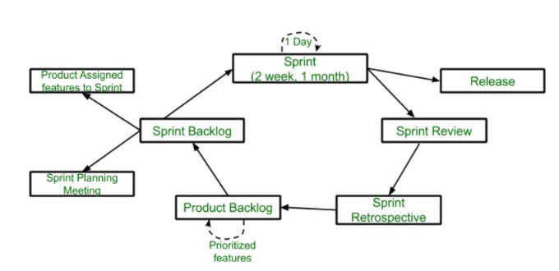
Lifecycle of scrum

Slide 72
Sprint: A Sprint is a time-box of one month or less. A new Sprint starts immediately after the completion of the previous Sprint.
Release: When the product is completed then it goes to the Release stage.
Sprint Review: If the product still have some non-achievable features then it will be checked in this stage and then the product is passed to the Sprint Retrospective stage.
Sprint Retrospective: In this stage quality or status of the product is checked.
Product Backlog: According to the prioritize features the product is organized.
Sprint Backlog: Sprint Backlog is divided into two parts Product assigned features to sprint and Sprint planning meeting.

Slide 73
Advantage of using Scrum framework:
Scrum framework is fast moving and money efficient.
Scrum framework works by dividing the large product into small sub-products. It’s like a divide and conquer strategy
In Scrum customer satisfaction is very important.
Scrum is adaptive in nature because it have short sprint.
As Scrum framework rely on constant feedback therefore the quality of product increases in less amount of time

Slide 74
Disadvantage of using Scrum framework:
Scrum framework do not allow changes into their sprint.
Scrum framework is not fully described model. If you want to adopt it you need to fill in the framework with your own details like Extreme Programming(XP), Kanban, DSDM.
It can be difficult for the Scrum to plan, structure and organize a project that lacks a clear definition.
The daily Scrum meetings and frequent reviews require substantial resources.

Slide 75
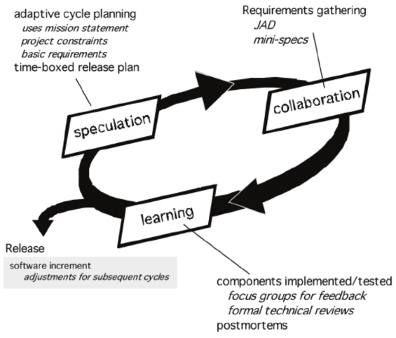
ASD Model

Slide 76
Advantages of adaptive software development
There are several benefits to the ASD approach. These include:
A better and stronger overall end product.
Increased transparency between developers and customers.
A user-first approach which leads to a more intuitive piece of software.
Higher likelihood of on-time (or early!) delivery,

Slide 77
Disadvantages of adaptive software development drawbacks
However, no agile framework is perfect! With ASD, there are a few drawbacks that need to be weighed against the benefits:
Extensive testing can lead to higher project costs.
The level of user involvement required can be difficult to resource.
An emphasis on constant product iteration and feedback can lead to burnout.
Lastly, ASD works better where teams can be dedicated solely to a single project.

Slide 78
Requirement Engineering
“Requirement engineering can be defined as the systematic process of documenting requirements through an interactive and co-operative process of analyzing the problem, documenting the resulting observations in a variety of representation format and checking the accuracy of the understanding gain.”
Requirements engineering is the discipline that involves establishing and documenting requirements. The various activities associated with requirements engineering are elicitation, specification, analysis, verification and validation, and management.
A software requirement is a capability that somebody needs or wants. It can be a component of an entire new application , a new feature for an existing application(an enhancement), or a request to correct a current shortcoming

Slide 79
Requirement Engineering tools/ Techniques
1. Psychology and Sociology
2. marketing
3. Object oriented Analysis
4. observation report
5. Questionnaire ( survey , poll )
6. Use cases
7. User stories
8. Requirement workshop
9. Prototyping
10. Structured Analysis
11. Participative Design

Slide 80
Requirements Engineering Process consists of the following main activities:
Requirements elicitation
Requirements specification
Requirements verification and validation
Requirements management

Slide 81
Requirement engineering Process
1. Feasibility Study
2. Requirement Elicitation
3. Requirement Analysis
4. Documentation or Requirement specification
5. Requirement Validation
6. Review of user needs
7. Management of user needs

Slide 82
1. Feasibility Study
1. Information Assessment
2. Information Collection
3. Report Writing

Slide 83
2. Requirement Elicitation
1. Brainstorming
2. Interviewing
3. FAST(Facilitated Application Specification Technique)
4. Joint Application Design(JAD)
5. Use Case Scenarios
6. Quality Function Deployment(QFD)
7. Form Analysis
8. Task Analysis
9. Delphi Techniques

Slide 84
Brainstorming
Three roles are required for Brainstorming Session:-
Leader
Scribe
Participant
FAST(Facilitated Application Specification Technique)
In order to reduce the expectation gap, a team oriented approach is develoed for requirements gathering known as FAST.

Slide 85
Interviewing
Create the questions
Select the Interviewer
Conduct the Interview
Quality Function Deployment(QFD)
Normal Requirement
Expected Requirement
Exciting Requirement

Slide 86
Delphi Techniques

Slide 87
3. Requirement Analysis
What is the Problem?
Why is it important to solve the problem?
What are the possible solutions to the problem?
What are the exact data inputs and data outputs to the system?
What are likely complexities that might arise while solving the problem?

Slide 88
4. Requirement Specification
The production of the requirements stage of the software development process is Software Requirements Specifications (SRS) (also called a requirements document). This report lays a foundation for software engineering activities and is constructing when entire requirements are elicited and analyzed. SRS is a formal report, which acts as a representation of software that enables the customers to review whether it (SRS) is according to their requirements. Also, it comprises user requirements for a system as well as detailed specifications of the system requirements.

Slide 89
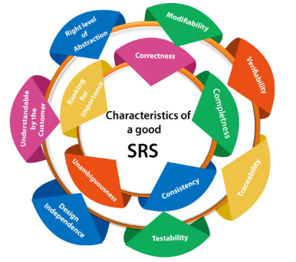
Characteristics of a good SRS document

Slide 90
5. Review of user needs
6. Management of user needs

Slide 91
Information Modeling
1. SA Methodology:
DFD
Context Diagram
Event List
Data Dictionary
Process Spec.
ER Diagram
State transition Diagram
2. SD Methodology

Slide 92
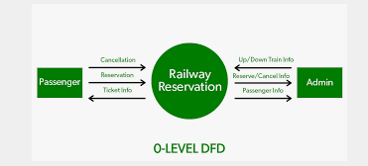
DFD
Context diagram /0 level DFD

Slide 93
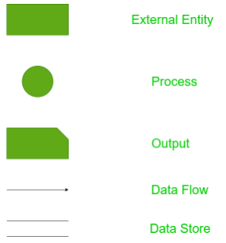

Slide 94
Advantage and Disadvantage of DFD:-
1. Advantages of data flow diagram:
It aids in describing the boundaries of the system.
It is beneficial for communicating existing system knowledge to the users.
A straightforward graphical technique which is easy to recognise.
DFDs can provide a detailed representation of system components.
It is used as the part of system documentation file.
DFDs are easier to understand by technical and nontechnical audiences
It supports the logic behind the data flow within the system.

Slide 95
Disadvantages of data flow diagram:
It make the programmers little confusing concerning the system.
The biggest drawback of the DFD is that it simply takes a long time to create, so long that the analyst may not receive support from management to complete it.
Physical considerations are left out.

Slide 96
Context diagram /0-Level diagram
1- Level DFD diagram
2- level DFD Diagram

Slide 97
Process Specification:-
Used to give the description of logic contained in a process at the lowest level of decomposition. Process specification can be written using:-
Decision table
Decision tree
Flow charts
Structural language

Slide 98
Design engineering
Introduction to design process:
The main aim of design engineering is to generate a model which shows firmness, delight and commodity.
Software design is an iterative process through which requirements are translated into the blueprint for building the software.

Slide 99
Software Design Models
1. Static Model- Object & Class Diagram, use case diagrams, Implementation Diagrams, Operation Specification,
2. Dynamic Model- Interaction Diagram, State Charts, Data Flow diagrams, Decision tree and tables

Slide 100
General Design Process
Analyse the Problem
Generate/ Define the design
Review the design
Evaluate the design

Slide 101
Design concepts
The set of fundamental software design concepts are as follows:
1. Abstraction: A solution is stated in large terms using the language of the problem environment at the highest level abstraction.
The lower level of abstraction provides a more detail description of the solution.
A sequence of instruction that contain a specific and limited function refers in a procedural abstraction.
A collection of data that describes a data object is a data abstraction.

Slide 102
2. Architecture: The complete structure of the software is known as software architecture.
Structure provides conceptual integrity for a system in a number of ways.
The architecture is the structure of program modules where they interact with each other in a specialized way.
The components use the structure of data.
The aim of the software design is to obtain an architectural framework of a system.
The more detailed design activities are conducted from the framework.

Slide 103
3. Patterns: A design pattern describes a design structure and that structure solves a particular design problem in a specified content.
4. Modularity: A software is separately divided into name and addressable components.
Sometime they are called as modules which integrate to satisfy the problem requirements.
Modularity is the single attribute of a software that permits a program to be managed easily.

Slide 104
5. Information hiding: Modules must be specified and designed so that the information like algorithm and data presented in a module is not accessible for other modules , not requiring that information.
6. Functional independence:
The functional independence is the concept of separation and related to the concept of modularity, abstraction and information hiding.
The functional independence is accessed using two criteria i.e Cohesion and coupling.

Slide 105
Cohesion: Cohesion is an extension of the information hiding concept. A cohesive module performs a single task and it requires a small interaction with the other components in other parts of the program.
Coupling: Coupling is an indication of interconnection between modules in a structure of software.
Refinement: Refinement is a top-down design approach. It is a process of elaboration.
Refactoring: It is a reorganization technique which simplifies the design of components without changing its function behavior.
Design classes: The model of software is defined as a set of design classes.

Slide 106
Modularity
In software engineering, modularity refers to the extent to which a software/Web application may be divided into smaller modules. Software modularity indicates that the number of application modules are capable of serving a specified business domain.
Modularity is successful because developers use prewritten code, which saves resources. Overall, modularity provides greater software development manageability.

Slide 107
Advantages/ Importance of Modularity
1. Reduction in Product Development Time
2. Customization and Upgrades
3. Cost Efficiencies Due to Amortization
4. Quality
5. Design Standardization
6. Reduction in Order Lead Time

Slide 108
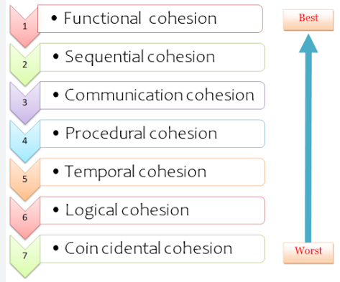
Cohesion

Slide 109
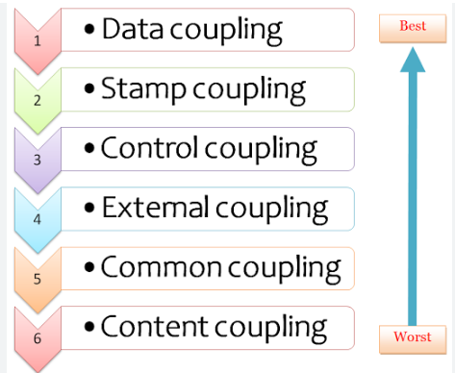
Coupling

Slide 110
Building analysis model
At technical level,SE begins with a building an analysis model of a target system
Requirements analysis
1. specifies software’s operational characteristics
2. indicates software's interface with other system ,with elements 
3. Establishes constraints that software must meet.

Slide 111
Data modelling
Data modelling is the process used to structure how data is stored, as well as modelling relationships within the data.
Database Data Modelling & Design Options
Relational Databases (Entity models): These are made from tables (tabular data) with solutions including SQL.
Object Databases (NoSQL): These are made up of key, value pairs and don’t have a strict schema, several solutions include MongoDB.
Graph Databases (Tree): Graph databases are often seen within social networks such as Facebook, a graph database is composed of nodes and edges.

Slide 112
Flow oriented modelling
It shows how data objects are transformed by processing the function.
The Flow oriented elements are:
Data flow model: It is a graphical technique. It is used to represent information flow.
The data objects are flowing within the software and transformed by processing the elements.
The data objects are represented by labeled arrows. Transformation are represented by circles called as bubbles.
DFD shown in a hierarchical fashion. The DFD is split into different levels. It also called as 'context level diagram.

Slide 113
Contd…
Control flow model: Large class applications require a control flow modeling. The application creates control information instated of reports or displays. The applications process the information in specified time. An event is implemented as a boolean value. For example, the boolean values are true or false, on or off, 1 or 0.
Control Specification: A short term for control specification is CSPEC. It represents the behavior of the system. The state diagram in CSPEC is a sequential specification of the behavior. The state diagram includes states, transitions, events and activities. State diagram shows the transition from one state to another state if a particular event has occurred.

Slide 114
Contd…
Process Specification: A short term for process specification is PSPEC. The process specification is used to describe all flow model processes. The content of process specification consists narrative text, Program Design Language(PDL) of the process algorithm, mathematical equations, tables or UML activity diagram.

Slide 115
Levels of Software Design process
1. Interface design
2. Architecture Design
3. Detailed Design

Slide 116
User Interface design
User interface is the front-end application view to which user interacts in order to use the software. The software becomes more popular if its user interface is:
Attractive
Simple to use
Responsive in short time
Clear to understand
Consistent on all interface screens

Slide 117
There are three types of User Interface:
Command Line Interface: Command Line Interface provides a command prompt, where the user types the command and feeds to the system. The user needs to remember the syntax of the command and its use.
Graphical User Interface: Graphical User Interface provides the simple interactive interface to interact with the system. GUI can be a combination of both hardware and software. Using GUI, user interprets the software.
Menu Based User Interface:-

Slide 118
Principles of User Interface design
1. Flexibility
2. Learnability
3. Robustness

Slide 119
Golden rules For UI designing
1. Place the user in control
2. Reduce the user’s memory load
3. Make the interface consistent

Slide 120
Design Steps for UI
1.Analysis and Modeling
2. Design
3. Construction
4. Validation

Slide 121
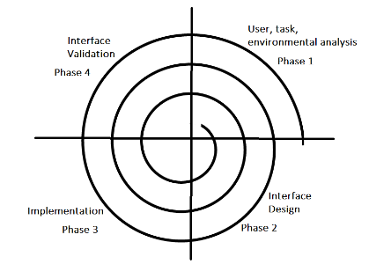
User Interface Design Process:

Slide 122
Architectural/ Structural design
1. Function Oriented Design
2. Object Oriented Design
In function-oriented design, the system is comprised of many smaller sub-systems known as functions. These functions are capable of performing significant task in the system. The system is considered as top view of all functions.
Function oriented design inherits some properties of structured design where divide and conquer methodology is used.
This design mechanism divides the whole system into smaller functions, which provides means of abstraction by concealing the information and their operation.. These functional modules can share information among themselves by means of information passing and using information available globally.

Slide 123
Design Process for Function oriented design
The whole system is seen as how data flows in the system by means of data flow diagram.
DFD depicts how functions changes data and state of entire system.
The entire system is logically broken down into smaller units known as functions on the basis of their operation in the system.
Each function is then described at large.

Slide 124
2. Object oriented design works around the entities and their characteristics instead of functions involved in the software system. This design strategies focuses on entities and its characteristics. The whole concept of software solution revolves around the engaged entities.
Design Process
Software design process can be perceived as series of well-defined steps. Though it varies according to design approach (function oriented or object oriented, yet It may have the following steps involved:
A solution design is created from requirement or previous used system and/or system sequence diagram.
Objects are identified and grouped into classes on behalf of similarity in attribute characteristics.
Class hierarchy and relation among them is defined.
Application framework is defined.

Slide 125
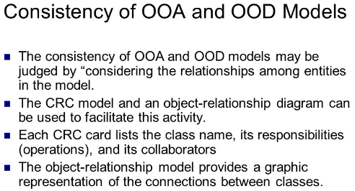
OOA and OOD:-

Slide 126
Introduction to Use Case Diagram
What are Use Cases?
In software and systems engineering, a use case is a list of actions or event steps, typically defining the interactions between a role (known in the Unified Modeling Language as an actor) and a system, to achieve a goal. The actor can be a human, an external system, or time. In systems engineering, use cases are used at a higher level than within software engineering, often representing missions or stakeholder goals. Another way to look at it is a use case describes a way in which a real-world actor interacts with the system.
In a system use case you include high-level implementation decisions. System use cases can be written in both an informal manner and a formal manner.

Slide 127
Contd…
What is the importance of Use Cases?
Use cases have been used extensively over the past few decades. The advantages of Use cases includes:
The list of goal names provides the shortest summary of what the system will offer.
It gives an overview of the roles of each and every component in the system. It will help us in defining the role of users, administrators etc.
It helps us in extensively defining the user’s need and exploring it as to how it will work

Slide 128
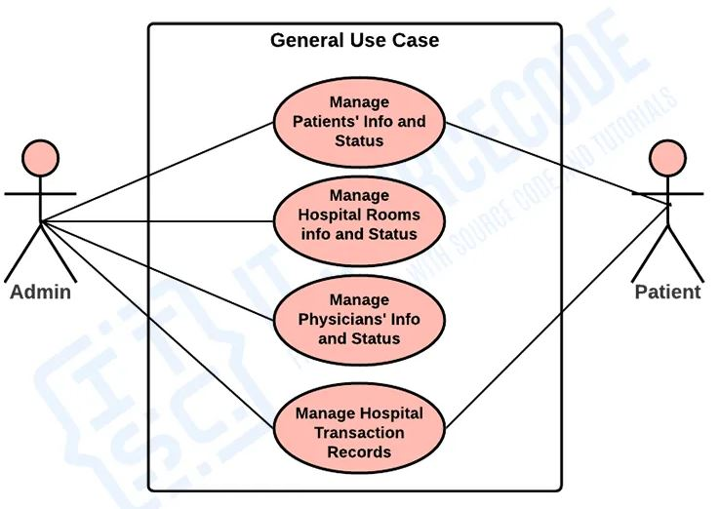
Contd…
The features of the system depends on the users of it.
General use case
Figure . General Use case diagram of hospital management system

Slide 129
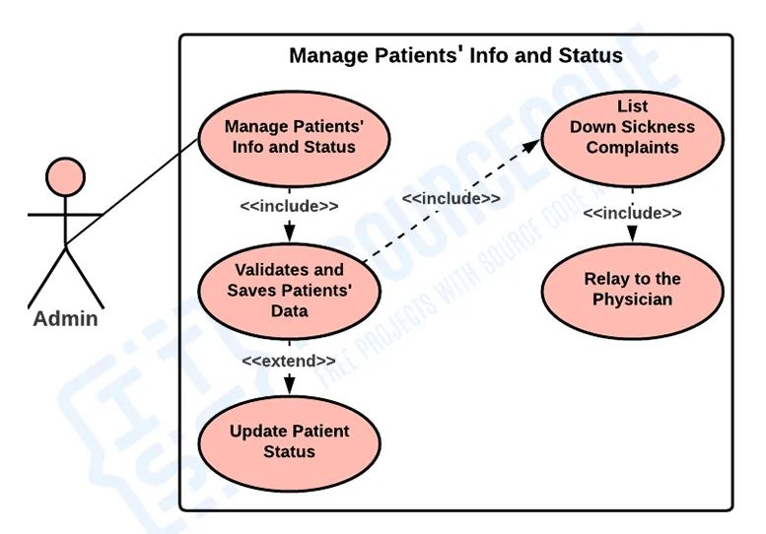
Contd…
Monitor and Manage Patients’ Information and Status
Figure . Use case diagram of Monitor and Manage Patients’ Information and Status

Slide 130
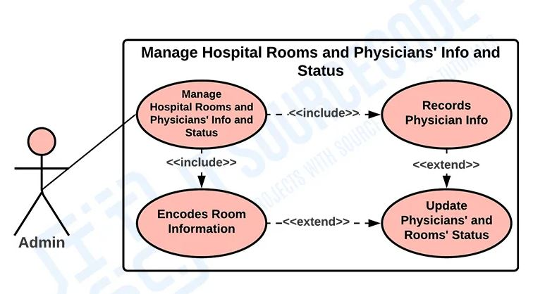
Contd…
Manage Hospital Rooms and Physicians’ Info and Status
Figure . Use case diagram of Manage Hospital Rooms and Physicians’ Info and Status

Slide 131
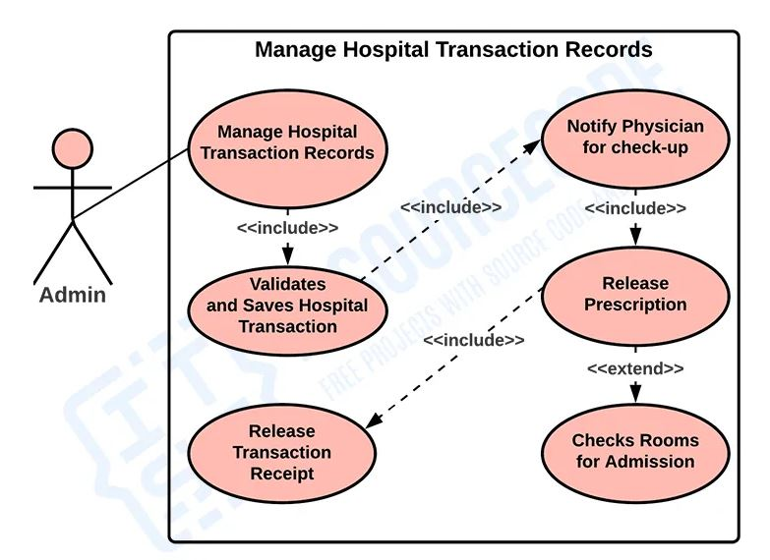
Contd…
Monitor Hospital Transaction Records
Figure . Use case diagram of Monitor Hospital Transaction Records

Slide 132
Introduction to class diagram
A Class Diagram in Software engineering is a static structure that gives an overview of a software system by displaying classes, attributes, operations, and their relationships between each other.
Class Diagram defines the types of objects in the system and the different types of relationships that exist among them. It gives a high-level view of an application.
This modeling method can run with almost all Object-Oriented Methods. A class can refer to another class.

Slide 133
Contd…
Benefits of Class Diagram
Class Diagram Illustrates data models for even very complex information systems
It provides an overview of how the application is structured before studying the actual code. This can easily reduce the maintenance time
It helps for better understanding of general schematics of an application.
Allows drawing detailed charts which highlights code required to be programmed
Helpful for developers and other stakeholders.

Slide 134
Contd…
Essential elements of A UML class diagram
Class Name
Attributes
Operations
Class Name:
The name of the class is only needed in the graphical representation of the class. It appears in the topmost compartment. A class is the blueprint of an object which can share the same relationships, attributes, operations, & semantics.
The class is rendered as a rectangle, including its name, attributes, and operations in separate compartments.

Slide 135
Contd…
Attributes:
An attribute is named property of a class which describes the object being modeled.
Attributes characteristics
The attributes are generally written along with the visibility factor.
Public, private, protected and package are the four visibilities which are denoted by +, -, #, or ~ signs respectively.
Visibility describes the accessibility of an attribute of a class.
Attributes must have a meaningful name that describes the use of it in a class.

Slide 136
Contd…
Relationships
Dependencies
Generalizations
Associations
Aggregation
Composition
Generalization
Realization

Slide 137
Example of use case diagram
Classes of Library Management System :
Library Management System class – It manages all operations of Library Management System. It is central part of organization for which software is being designed.
User Class – It manages all operations of user.
Librarian Class – It manages all operations of Librarian.
Book Class – It manages all operations of books. It is basic building block of system.

Slide 138
Contd…
Account Class – It manages all operations of account.
Library database Class – It manages all operations of library database.
Staff Class – It manages all operations of staff.
Student Class – It manages all operations of student.

Slide 139
Contd…
Attributes of Library Management System :
Library Management System Attributes – User Type, Username, Password
User Attributes – Name, Id
Librarian Attributes – Name, Id, Password, Search String
Book Attributes – Title, Author, ISBN, Publication

Slide 140
Contd…
Account Attributes – no_borrowed_books, no_reserved_books, no_returned_books, no_lost_books fine_amount
Library database Attributes – List_of_books
Staff Class Attributes – Dept
Student Class Attributes – Class

Slide 141
Contd…
Methods of Library Management System :
Library Management System Methods – Login(), Register(), Logout()
User Methods – Verify(), CheckAccount(), get_book_info()
Book Methods – Show_duedt(), Reservation_status(), Feedback(), Book_request(), Renew_info()
Account Methods – Calculate_fine()
Library database Methods – Add(), Delete(), Update(), Display(), Search()

Slide 142
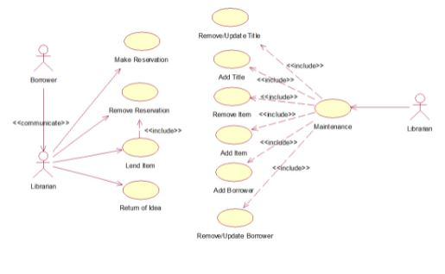
Contd…
Figure 1: Use case diagram

Slide 143
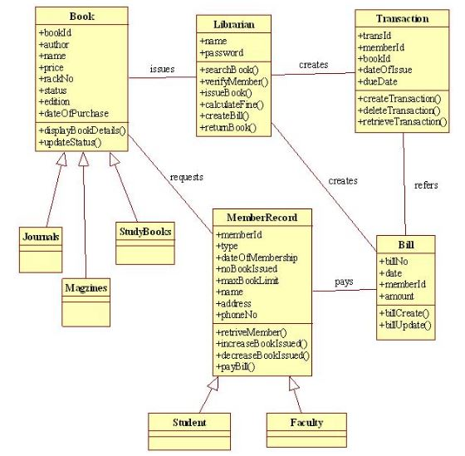
Contd…
Figure 2: Class diagram

Slide 144
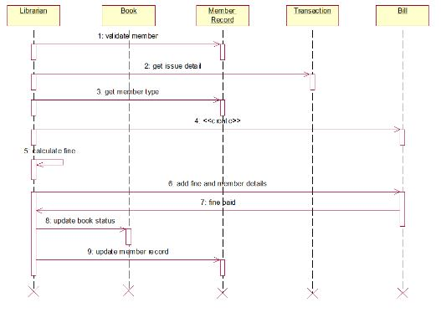
Contd…
Figure 3: Sequence diagram

Slide 145
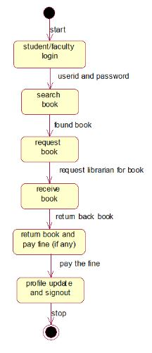
Contd…
Figure 4: Statechart diagram

