Slide 1
Mapping
The basic characteristic of cache memory is its fast access time. Therefore, very little or no time must be wasted when searching for words in the cache.
The transformation of data from main memory to cache memory is referred to as a mapping process.
Three types of mapping procedures are of practical interest when considering the organization of cache memory:
1. Associative mapping
2. Direct mapping
3. Set-associative mapping
For specific example of mapping procedures, consider a memory organization as shown in previous Fig. containing Cache block diagram.
The main memory can store 32K words of 12 bits each. The cache is capable of storing 512 of these words at any given time.
For every word stored in cache, there is a duplicate copy in main memory. The CPU communicates with both memories.
It first sends a 15-bit address to cache. If there is a hit, the CPU accepts the 12-bit data from cache.
If there is a miss, the CPU reads the word from main memory and the word is then transferred to cache.

Slide 2
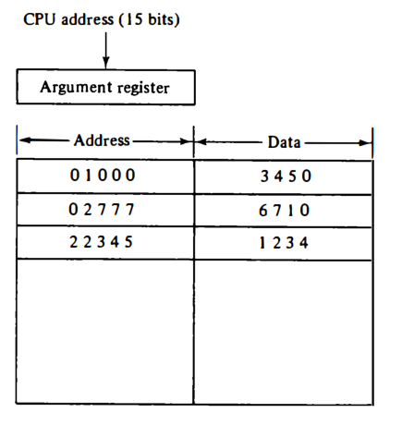
Associative Mapping
The fastest and most flexible cache organization uses an associative memory.
This organization is illustrated in Fig.
The associative memory stores both the address and content (data) of the memory word.
This permits any location in cache to store any word from main memory.
The diagram shows three words presently stored in the cache.
The address value of 15 bits is shown as a five-digit octal number and its corresponding 12 -bit word is shown as a four-digit octal number.
Associative mapping cache

Slide 3
Operation of Associative Mapping
A CPU address of 15 bits is placed in the argument register and the associative memory is searched for a matching address.
If the address is found, the corresponding 12-bit data is read and sent to the CPU.
If no match occurs, the main memory is accessed for the word.
The ad­dress--data pair is then transferred to the associative cache memory.
If the cache is full, an address--data pair must be displaced to make room for a pair that is needed and not presently in the cache.
The decision as to what pair is replaced is determined from the replacement algorithm that the designer chooses for the cache.
A simple procedure is to replace cells of the cache in round-robin order whenever a new word is requested from main memory.
This constitutes a first-in first-out (FIFO) replacement policy.

Slide 4
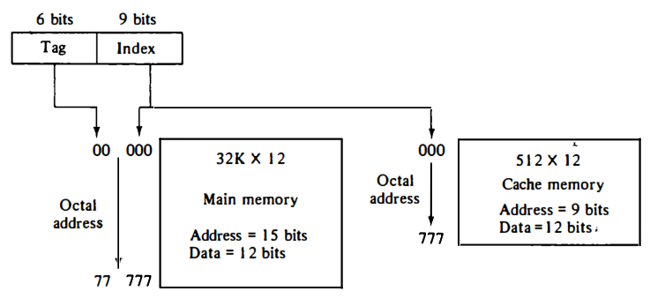
Direct Mapping
Associative memories are expensive compared to random-access memories because of the added logic associated with each cell. The possibility of using a random-access memory for the cache is investigated in Fig.
The CPU address of 15 bits is divided into two fields. The nine least significant bits constitute the index field and the remaining six bits form the tag field.
The figure shows that main memory needs an address that includes both the tag and the index bits.
The number of bits in the index field is equal to the number of address bits required to access the cache memory.

Slide 5
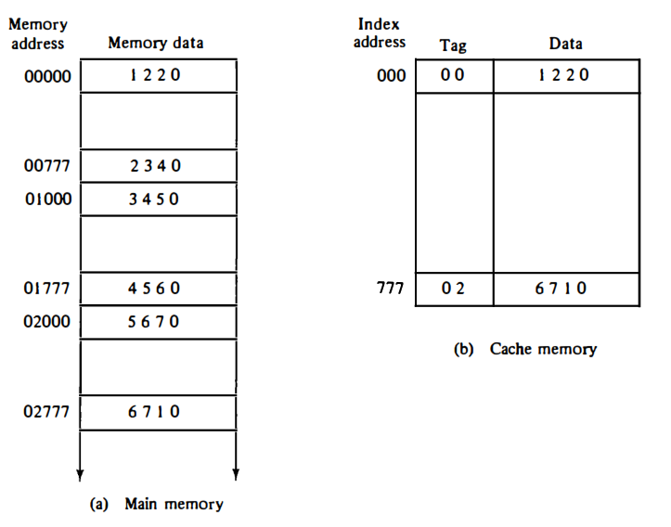
In the general case, there are 2^{k} words in cache memory and 2^{n} words in main memory. The n-bit memory address is divided into two fields: k bits for the index field and n - k bits for the tag field.
The direct mapping cache organization uses the n-bit address to access the main memory and the k-bit index to access the cache.
The internal organization of the words in the cache memory is as shown in Fig b. Each word in cache consists of the data word and its associated tag.
When a new word is first brought into the cache, the tag bits are stored alongside the data bits.
When the CPU generates a memory request, the index field is used for the address to access the cache.

Slide 6
The tag field of the CPU address is compared with the tag in the word read from the cache.
If the two tags match, there is a hit and the desired data word is in cache.
If there is no match, there is a miss and the required word is read from main memory.
It is then stored in the cache together with the new tag, replacing the previous value.
The disadvantage of direct mapping is that the hit ratio can drop considerably if two or more words whose addresses have the same index but different tags are accessed repeatedly.
However, this possibility is minimized by the fact that such words are relatively far apart in the address range (multiples of 512 locations in this example.)

Slide 7
Operation of Direct Mapping
To see how the direct-mapping organization operates, Consider the nu­merical example shown in Fig.
The word at address zero is presently stored in the cache (index = 000, tag = 00, data = 1220).
Suppose that the CPU now wants to access the word at address 02000. The index address is 000, so it is used to access the cache.
The two tags are then compared. The cache tag is 00 but the address tag is 02, which does not produce a match.
Therefore, the main memory is accessed and the data word 5670 is transferred to the CPU.
The cache word at index address 000 is then replaced with a tag of 02 and data of 5670.

Slide 8
Set-Associative Mapping
Disadvantage of direct mapping is that two words with the same index in their address but with different tag values cannot reside in cache memory at the same time.
Therefore, a third type of cache organ­ization, called set-associative mapping, is an improvement over the direct­ mapping organization in that each word of cache can store two or more words of memory under the same index address.
Each data word is stored together with its tag and the number of tag-data items in one word of cache is said to form a set.
An example of a set-associative cache organization for a set size of two is shown in Fig.
Each index address refers to two data words and their associated tags.
Each tag requires six bits and each data word has 12 bits, so the word length is 2(6 + 12) = 36 bits.
An index address of nine bits can accommodate 512 words.
Thus the size of cache memory is 512 x 36.
It can accommodate 1024 words of main memory since each word of cache contains two data words.
In general, a set-associative cache of set size k will accommo­date k words of main memory in each word of cache.

Slide 9
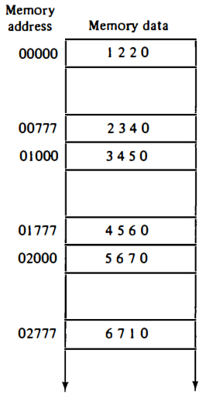
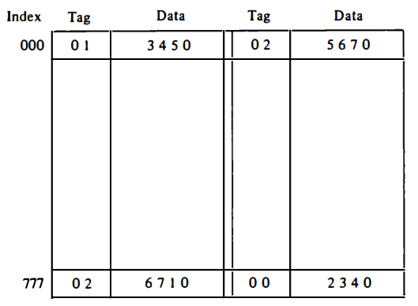
Operation of Set Associative Mapping
The octal numbers listed in Fig. are with reference to the main memory.
The words stored at addresses 01000 and 02000 of main memory are stored in cache memory at index address 000.
Similarly, the words at addresses 02777 and 00777 are stored in cache at index address 777.
When the CPU generates a memory request, the index value of the address is used to access the cache.
The tag field of the CPU address is then compared with both tags in the cache to determine if a match occurs.

Slide 10
The comparison logic is done by an associative search of the tags in the set similar to an associative memory search: thus the name "set-associative."
The hit ratio will improve as the set size increases because more words with the same index but different tags can reside in cache.
However, an increase in the set size increases the number of bits in words of cache and requires more complex comparison logic.
When a miss occurs in a set-associative cache and the set is full, it is necessary to replace one of the tag-data items with a new value.
The most common replacement algorithms used are: random replacement, first-in, first­ out (FIFO), and least recently used (LRU).
With the random replacement policy the control chooses one tag-data item for replacement at random.
The FIFO procedure selects for replacement the item that has been in the set the longest.
The LRU algorithm selects for replacement the item that has been least recently used by the CPU.
Both FIFO and LRU can be implemented by adding a few extra bits in each word of cache.

