Slide 1
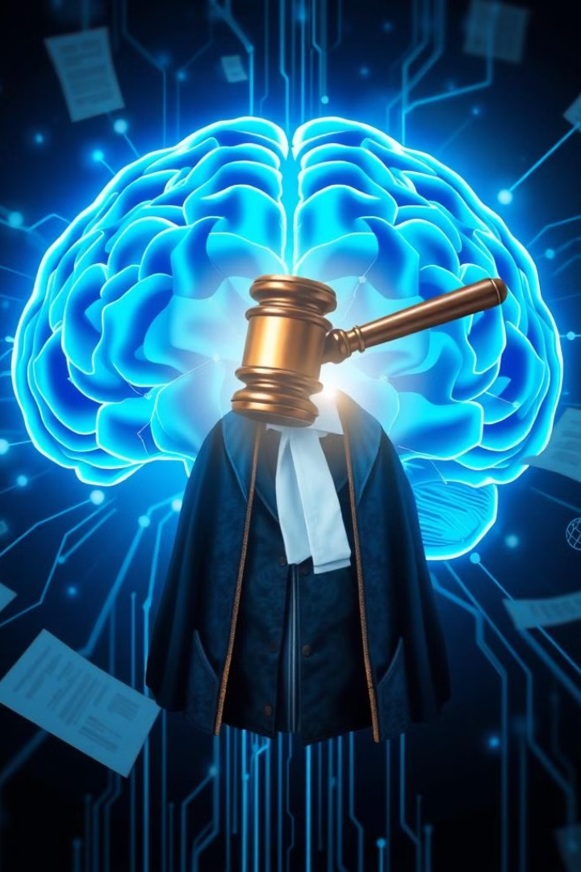
AI-Driven Research Engine for Commercial Courts
This presentation explores an AI-driven legal research engine. The engine uses neural networks and NLP to provide judges and lawyers with case predictions, precedents, and legal information. This helps streamline commercial dispute resolution in Indian courts.
Team Name: Enigma
Team Member: Satvick Shekhawat, Satendra Rathaur, Shubham
Team Mentor: Dr. Laxman Singh

Slide 2



Problem Statement
Case Backlog
Commercial courts in India face a significant backlog of cases, leading to extended delays in resolving disputes.
Research Bottlenecks
Judges often encounter difficulties in efficiently navigating the vast legal landscape to find relevant precedents and case law.
Predictive Insights
The lack of reliable tools for predicting case outcomes makes it challenging to assess the likelihood of success or failure for parties involved.

Slide 3
Solution Overview
Automated Research
Predictive Analytics
Enhanced Efficiency
The engine automates legal research, saving time and effort for judges and legal professionals.
Neural networks analyze case data and predict potential outcomes, providing valuable insights for decision-making.
The AI-driven tool streamlines legal research, reducing the time and effort required to find relevant precedents and case law.

Slide 4
AI-Driven Research Engine for Commercial Courts
Streamlined Legal Research
Predictive Case Outcomes
The research engine provides judges and legal professionals with efficient access to relevant case law, legal precedents, and statutes, saving valuable time and effort.
The AI system analyzes case data and historical outcomes to generate accurate predictions on the likely resolution of new cases, providing valuable insights for decision-making.

Slide 5
Workflow of the Research Engine
1
Data Input
The engine ingests diverse legal data, including case records, legal texts, and historical case outcomes from various sources.
2
Preprocessing
Data undergoes meticulous cleaning, tokenization, and extraction of relevant legal entities to prepare it for analysis.
3
Neural Network
A robust neural network trained on TensorFlow analyzes legal documents and predicts case outcomes based on the learned patterns.
4
Custom Queries
Judges can perform tailored searches based on specific legal requirements, ensuring focused and relevant results.
5
Output
The engine delivers valuable insights, including predicted case outcomes, relevant precedents, and key legal principles to inform judicial decisions.

Slide 6




Neural Network Model Structure
Input Layer
1
Case metadata, such as jurisdiction, court, and type of dispute, serves as the foundation for the network's analysis.
Hidden Layers
2
Multiple dense layers capture complex relationships and patterns within the legal data, enabling deeper understanding.
NLP Layer
3
An LSTM or BERT layer processes textual data, analyzing legal documents and extracting relevant information.
Output Layer
4
The final layer generates predictions on case outcomes, such as resolution time or the likelihood of a successful outcome.

Slide 7
How the Model Works
1
Data Aggregation
The system gathers legal data from diverse sources, including case records, statutes, legal articles, and historical court rulings.
2
Preprocessing
Legal texts are cleaned, tokenized, and structured to enable efficient processing and analysis by the AI system.
Model Training
3
The neural network is trained on historical case data using TensorFlow, learning patterns and relationships in legal precedents and outcomes.
Prediction
4
The trained model analyzes new cases, considering legal documents, case metadata, and historical patterns to predict potential outcomes.
Custom Search
5
Judges can perform tailored searches based on specific legal requirements, accessing relevant case law, precedents, and statutes.

Slide 8








Technology Stack
Django
HTML/CSS/Bootstrap
MongoDB
TensorFlow
A powerful Python framework for developing backend applications, handling requests, and managing data efficiently.
For building a user-friendly interface, providing intuitive navigation and presentation of legal information.
A NoSQL database ideal for storing and managing large volumes of unstructured legal data, such as case records and legal texts.
A powerful machine learning library that enables the development and training of neural networks for accurate case outcome predictions.
GPT Models
Neural Networks
API Integrations
Google Cloud
Advanced natural language processing models that analyze legal documents, extract key information, and provide comprehensive understanding of legal concepts.
Neural networks are used for predictive analytics, learning from historical case data to predict outcomes of future cases, providing valuable insights to judges and legal professionals.
Seamless integration with external legal data sources, enabling access to a wider range of legal information and enhancing research capabilities.
Provides scalable infrastructure for hosting the research engine, ensuring reliable performance and availability for users.

Slide 9
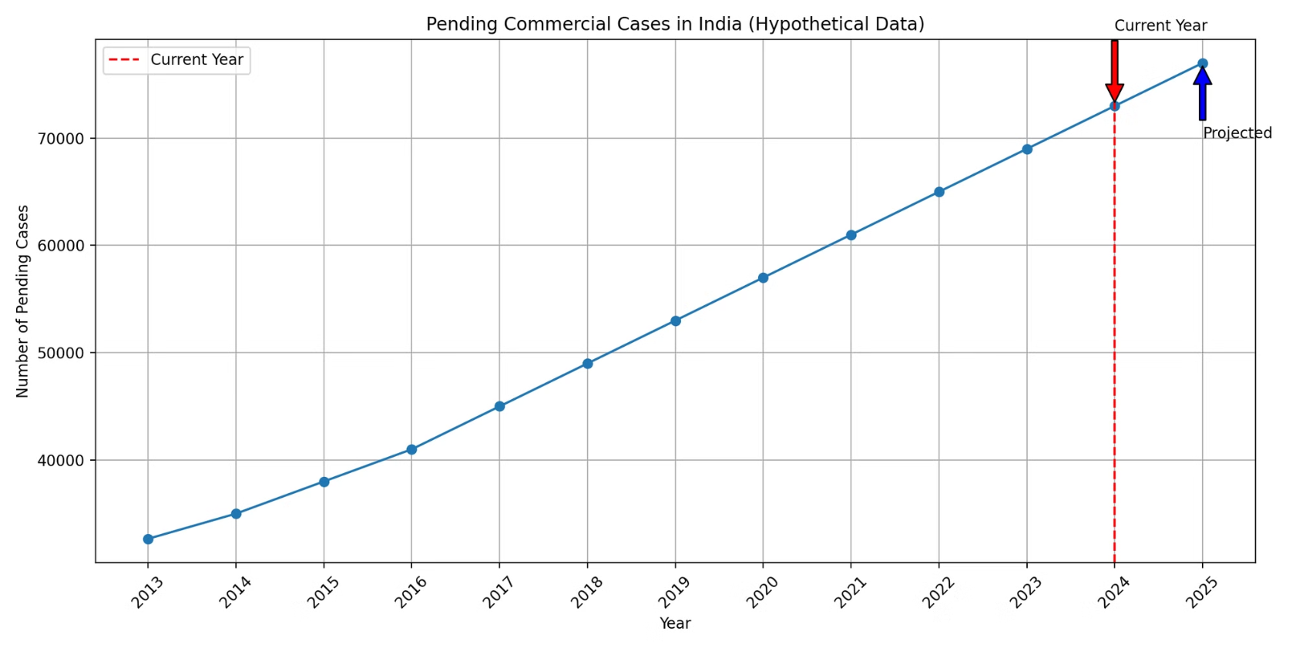
Trends in Commercial Court Case Pendency

Slide 10
Indian Supreme Court Judgments Dataset
Overview
Dataset Source
Dataset Size
Key Attributes
Kaggle is a data science platform offering datasets, competitions, and community resources, promoting collaboration among data enthusiasts and professionals.
The dataset contains 35,000 Supreme Court judgments from India (1950-2021), crucial for legal research and AI applications in law.
Case Number for identification, Case Name for reference, Judgment Date for timing, Judgment Text for details, and Additional Metadata for context.

Slide 11
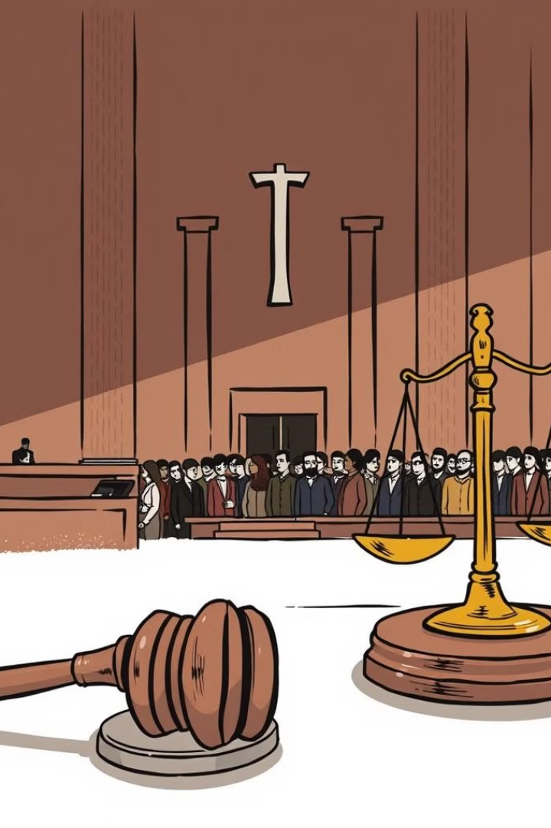
Conclusion and Future Prospects
Revolutionizing Legal Research
The AI-driven research engine offers a transformative approach to commercial court case handling, enhancing legal research and streamlining decision-making processes.
Accelerated Case Resolution
By providing accurate predictions and efficient access to relevant precedents, the engine significantly reduces the time and effort required to resolve commercial disputes.
Expanding Applications
Future prospects include expanding the model's capabilities to encompass a broader range of legal cases, further revolutionizing the legal landscape.

