Slide 1

SMART INDIA HACKATHON 2026
TITLE PAGE
Problem Statement ID: SIH26117
Problem Statement Title: Sovereign On-Premise Agentic AI Workbench using Open-Weight Multimodal LLMs for Confidential Industrial Work
Theme: Smart Automation
PS Category: Software
Team ID: [To Be Filled]
Team Name: Sovereign Forge

Slide 2
IDEA TITLE
SOVARA: Sovereign On-Premise Agentic AI Workbench
PROBLEM:
Industrial organizations handle confidential:
• SOPs, manuals & inspection reports
• Engineering drawings & P&IDs
• Spreadsheets and operational data
External AI services can create confidentiality, compliance and control concerns. Industrial work also requires evidence, tool execution, and controlled human decisions.
PROPOSED SOLUTION:
SOVARA is a sovereign, on-premise agentic AI workbench that runs open-weight AI models and supporting tools on enterprise infrastructure.
Core capabilities:
• Local open-weight LLM/VLM
• Local OCR
• Enterprise RAG
• Agentic planning and execution
• Python / Excel / file tools
• Verification and risk assessment
• Human review for high-risk outputs
• Local document generation
INNOVATION / UNIQUENESS:
• Designed for confidential industrial knowledge work
• Multimodal reasoning across P&IDs, PDFs, and spreadsheets
• Automatic capability routing before expensive planning
• Evidence-grounded answers with citations
• Verification, risk assessment & human-review layer
• Designed for air-gapped deployment

Slide 3
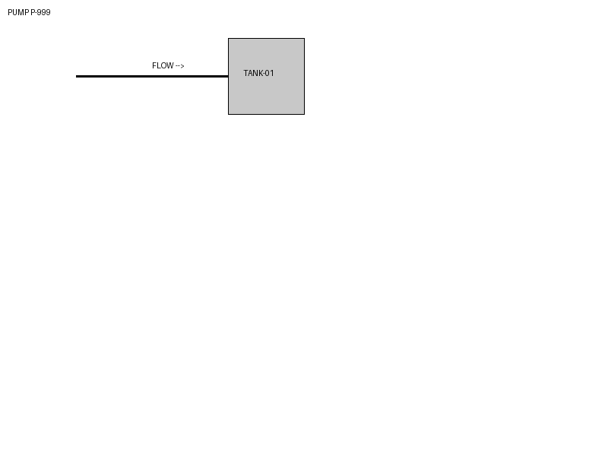
TECHNICAL APPROACH
From a natural-language request to a controlled industrial action
1. USER REQUEST
2. UNDERSTAND
3. CAPABILITY ROUTING
TECHNOLOGY STACK
AI Models:
• Qwen3:4B, Gemma3:4B
• Qwen2.5-VL:3B
Knowledge & Search:
• Nomic Embed, Qdrant
Multimodal Processing:
• EasyOCR, PyTorch, PDF/Image tools
Agentic Framework:
• LangGraph
Execution Tools:
• Python, Pandas / Excel, File tools
Backend & Outputs:
• Python, FastAPI
• DOCX, XLSX, PPTX, PDF
4. PLAN (Complex Tasks)
5. EXECUTE (RAG, VLM, Tools)
6. SYNTHESIZE
7. VERIFY
8. RISK / HUMAN REVIEW
9. OUTPUT
WORKING PROTOTYPE:
Multimodal P&ID Analysis
The system natively processes engineering drawings (like this P-101 pump diagram), links it with XLSX inspection data, and extracts relevant text from the Maintenance SOP.

Slide 4
FEASIBILITY AND VIABILITY
Practical path to secure industrial deployment
FEASIBLE NOW
• Local LLM/VLM inference
• Local RAG + Qdrant
• Local OCR
• Real PDF/image/XLSX processing
• FastAPI browser workbench
• Local document generation
• Verification and risk pipeline
CHALLENGES
• Limited GPU VRAM on edge devices
• Local inference latency vs Cloud
• P&ID/image quality dependency
• Secure sandbox deployment (current local subprocess is not true isolation)
MITIGATION
• Fast capability routing
• Lightweight open-weight models
• Evidence-grounded generation
• Verification + risk classification
• Human review for high-risk outputs
• Docker isolation for production deployment

Slide 5
IMPACT AND BENEFITS
Accelerating industrial workflows with controlled AI
TARGET USERS
• Maintenance engineers
• Engineering teams
• Process / operations teams
• Industrial knowledge workers
IMPACT
• Faster access to institutional knowledge
• Faster analysis of inspection and process data
• Evidence-backed engineering assistance
• Automated generation of structured reports
• Better reuse of enterprise knowledge
• Controlled AI assistance for high-stakes workflows
KEY BENEFITS
SECURITY / CONTROL
Confidential knowledge can remain on enterprise infrastructure.
PRODUCTIVITY
Reduces manual effort across document, spreadsheet and knowledge workflows.
ENGINEERING SUPPORT
Connects drawings, reports, procedures and structured data in one workflow.
KNOWLEDGE RETENTION
Makes enterprise manuals, SOPs and historical records easier to use.
DECISION SUPPORT
Adds verification, risk classification and human review instead of autonomous uncontrolled decisions.

Slide 6
RESEARCH AND REFERENCES
06 / 06
Industrial datasets and core AI technology stack
RESEARCH / EVALUATION DATASETS
* Note: These datasets are for system evaluation/benchmarking, not LLM fine-tuning.
• Tennessee Eastman Process
For industrial process fault detection and decision-support evaluation.
• Centrifugal Pump Multi-Fault Vibration Dataset
For pump condition monitoring and fault diagnosis evaluation.
• PIDQA
For P&ID question answering and spatial/relationship reasoning evaluation.
• PID2Graph
For P&ID graph/relationship reasoning evaluation.
• NASA IMS Bearings
For bearing fault/condition-monitoring evaluation.
• AI4I 2020
For industrial predictive-maintenance evaluation.
TECHNICAL REFERENCES
• Ollama (Local Model Serving)
• Qdrant (Vector Database)
• LangGraph (Agentic Framework)
• EasyOCR (Optical Character Recognition)
• Qwen / Qwen2.5-VL (Open-Weight Models)
• Nomic Embed (Text Embedding)
• Relevant academic research on P&ID digitization and Multimodal LLMs in industrial contexts.

