Slide 1
Sales Performance Analysis of Walmart Stores
Using SQL Queries and Data Insights

Slide 2
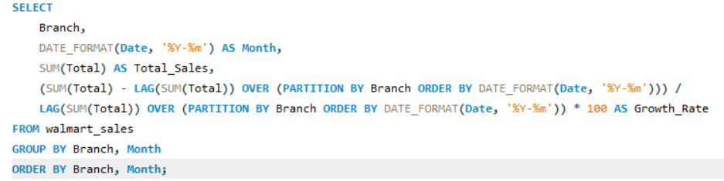
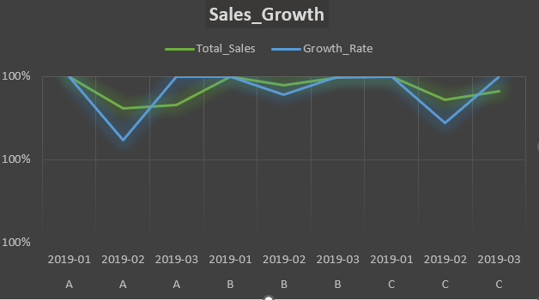
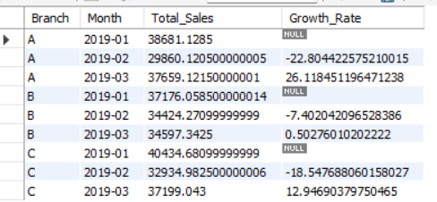
Task1 : Top Branch by Sales Growth Rate
QUERY
GRAPH
OUTPUT

Slide 3
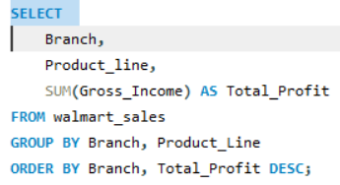
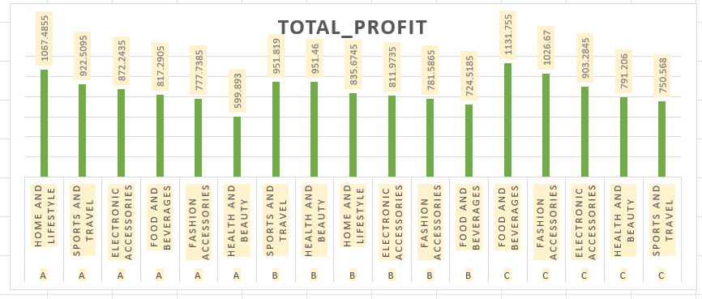
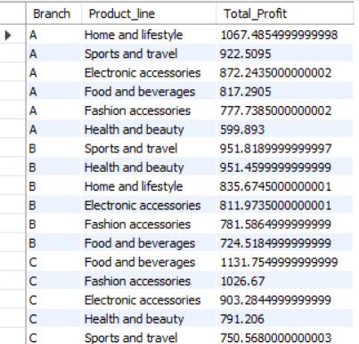
Task 2: Most Profitable Product Line for Each Branch
QUERY
CHART
OUTPUT

Slide 4
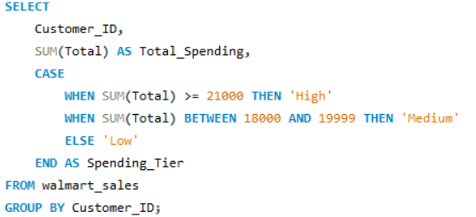
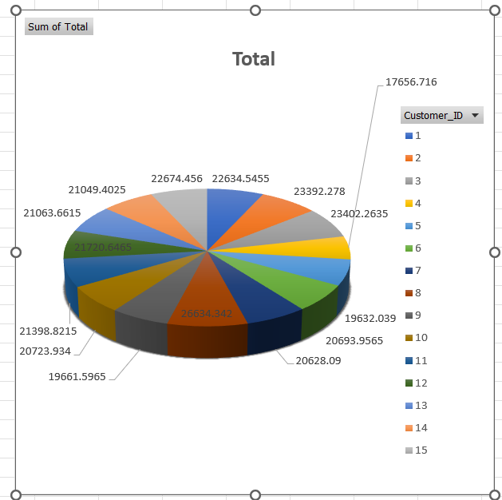
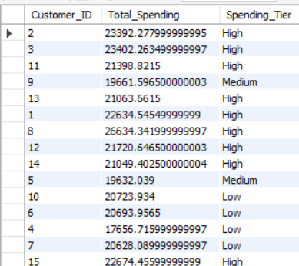
Task 3: Customer Segmentation Based on Spending
QUERY
PIE CHART
OUTPUT

Slide 5
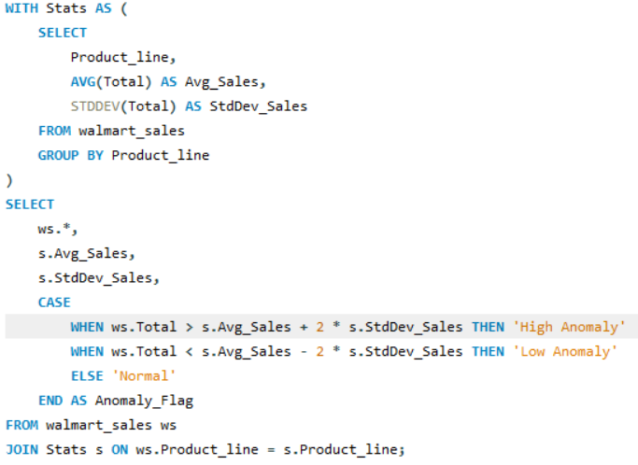
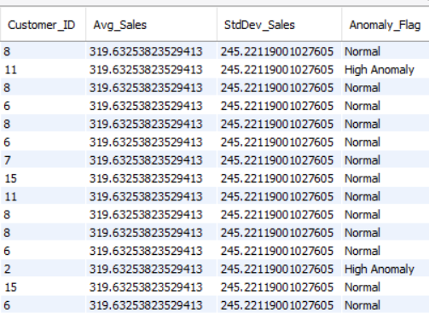
Task 4: Detecting Anomalies in Sales Transactions
QUERY
OUTPUT

Slide 6
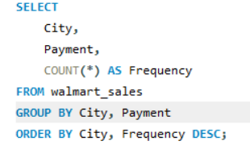
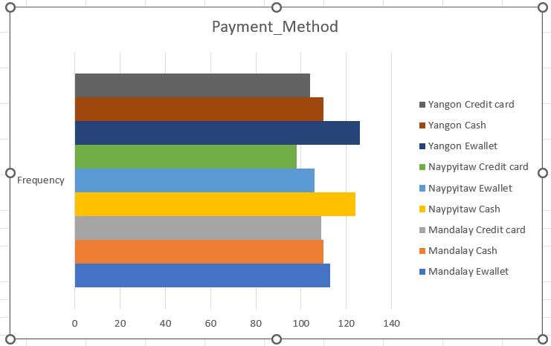
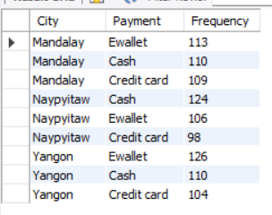
Task 5: Most Popular Payment Method by City
QUERY
GRAPH
OUTPUT

Slide 7
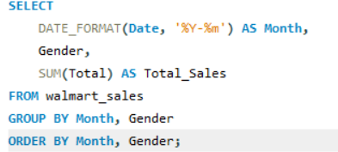
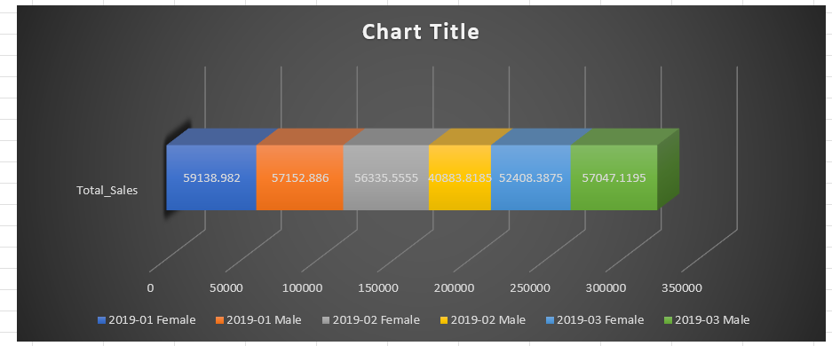
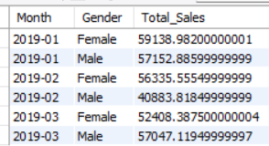
Task 6: Monthly Sales Distribution by Gender
QUERY
CHART
OUTPUT

Slide 8
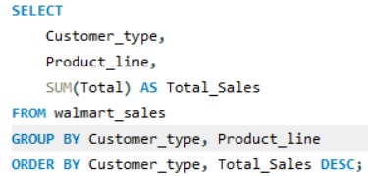
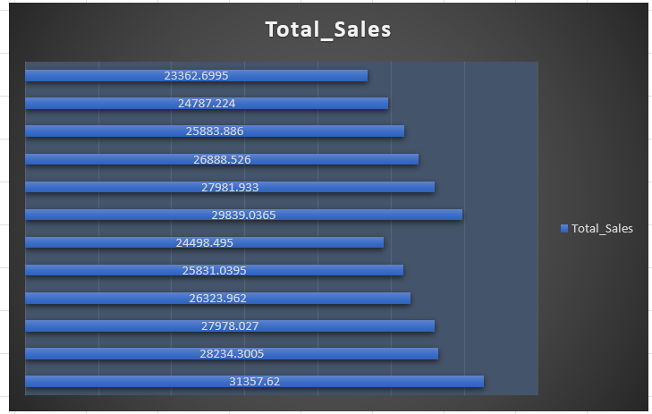
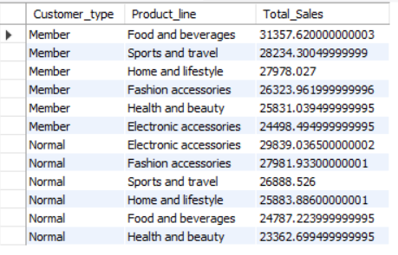
Task 7: Best Product Line by Customer Type
QUERY
CHART
OUTPUT

Slide 9
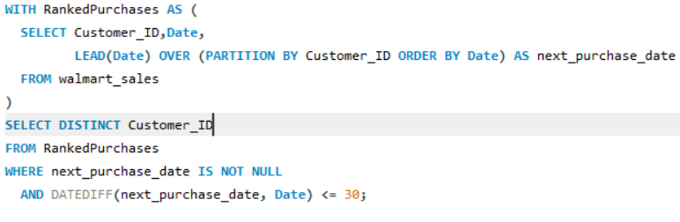
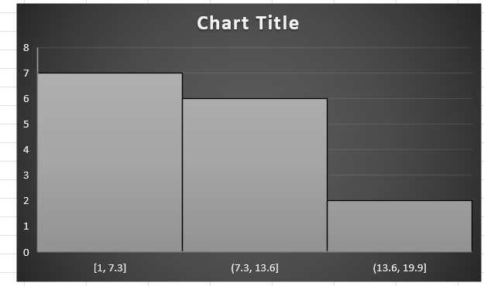
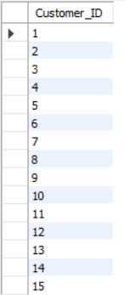
Task 8: Identifying Repeat Customers
QUERY
GRAPH
OUTPUT

Slide 10
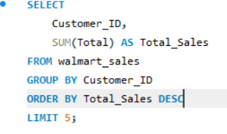
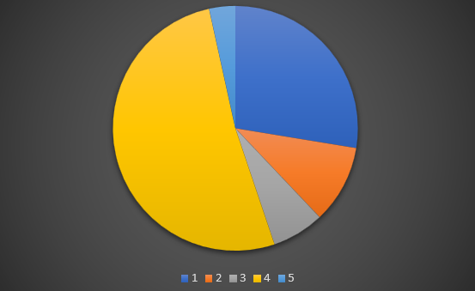
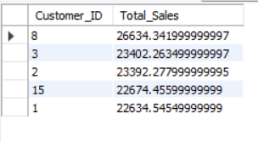
Task 9: Top 5 Customers by Sales Volume
QUERY
PIECHART
OUTPUT

Slide 11
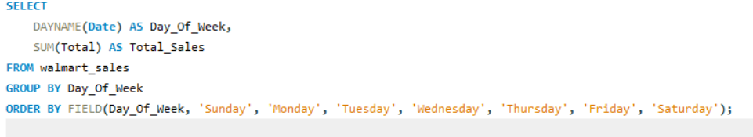
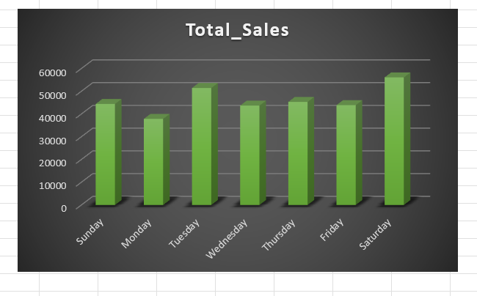
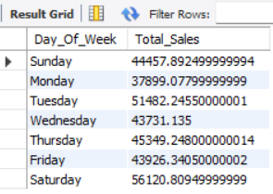
Task 10: Sales Trends by Day of the Week
QUERY
GRAPH
OUTPUT

Slide 12
Video Introduction
https://drive.google.com/file/d/1L3VruYQWIoDW6q33qZ3UMDkxYSiWHryy

