Slide 1

Chapter 15
Key Management
Copyright © The McGraw-Hill Companies, Inc. Permission required for reproduction or display.

Slide 2
Chapter 15
Objectives
To explain the need for a key-distribution center
To show how a KDC can create a session key
To show how two parties can use a symmetric-key
agreement protocol to create a session key
To describe Kerberos as a KDC and an
authentication protocol
To explain the need for certification authorities
for public keys
To introduce the idea of a Public-Key
Infrastructure (PKI) and explain some of its duties

Slide 3
15-1 SYMMETRIC-KEY DISTRIBUTION
Symmetric-key cryptography is more efficient than asymmetric-key cryptography for enciphering large messages. Symmetric-key cryptography, however, needs a shared secret key between two parties. The distribution of keys is another problem.
Topics discussed in this section:
15.1.1 Key-Distribution Center: KDC
15.1.2 Session Keys

Slide 4
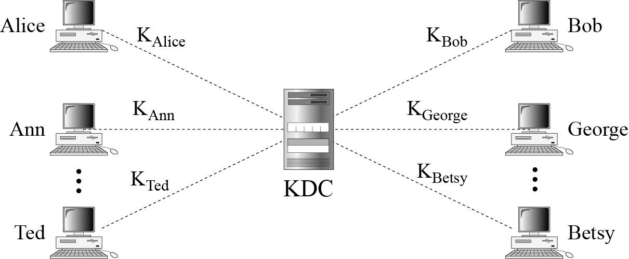
15.1.1 Key-Distribution Center: KDC
Figure 15.1 Key-distribution center (KDC)

Slide 5
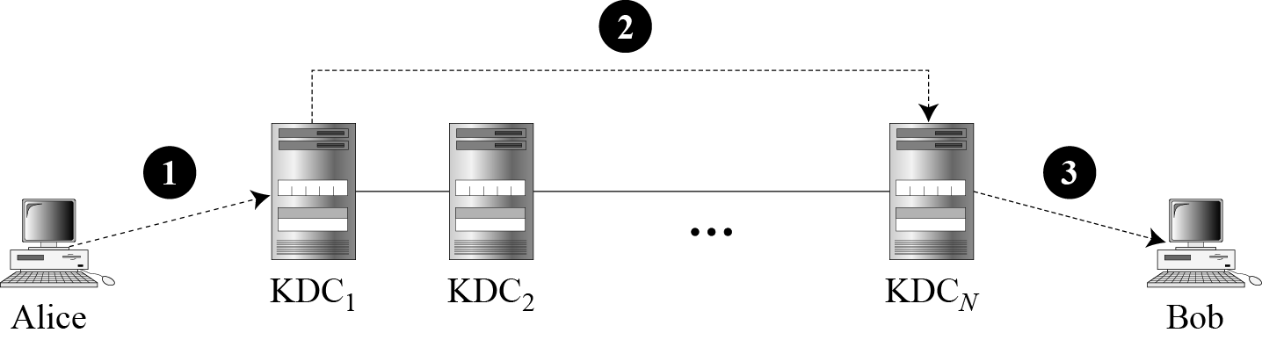
15.1.1 Continued
Flat Multiple KDCs.
Figure 15.2 Flat multiple KDCs

Slide 6
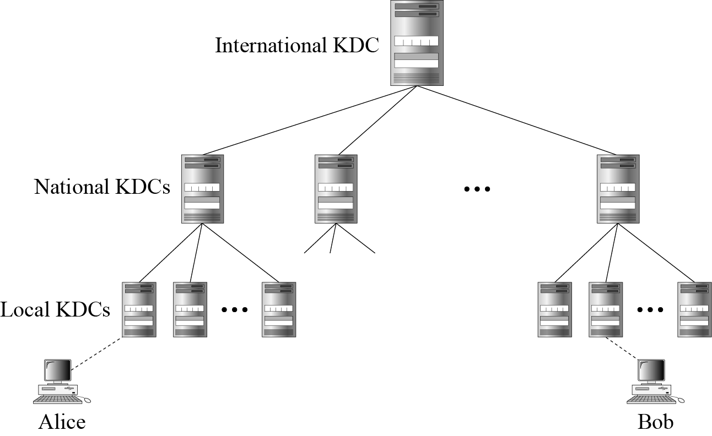
15.1.1 Continued
Hierarchical Multiple KDCs
Figure 15.3 Hierarchical multiple KDCs

Slide 7

15.1.2 Session Keys
A KDC creates a secret key for each member. This secret key can be used only between the member and the KDC, not between two members.
Note
A session symmetric key between two parties is used only once.

Slide 8
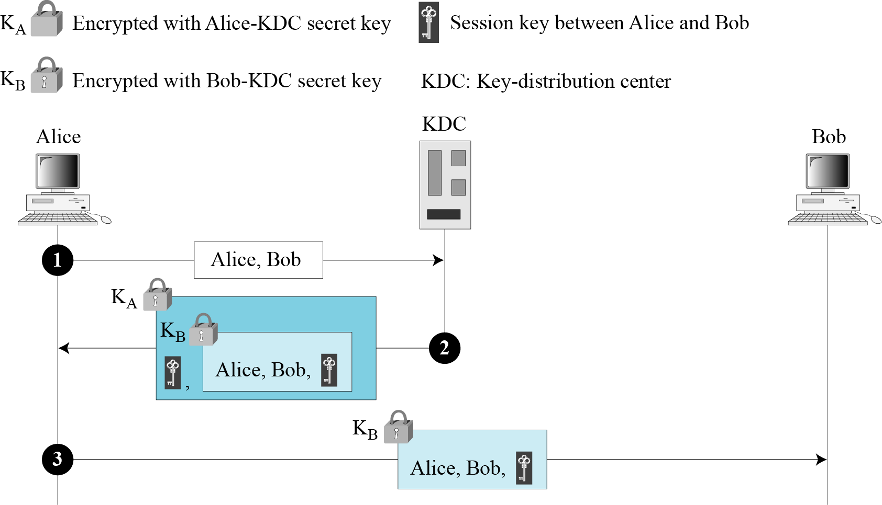
15.1.2 Continued
A Simple Protocol Using a KDC
Figure 15.4 First approach using KDC

Slide 9
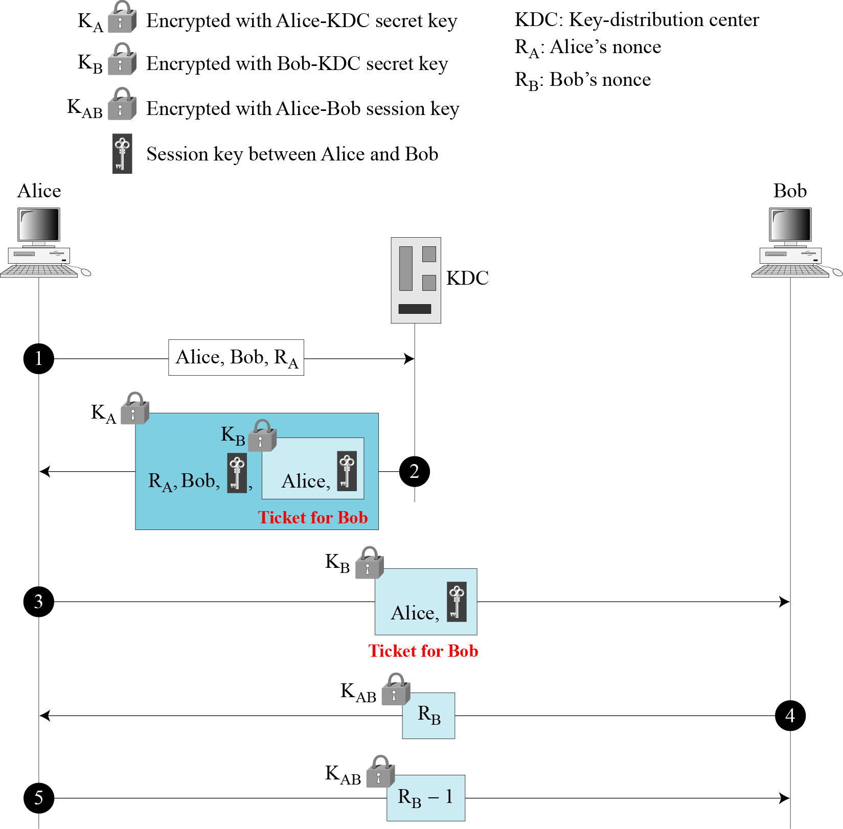
15.1.2 Continued
Needham-Schroeder Protocol
Figure 15.5
Needham-Schroeder
protocol

Slide 10
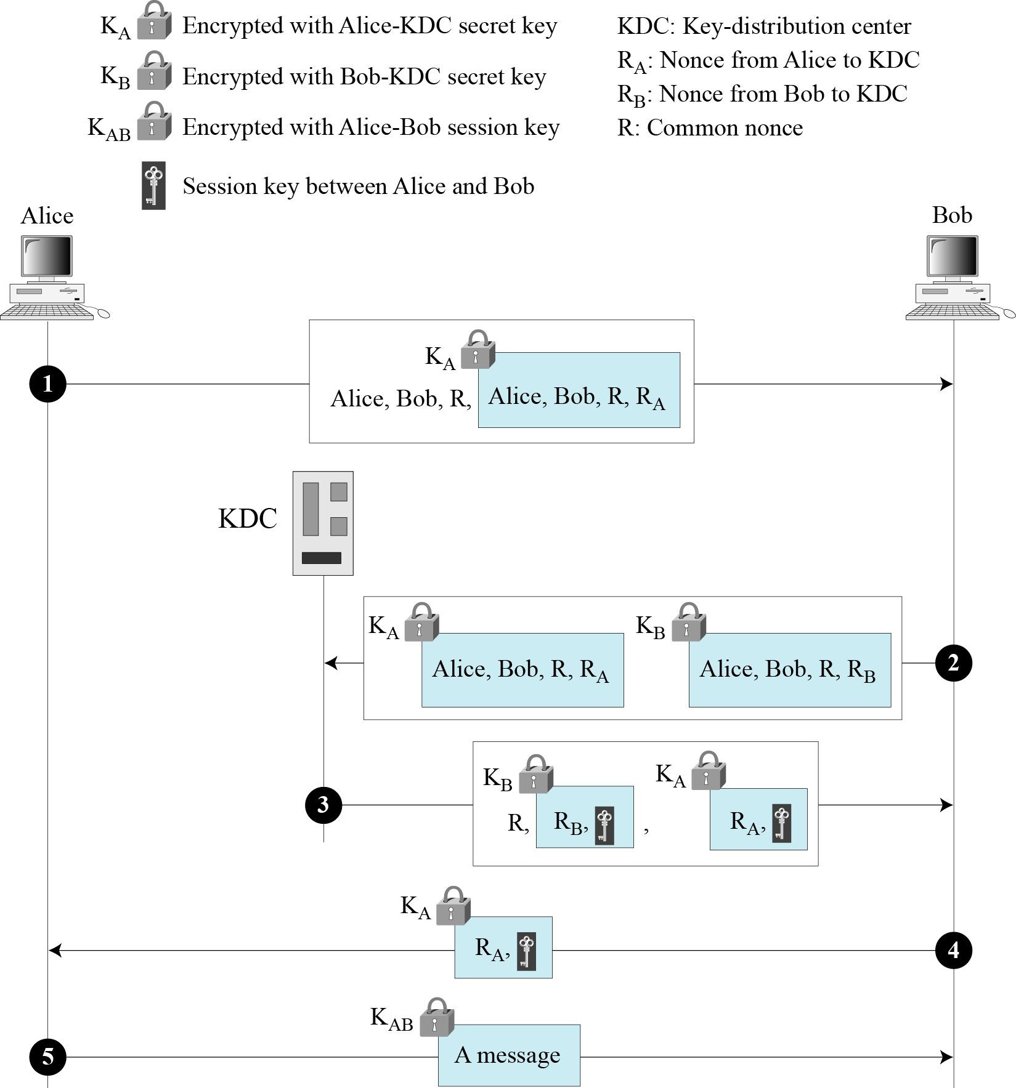
15.1.2 Continued
Otway-Rees Protocol
Figure 15.6
Otway-Rees protocol

Slide 11
15-2 KERBEROS
A backbone network allows several LANs to be connected. In a backbone network, no station is directly connected to the backbone; the stations are part of a LAN, and the backbone connects the LANs.
Kerberos is an authentication protocol, and at the same time a KDC, that has become very popular. Several systems, including Windows 2000, use Kerberos. Originally designed at MIT, it has gone through several versions.
Topics discussed in this section:
15.2.1 Servers
15.2.2 Operation
15.2.3 Using Different Servers
15.2.4 Kerberos Version 5
14.2.5 Realms

Slide 12
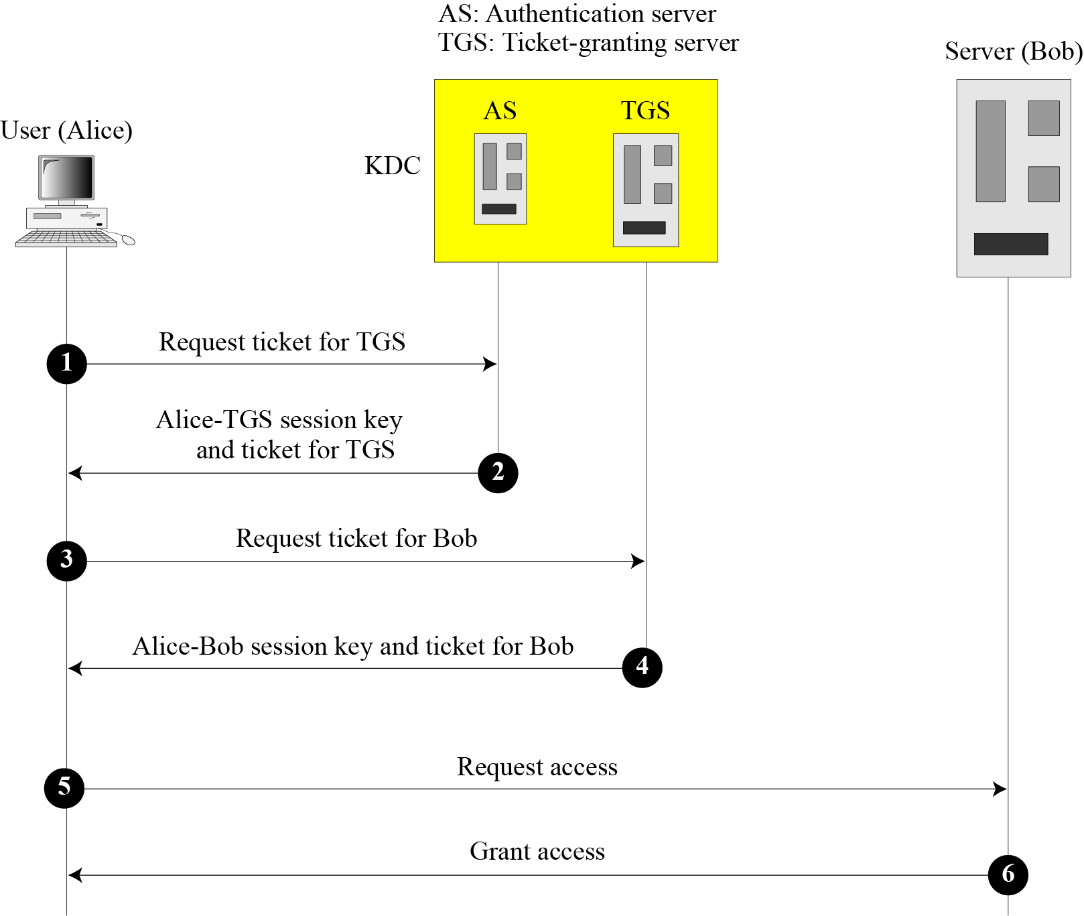
15.2.1 Servers
Figure 15.7 Kerberos servers

Slide 13
15.2.1 Continued
Authentication Server (AS)
The authentication server (AS) is the KDC in the Kerberos protocol.
Ticket-Granting Server (TGS)
The ticket-granting server (TGS) issues a ticket for the real server (Bob).
Real Server
The real server (Bob) provides services for the user (Alice).

Slide 14
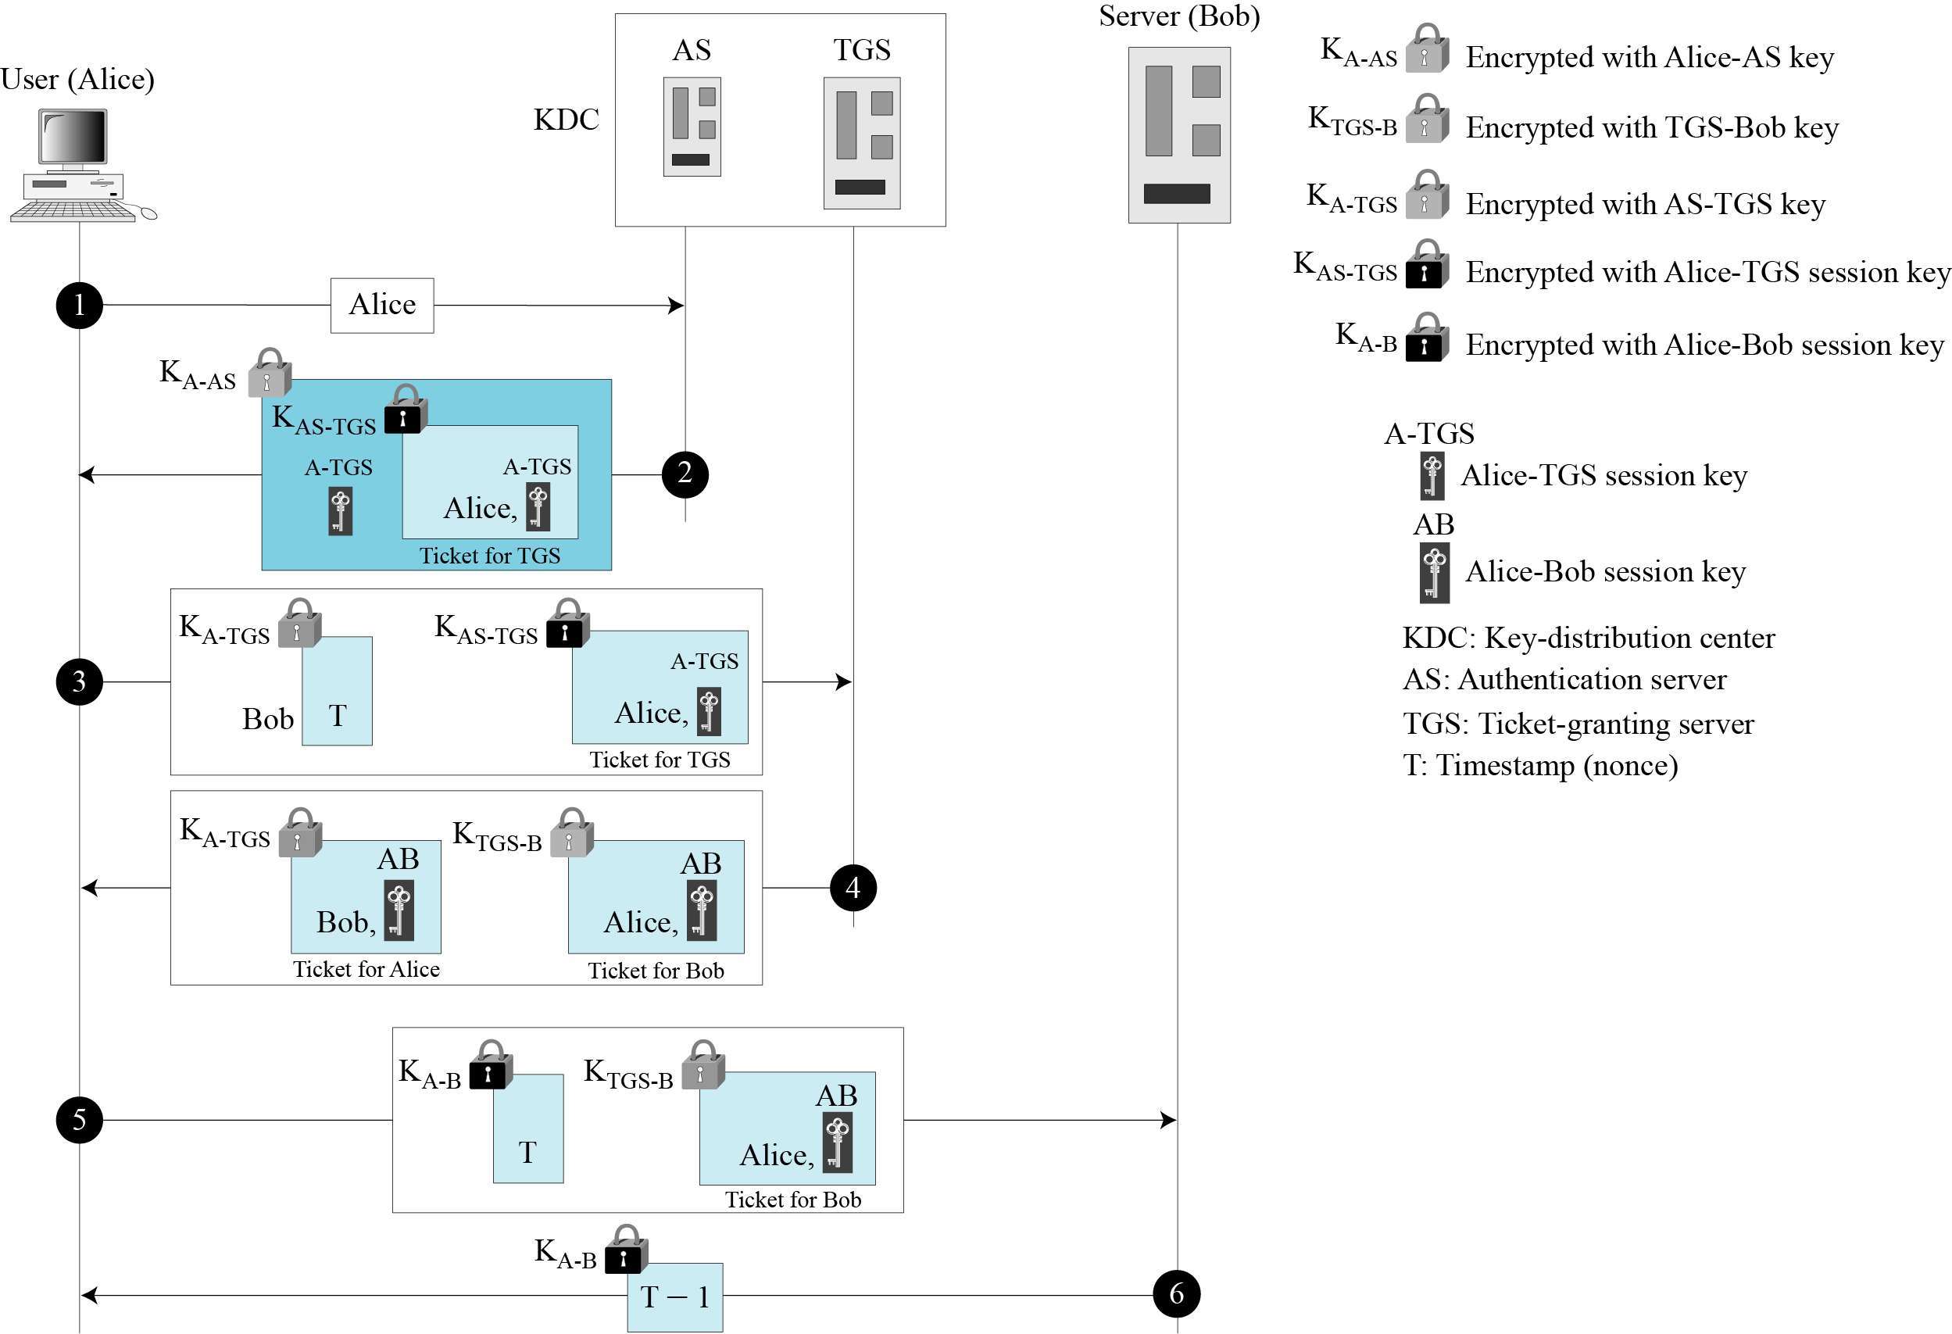
15.2.2 Operation
Figure 15.8 Kerberos example

Slide 15
15.2.3 Using Different Servers
Note that if Alice needs to receive services from different servers, she need repeat only the last four steps.

Slide 16
15.2.4 Kerberos Version 5
The minor differences between version 4 and version 5 are briefly listed below:
Version 5 has a longer ticket lifetime.
Version 5 allows tickets to be renewed.
Version 5 can accept any symmetric-key algorithm.
Version 5 uses a different protocol for describing data types.
Version 5 has more overhead than version 4.

Slide 17
15.2.5 Realms
Kerberos allows the global distribution of ASs and TGSs, with each system called a realm. A user may get a ticket for a local server or a remote server.

Slide 18
15-3 SYMMETRIC-KEY AGREEMENT
Alice and Bob can create a session key between themselves without using a KDC. This method of session-key creation is referred to as the symmetric-key agreement.
Topics discussed in this section:
15.3.1 Diffie-Hellman Key Agreement
15.3.2 Station-to-Station Key Agreement

Slide 19
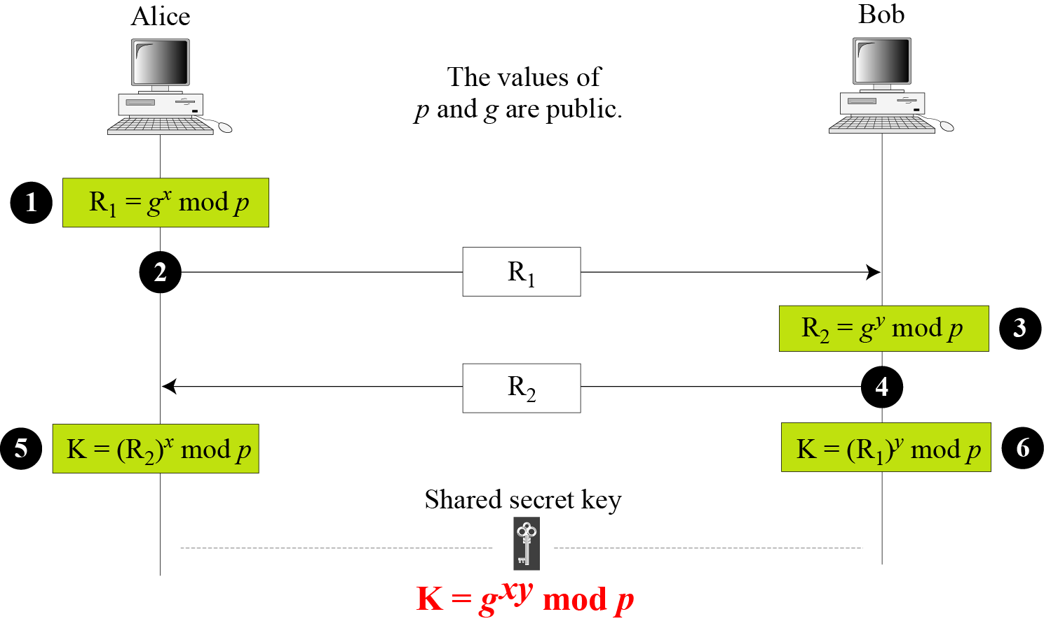
15.3.1 Diffie-Hellman Key Agreement
Figure 15.9 Diffie-Hellman method

Slide 20
15.3.1 Continued
Note
The symmetric (shared) key in the Diffie-Hellman method is K = g^{xy} mod p.

Slide 21
15.3.1 Continued
Example 15.1
Let us give a trivial example to make the procedure clear. Our example uses small numbers, but note that in a real situation, the numbers are very large. Assume that g = 7 and p = 23. The steps are as follows:
Alice chooses x = 3 and calculates R₁ = 73 mod 23 = 21.
Bob chooses y = 6 and calculates R₂ = 76 mod 23 = 4.
Alice sends the number 21 to Bob.
Bob sends the number 4 to Alice.
Alice calculates the symmetric key K = 43 mod 23 = 18.
Bob calculates the symmetric key K = 216 mod 23 = 18.
The value of K is the same for both Alice and Bob;
g^{xy} mod p = 718 mod 35 = 18.

Slide 22
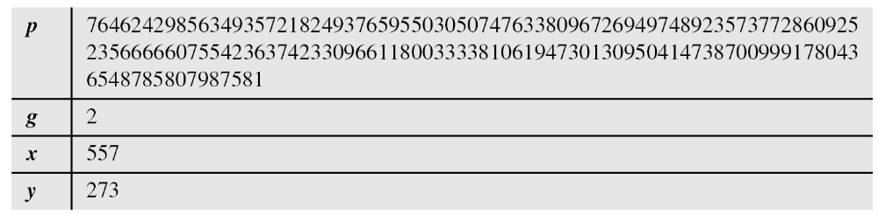
15.3.1 Continued
Example 15.2
Let us give a more realistic example. We used a program to create a random integer of 512 bits (the ideal is 1024 bits). The integer p is a 159-digit number. We also choose g, x, and y as shown below:

Slide 23
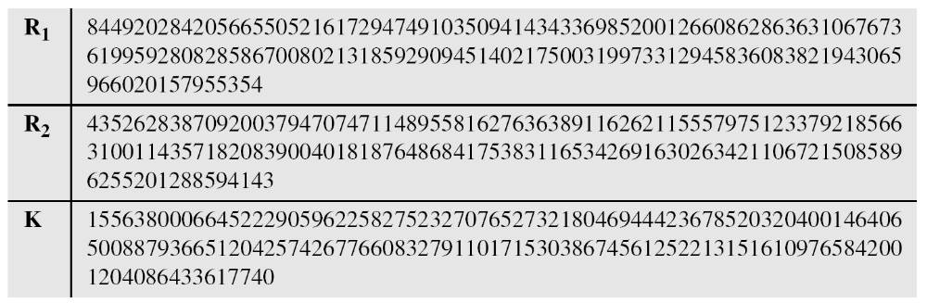
15.3.1 Continued
Example 15.2
Continued
The following shows the values of R₁, R₂, and K.

Slide 24
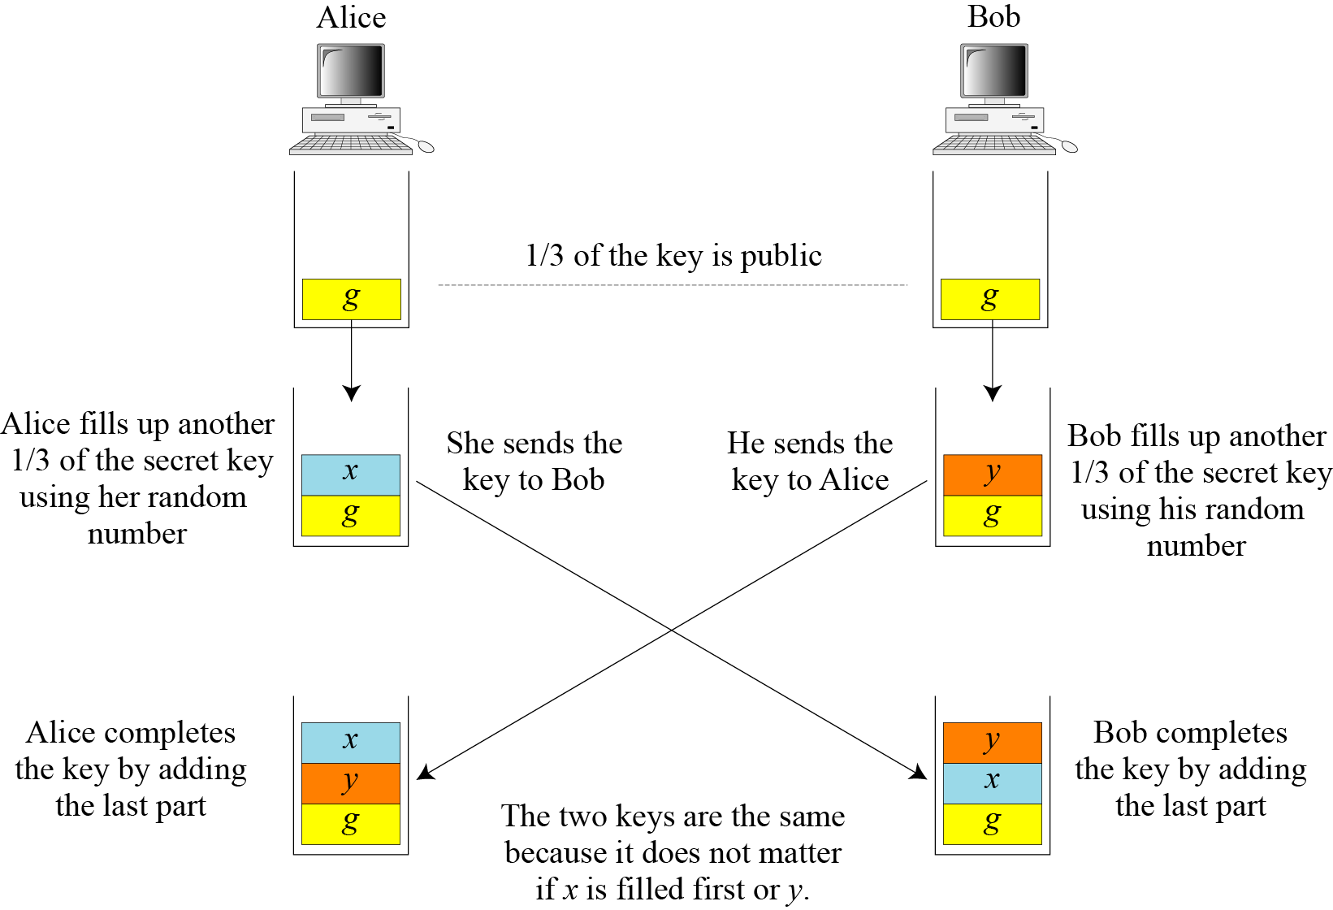
15.3.1 Continued
Figure 15.10 Diffie-Hellman idea

Slide 25
15.3.1 Continued
Security of Diffie-Hellman
Discrete Logarithm Attack
Man-in-the-Middle Attack

Slide 26
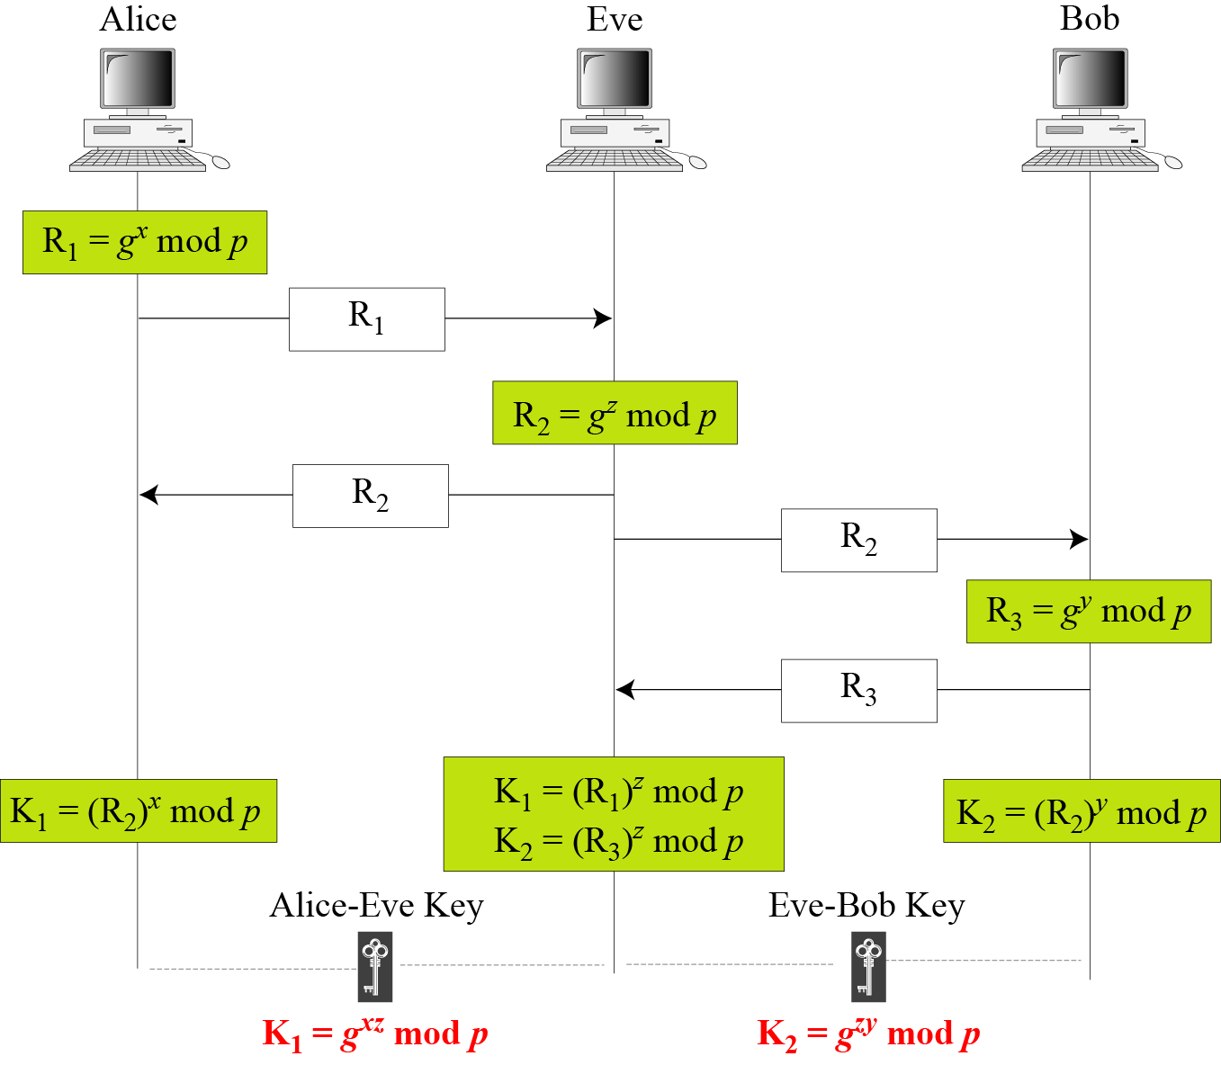
15.3.1 Continued
Figure 15.11 Man-in-the-middle attack

Slide 27
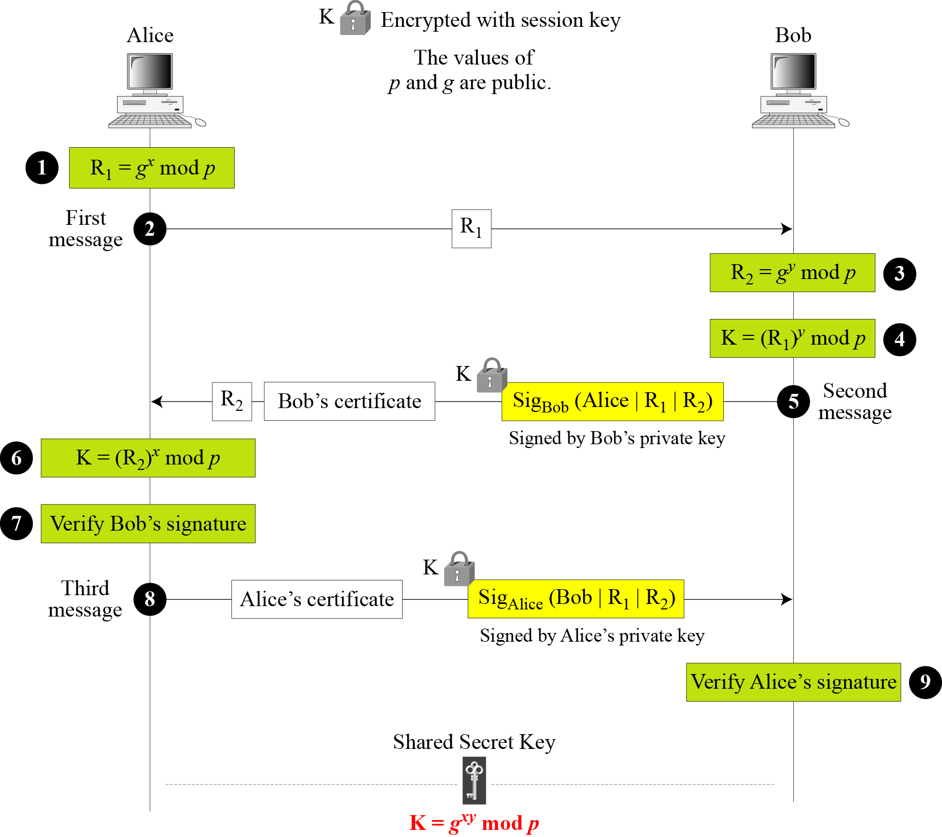
15.3.2 Station-to-Station Key Agreement
Figure 15.12 Station-to-station key agreement method

Slide 28
15-4 PUBLIC-KEY DISTRIBUTION
In asymmetric-key cryptography, people do not need to know a symmetric shared key; everyone shields a private key and advertises a public key.
Topics discussed in this section:
15.4.1 Public Announcement
15.4.2 Trusted Center
15.4.3 Controlled Trusted Center
15.4.4 Certification Authority
15.4.5 X.509
15.4.6 Public-Key Infrastructures (PKI)

Slide 29
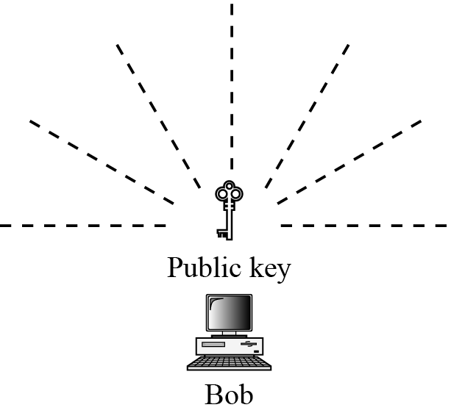
15.4.1 Public Announcement
Figure 15.13 Announcing a public key

Slide 30
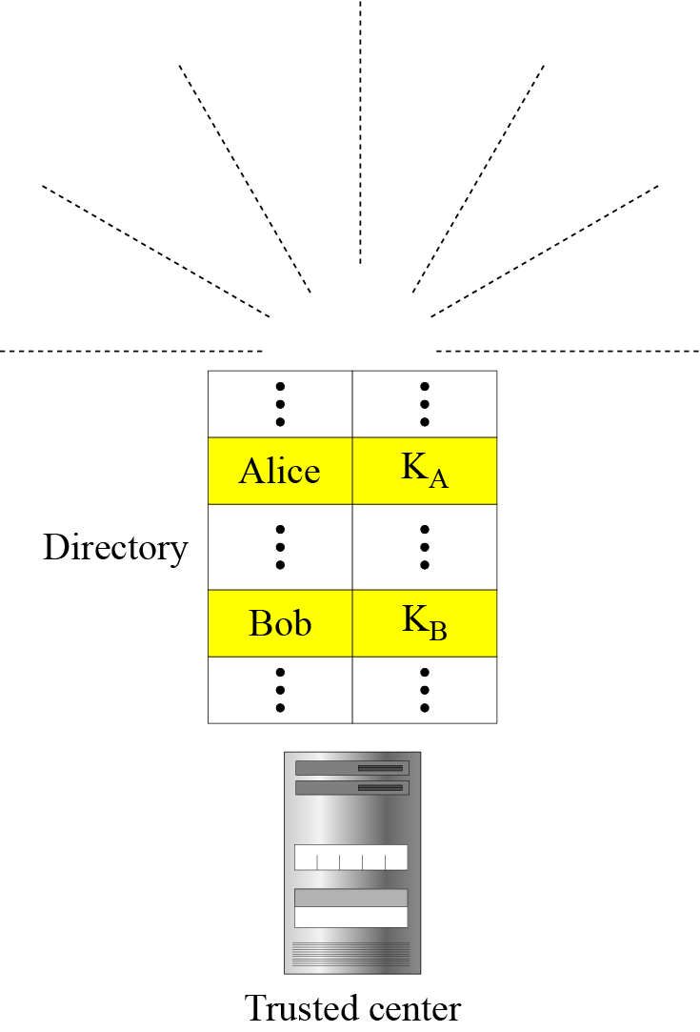
15.4.2 Trusted Center
Figure 15.14 Trusted center

Slide 31
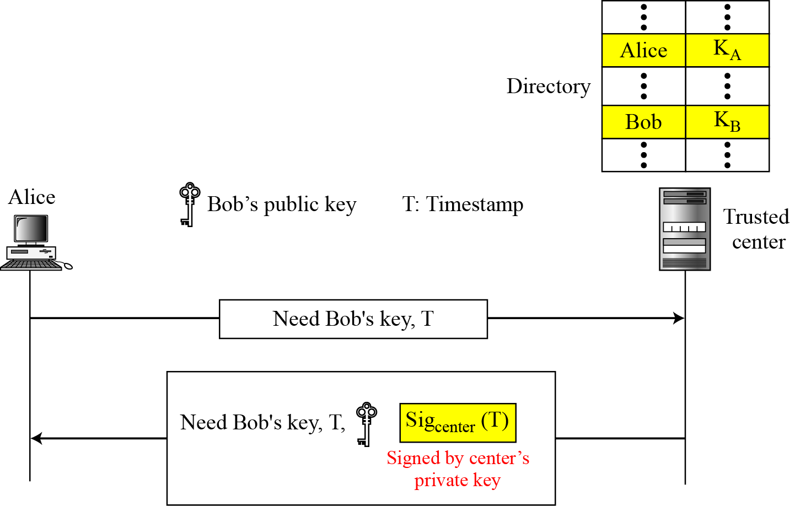
15.4.3 Controlled Trusted Center
Figure 15.15 Controlled trusted center

Slide 32
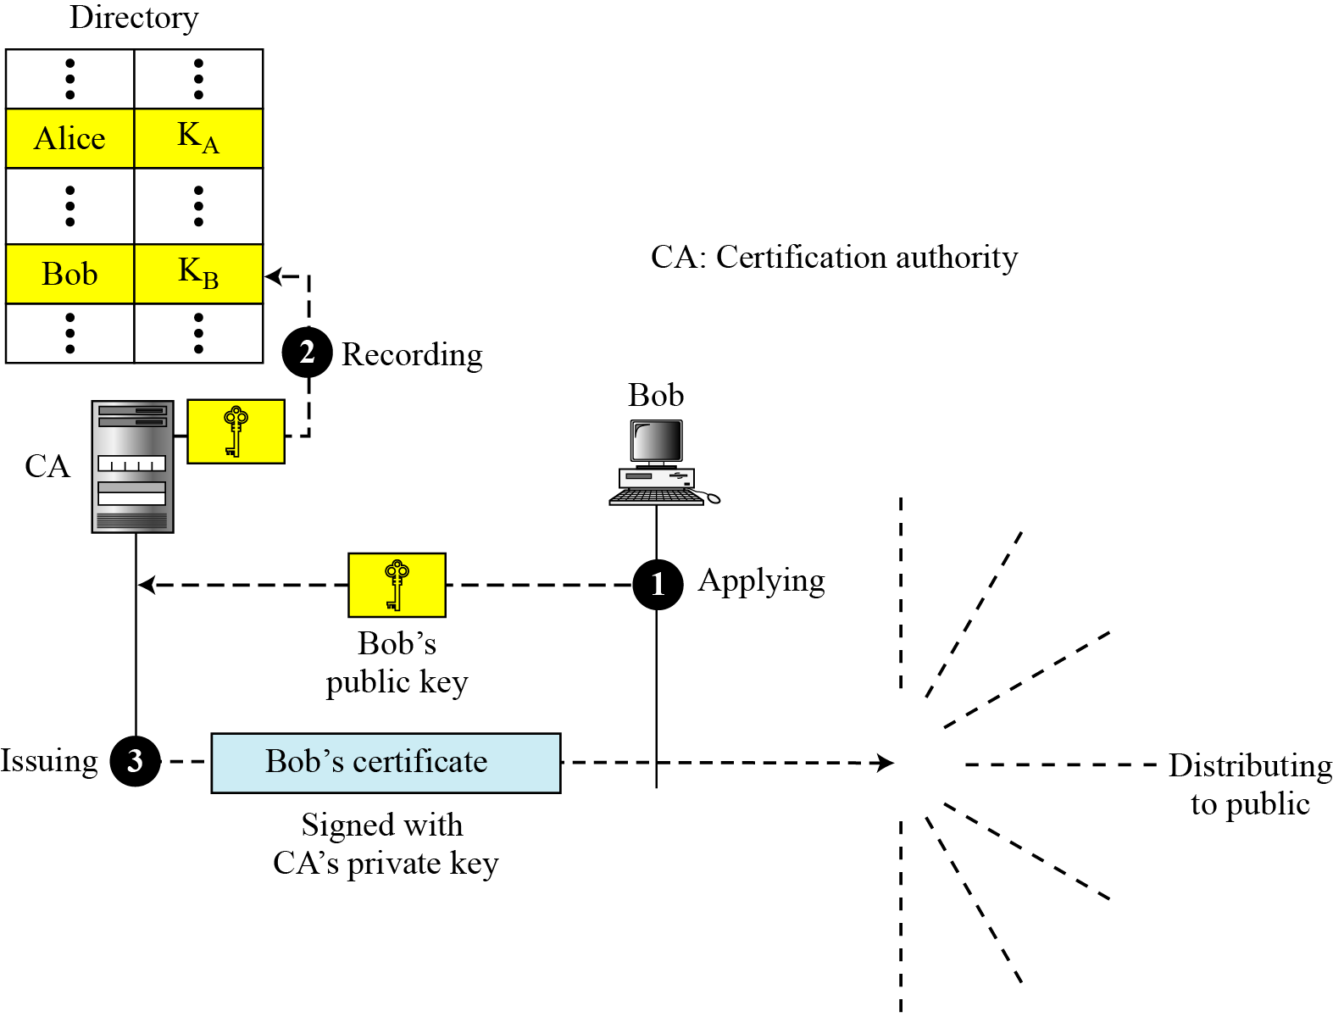
15.4.4 Certification Authority
Figure 15.16 Certification authority

Slide 33
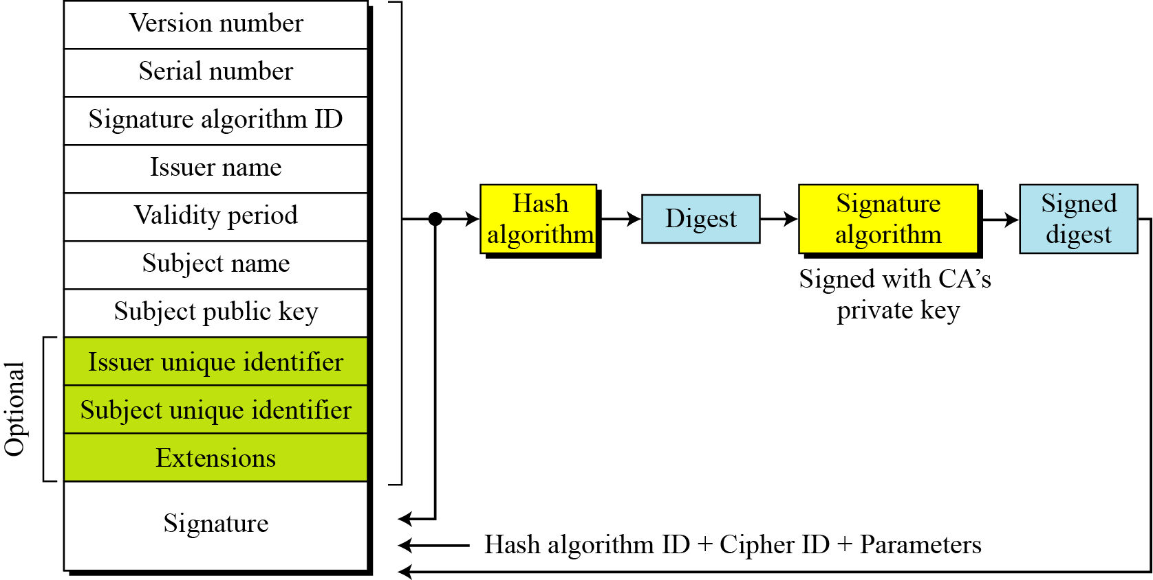
15.4.5 X.509
Certificate
Figure 15.17 shows the format of a certificate.

Slide 34
15.4.5 Continued
Certificate Renewal
Each certificate has a period of validity. If there is no problem with the certificate, the CA issues a new certificate before the old one expires.
Certificate Renewal
In some cases a certificate must be revoked before its expiration.
Delta Revocation
To make revocation more efficient, the delta certificate revocation list (delta CRL) has been introduced.

Slide 35
15.4.5 Continued
Figure 15.17 Certificate revocation format

Slide 36
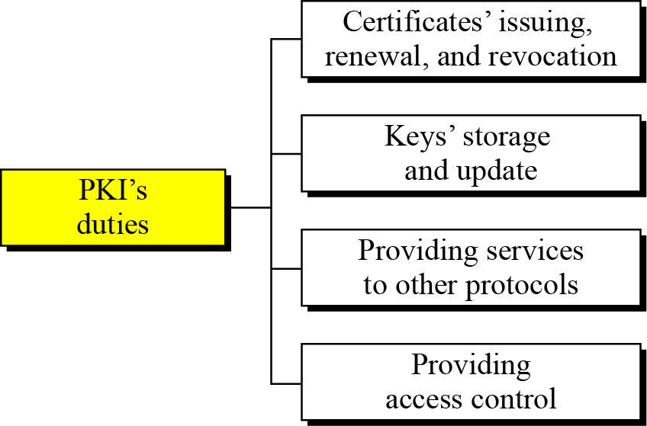
15.4.6 Public-Key Infrastructures (PKI)
Figure 15.19 Some duties of a PKI

Slide 37
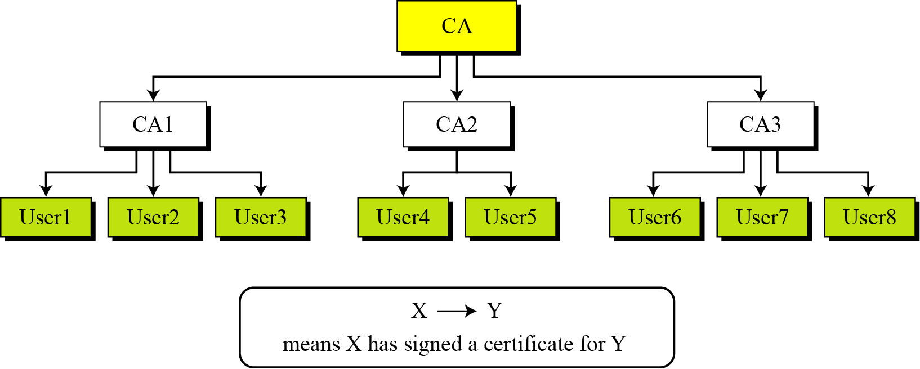
15.4.6 Continued
Trust Model
Figure 15.20 PKI hierarchical model

Slide 38
15.4.6 Continued
Example 15.3
Show how User1, knowing only the public key of the CA (the root), can obtain a verified copy of User3’s public key.
Solution
User3 sends a chain of certificates, CA<<CA1>> and CA1<<User3>>, to User1.
a. User1 validates CA<<CA1>> using the public key of CA.
b. User1 extracts the public key of CA1 from CA<<CA1>>.
c. User1 validates CA1<<User3>> using the public key of CA1.
d. User1 extracts the public key of User 3 from CA1<<User3>>.

Slide 39
15.4.6 Continued
Example 15.4
Some Web browsers, such as Netscape and Internet Explorer, include a set of certificates from independent roots without a single, high-level, authority to certify each root. One can find the
list of these roots in the Internet Explorer at Tools/Internet Options/Contents/Certificate/Trusted roots (using pull-down menu). The user then can choose any of this root and view the certificate.

Slide 40
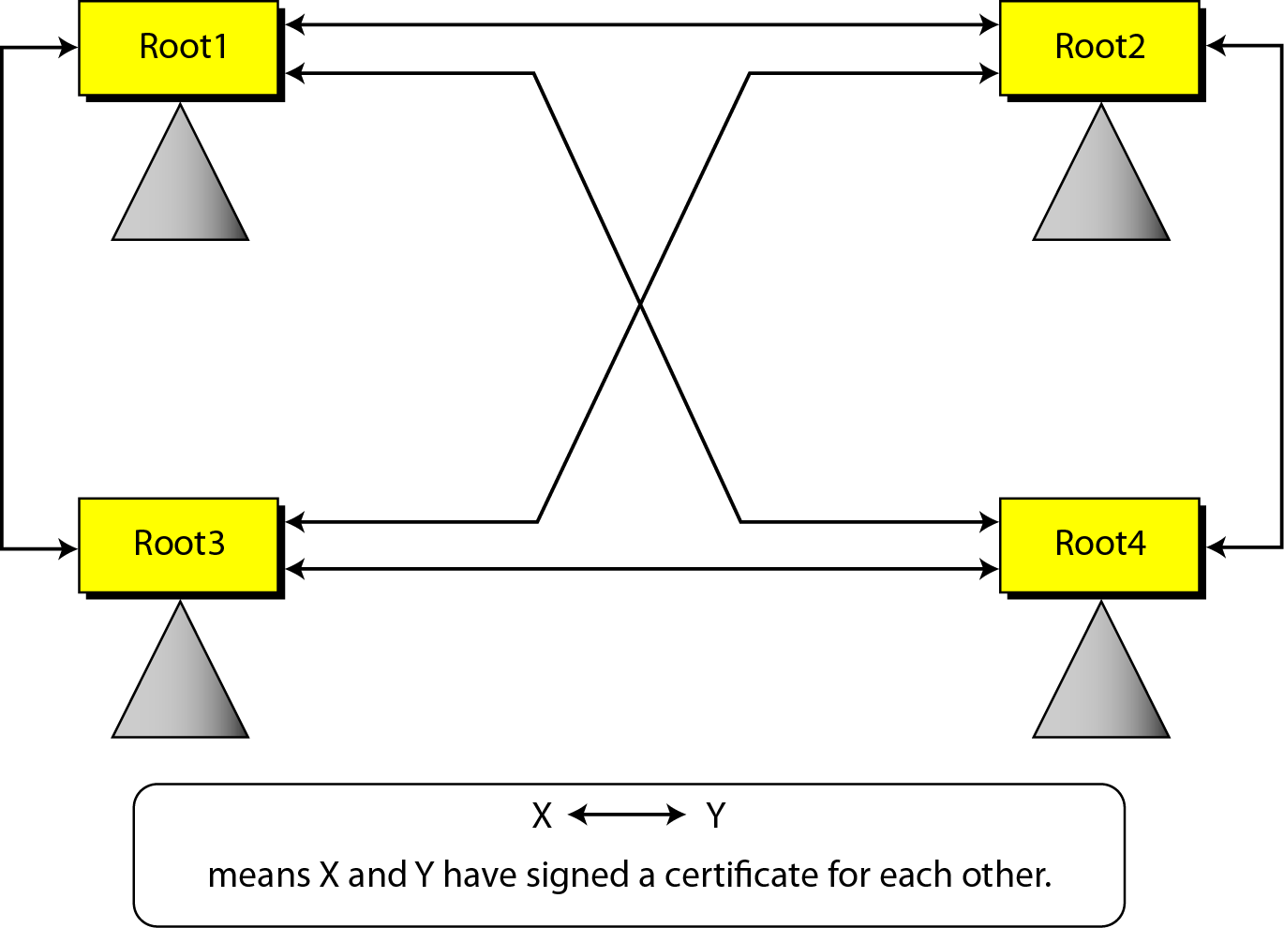
15.4.6 Continued
Figure 15.21 Mesh model

Slide 41
15.4.6 Continued
Example 15.5
Alice is under the authority Root1; Bob is under the authority Root4. Show how Alice can obtain Bob’s verified public key.
Solution
Bob sends a chain of certificates from Root4 to Bob. Alice looks at the directory of Root1 to find Root1<<Root1>> and
Root1<< Root4>> certificates. Using the process shown in Figure 15.21, Alice can verify Bob’s public key.

