Slide 1
Cyclone Intensity Estimation Using Deep Learning Models
Batch 1
Team Members:
BL.EN.U4EAC21035 Konduru Praveen Karthik BL.EN.U4EAC21071 Sri Sai Suhas Sanisetty
BL.EN.U4EAC21075 Tarduvai Satvik Gupta

Slide 2
Introduction
Cyclones cause widespread damage; early intensity prediction is critical.
Traditional statistical models lack adaptability and spatial learning.
Deep learning and hybrid AI approaches can potentially enhance accuracy.
This project investigates CNNs, PSO, SVR, and regression models.
Focused on the Indian Ocean region with real satellite data.
Aims to contribute to improved disaster response and mitigation systems.

Slide 3
Problem Statement
Accurate cyclone intensity prediction is challenging due to chaotic atmospheric dynamics.
Traditional meteorological models may fail to capture spatial texture in satellite imagery.
Need for models that can automatically learn relevant features from image data.
This project addresses the challenge using deep learning and hybrid optimization methods.
Goal: Predict cyclone intensity (Vmax) using infrared imagery.
Deliver robust predictions across unseen data for real-time forecasting use.

Slide 4
Objectives
1
Develop a predictive model for cyclone intensity.
2
Use CNN and hybrid approaches like PSO + SVR and PSO + Regression.
3
Optimize model performance using metaheuristic algorithms.
4
Identify models best suited for operational use
5
Provide interpretable results and benchmark multiple techniques.
6
Validate robustness across training, validation, and test splits.

Slide 5
Literature Survey
SI.No. | Year | Paper Title | Summary | Techniques used | Research Gap
1. | 2024 | Deep Larning Based Cyclone Intensity Estimation using INSAT -3D IR Imagery | Uses deep learning to estimate cyclone strength from satellite images | Dvorak Technique, CNN | Focuses only on intensity estimation, not path prediction.
2. | 2024 | Deep learning based Tropical Cyclone Intensity Estimation System | Estimates wind speed of cyclones using deep learning from satellite dataset | CNN, Advanced Dvorak Technique(ADT), Deviation Angle Variance (DAVT) | Struggles with accuracy for weaker storms with disorganized cloud patterns
3. | 2020 | Deep Learning Algorithm for Satellite Imaging-Based Cyclone Detection | This study focuses on classifying satellite images to detect cyclones and predict their path using deep learning. | Optical flow, interpolation, backward-warping | Lack of high-resolution satellite data. Better methods for predicting storms in real -time are needed.
4. | 2019 | Cyclone Tracking Using Multiple Satellite Image Sources | This paper introduces a system to track cyclones using multiple satellite images. It combines different detection methods for accuracy. | Hough transform, particle filter, Kalman filter | Struggles with low-resolution or incomplete satellite data. Improvements needed to handle diverse data sources.

Slide 6
Dataset Description
Source: Kaggle Dataset - "Cyclone Intensity Prediction - Indian Ocean"
Content Overview:
Satellite infrared (IR) images of cyclones over the Indian Ocean.
Each image represents a snapshot of cyclone activity.
Labels provided as Vmax (maximum wind speed/intensity in knots).
Data Composition:
Infrared/: Contains grayscale cyclone IR images.
label.csv: Contains Filename and Vmax columns.

Slide 7
Dataset Description
Image Characteristics:
Resolution: ~64x64 pixels used in modeling (resized from originals).
Grayscale (1 channel) input.
Dataset Size:
15101 labeled images used for training and testing.
Challenge: Predicting a continuous value (regression) from visual texture and shape of cloud formations.
Potential for expansion with time-series IR image stacking.
Dataset is publicly available, aiding reproducibility and benchmarking.

Slide 8
Data Preprocessing
Preprocessing steps:
Resizing images to 64x64 pixels
Grayscale normalization [0,1]
Mapping Filename to full path
Extracting Vmax labels from label.csv
Splitting: Train (70%), Validation (15%), Test (15%)
Goal: Prepare consistent inputs for deep learning and regression models.
Data augmented through shuffling and batching.
Ensures uniform scale across all samples to reduce bias.

Slide 9
CNN Model Architecture
Layer 1: Conv2D (16 filters, 3x3) + ReLU + MaxPool
Layer 2: Conv2D (32 filters, 3x3) + ReLU + MaxPool
Layer 3: Conv2D (64 filters, 3x3) + ReLU + MaxPool
Flatten → Dense (128 units) → Output (1 unit for regression)
Training: Adam optimizer, MSE loss, 20 epochs
Batch Size: 32, Input Shape: (1, 64, 64)
No dropout used; kept minimal for interpretability.

Slide 10
Performance Of CNN
Epochs = 20:
Train R²: 0.785 | MAE: 12.34 | MSE: 254.72
Validation R²: 0.7284 | MAE: 13.63 | MSE: 327.53
Test R²: 0.7276 | MAE: 13.72 | MSE: 321.18
Insights: Stable generalization across splits; performs well.
Limitations: Requires fine-tuning.
Training converged rapidly without overfitting.
Still room for improvement through regularization or deeper layers.

Slide 11
Alternate Models used
PSO + Linear Regression / Ridge / Lasso:
Works well for reduced dimensionality.
Ridge best with alpha = 100 → MAE: 22, R²: 0.31
PSO + SVM (RBF kernel):
Outstanding performance with selected features
MAE: 14.9, R²: 0.64 (Test)
Better generalization with fewer assumptions than neural networks.
Easier to interpret and faster to train for real-time applications.

Slide 12
2nd Best Performing Model
Feature selection using PSO (feature count = 2141)
Model: SVM with RBF kernel, C=100
Results: MAE: 14.9, R²: 0.64
Code Snippet (Scikit-learn): from sklearn.svm import SVR model = SVR(kernel='rbf', C=100) model.fit(X_train_selected, y_train) y_pred = model.predict(X_test_selected)
Conclusion: Best hybrid model when using PSO for feature optimization.
Combines robust feature selection with powerful non-linear regression.
Suitable for rapid prediction deployment after initial training.

Slide 13
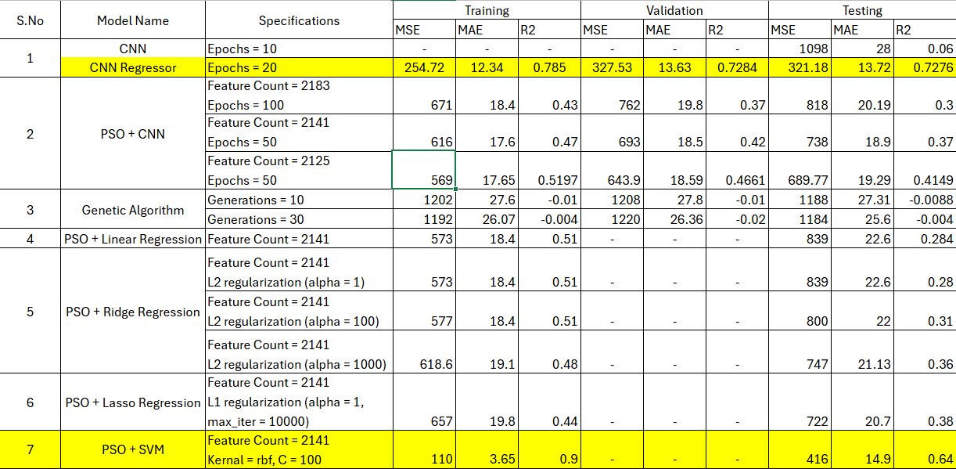
Summary Of Results
Notes:
https://aseblr-my.sharepoint.com/:x:/g/personal/bl_en_u4eac21075_bl_students_amrita_edu/EVMOkk2eTkBNqtnUrsGRbMQBWTL3iWxojzXG1VUzfUlVOg?e=IwgUuB

Slide 14
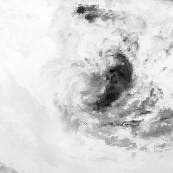
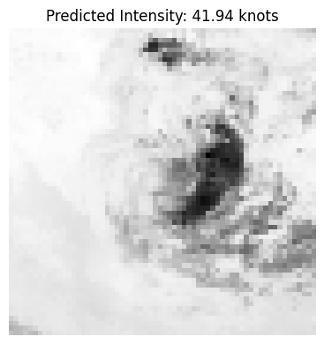
Output of 1st Best Performing Model

Slide 15
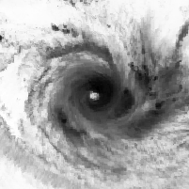
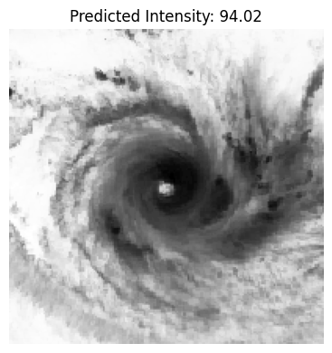
Output of 2nd Best Performing Model

Slide 16
Conclusion & Future Scope
CNN provides a solid base model for cyclone prediction.
PSO is powerful for feature selection, not CNN weight tuning.
Hybrid models (e.g., CNN + SVM) offer a balanced trade-off.
Model performance depends on smart preprocessing and optimization.
Evaluation metrics confirm generalization capabilities.
Open avenues for further experimentation with ensemble methods.

Slide 17
References
Cyclone_Intensity_Prediction_IndianOcean
U. N, J. Vinod, K. M. Komal and J. James, "Deep Learning Based Cyclone Intensity Estimation using INSAT-3D IR Imagery," 2024 IEEE International Conference on Interdisciplinary Approaches in Technology and Management for Social Innovation (IATMSI), Gwalior, India, 2024, pp. 1-5.
M. -S. Chen and C. -J. Zhang, "Deep learning fusion of multi-channel satellite images improves the accuracy of tropical cyclone intensity estimation," 2024 16th International Conference on Intelligent Human-Machine Systems and Cybernetics (IHMSC), Hangzhou, China, 2024, pp. 124-127.
S. Shakya, S. Kumar and M. Goswami, "Deep Learning Algorithm for Satellite Imaging Based Cyclone Detection," in IEEE Journal of Selected Topics in Applied Earth Observations and Remote Sensing, vol. 13, pp. 827-839, 2020.
Panangadan, Anand, Shen-Shyang Ho, and Ashit Talukder. "Cyclone tracking using multiple satellite image sources." Proceedings of the 17th ACM SIGSPATIAL International Conference on Advances in Geographic Information Systems.

