Slide 1

teliport
Team – web weaver
Indian Institute of Technology(ISM) Dhanbad
Ankit Kumar
Satvik Asthana

Slide 2
content
Problem Analysis
Solution Overview
Execution strategy
Project execution timeline
Required Tools
KPIs

Slide 3
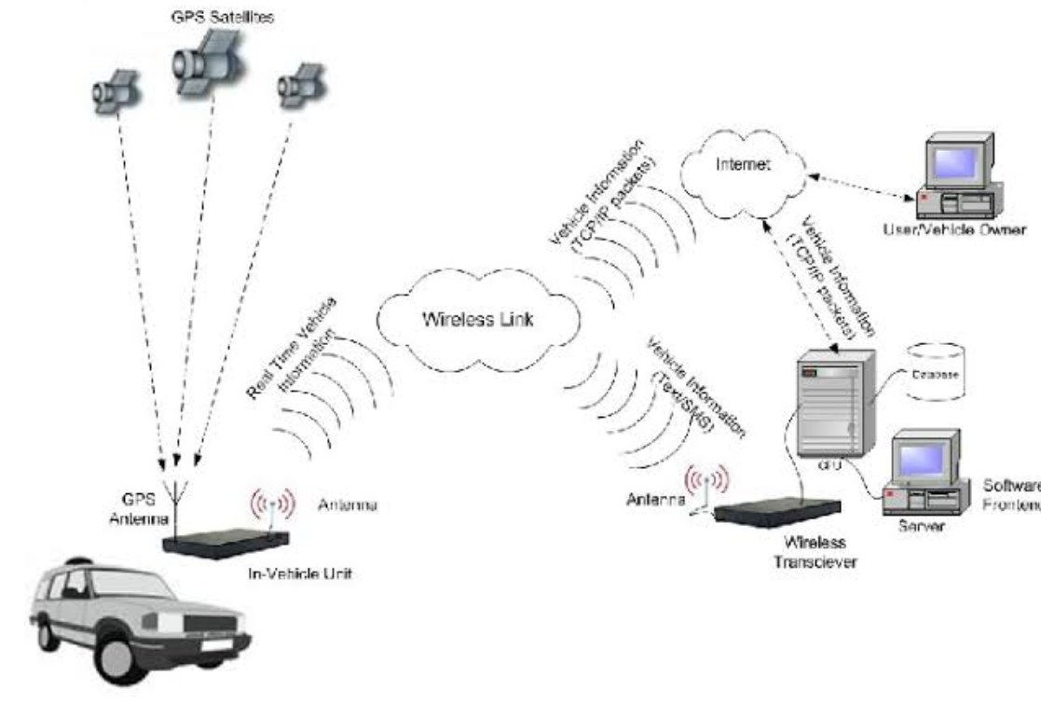
Problem Analysis
Huge data of different types need to be transferred between vehicle and external
entities. This data transfer needs to be secure, resilient, reliable, low latency and high throughput.
The IoT market in road transportation system dominated the market in 2015 and accounted for around 29% of the overall market revenue. IoT solutions help to provide real-time data about transport vehicles. Vendors are integrating connected vehicles with IoT applications to track vehicle location. IoT solutions enhance road transportation system through intelligent IT solutions for transit management and smart traffic management systems. IoT applications integrated with analytics solutions are used to gather and analyze data collected from smart and connected devices with the help of telematics and sensor technology.
The history of IoT vehicular transport can be traced back to the early 1990s, when researchers began to develop systems that could collect and transmit data from vehicles to other devices. In 1993, General Motors (GM) developed a system called OnStar, which was one of the first commercial IoT vehicular transport systems. OnStar used GPS and cellular technology to track the location of vehicles and to provide emergency assistance to drivers.
In the early 2000s, the development of IoT vehicular transport technologies accelerated. In 2003, the US Department of Transportation (USDOT) launched the Vehicle Infrastructure Integration (VII) program, which aimed to develop technologies that could improve communication and coordination between vehicles and infrastructure. The VII program led to the development of a number of IoT vehicular transport technologies, including Dedicated Short-Range Communications (DSRC) and Vehicle-to-Vehicle (V2V) communication.
In the 2010s, the development of IoT vehicular transport technologies continued to progress. In 2011, the USDOT launched the Intelligent Transportation Systems (ITS) Joint Program Office, which is responsible for coordinating the development and deployment of ITS technologies in the United States. The ITS Joint Program Office has supported the development of a number of IoT vehicular transport technologies, including Cellular-Vehicle-to-Everything (C-V2X) communication and Connected Vehicle Systems (CVSs).

Slide 4





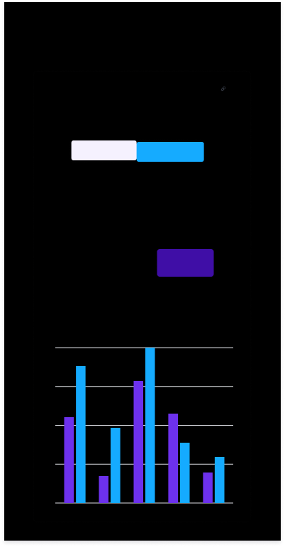
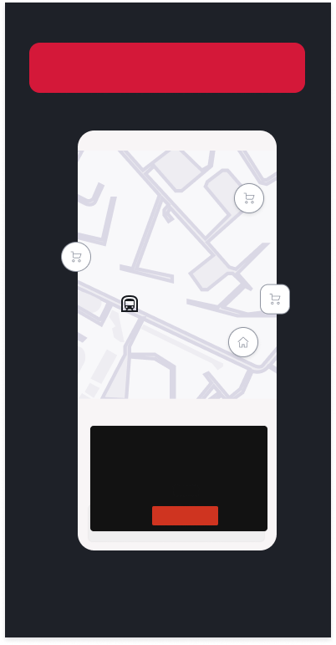
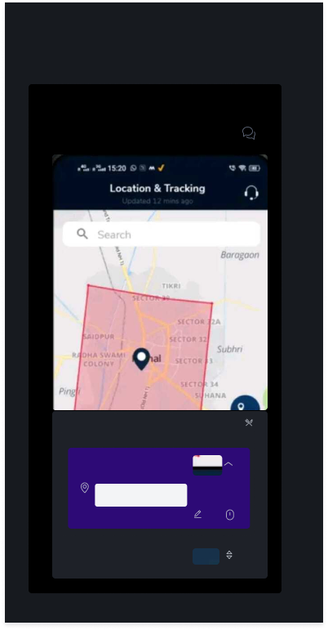
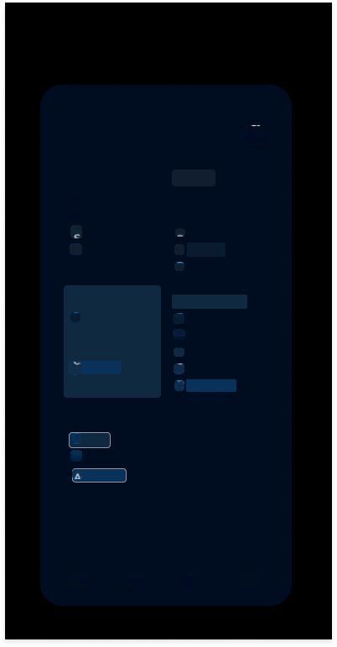
Traffic Navigation Throughout the’ upcoming route
Notification feed (Abour Car , due service, maintenance alert, manufacturing details
Tracking and Location using Polygon Geofence Technology
See a detailed analysis of your car daily,monthly or weekly trips.
Improve your driving experience with
Safeguard your car with
Access the alerts with categorised
Driving Analysis
Share Car location feature lets you share
Polygon Geofence
Notifications Feed
your vehicle live location with your friends and family to ensure your safety.
1743
Quis L
1520
Pariat
1741
Conse
Trips
Location &Tracking
Notifications Feed
Er9a-HR26TC2017383
Updated 12mins ago
Ertiga HR26TC2017383
Trip History
Safety
Security
Driving Analysis
E-Cal
Theft
Tow Away
Geofence
24
Seat Belt
Safe Time
Breakdown
Valet Alert
Total Trips
Overspeeding
immobiizer
90
18.84
Convenience 1
Convenience 2
Max.Speed (km/h)
Avg Speed (km/h)
ACaling
Aiarm
Trp Start
Lead Battery
07:20
10.84
Trip End
Vehicle Lights
Travel Time (hhmm)
Fuel Eco.kmp))
Low Fual
HazardLights
Low Rango
Car Uniocked
Geofence
App related
You can create maximum 5 Geofences
Server
Until the end of the trip
Contract
karnal
Gunst User
1hour
Share
Geofence Location
panipat

Slide 5
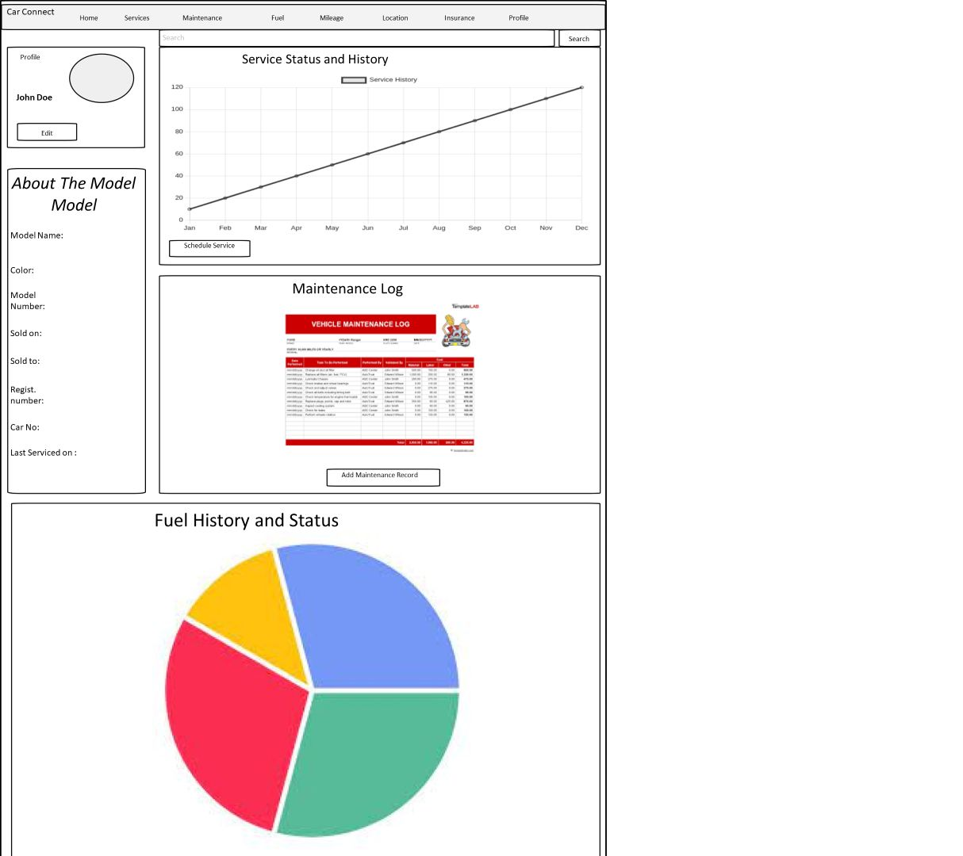



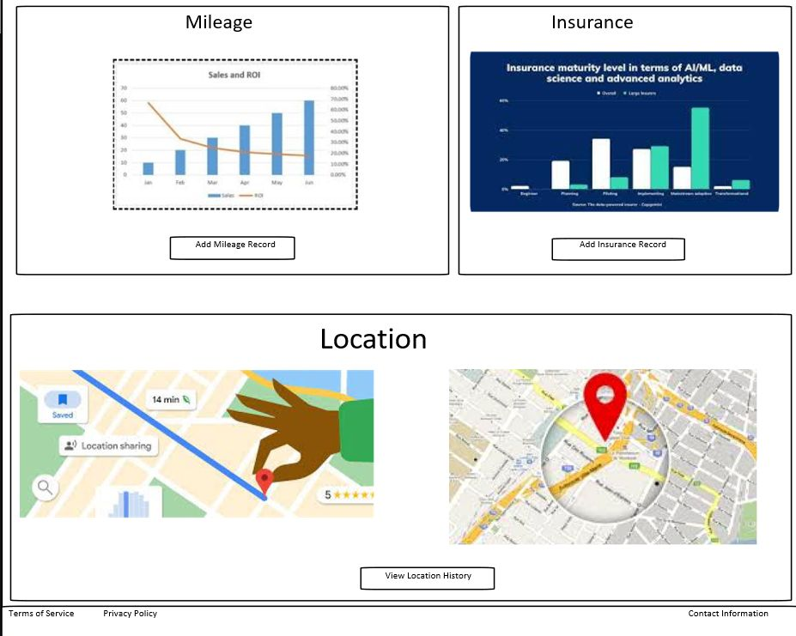
Website wIre-framing for Car Connect website. Containing Important features like: Dashboard Data (#1 - 09/10) Fuel Status (#3 - 8/10) Service history and Scheduling (#4 - 7.5/10) Maintenance Log (#6 - 6.5/10) Mileage Tracking (#5 - 7/10) Location Tracking (#7 - 06/10) Information about the car (#2-8.5/10) Insurance Coverage and details. (#8- 5.5/10)

Slide 6
Execution strategy
Project Initiation and Planning
Project Scope Definition: Clearly define the boundaries and objectives of the project, including the functionalities of the data exchange software and the mobile application.
Resource Identification: Determine the necessary resources, including hardware, software, and skilled personnel required for development.
2. Technical Design and Architecture
System Architecture Design: Create detailed technical designs and architecture diagrams, specifying the flow of data, integration points, and interaction between the vehicle systems, cloud-based infrastructure, and the mobile application.
Selection of Tools and Technologies: Choose appropriate programming languages, frameworks, and cloud platforms based on project requirements and compatibility.
3. Development Phase
Parallel Development of Data Exchange Software and Mobile Application
Set up separate development teams to work concurrently on the data exchange software for vehicles and the mobile application.
Develop a roadmap with specific milestones for both software components.
4. Testing and Quality Assurance
Unit and Integration Testing: Conduct rigorous testing of individual components and integrated systems to ensure functionality and compatibility.
User Acceptance Testing (UAT): Engage a group of users to test the systems and gather feedback for improvements.

Slide 7
5. Deployment and Integration
Deployment of Data Exchange Software: Implement the data exchange software on vehicles, ensuring compatibility and seamless integration with vehicle systems.
Deployment of Mobile Application: Publish the mobile application on relevant app stores after comprehensive testing and validation.
6. Monitoring and Maintenance
Performance Monitoring: Implement monitoring tools to track system performance, data transfer metrics, and user interactions.
Continuous Improvement: Gather user feedback and usage analytics to identify areas for enhancement and updates.
7. Security and Compliance
Security Measures: Ensure compliance with data security regulations and best practices for data transmission and storage.
Regular Audits and Updates: Schedule routine security audits and update the systems to address potential vulnerabilities.
8. Training and Support
User Training: Provide necessary training to users for utilizing the mobile application and understanding its features.
Ongoing Support: Establish a support system to address user queries, issues, and provide continuous assistance.
Real-world Implementation
Partnerships and Collaborations
Collaborate with automotive manufacturers, tech companies, and service providers to implement the solution on a broader scale.
Pilot Testing and Scale-Up
Begin with a pilot deployment to test the system in a real-world environment before scaling up the implementation.

Slide 8
TIMELINE
Phase 2
Phase 1
Project Initiation and Planning
(Duration: 1 Month)
Week 1: Project Kickoff and Planning
Week 2: Requirement Gathering and Technical Design
Week 3-4: Finalize Technical Design and Resource Acquisition
Development
(Duration:3-4 Months)
Week 1-8
Concurrent Development of Data exchange software and Mobile App
Week 9-12
Integration and Testing
Define project scope, objectives, and key deliverables.
Identify and allocate resources including personnel and tools.
Parallel development of the data exchange software for vehicles and the mobile application.
Create a detailed roadmap with milestones for both components.
Gather detailed technical requirements for data exchange software and the mobile application.
Begin initial design discussions and architecture planning.
Integrate individual components and conduct rigorous testing (unit, integration, and UAT) to ensure functionality and compatibility.
Complete technical architecture design and documentation.
Procure necessary tools, hardware, and software required for development.

Slide 9
Phase 3
Phase 4
Deployment and Rollout
(Duration:1 Month)
Week 1-2
Deployment of Data exchange and Mobile App
Monitoring , Maintenance
and
Optimization(Ongoing)
Post- Deployment (Ongoing)
Monitoring
and
Maintenance
Deploy data exchange software on vehicles and ensure seamless integration with vehicle systems.
Publish the mobile application on relevant app stores after final testing and validation.
Implement monitoring tools to track system performance, user interactions, and data transfer metrics.
Schedule regular maintenance and updates to address any identified issues or potential improvements.

Slide 10
TOOLS
Standard PCs or laptops for software development, programming, and designing.
HARDWARE
Computers and Laptops
Smartphones and devices
Software and Development Tools
Integrated Development Environment(IDEs)
For Mobile Application Development
Resources
Version Control
Internet Connectivity
Database Software
Design Tools
Technical Documentation and Research Material
Test devices for application deployment and testing the mobile app on Android and iOS platforms.
Flutter or React Native for cross-platform mobile app development.
Android Studio for Android app development.
Xcode for iOS app development (specifically on Mac machines).
Git and GitHub for code versioning and collaboration.
MySQL or SQLite for local data storage and testing purposes.
Adobe XD, Sketch, or Figma for UI/UX design and wireframing.
Stable and high-speed internet access for research, documentation, and access to development resources.
Access to technical libraries, online resources, academic databases, and relevant journals to gather information about connected vehicle technology and application development.

Slide 11
KPIs
(Key Performance Indicators)
Security
Encryption and Authentication
Highlight the use of robust encryption methods and authentication protocols in data exchange. Conduct a demonstration showing how data is encrypted during transmission from the vehicle to the cloud and emphasize the security measures in place to prevent unauthorized access.
Reliability
Error Handling and Redundancy
Present a demonstration that simulates network disruptions or errors in data transmission, showcasing how the system handles such issues without data loss. Highlight redundancy mechanisms ensuring continuous data flow even under adverse conditions.
Resilience
Failover and Recovery Procedures
Demonstrate the system's ability to recover from failures or disruptions. Simulate a failure scenario and showcase the recovery process, emphasizing the system's ability to resume operations without significant downtime.
Latency
Real-time Data Transmission
Present live demonstrations showing the near-real-time transmission of critical data from the vehicle sensors to the mobile application. Measure and showcase the minimal delay in accessing and displaying real-time vehicle data on the user's mobile app.
Throughput
Data Transfer Speed and Capacity
Conduct tests to measure the rate at which data is transferred between the vehicle and the cloud. Showcase the high throughput capability of the system, demonstrating its ability to handle large volumes of data efficiently and consistently.

