Slide 1
MAHARAJA AGRASEN INSTITUTE OF TECHNOLOGY
Department of Computer Science and Engineering
Evolution and Unified Performance Evaluation of Clustering Techniques in Heterogeneous Wireless Sensor Networks
Presented by
Vansh Tomar
Satvik Rastogi
Ansh Rai
Under the guidance of
Ashish Sharma
Yogesh Sharma
Assistant Professors, Dept. of CSE
Minor Project | Second Defense | September 2026

Slide 2
PROBLEM STATEMENT
The comparison everyone makes does not actually hold
▪ Twenty-five years of protocols, three generations. Heuristics, then explicit optimization, then learned selection.
▪ Each was measured on its own simulator. Field size, node count, packet length, energy budget and channel all differ between papers.
▪ Almost always against LEACH alone, and almost always on a channel with no packet loss.
▪ The assumptions that decide the winner go unstated. Whether a centralized protocol pays for its uplink is worth a quarter of the entire energy budget.
▪ Which death point you report can reverse a ranking, and the author picks which one to publish.
So the question we ask
When a paper reports a margin over LEACH, is that evidence about the algorithm, or evidence about the harness it was measured in?
Right now there is no way to tell them apart.
Aim: build one benchmark in which all three generations run under provably identical physical conditions, with every modeling choice disclosed.
2

Slide 3
ABSTRACT
What we built and what it found
▪ Nine clustering protocols plus a no-clustering baseline run on a single engine that owns energy accounting, packet sizing, fusion, the channel and the counting of delivered readings. A protocol returns only a cluster structure.
▪ Trials are paired. At a given run index every protocol sees the same topology, the same per-link shadowing and the same sensor readings, so differences are tested with sign-flip permutation, paired bootstrap intervals and Holm correction.
▪ 1,950 runs in total: 600 across two channel configurations, and 1,350 across a grid of three node counts by three field areas.
▪ Bracketing transmit power retracts one of our own comparisons. The fuzzy and deep Q-network advantage over LEACH is +417 and +426 rounds with packet loss, and falls to +17 and +22 rounds, no longer significant, once loss is removed.
▪ The scale sweep finds the same boundary from the other side. Distance to the sink sets the regime, not node density, and in a 50 x 50 m field clustering is worse than no clustering at all.
3

Slide 4
INTRODUCTION
Scope, motivation and the hard parts
SCOPE
MOTIVATION
CHALLENGES
▪ 10 configurations, 3 generations, 1 engine
▪ 100 nodes in 100 x 100 m, sink at (50, 150)
▪ Two channels: with and without packet loss
▪ Nine deployment scales, 50 to 150 m fields
▪ Homogeneous, static nodes; failure by energy only
▪ A designer choosing a protocol today cannot get a straight answer out of the literature
▪ Reported gains are entangled with the harness that produced them
▪ Learned protocols are arriving fast, with no common yardstick against the heuristics they claim to beat
▪ Fairness has to be structural, not promised in prose
▪ Topology variance is larger than the differences between protocols, so unpaired tests waste their power
▪ Unspecified parameters, transmit power above all, can decide the ranking outright
▪ Accounting choices are worth more than the algorithms
Standing rule: no protocol is tuned to reproduce a published number. Disagreement with the source tables is expected, not an error.
4

Slide 5
LITERATURE SURVEY
Three generations of answers to one question
Gen. | Protocol | How it picks the cluster head | Ref.
G1 | LEACH | Probabilistic threshold with an epoch constraint | Heinzelman 2000
G1 | PEGASIS | No clusters; greedy nearest-neighbor chain | Lindsey 2002
G1 | TEEN / APTEEN | LEACH clustering; suppress by sensed-value threshold | Manjeshwar 2001, 2002
G2 | NSGA-II | Multi-objective search, three objectives, knee point | Deb 2002
G2 | Type-2 Fuzzy | 27-rule interval type-2 base, Karnik-Mendel reduction | Mendel 2002
G3 | SOM | Kohonen map over position and residual energy | Kohonen 1990
G3 | DQN | Learned Q-value ranking, temporal credit assignment | Mnih 2015
G3 | GCN | Learned graph scoring over a 6-NN graph | Kipf 2017
THE GAP WE FOUND
The comparability problem is itself a documented finding in network simulation.
Kurkowski (2005) and Pawlikowski (2002) show that most published simulation studies cannot be reproduced or compared.
Nobody has applied that lesson to clustering protocols across all three generations. That is our gap.
What none of them share: a common simulator, a common channel model, a common energy budget, or a stated position on who pays for control traffic. Every one of those four decides the ranking.
5

Slide 6
TECHNOLOGY STACK
Deliberately small, and that is the point
CORE
SCALE AND TESTING
WRITING
▪ Python 3.11
▪ NumPy for every numerical path
▪ pandas for aggregation
▪ Matplotlib for all figures
▪ multiprocessing, 14 to 16 workers
▪ pytest, plus 18 static audit checks
▪ Deterministic seeding by keyed hash
▪ LaTeX with IEEEtran
▪ Tables generated from CSVs, never typed
▪ Git for the full history
WHAT WE LEFT OUT ON PURPOSE
No PyTorch, no TensorFlow, no SciPy. The backpropagation for both the deep Q-network and the graph network is hand-written NumPy, verified against central finite differences.
Per-round setup time is one of our reported metrics. If one protocol ran on an optimized C++ backend and another on plain Python, that column would measure the framework, not the algorithm.
6

Slide 7
ARCHITECTURE
Fairness is enforced by the code, not promised in the write-up
THE ENGINE OWNS
Energy, through one charging function • packet sizing • the fusion charge • the channel and its ARQ retries • TDMA slots and latency • counting delivered readings
A PROTOCOL RETURNS
A set of cluster head identities, and a membership map.
Nothing else. It cannot touch energy or liveness.
▪ Paired seeding. Run index i generates the positions, the initial energies, the per-link shadowing matrix and the full sensor stream. That order depends only on i, never on which protocol is running.
▪ A static audit, 18 checks. Confirms no protocol implementation writes to the energy or liveness arrays, calls the charging function, or picks its own packet sizes.
▪ Three invariants the engine will not let a protocol break. Transmissions execute in hop-depth order, a fusing node emits at most one packet, and the engine counts delivered readings itself rather than letting a protocol declare its own.
▪ Conservation, asserted every run. Energy in equals energy out to 1e-9 J. That single assertion is the primary correctness check on the whole simulator.
7

Slide 8
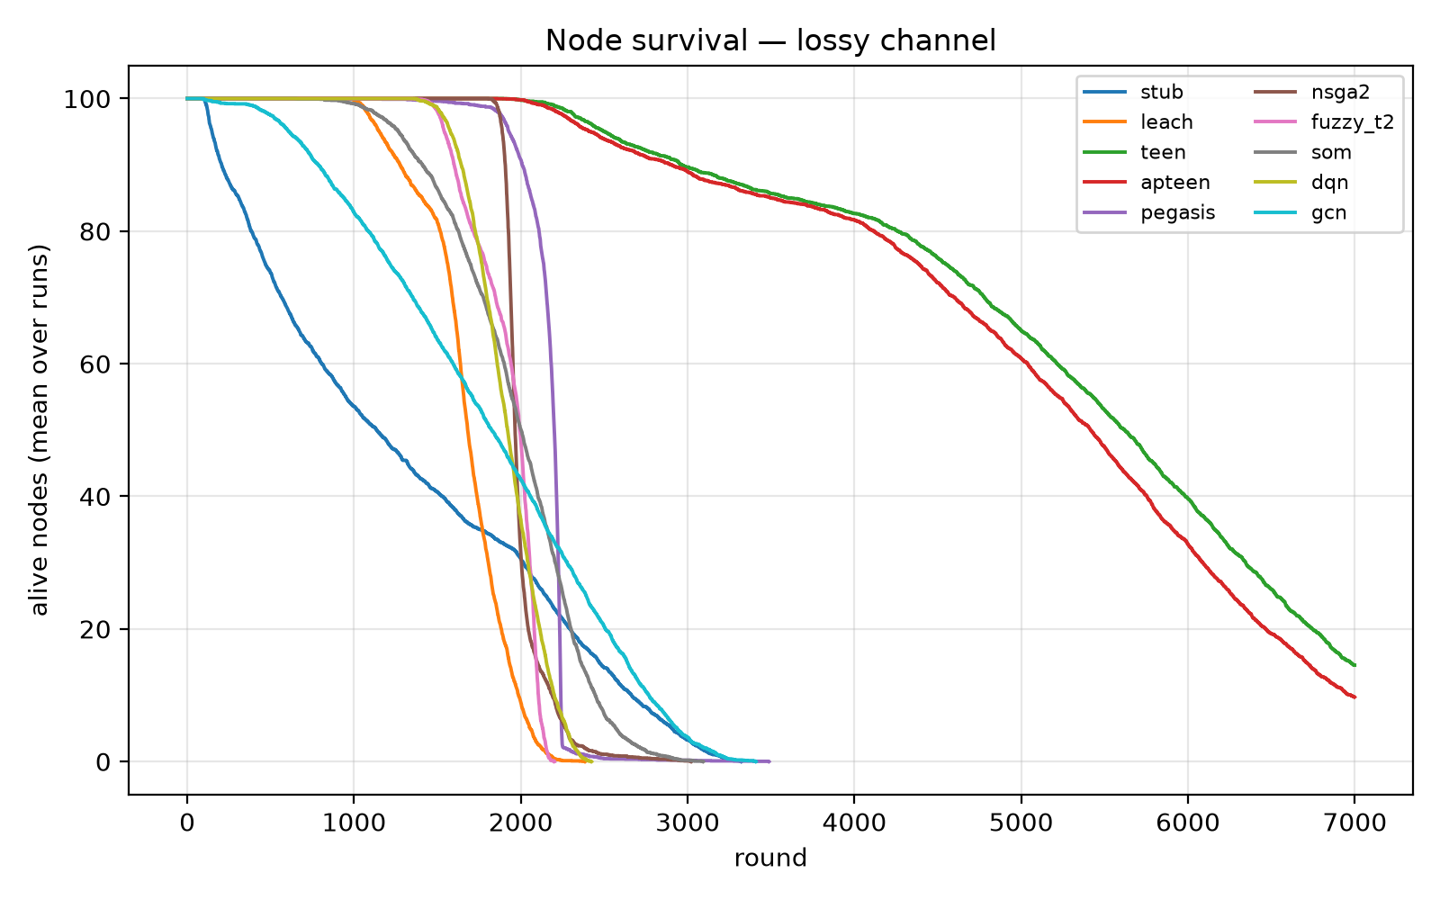
PROTOTYPE
The simulator runs end to end today
▪ All 10 configurations implemented and passing verification.
▪ 1,950 runs complete. 600 for the headline channel pair in 80 minutes on 16 cores, 1,350 for the scale grid in 222 minutes on 14.
▪ Seven verification gates, all green. Energy conservation, hand-checked radio energies either side of the crossover, an invariant suite, determinism, the static audit, an independent recomputation, and the packet-error curve.
▪ Reproducible exactly. Three repeats per seed diff to zero on every per-round field for all nine protocols.
▪ Outputs. Per-round CSVs for every run, 14 figures, and every LaTeX table in the paper generated straight from those CSVs rather than typed by hand.
Living nodes against round, lossy channel, averaged over 30 paired trials. The baseline and the clustered protocols cross, which is why we report four lifetime measures rather than one.
8

Slide 9
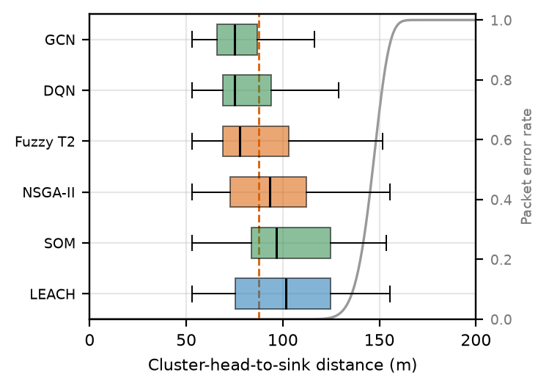
RESULTS SO FAR
Four findings, and one of them retracts our own claim
▪ Clustering redistributes lifetime, it does not extend it. LEACH reaches first node death at 1,046 rounds against the baseline's 114, a factor of 9.2. But its last node dies at 2,191 against the baseline's 3,202.
▪ We retract one of our own comparisons. The fuzzy system and the deep Q-network beat LEACH by 417 and 426 rounds under packet loss. Remove the loss and the same comparisons give 17 and 22 rounds, no longer significant.
▪ The cause is the tail, not the average. Packet error is near zero below 120 m and every protocol's mean head distance sits below that. LEACH puts 29.9% of its head-rounds beyond 120 m and spends 6.39% of its budget retransmitting; the Q-network puts 5.1% out there and spends 2.31%.
▪ It is a regime, not a rule. In a 50 x 50 m field, where no link reaches the error waterfall, the no-clustering baseline outlives LEACH.
Head-to-sink distance per protocol, drawn over the packet-error curve. Every mean sits in the flat region; only the tails reach the waterfall.
Across the six single-hop protocols, tail share predicts retry energy at r = 0.95.
9

Slide 10
References
[1] W. R. Heinzelman, A. Chandrakasan and H. Balakrishnan, “Energy-Efficient Communication Protocol for Wireless Microsensor Networks,” Proc. HICSS, 2000.
[2] S. Lindsey and C. S. Raghavendra, “PEGASIS: Power-Efficient Gathering in Sensor Information Systems,” Proc. IEEE Aerospace Conf., 2002.
[3] A. Manjeshwar and D. P. Agrawal, “TEEN: A Routing Protocol for Enhanced Efficiency in Wireless Sensor Networks,” Proc. IPDPS Workshops, 2001.
[4] K. Deb, A. Pratap, S. Agarwal and T. Meyarivan, “A Fast and Elitist Multiobjective Genetic Algorithm: NSGA-II,” IEEE Trans. Evol. Comput., vol. 6, no. 2, 2002.
[5] J. M. Mendel and R. I. B. John, “Type-2 Fuzzy Sets Made Simple,” IEEE Trans. Fuzzy Syst., vol. 10, no. 2, 2002.
[6] T. Kohonen, “The Self-Organizing Map,” Proc. IEEE, vol. 78, no. 9, 1990.
[7] V. Mnih et al., “Human-Level Control Through Deep Reinforcement Learning,” Nature, vol. 518, 2015.
[8] T. N. Kipf and M. Welling, “Semi-Supervised Classification with Graph Convolutional Networks,” Proc. ICLR, 2017.
[9] S. Kurkowski, T. Camp and M. Colagrosso, “MANET Simulation Studies: The Incredibles,” ACM SIGMOBILE MC2R, vol. 9, no. 4, 2005.
[10] K. Pawlikowski, H.-D. J. Jeong and J.-S. R. Lee, “On Credibility of Simulation Studies of Telecommunication Networks,” IEEE Commun. Mag., vol. 40, no. 1, 2002.
[11] T. S. Rappaport, Wireless Communications: Principles and Practice, 2nd ed. Prentice Hall, 2002.
[12] S. Holm, “A Simple Sequentially Rejective Multiple Test Procedure,” Scand. J. Statist., vol. 6, no. 2, 1979.
The manuscript cites 47 references in full. Configuration constants, per-round outputs and verification artifacts are released with the code.
10

