Slide 1

Customer Shopping Behavior Analysis
Uncovering insights from transactional data to guide strategic business decisions.

Slide 2
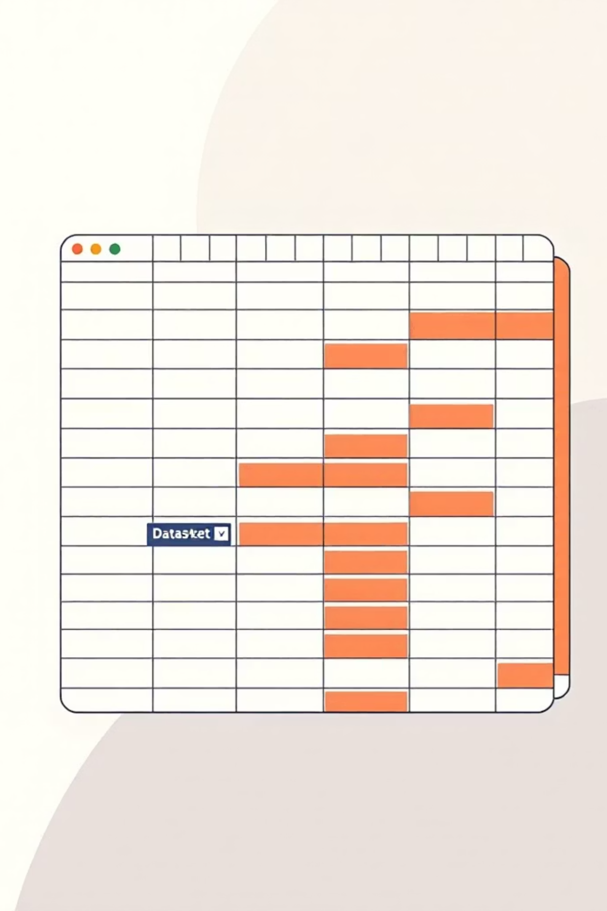
Project Overview & Dataset
Project Goal
Dataset Snapshot
Analyze 3,900 purchases to understand spending, segments, preferences, and subscriptions.
Rows: 3,900
Columns: 18
Key Features: Demographics, Purchase Details, Behavior
Missing Data: 37 in Review Rating

Slide 3
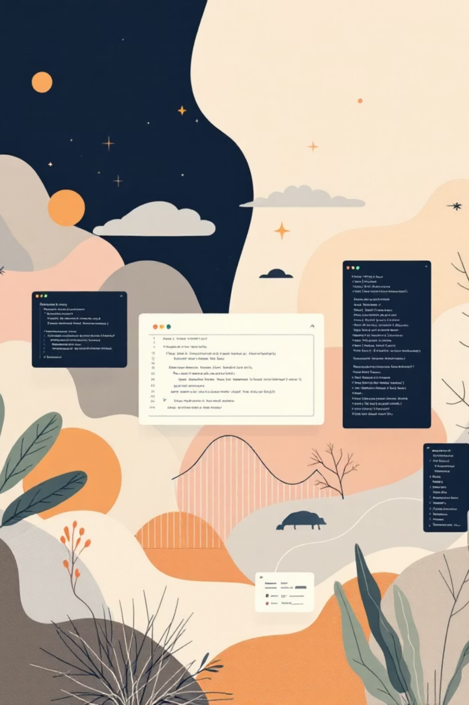
Exploratory Data Analysis (Python)
01
Data Loading & Exploration
Imported with pandas, checked structure and summary statistics.
02
Data Cleaning
Handled missing 'Review Rating' by median imputation, standardized column names.
03
Feature Engineering
Created 'age_group' and 'purchase_frequency_days'.
04
Database Integration
Loaded cleaned data into PostgreSQL for SQL analysis.

Slide 4
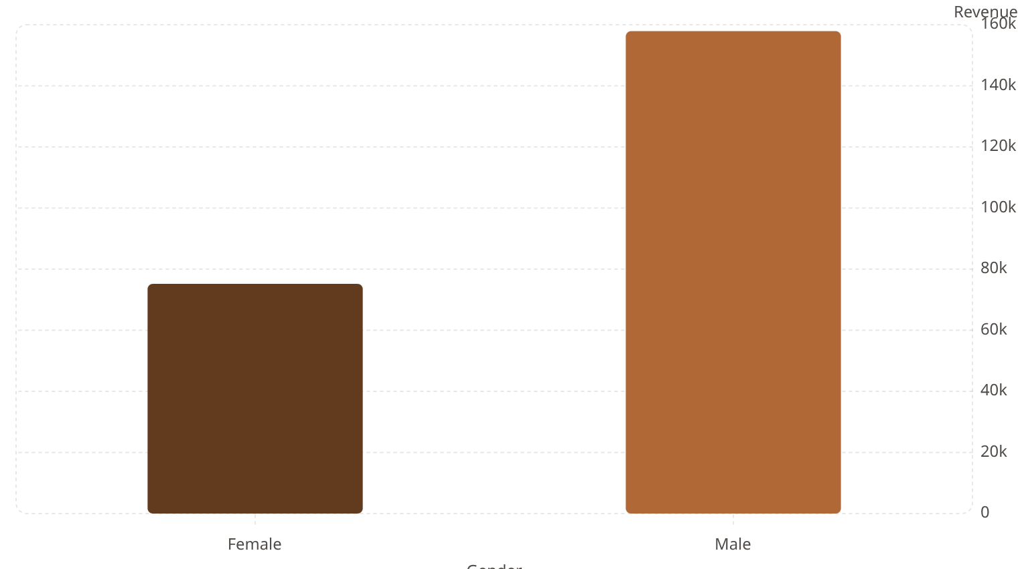
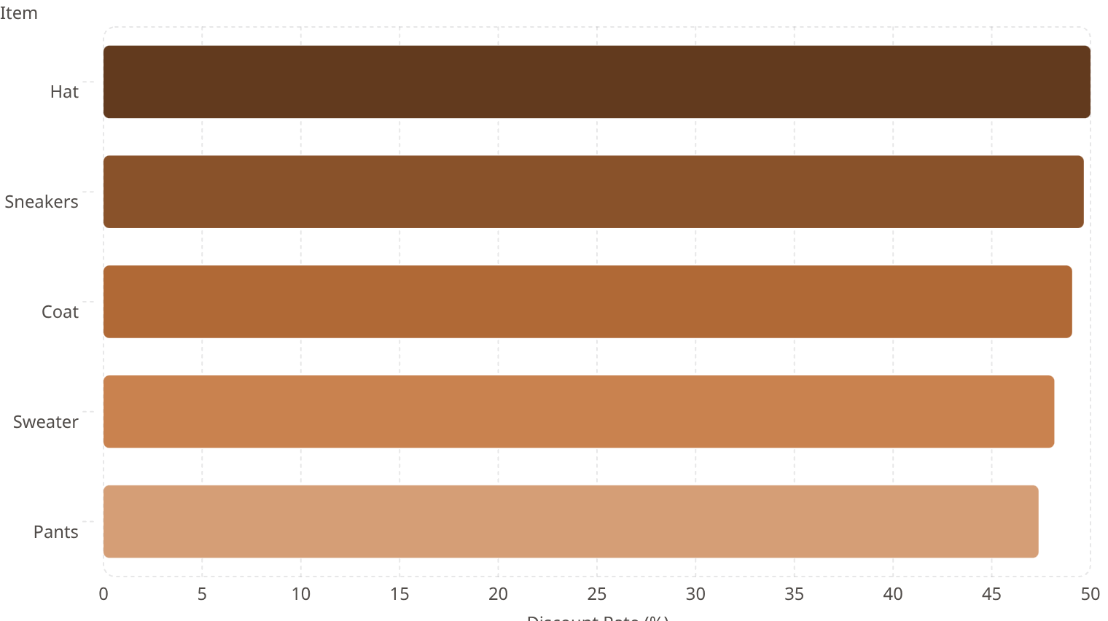
Key SQL Insights: Revenue & Discounts
Revenue by Gender
High-Spending Discount Users
Identified 839 customers using discounts but spending above average.
Discount-Dependent Products

Slide 5
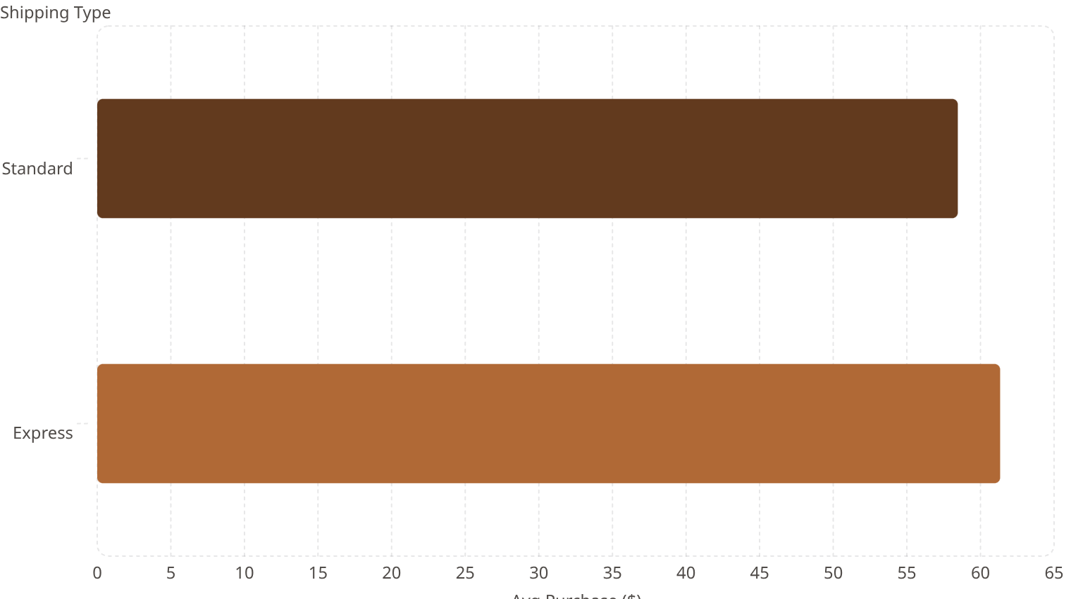
Key SQL Insights: Products & Shipping
Top 5 Products by Rating
Shipping Type Comparison
Item Purchased
Avg Rating
Gloves
3.86
Sandals
3.84
Boots
3.82
Hat
3.80
Skirt
3.78

Slide 6
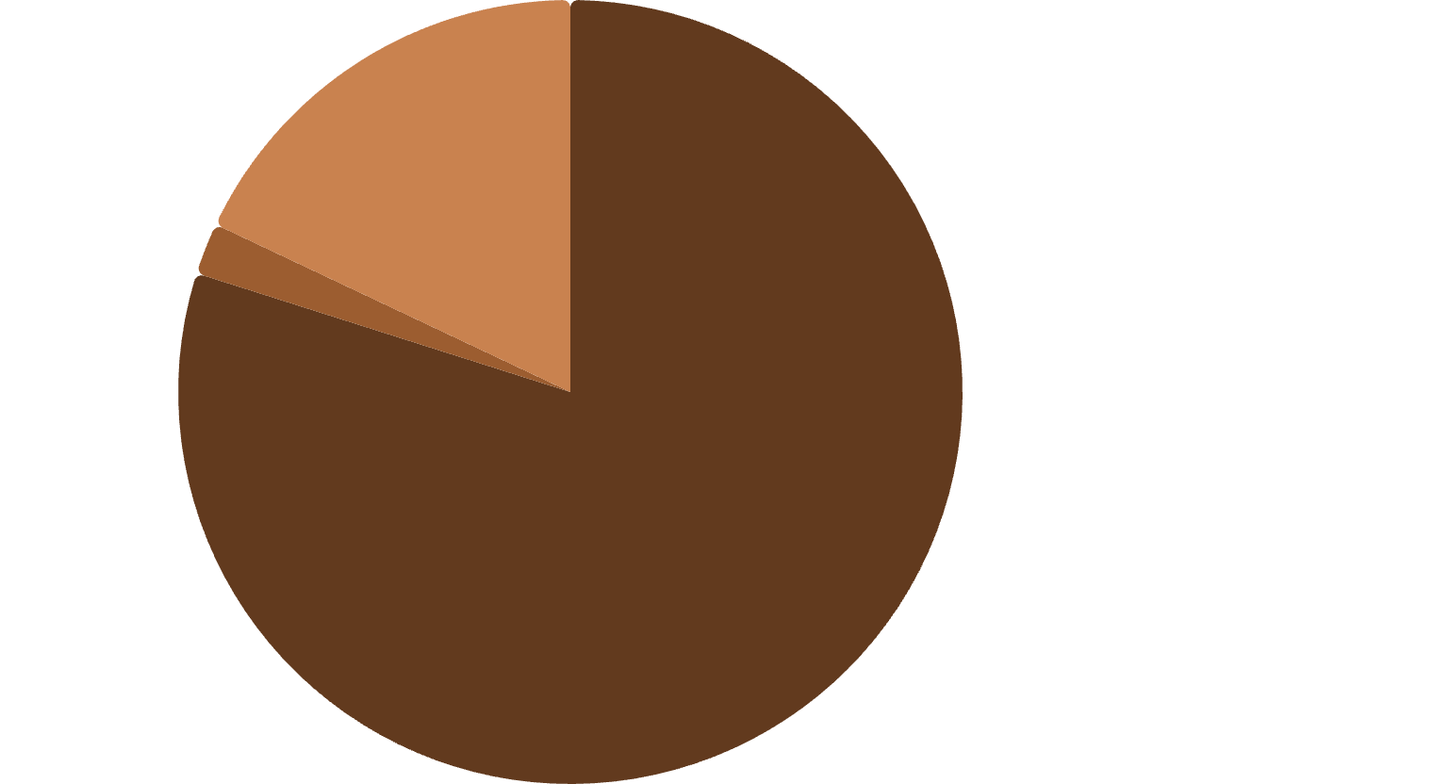
Key SQL Insights: Subscriptions & Segments
Subscribers vs. Non-Subscribers
Customer Segmentation
Status
Customers
Avg Spend
Total Revenue
Yes
1053
59.49
62645.00
No
2847
59.87
170436.00
Loyal·79.9%
·79.9%
·
New·2.13%
·2.13%
·
Returning·17.97%
·17.97%
·

Slide 7
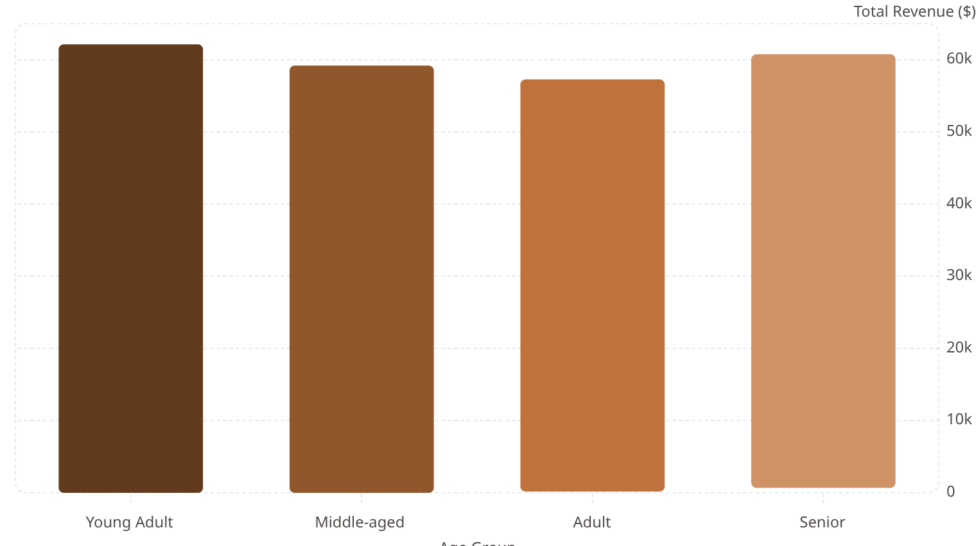
Key SQL Insights: Product Categories & Age
Top 3 Products per Category
Revenue by Age Group
Category
Item Purchased
Total Orders
Accessories
Jewelry
171
Accessories
Sunglasses
161
Clothing
Blouse
171
Clothing
Pants
171
Footwear
Sandals
160
Footwear
Shoes
150

Slide 8
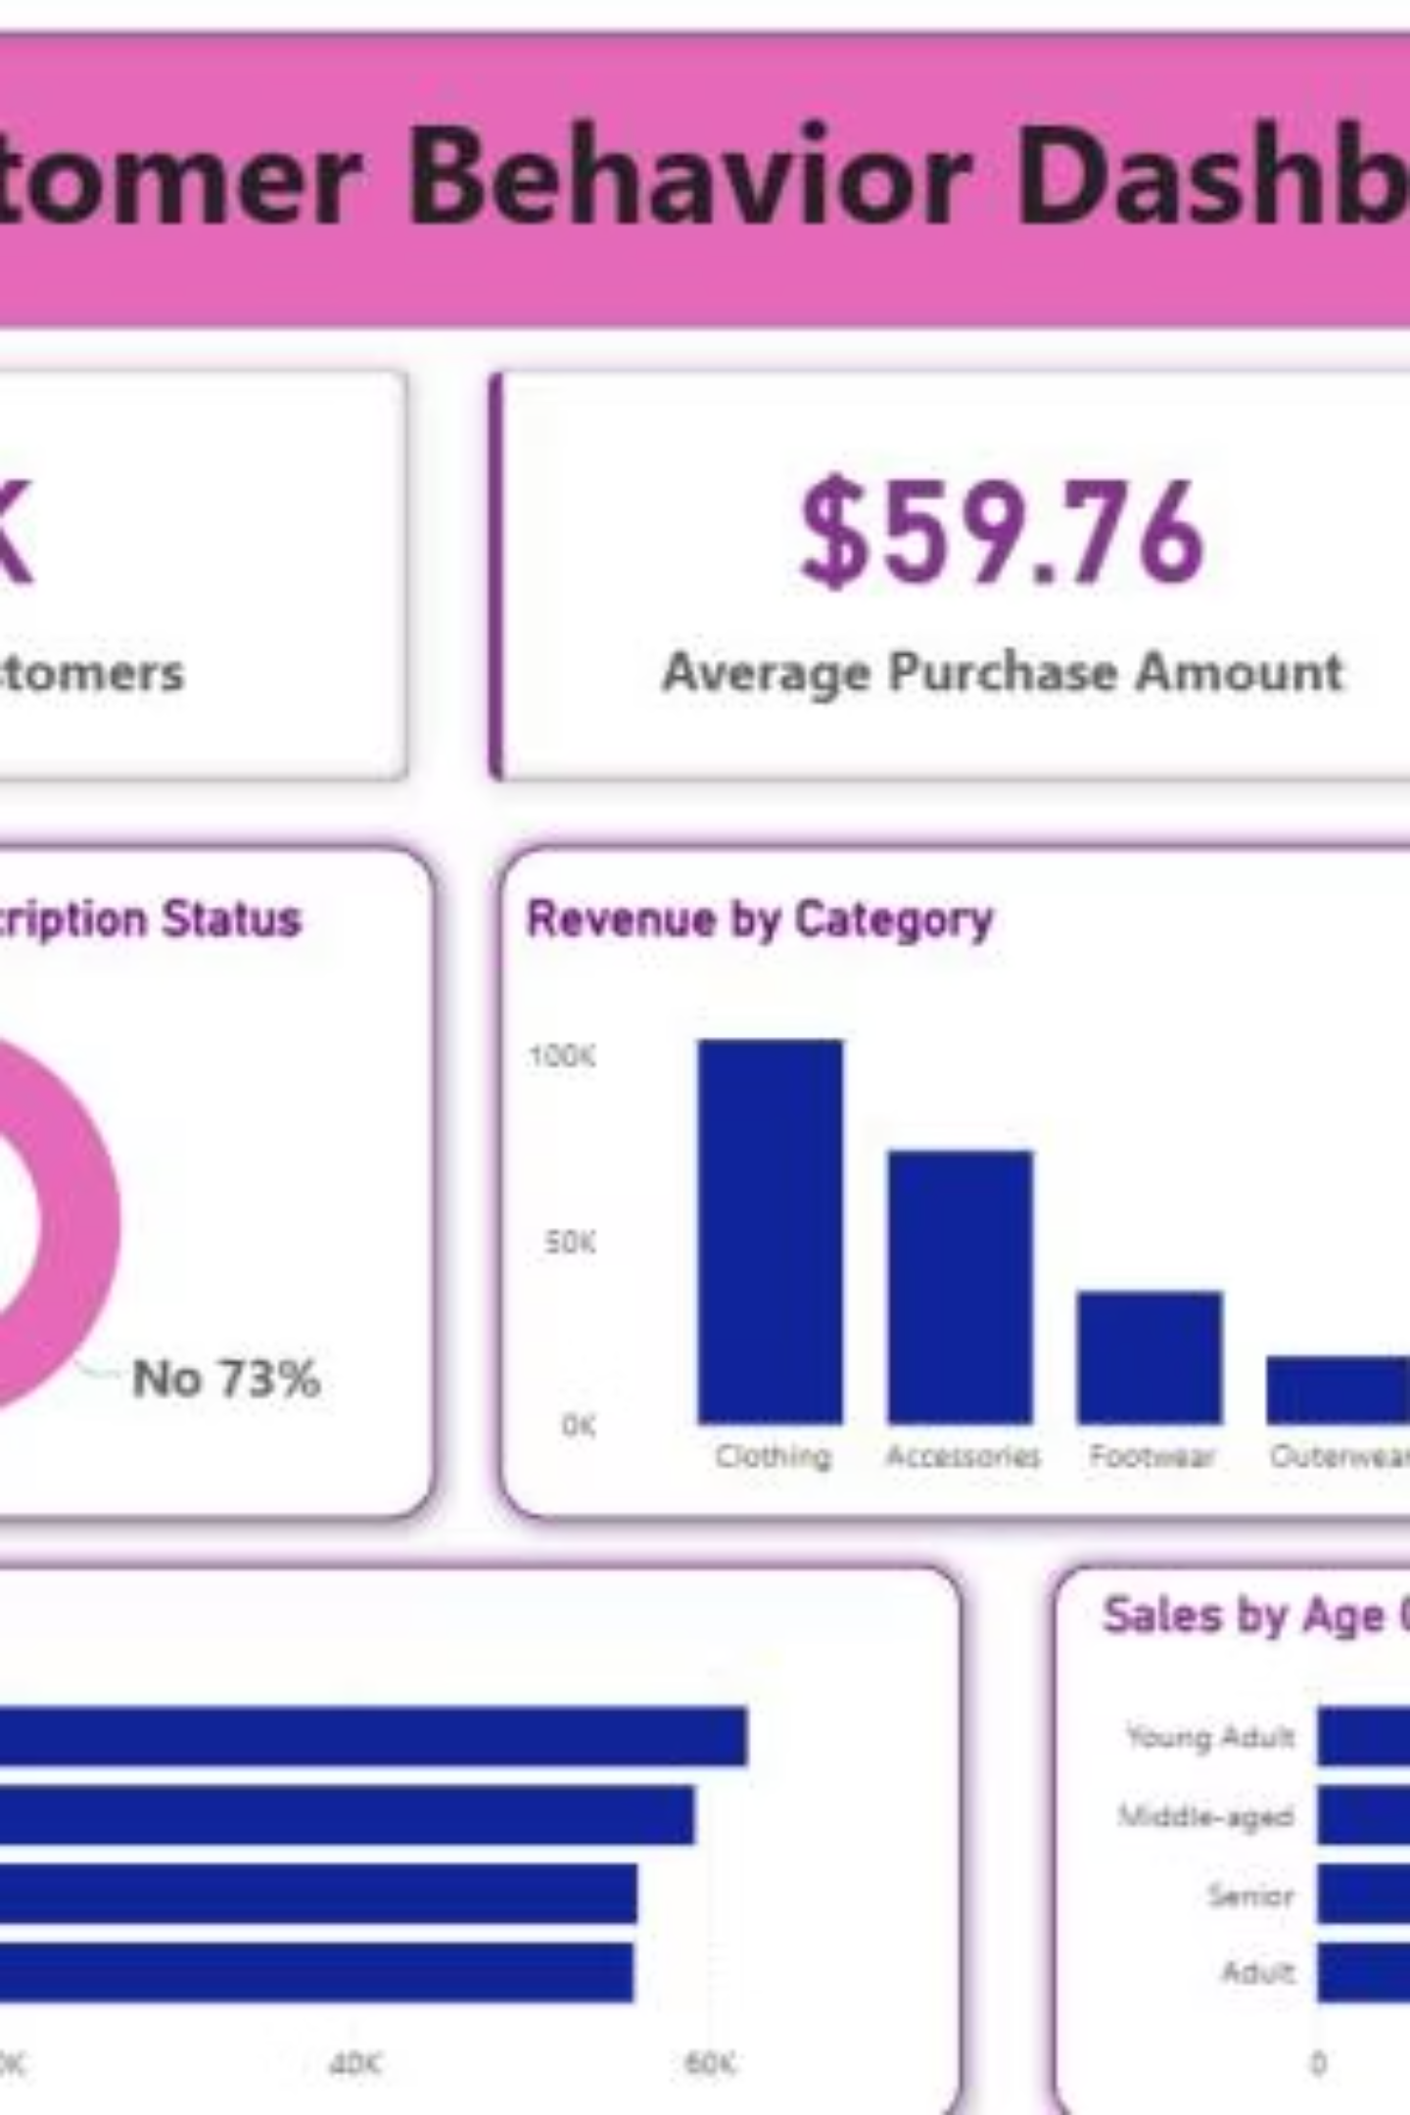
Dashboard in Power BI
3.9K
$59.76
3.75
Customers
Avg Purchase
Avg Review

Slide 9
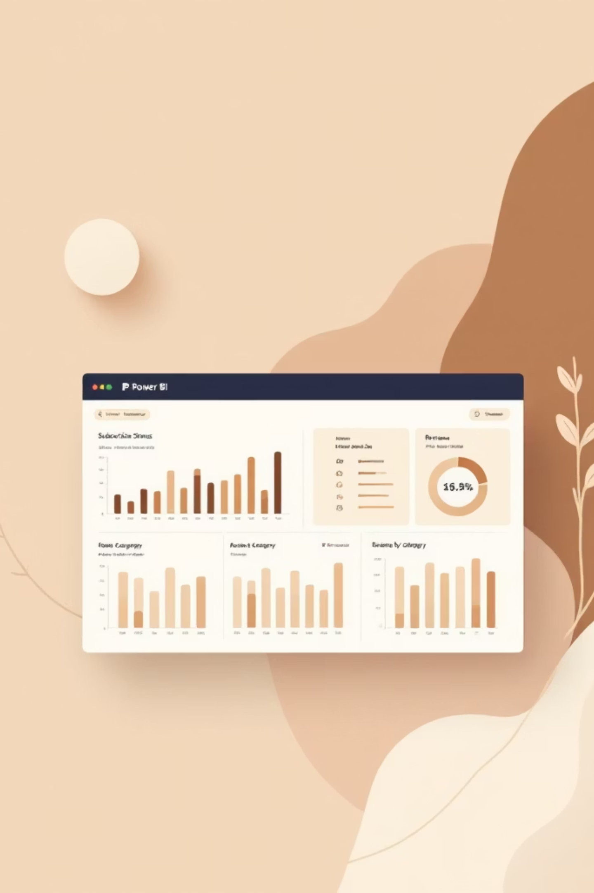
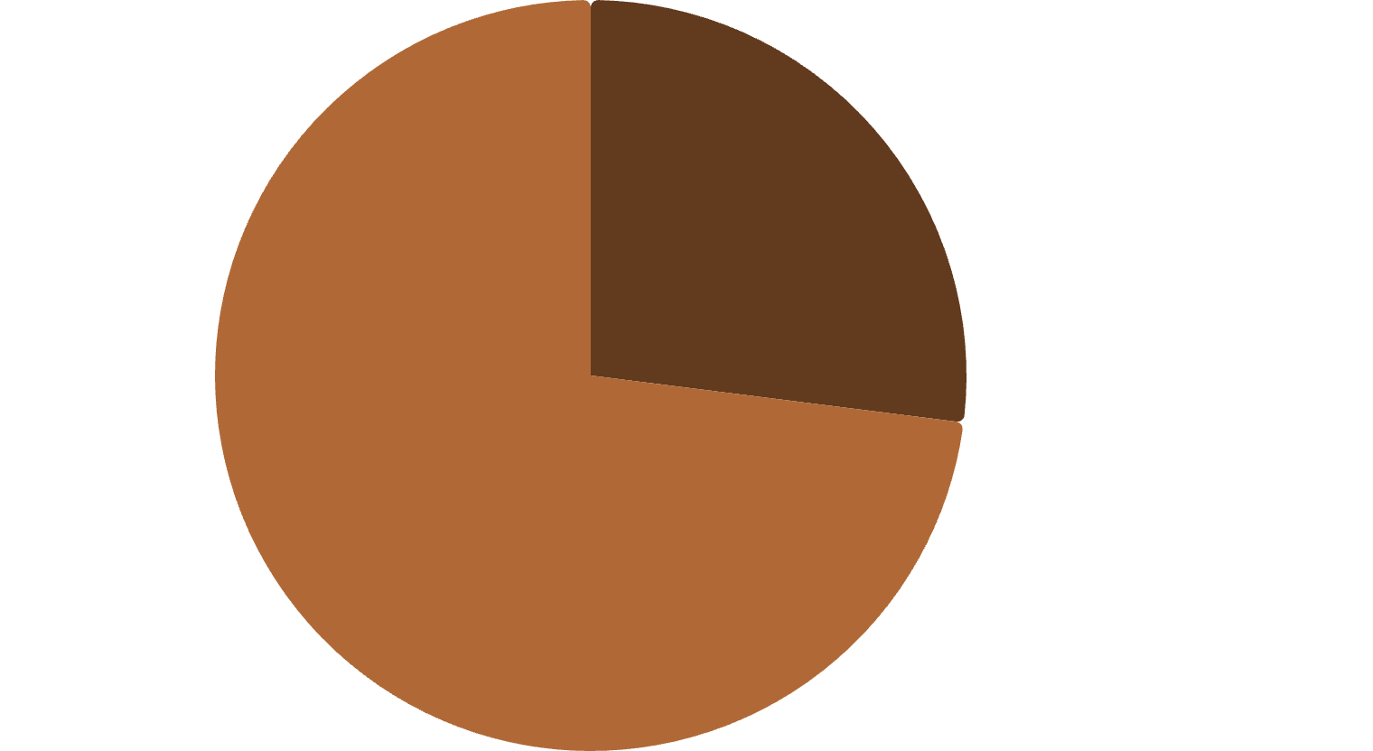
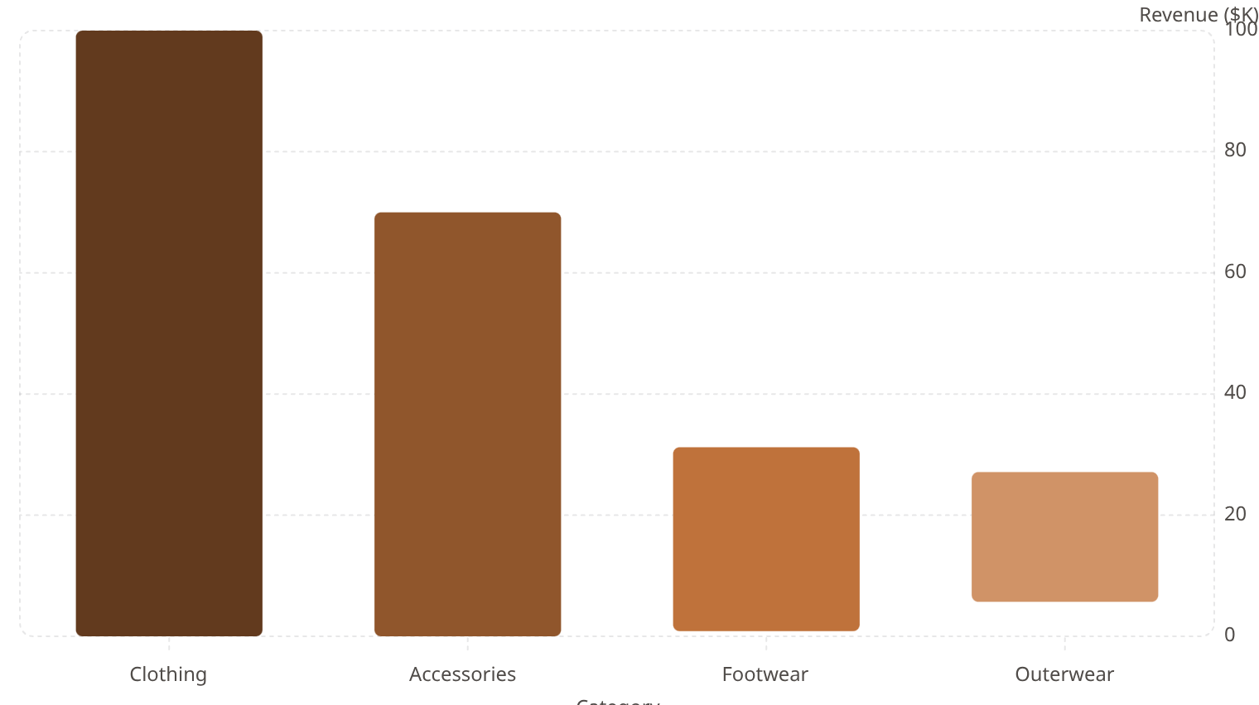
Dashboard: Key Visuals
% Customers by Subscription
Revenue by Category
Yes·27%
·27%
·
No·73%
·73%
·

Slide 10
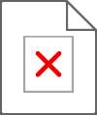
Business Recommendations
Boost Subscriptions
Customer Loyalty
Review Discount Policy
Promote exclusive benefits for subscribers.
Reward repeat buyers to foster loyalty.
Balance sales boosts with margin control.
Product Positioning
Targeted Marketing
Highlight top-rated and best-selling products.
Focus on high-revenue age groups and express-shipping users.

