Slide 1
EQUITY RESEARCH REPORT OF ICICI BANK LTD.
BY HARJAP SINGH AND SATVIK CHANDRA SHUKLA

Slide 2
INTRODUCTION TO SECTOR AND COMPANY
ICICI Bank Limited belongs to tertiary sector and provides various banking products and financial services in India and internationally. It operates in Retail Banking, Wholesale Banking, Treasury, and Others Banking segments. The company offers savings, salary, pension, current, and other accounts;It also provides home, two wheeler , personal, gold, and commercial business loans. In addition, the company offers insurance products; investment products, such as mutual funds, gold monetization schemes, and initial public offerings.
ICICI Bank Limited was founded in 1955 and is headquartered in Mumbai, India.
It was formed by the Industrial Credit and Investment Corporation of India (ICICI) , a financial institution, which later merged itself with the bank.
Today,the bank has a network of 5275 branches and 15589 ATMs across India and has a presence in 17 countries.

Slide 3
EVOLUTION
The real journey of ICICI bank started from 1994 when it received the Certificate for Commencement of Business. During initial periods it has just 15 centers covering 12 states .
It start making impression when it start branding the services with names like `Maxicash' for services accounts, `Money Plus' for Current Account, `Quantum' for fixed deposit account, and `Power Pay' so on....
The bank set up a fully computerised environment , all offices continuously upgrading its strong systems and procedures with special emphasis on risk management and finally bring the " INTERNET BANKING " first time in India in 1998.
.

Slide 4
EVOLUTION
ICICI Bank became the first Indian bank to list on the New York Stock Exchange with its $175-million American depository shares issue generating a demand book 13 times its size at $2.2 billion in 2000.
With passage of time , it start rising even more when It start alling with sky-communications, Ford India , Indian Oil Corporation and proposes to bring credit cards to the "large, underserved population" in rural and semi-urban areas and announced the launch of mobile banking services for its customers, using the wireless application protocol (WAP) technology.
ICICI Bank facilitated the setting up of "FINO Cross Link to Case Link Study" , as a company that would provide technology solutions and services to reach the underserved and underbanked population of the country. Using technologies like smart card,, biometrics and a basket of support services, FINO enables financial institutions to .

Slide 5
2008 CRISIS , DOWN FALL OF ICICI
No Indian institution was affected as badly as ICICI Bank by the global financial crisis. So deep were the concerns over ICICI Bank at that time that Infosys, whose founder NR Narayana Murthy was once on ICICI Bank board, withdrew Rs 1,000 crore of its fixed deposits with the bank and moved them to State Bank of India.
Smaller depositors were queuing up at ATMs, and ICICI had to move truckloads of cash to meet demand.Rumours were spread that ICICI will crash and people will lost their money. Things cool down when RBI publicly fade up such rumours
It has been said that ICICI Bank has lost $250 million internationally due to the crisis.

Slide 6
ICICI BANK-VIDEOCON MONEY LAUNDERING SCAM CASE
The case involves ₹3,250 crore in loans given by the ICICI to the Videocon Group, controlled by the industrialist Venugopal Dhoot, when Chanda Kochhar was leading the bank.
Videocon group had made around 28 proposals to the ICICI Bank, of which, around eight were sanctioned. Chanda Kochhar was part of the sanctioning as well as recommending committee in four such proposals made by the Videocon group.
The ICICI Bank sanctioned loans worth ₹1,875 crore to the Videocon Group and the companies associated with it between 2009 and 2011. Most of these loans were in complete violations of banking regulations and ICICI Bank policies.
Chanda Kochhar was the CEO and Managing Director of the ICICI Bank then.
Within months of sanctioning of the loans, Dhoot's Supreme Energy had granted a loan of ₹64 crore to NuPower Renewables, in which Deepak Kochhar has 50% stake.
Investigators allege the ₹64 crore loan to Kochhar's firm was part of a quid pro quo deal.
The ED, during its investigation, found that loans sanctioned to the Videocon group were kept alive by evergreen IMG or refinancing of loans worth around ₹1,730 crore, which turned into NPA in June 2017.
The major drop in values of Financial Ratios in the upcoming slides is also due to this event being exposed in the years 2017 2018.

Slide 7
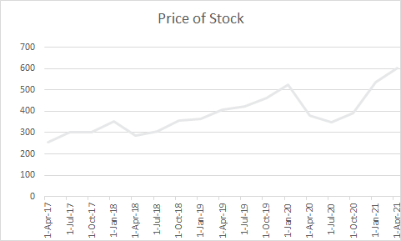
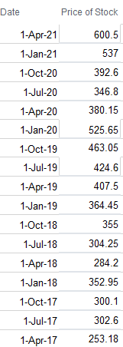
PRICE OF STOCK

Slide 8
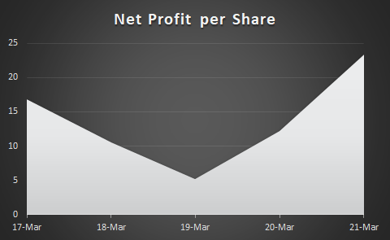
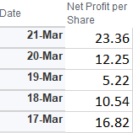
NET PROFIT PER SHARE

Slide 9
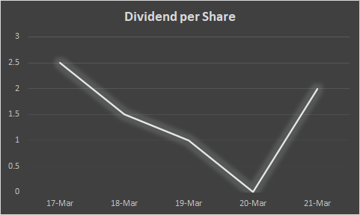
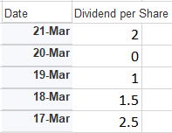
DIVIDEND PER SHARE

Slide 10
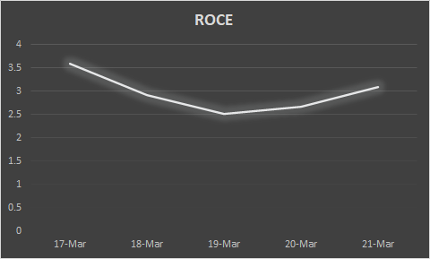
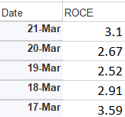
ROCE

Slide 11
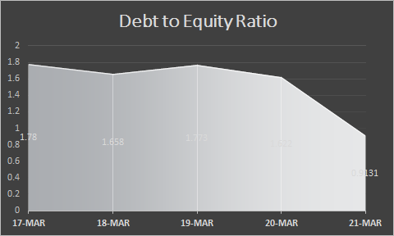
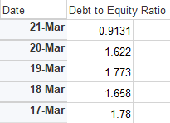
DEBT TO EQUITY RATIO

Slide 12
SOME NOTABLE REMARKS:
High return of equity as compare to peers definitely attracts the people ,that is the reason , it continously rises in stock market (market value per share is 649 (present time) .
ICICI as being old bank , having already the experience of crisis of 2008 , which gives it sharp edge over dealing with harsh conditions.
The above ratios are representing the data in past 5 years in decreasing order which tell that company is employ friendly and its contuiously growing branches may help it support in crisis.(as all countries have different situations, it may have lost in one which may be balance by the profit in other country )
Net Profit/ Employee (Rs.) | - | 798,519.16 | 387,642.38 | 819,281.33 | 1,183,120.75
Business/ Branches (Rs.) | - | 2,660,140,804.47 | 2,543,221,694.30 | 2,205,404,754.67 | 1,967,569,379.38

Slide 13
SOME COMPARISON
ICICI Bank |  | 2021 | 2020 | 2019 | 2018 | 2017
Net Profit Margin (%) |  | 20.46 | 10.60 | 5.30 | 12.33 | 18.09
Return on Equity (%) |  | 10.97 | 6.99 | 3.19 | 6.63 | 10.11
Operating Profit M. |  | -3.50 | -11.38 | -17.58 | -19.36 | -17.91
Axis Bank |  | 2021 | 2020 | 2019 | 2018 | 2017
Net Profit Margin (%) |  | 10.35 | 2.59 | 8.50 | 0.60 | 8.26
Return on Equity (%) |  | 6.48 | 1.91 | 7.01 | 0.43 | 6.59
Operating Profit M. |  | -12.96 | -22.20 | -15.37 | -23.35 | 17.98
SBI Bank |  | 2021 | 2020 | 2019 | 2018 | 2017
Net Profit Margin (%) |  | 7.69 | 5.63 | 0.35 | -2.96 | 5.97
Operating profit M. |  | -8.70 | -11.94 | -14.14 | -23.19 | -14.23
Return om Equity(%) |  | 8.86 | 6.95 | 0.39 | -3.37 | 6.69

Slide 14
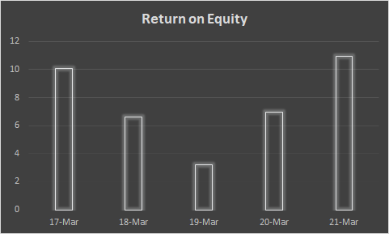
RETURN ON EQUITY

Slide 15
STEPS TAKEN BY MANAGEMENT OF ICICI BANK .
The strategic focus of the Bank during fiscal 2020 was to continue to grow its core operating profits in a risk-calibrated and granular manner. This was driven by the objective of ‘One Bank, One ROE’, that enabled synergies across businesses. Further, the principle of 'Fair to Customer, Fair to Bank' emphasising the need to deliver fair value to customers while creating value for shareholders, guides the Bank’s operations.
A strategic focus in this regard was to extensively leverage data analytics and market intelligence to create strategies and unique value propositions across market segments. It also facilitated better targeting, resourcing, channel and product alignment, capability building and marketing and alliances. The Bank enhanced its focus on exploring customer ecosystems that offered the opportunity to provide a wide range of products and services.
Advancements in technology have enabled the Bank to reimagine various customer journeys and create industry-specific solutions. These solutions not only digitise and thereby simplify processes, but also help customers to digitise their entire ecosystem which includes their vendors, partners and customers. The Bank has also entered into partnerships, especially with fintechs, to enhance the customer proposition. Some of these partnerships are in the area of supply chain finance and specialised ERP service providers

Slide 16
FUTURE PREDICTION AND CONCLUSION.
As the competitors Like HDFC are also rapidly growing in technology like ICICI, ICICI start giving a lot of cash back on purchases or paying bills through debit card, this makes the customer happy.
Recent year’s net income growth rate, ROE, NPM shows the positive growth or progress of ICICI which symbolises the good news for the investors of ICICI bank.
The Perpetual growth rate of ICICI bank comes out nearly to 10.7% and rate of net income return is also sharply increases during these years.
But at the same time, HDFC is also supposes to be its biggest rivarly which can create problem for ICICI in future. Even now HDFC show higher ROE as compare to ICICI . HDFC takes benefit of VIDEOCON FRAUD case of ICICI.
So we can say that ICICI bank will also be preferrable option for the investors in coming years.

