Slide 1
IBM University Engagement Project Submission
“Exploring the Power of Agentic AI with IBM Granite and LangFlow”

Slide 2

Project Tile – [Chronic Care AI Agent]
Domain of Project – [ Healthcare]
Student Name | Recent Passport Photo | Email ID | Mobile number [WhatsApp]
Bhamidipati Satwika |  | satwika.xb.22@gmail.com | 8179352004

Slide 3
Problem Statement -
Problem Statement : Chronic Care AI Agent
The Challenge
Chronic diseases require continuous monitoring.
Patients may miss important changes in health readings.
Manual monitoring is time-consuming.
Medication non-adherence can increase health risks.
Patients and healthcare providers need timely insights.
The Objective
Over 500 million people worldwide live with diabetes alone. Hypertension and heart disease add hundreds of millions more. Chronic conditions demand continuous vigilance — yet healthcare systems are episodic by design.
Patients receive care only during scheduled visits — critical warning signs go undetected in between
Manual self-monitoring is inconsistent, error-prone, and rarely reaches providers in time
Providers lack real-time visibility into patient trends, leading to reactive rather than proactive care
The patient–provider communication gap results in delayed interventions and avoidable complications

Slide 4
Proposed Solution -
Continuously analyzes patient health data.
Detects abnormal readings and health trends.
Generates personalized health insights.
Provides medication adherence reminders.
Sends alerts to providers for high-risk cases.
Supports Diabetes, Hypertension and Heart Conditions.
⚠ Delayed Detection
Warning signs missed between clinic visits
📋 Data Fragmentation
Wearable, lab, and patient data live in silos
🔔 No Proactive Alerts
Providers alerted only after crises occur
🌐 Access Gap
Personalised monitoring is a privilege, not a standard
Proposed Solution & Objectives
ChronicCare AI acts as a continuous AI monitoring agent — analysing patient inputs through deterministic engines and IBM Granite to surface insights, issue alerts, and bridge the patient–provider gap.

Slide 5
Continuous Monitoring
Analyse glucose, blood pressure, heart rate, and sleep data from wearable and manual inputs in near real-time
Early Warning Detection
Deterministic risk engine flags Low / Moderate / High / Critical demo risk levels using illustrative thresholds
Granite AI Summaries
IBM Granite explains results in patient-friendly language, highlights trends, and offers lifestyle suggestions
Dual Dashboards & Alerts
Separate patient and provider dashboards; automated High/Critical alerts sent to providers proactively
ChronicCare AI is a monitoring and decision-support prototype using synthetic/demo data only. It does not diagnose, prescribe, or replace healthcare professionals.

Slide 6
Technology Used
IBM watsonx.ai – AI/LLM platform
IBM Granite 4-H Small – intelligent health summaries
Python – backend and AI logic
Flask – web application/API
Pandas – health-data processing
HTML, CSS, JavaScript – dashboards
Chart.js – health trend visualization
IBM Bob – AI-assisted development

Slide 7
Architecture blueprint
End-to-end flow from patient data entry to personalised insights across both dashboards — powered by a hybrid deterministic + generative AI pipeline
Architecture Flow
Patient / Wearable Data
↓
Data Processing
↓
Risk Engine + Trend Engine
↓
IBM Granite 4-H Small
↓
Personalized Health Insights
↓
Patient Dashboard + Provider Dashboard
↓
Alerts & Notifications

Slide 8

Role of Agentic AI in the solution
Role of Agentic AI in Nutrition Agent
The AI agent uses specialized functions/tools:
calculate_risk() – evaluates current readings
get_patient_history() – retrieves historical data
detect_trends() – identifies increasing/decreasing trends
generate_health_summary() – creates personalized insights
create_provider_alert() – generates alerts for high-risk cases
This makes the system proactive rather than just a chatbot.

Slide 9

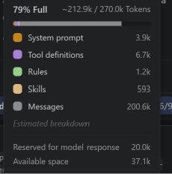
Token Usage
24.38 token are used
Before Prompt
After the Prompt
·
·
·

Slide 10
Novelty and Uniqueness
The proposed Nutrition Agent stands out by combining Agentic AI, RAG, and personalization into a single intelligent system.
What Makes ChronicCare AI Unique?
Combines Agentic AI + deterministic risk analysis
Uses IBM Granite for personalized explanations
Historical trend-based monitoring
Patient + provider dashboards
Automated provider alerts
Medication adherence support
Uses synthetic/demo data for safe testing
Does not diagnose, prescribe, or change medication

Slide 11
Git Hub Link
Please test and Paste the working Github URL:https://github.com/Satwii24/ChronicCareAI
·
·
·

Slide 12
Future Scope
Real wearable integration
Real-time health monitoring
Mobile application
Multilingual voice assistant
Integration with electronic medical records
More advanced predictive analytics
·
·

Slide 13
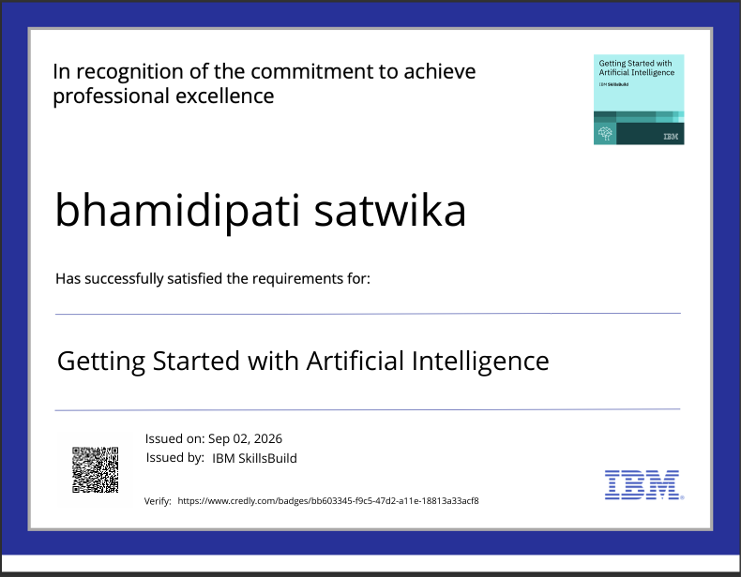
Certificates Earned:
Please add your credly certificate

Slide 14
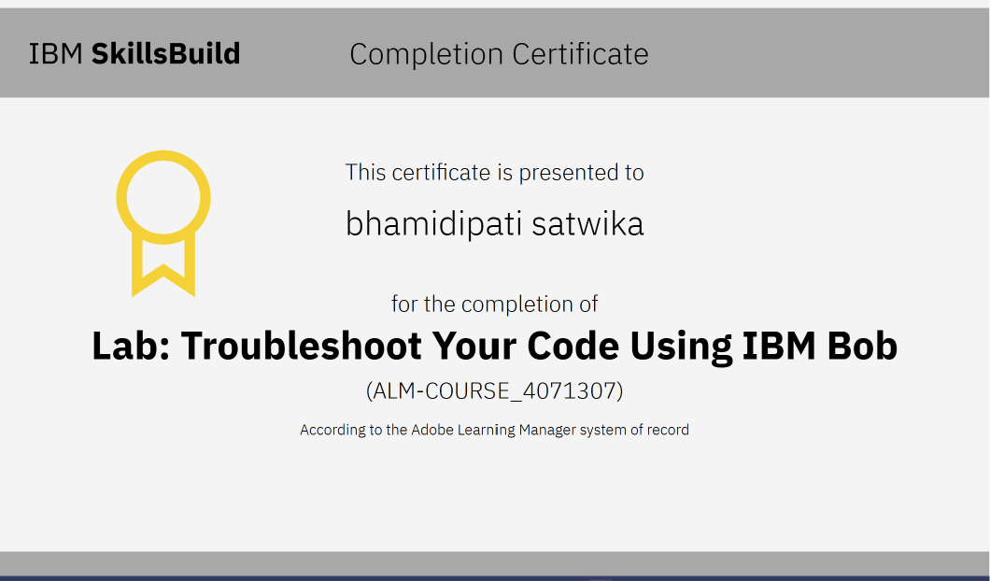
Certificates Earned:​
Add your IBM BOB Certificate

Slide 15


