Slide 1

CONSOLE GAME MANAGEMENT SYSTEM
Software Development PROJECT
Guide :-Prof. G D Bhutkar
Name : Satvik Ganesh Bhor
Roll No: 35
Division: CS-A
GR No: 11910532

Slide 2
CONTENT
Problem Statement
Objective
Domain
Tools and Technology
Methodology
Description
Conclusion
Reference
Vishwakarma Institute of Technology, Pune

Slide 3
Problem statement
To make an interactive and multitasking gaming platform for the user to play many games at one place.
Vishwakarma Institute of Technology, Pune

Slide 4
Project Objective
To learn C++ programming basic and Advance concepts.
To get well acquainted with different types of syntax used .
To create a interactive platform and multi-gaming system for entertainment of user.
Vishwakarma Institute of Technology, Pune

Slide 5


Tools & technology
Programming Language
C++
Tools/Platform:
Visual Studio Code(VS Code).
Vishwakarma Institute of Technology, Pune

Slide 6
methodology
Header Files :
Header files contain definitions of Functions and Variables, which is imported or used into any C++ program by using the pre-processor #include statement.
Header file have an extension ".h" which contains C++ function declaration and macro definition.
Types of Header Files in C++
Pre-existing header files: Files which are already available in C/C++ compiler we just need to import them.
User-defined header files: These files are defined by the user and can be imported using “#include”.
Vishwakarma Institute of Technology, Pune

Slide 7
methodology
Header Files :
Pre-existing header files that we are using:
iostream
windows.h
String
Cstdlib
Ctime
Conio.h
Unistd.h
Iomanip
fstream
Syntax:
#include <filename.h>
or
#include "filename.h"
Vishwakarma Institute of Technology, Pune

Slide 8
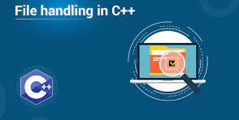
methodology
File handling in CPP:
Files are used to store data in a storage
device permanently.
File handling provides a mechanism to store the output of a program in a file and to perform various operations on it.
In C++ we have a set of file handling methods. These include ifstream, ofstream, and fstream
Vishwakarma Institute of Technology, Pune

Slide 9
methodology
DATATYPE | DESCRIPTION
ofstream | This is used to create a file and write data on files
ifstream | This is used to read data from files
fstream | This is used to both read and write data from/to files
Vishwakarma Institute of Technology, Pune

Slide 10
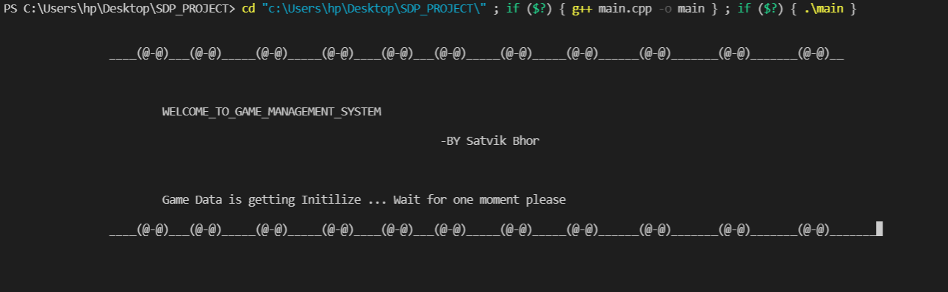
DESCRIPTION
Welcome page of Game management system
Vishwakarma Institute of Technology, Pune

Slide 11
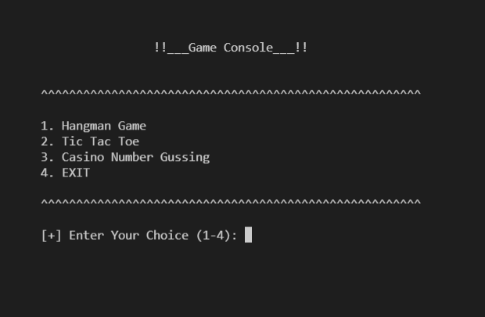
DESCRIPTION
In this project there are Three games where user can select any one game at a time and play the game.
The games are :-
Hangman Game 2.Tic Tac Toe 3.Casino number guessing
Game Console menu
Vishwakarma Institute of Technology, Pune

Slide 12
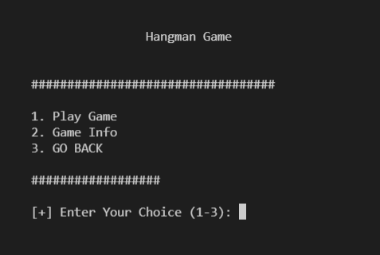
DESCRIPTION
Hangman Game
Inside the Game Menu we provided 3 options and user have to enter there choice according to what they want to do.
Game menu
Vishwakarma Institute of Technology, Pune

Slide 13
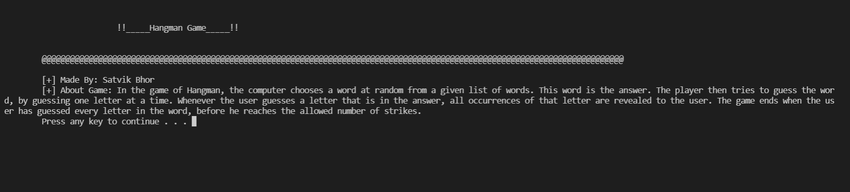
DESCRIPTION
Hangman Game
Features
1) Proper User guidance 2) Description of full Game(Information about Game)
Game Info
Vishwakarma Institute of Technology, Pune

Slide 14
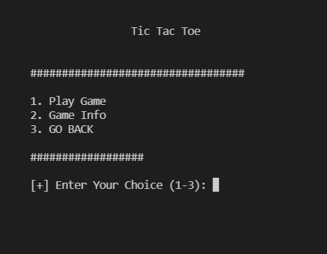
DESCRIPTION
2.Tic tac toe
Inside the Game Menu we provided 3 options and user have to enter there choice according to what they want to do.
Game menu
Vishwakarma Institute of Technology, Pune

Slide 15
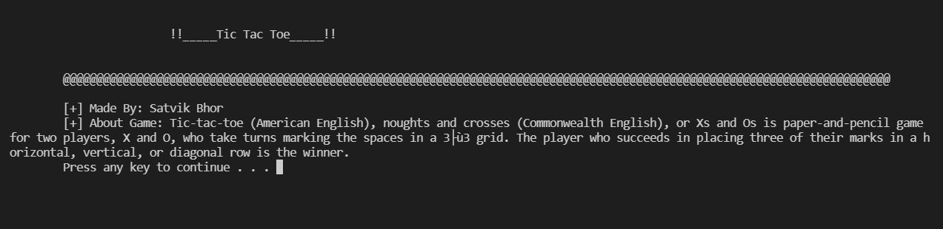
DESCRIPTION
2.Tic Tac Toe
Features
1) Proper User guidance 2) Description of full Game(Information about Game)
Game Info
Vishwakarma Institute of Technology, Pune

Slide 16
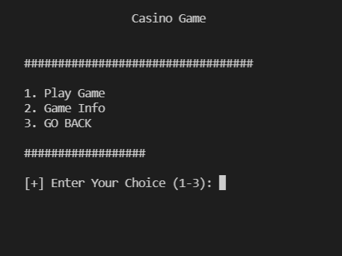
DESCRIPTION
3.Casino Game
Inside the Game Menu we provided 3 options and user have to enter there choice according to what they want to do.
Game menu
Vishwakarma Institute of Technology, Pune

Slide 17
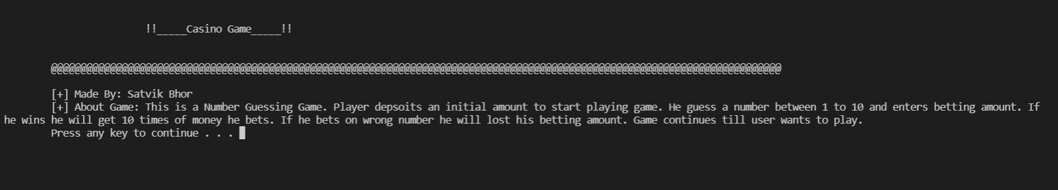
DESCRIPTION
3.Casino Game
Features
1) Proper User guidance 2) Description of full Game(Information about Game)
Game Info
Vishwakarma Institute of Technology, Pune

Slide 18
CONclusion
In the end of this project user is able to play multiple(3) games on a one platform without any error.
At every stage of system we provided proper guidelines for the user, it will make the system easy for the user.
By using File handling and other c++ concept we tried to make the system bugs free.
Finally, as per our objective we succesfully create a interactive platform and multi-gaming system for entertainment of user.
Vishwakarma Institute of Technology, Pune

Slide 19
references
https://www.geeksforgeeks.org/c-plus-plus/
https://www.youtube.com/playlist?list=PLk6CEY9XxSIA-xo3HRYC3M0Aitzdut7AA
https://www.w3schools.com/cpp/
https://www.tutorialspoint.com/cplusplus/cpp_files_streams.html
Vishwakarma Institute of Technology, Pune

Slide 20
end
THANK YOU…!
Vishwakarma Institute of Technology, Pune

