Slide 1
SYSTEMS SECURITY · SIDE-CHANNEL ATTACKS · INTEL SGX
SGX Enclave Key Recovery
via Single-Stepping & PTE Access-Bit Monitoring
FRAMEWORK
TARGET
PRIMITIVES
KEY LENGTH
SGX-Step
Production Enclave
APIC Timer + PTE A-Bit
128 bits
Professor In-Charge : Urbi Chatterjee
Supervisor : Dipesh
Satwik Raj Wadhwa (230937)
Divyansh Bansal (230381)

Slide 2
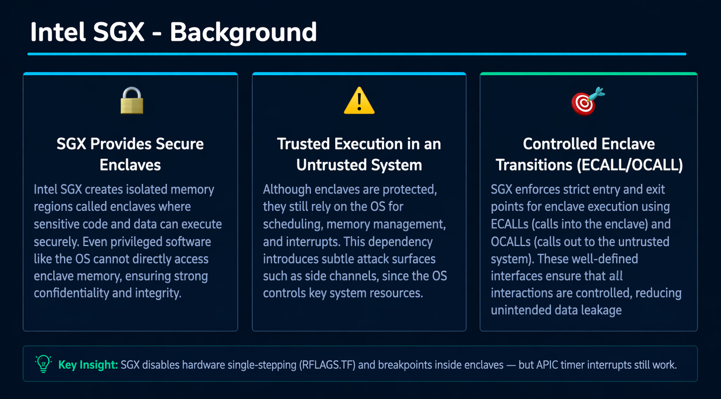
Intel SGX - Background
🔒
⚠️
🎯
SGX Provides Secure Enclaves
Trusted Execution in an Untrusted System
Controlled Enclave Transitions (ECALL/OCALL)
Intel SGX creates isolated memory regions called enclaves where sensitive code and data can execute securely. Even privileged software like the OS cannot directly access enclave memory, ensuring strong confidentiality and integrity.
Although enclaves are protected, they still rely on the OS for scheduling, memory management, and interrupts. This dependency introduces subtle attack surfaces such as side channels, since the OS controls key system resources.
SGX enforces strict entry and exit points for enclave execution using ECALLs (calls into the enclave) and OCALLs (calls out to the untrusted system). These well-defined interfaces ensure that all interactions are controlled, reducing unintended data leakage
Key Insight: SGX disables hardware single-stepping (RFLAGS.TF) and breakpoints inside enclaves — but APIC timer interrupts still work.

Slide 3
SGX-STEP Outline
Protected Execution
SGX Single-Step Flow
Enclave code/data is encrypted in the memory. The CPU decrypts it only inside the enclave boundary (between EENTER and EEXIT).
APIC Timer
Fires
Asynchronous Enclave Exit (AEX)
On any interrupt or fault, the CPU securely saves state to the SSA frame and exits the enclave to the untrusted handler.
▼
AEX — Save
Context to SSA
ERESUME
▼
The untrusted OS resumes the enclave via ERESUME. An Asynchronous Exit Pointer (AEP) is pushed so the OS can cleanly return.
Run AEP
(our spy code)
Debug vs. Production
▼
ERESUME
(next instruction)
Debug enclaves allow EDBGRD to read SSA. Production enclaves block all such reads — our attack works on production mode.

Slide 4
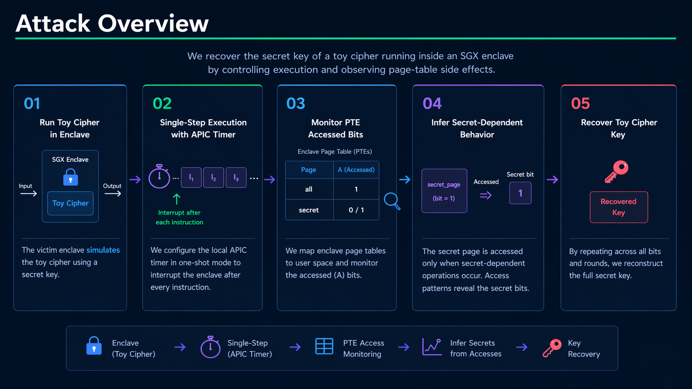
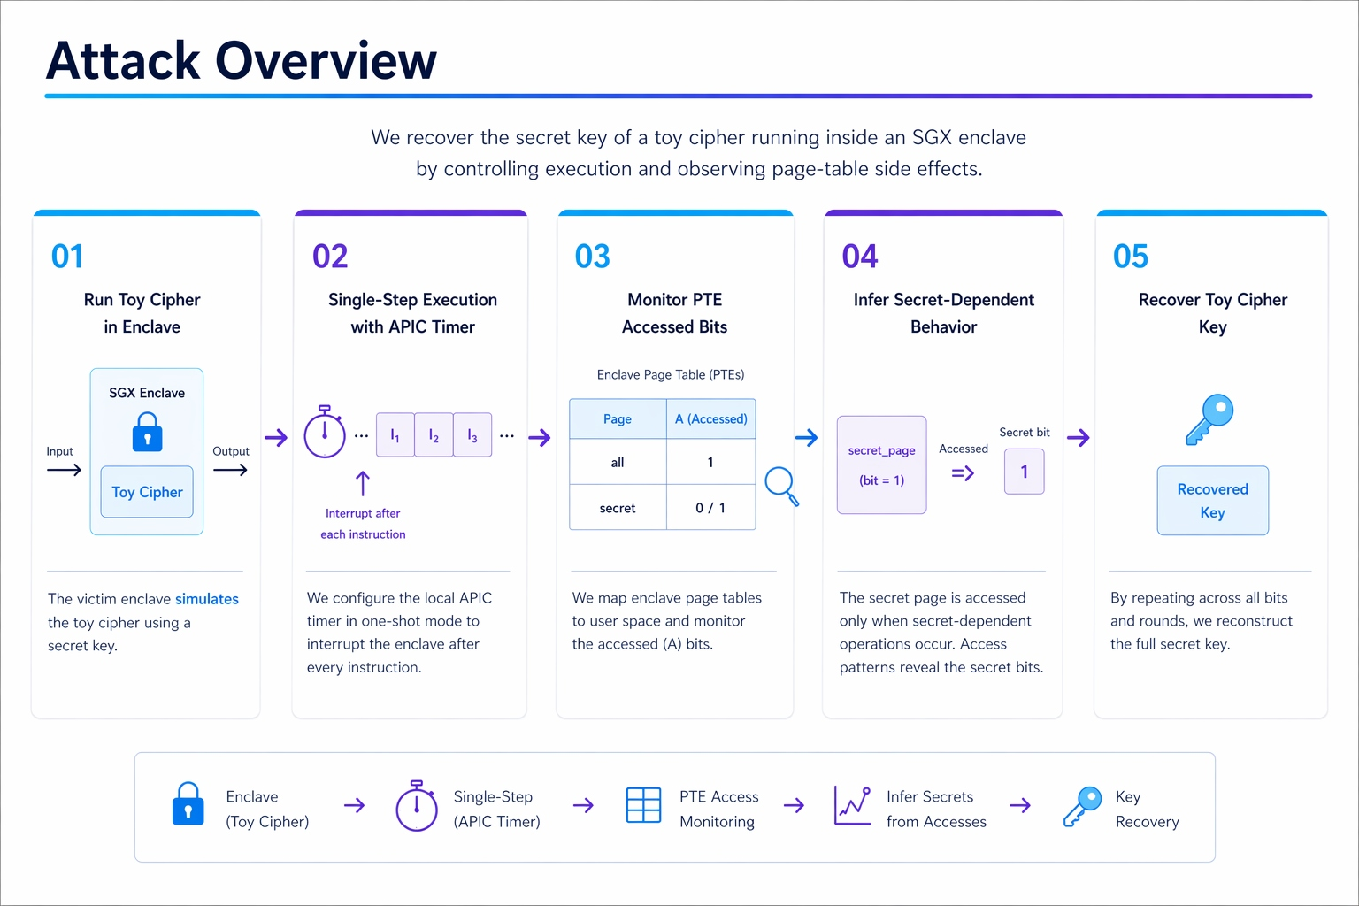

Slide 5
Full Attack Flow
Generate random 128-bit key
Initialize enclave (warm-up run)
1
2
128-bit secret generated (rand() & 1 per bit)
Passed as input to enclave function
Used as ground truth to evaluate attack accuracy
sgx_create_enclave() sets up trusted execution
First ecall_process_bits() performs a dry run
Ensures all enclave pages are loaded into memory
Map PTEs to user space
Setup interrupt-based single stepping
3
4
Map PTEs for all_function and secret_function
Clear accessed (A) bits in both pages
Enables attacker to monitor page accesses via A-bit changes
Register AEP callback (attack logic)
Configure APIC one-shot timer
Enables interrupt after every instruction
Enter enclave — attack begins
State machine decodes each bit
5
6
APIC timer armed just before enclave entry
ecall_process_bits() starts execution
Execution is repeatedly interrupted by AEP
Each interrupt exposes page access behavior
AEP callback checks accessed bits (q_all, q_sec)
Uses state variable temp to track execution flow
Access pattern determines bit value
Decoded bits stored in recovered[]

Slide 6
Enclave Design (encl.c)
// ── Runs ONLY when bit == 1 ──────────────────────────────────
aligned(4096)
int __attribute__((noinline, aligned(4096)))
secret_function(void) {
Forces each function onto its own 4 KB memory page — one PTE per function.
volatile int x = 0; memory_barrier; return x;
}
// ── Runs on EVERY iteration ───────────────────────────────────
noinline
int __attribute__((noinline, aligned(4096)))
Prevents compiler from inlining — preserves distinct call addresses in the binary.
all_function(void) {
volatile int x = 0; memory_barrier; return x;
}
NOP Sled (5000×20)
void ecall_process_bits(uint8_t *bits, size_t len) {
for (size_t i = 0; i < len; i++) {
100,000 NOPs between calls create a wide timing window for the APIC interrupt to land cleanly.
all_function(); // always called
/* NOP sled (100,000 nops) */
if (bits[i]) {
secret_function(); // only if bit == 1
memory_barrier
}
sfence + mfence + lfence — prevents CPU reordering that could confuse the PTE A-bit observation.
/* NOP sled (100,000 nops) */
}
}

Slide 7
AEP Callback – Core Logic
/* We track execution using page access bits:
q_all → page containing "all" function
q_sec → page containing "secret" function
temp → state variable (0: idle, 1: inside all, 2: after all) */
if (q_all.accessed && temp == 0 && !q_sec.accessed) {
// First access to 'all' → start of a new iteration
temp = 1;
} else if (q_all.accessed && temp == 1 && !q_sec.accessed) {
// Still executing inside 'all' → wait for it to complete
} else if (!q_all.accessed && temp == 1 && !q_sec.accessed) {
// 'all' has finished, now expecting possible 'secret' access
temp = 2;
} else if (temp == 2 && !q_all.accessed && q_sec.accessed) {
// 'secret' executed → infer secret bit = 1
temp = 0;
} else if (temp == 2 && q_all.accessed && !q_sec.accessed) {
// Moved to next iteration without 'secret' → bit = 0
temp = 0;
} else {
// Any unexpected pattern → reset state
temp = 0;
}
State 0 (IDLE)
Waiting for the all function to get accessed which will begin a new secret-bit evaluation cycle. “q_all.accessed==1” is our start of the cycle signal.
State 1 (IN_ALL)
The enclave is still executing on the all-page (q_all keeps getting hit). Thus this is the state inside all_function
State 2 (BETWEEN_ALL_AND_SEC)
Neither page was accessed this step: the enclave has reached the "quiet window" just before the conditional branch.
State 3 (KEY_BIT_EXTRACT)
Case 1: q_sec was accessed => secret bit=1
Case 2: q_all was accessed but q_sec was NOT => secret bit=0

Slide 8






Results & Evaluation
Using 1 second sleep during runs
Using 2 second sleep between runs
Key Engineering Challenges
⏱
APIC interrupts are asynchronous — running multiple attacks back-to-back causes IRQ state glitches. Solved by 1-second sleep between runs in check_accuracy.sh.
🧱
NOP sleds (5000×20 = 100,000 NOPs) between function calls widen the landing window so the single APIC interrupt reliably lands in the right region.

Slide 9
Thank You !
References
Built with SGX-Step · Van Bulck et al., SysTEX'17 · BunnyHop, USENIX Sec'23

