Slide 1
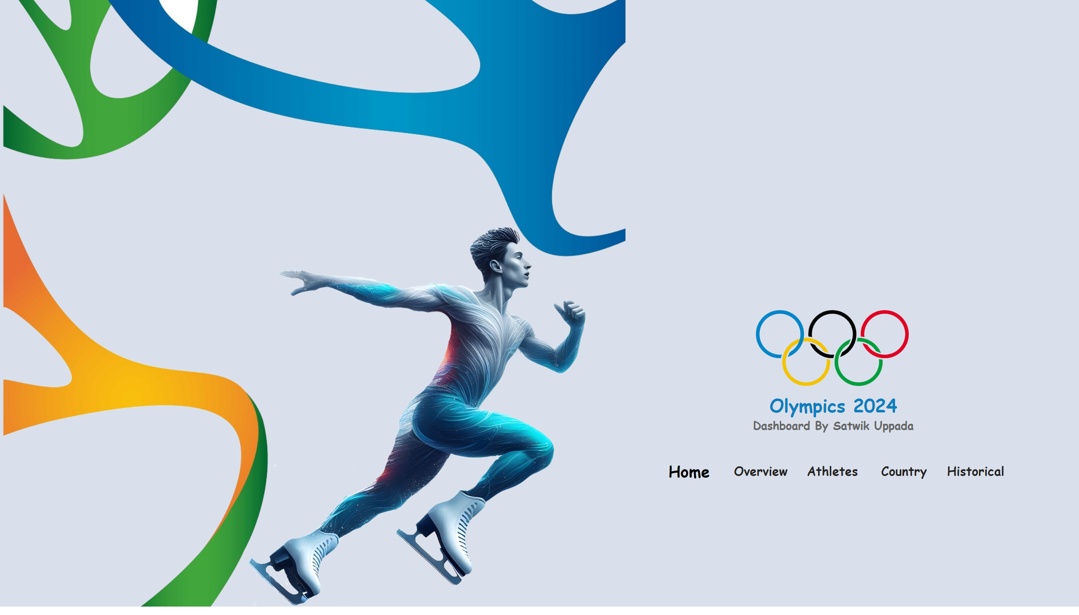
Home
Notes:
image
No alt text provided
image
No alt text provided
pageNavigator
No alt text provided
textbox
No alt text provided
image
No alt text provided
shape
No alt text provided

Slide 2
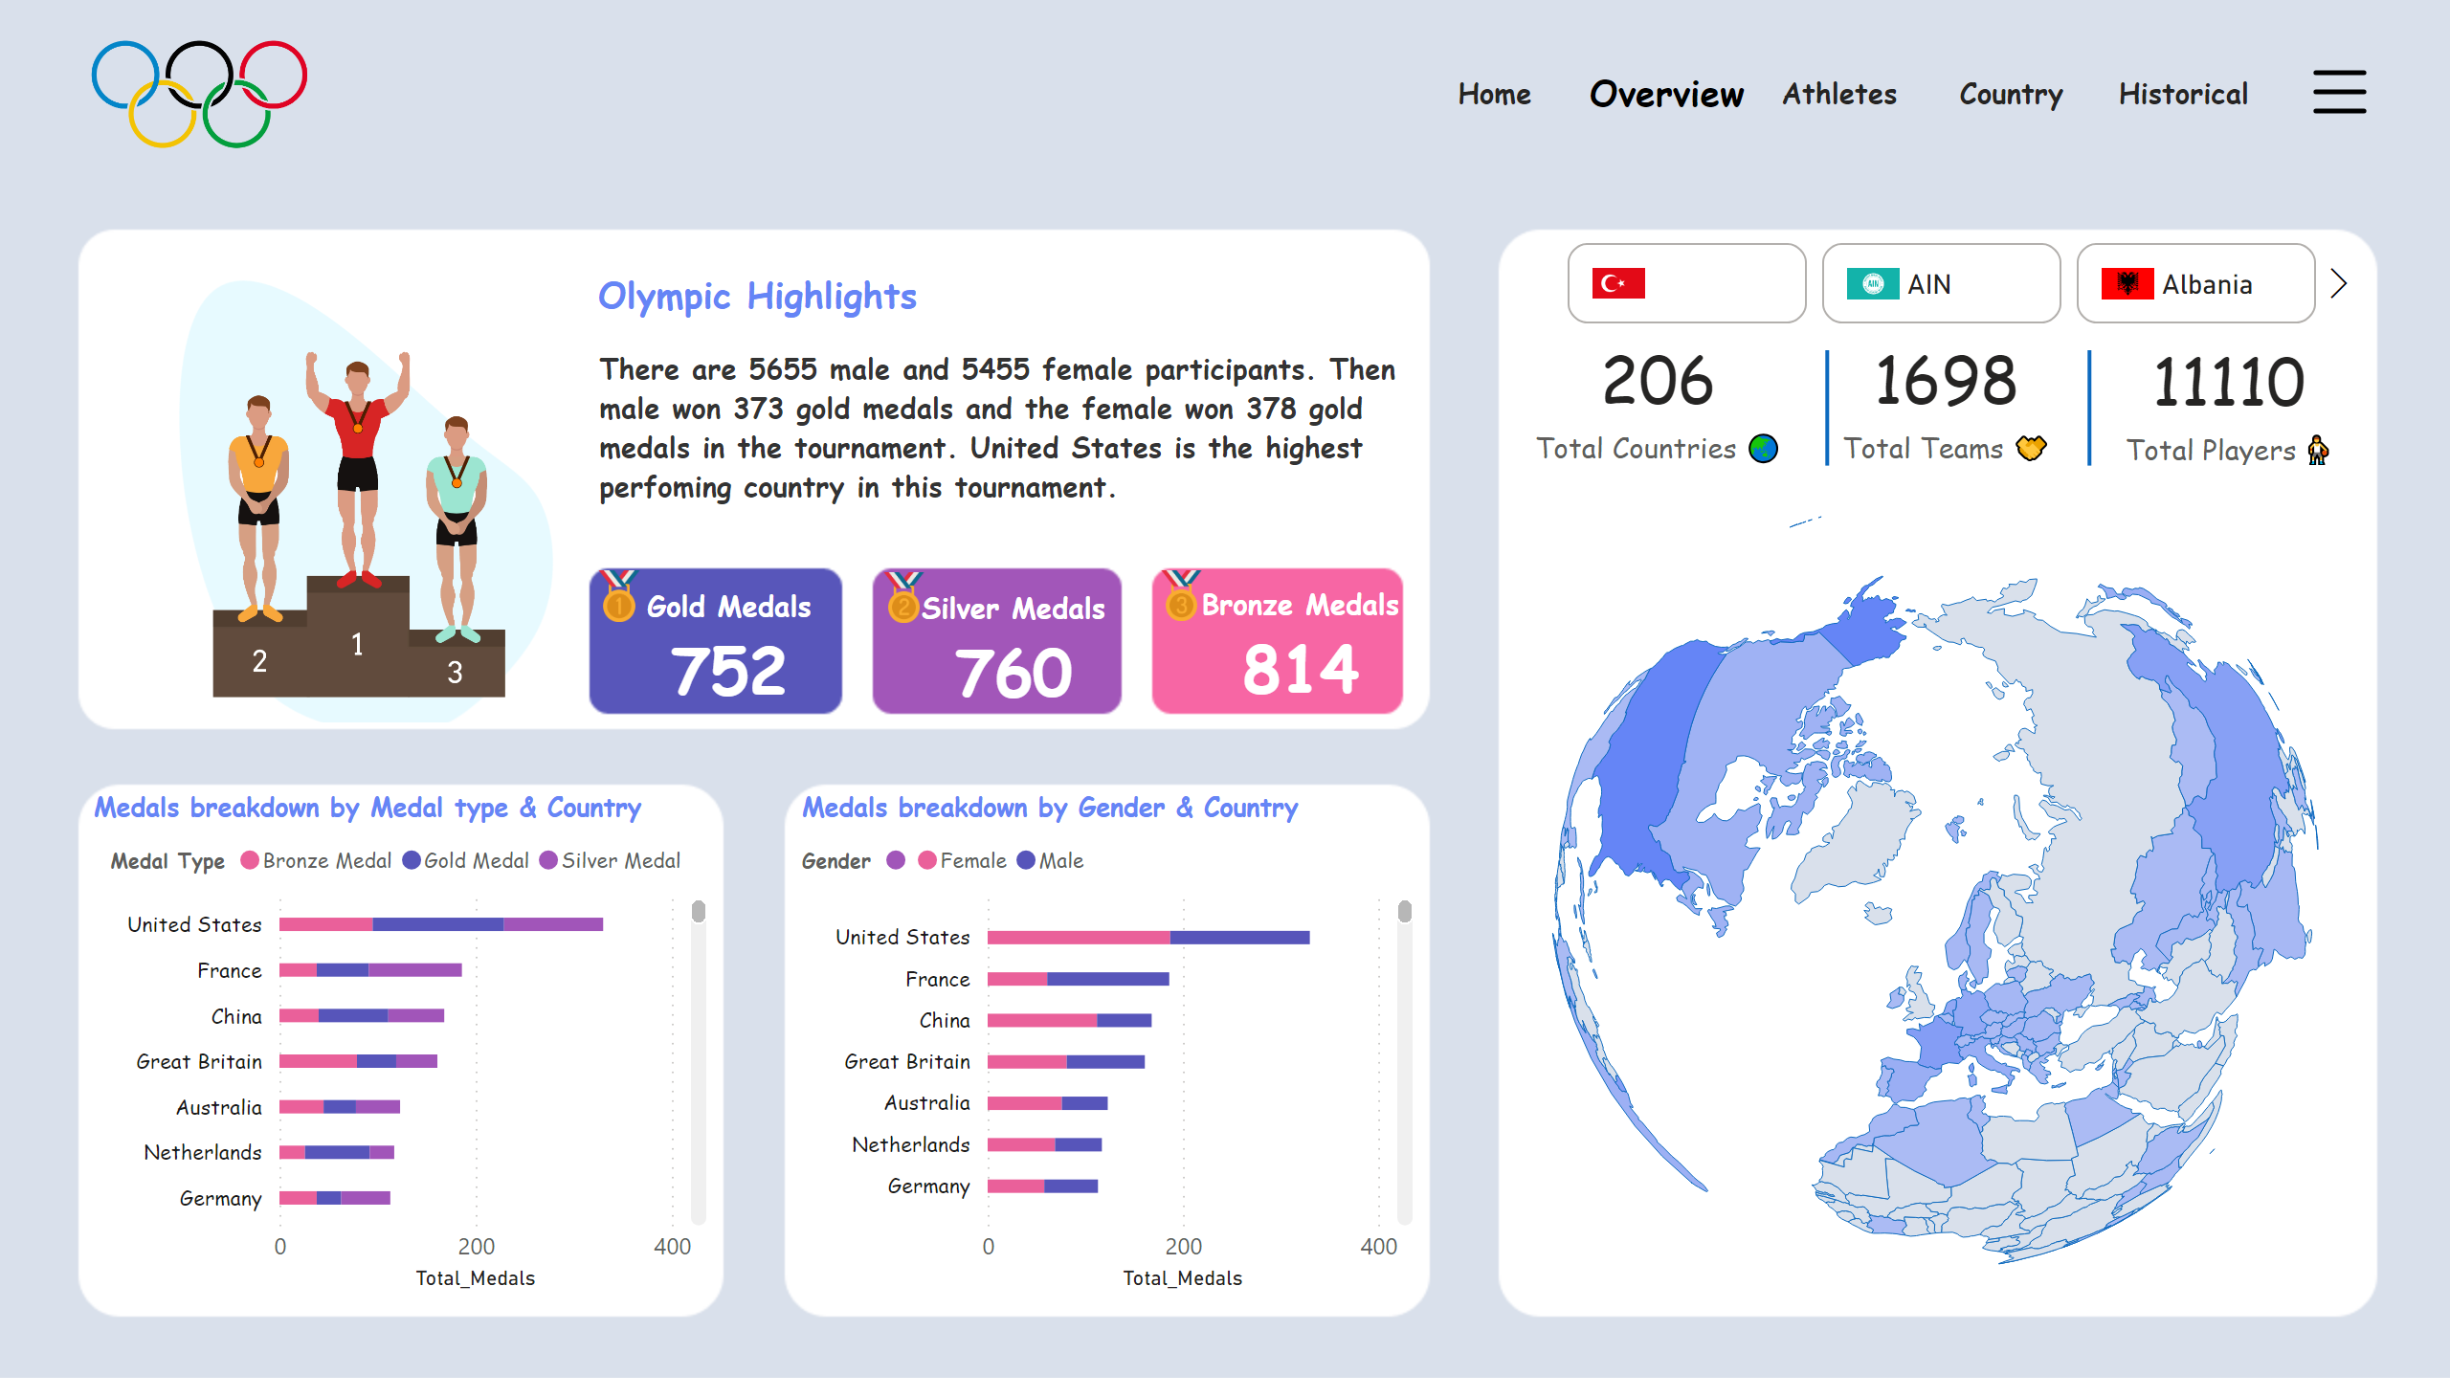
Overview
Notes:
cardVisual
No alt text provided
cardVisual
No alt text provided
cardVisual
No alt text provided
advancedSlicerVisual
No alt text provided
shapeMap
No alt text provided
Medals breakdown by Gender & Country
No alt text provided
Medals breakdown by Medal type & Country
No alt text provided
shape
No alt text provided
shape
No alt text provided
image
No alt text provided
image
No alt text provided
image
No alt text provided
image
No alt text provided
image
No alt text provided
card
No alt text provided
card
No alt text provided
card
No alt text provided
shape
No alt text provided
shape
No alt text provided
shape
No alt text provided
advancedSlicerVisual
No alt text provided
actionButton
No alt text provided
actionButton
No alt text provided
pageNavigator
No alt text provided

Slide 3
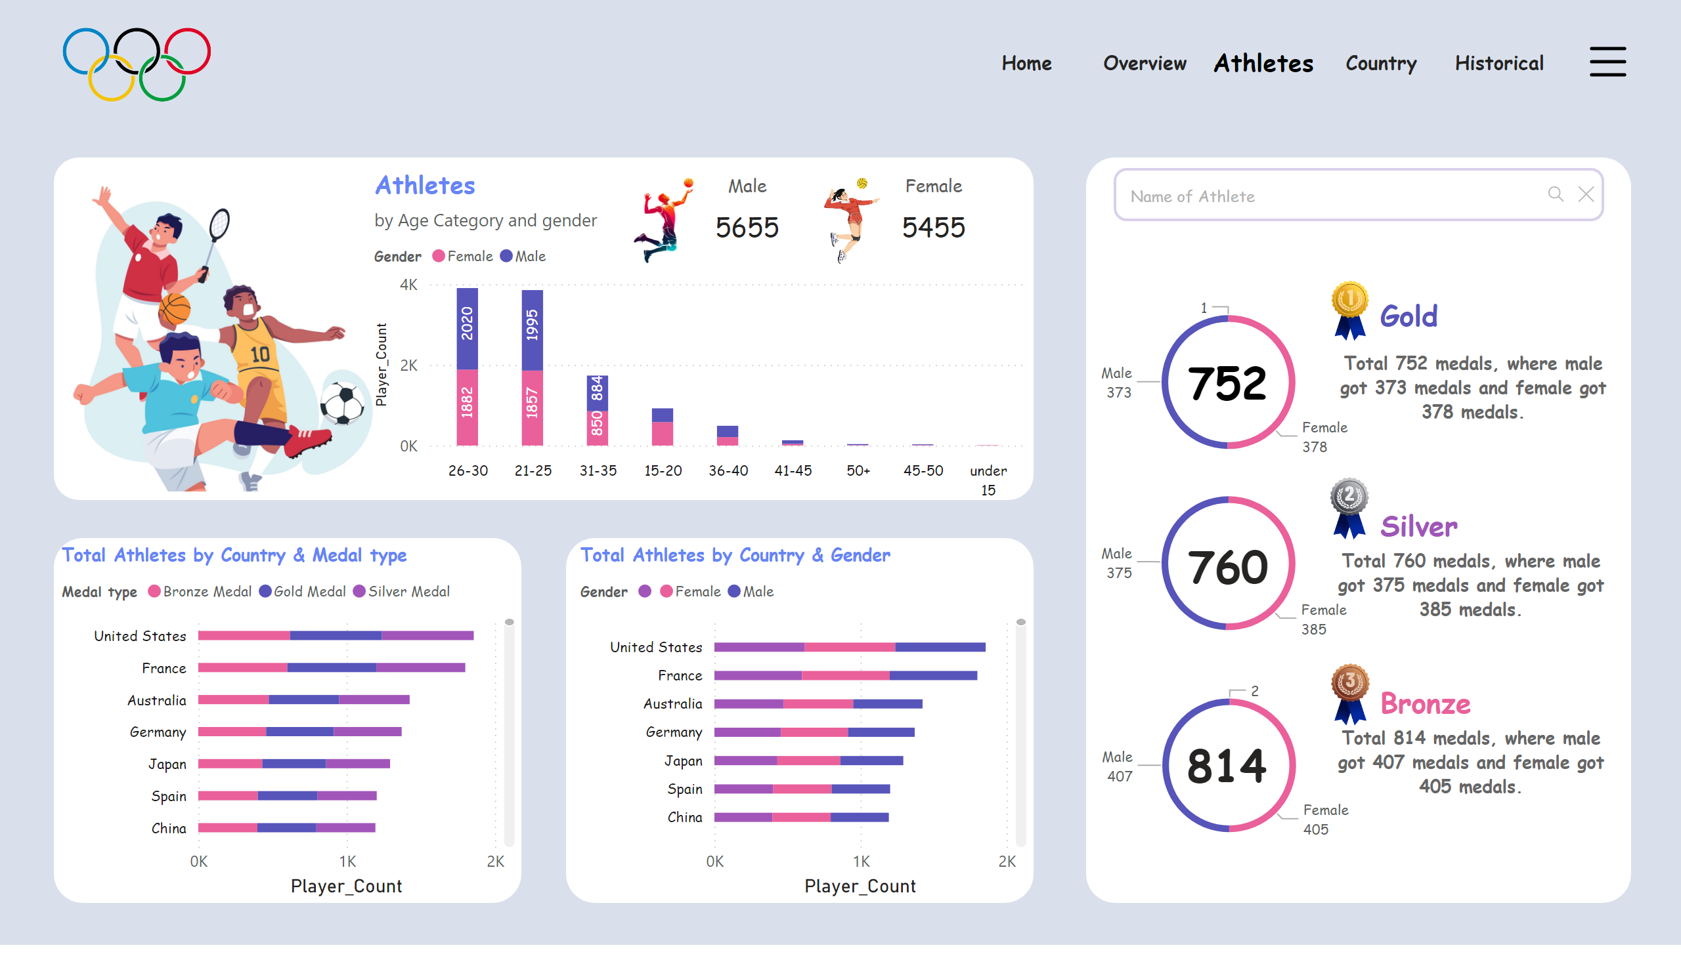
Athletes
Notes:
pageNavigator
No alt text provided
Total Athletes by Country & Gender
No alt text provided
Total Athletes by Country & Medal type
No alt text provided
image
No alt text provided
cardVisual
No alt text provided
cardVisual
No alt text provided
cardVisual
No alt text provided
donutChart
No alt text provided
donutChart
No alt text provided
donutChart
No alt text provided
card
No alt text provided
card
No alt text provided
card
No alt text provided
textbox
No alt text provided
textbox
No alt text provided
textbox
No alt text provided
textSearchSlicerF85E2E78BE4A4D7D9F99ED75B5D71C85
No alt text provided
image
No alt text provided
actionButton
No alt text provided
actionButton
No alt text provided
shape
No alt text provided
advancedSlicerVisual
No alt text provided
Athletes
No alt text provided
cardVisual
No alt text provided
cardVisual
No alt text provided
image
No alt text provided
image
No alt text provided
image
No alt text provided

Slide 4
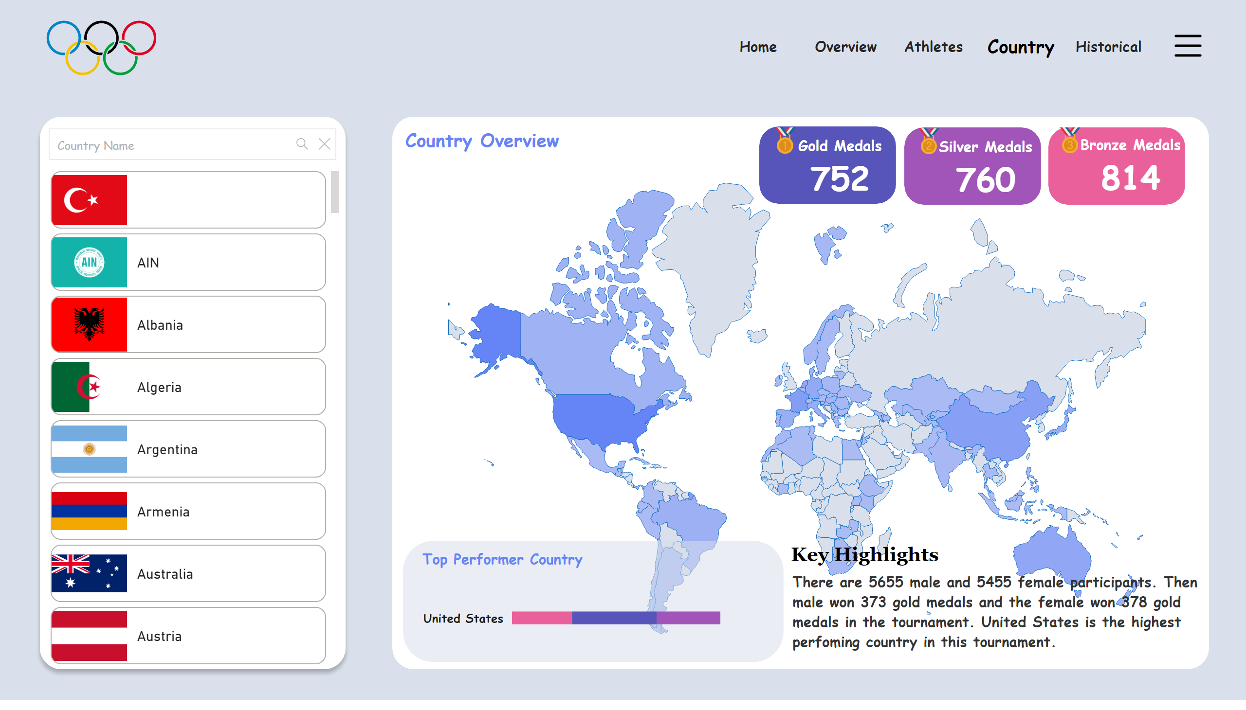
Country
Notes:
image
No alt text provided
shapeMap
No alt text provided
shape
No alt text provided
Top Performer Country
No alt text provided
shape
No alt text provided
shape
No alt text provided
cardVisual
No alt text provided
image
No alt text provided
cardVisual
No alt text provided
image
No alt text provided
image
No alt text provided
cardVisual
No alt text provided
shape
No alt text provided
shape
No alt text provided
shape
No alt text provided
textSearchSlicerF85E2E78BE4A4D7D9F99ED75B5D71C85
No alt text provided
shape
No alt text provided
pageNavigator
No alt text provided
actionButton
No alt text provided
shape
No alt text provided
advancedSlicerVisual
No alt text provided
actionButton
No alt text provided
advancedSlicerVisual
No alt text provided

Slide 5
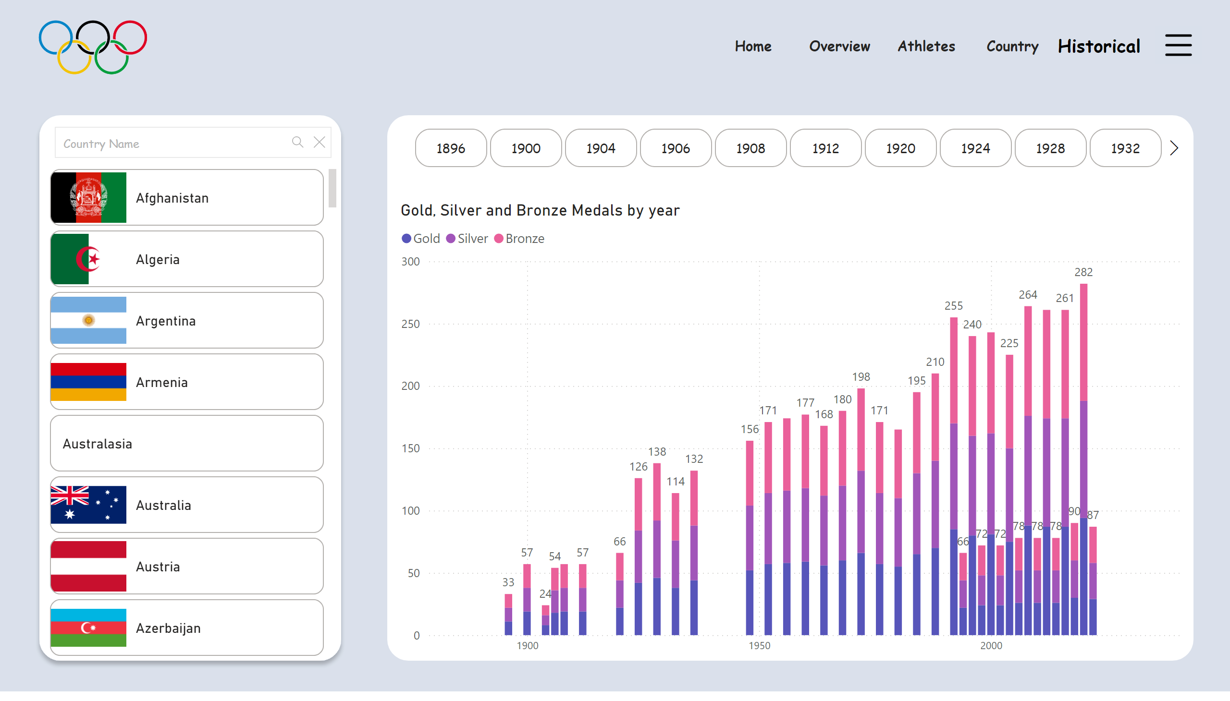
Historical
Notes:
image
No alt text provided
textSearchSlicerF85E2E78BE4A4D7D9F99ED75B5D71C85
No alt text provided
pageNavigator
No alt text provided
actionButton
No alt text provided
shape
No alt text provided
advancedSlicerVisual
No alt text provided
advancedSlicerVisual
No alt text provided
Gold, Silver and Bronze Medals by year
No alt text provided
advancedSlicerVisual
No alt text provided
actionButton
No alt text provided

