Slide 1
Voice Of Village : Fund Transparency and Issue Reporting System
GEETHANJALI COLLEGE OF ENGINEERING AND TECHNOLOGY
Internal Guide : Ch.Sandhya
Presented By :
Batch no : CSE2526MNP – E9
P.Uday – 22R11A05M9
V.Satwik Reddy - 22R11A05N9
M.Manikanth Reddy – 22R11A05M0

Slide 2
Introduction
The Voice of Village: Fund Transparency and Issue Reporting System is a web-based e-governance platform designed to improve transparency, accountability, and citizen participation at the village level. It provides a centralized system where villagers can report issues, request essential services, view announcements, and track village-related activities digitally.
This project mainly focuses on fund transparency and issue tracking, where government fund usage is published with proof documents by the Sarpanch, and public issues are monitored through defined status stages. With role-based access for Villagers, Sarpanch, and PDS Shopkeeper, the system ensures secure operations, efficient service delivery, and promotes a transparent and accountable village governance model.

Slide 3
Motivation
In many villages, issues such as water supply, electricity, road maintenance, and fund utilization are still handled through manual processes, leading to delays, lack of transparency, and poor communication between citizens and authorities. Villagers often have no clear way to track issue status or understand how government funds are being spent.
This project is motivated by the need to digitize village governance, improve public trust, and ensure accountability in administrative processes. By providing a transparent, role-based platform for issue reporting, fund tracking, donations, and PDS services, the system empowers villagers while enabling authorities to manage village operations more efficiently and responsibly.

Slide 4
Problem Statement
In many villages, issues such as water supply, electricity, road maintenance, and fund utilization are still handled through manual processes, leading to delays, lack of transparency, and poor communication between citizens and authorities. Villagers often have no clear way to track issue status or understand how government funds are being spent.
This project is motivated by the need to digitize village governance, improve public trust, and ensure accountability in administrative processes. By providing a transparent, role-based platform for issue reporting, fund tracking, donations, and PDS services, the system empowers villagers while enabling authorities to manage village operations more efficiently and responsibly.

Slide 5
Problem Statement
Objectives
The primary objective of this project is to design a centralized digital platform that enables transparent and efficient village governance. The system aims to allow villagers to report issues, request services, make donations, book PDS slots, and stay informed through announcements.
Additionally, the project seeks to provide administrators with tools to manage issues, approve requests, publish fund usage with proof, and monitor village activities. Overall, the goal is to improve transparency, accountability, and citizen participation in village administration.

Slide 6
Problem Statement
Scope :
Development of a web-based village e-governance system
Digital issue reporting and tracking for village problems
Government fund transparency with proof document uploads
Role-based access for Villagers, Sarpanch, and Shopkeeper
PDS slot booking and welfare service management
Users have access to the internet and basic digital devices
Admin (Sarpanch) updates data accurately and responsibly
Villagers provide genuine and valid information
Role-based authentication ensures secure system access
System is implemented for a single village environment
Assumptions :

Slide 7
Existing Systems & Limitations
Village governance is largely managed through manual and paper-based processes, leading to inefficiency.
Issues and service requests are reported verbally or through written applications without proper tracking.
Government fund usage lacks transparency, with information limited to notice boards or registers.
Manual handling results in delays, data inconsistency, and higher chances of errors.
Due to the absence of a unified digital platform, citizen participation and trust are low.

Slide 8
Literature Survey
Village Fund Management Transparency: A Lesson Learned (2018)
This study examines village fund management practices in rural governance with emphasis on transparency, budgeting, and community participation.
It highlights how lack of digital tracking leads to misuse of funds and reduced public trust.
The paper stresses the importance of public access to financial records and citizen involvement.
Relevance to Project: This work provides strong foundational support for implementing a web-based fund transparency system at village level.

Slide 9
Literature Survey
Village Fund Management Transparency: A Lesson Learned (2018)
This study examines village fund management practices in rural governance with emphasis on transparency, budgeting, and community participation.
It highlights how lack of digital tracking leads to misuse of funds and reduced public trust.
The paper stresses the importance of public access to financial records and citizen involvement.
Relevance to Project: This work provides strong foundational support for implementing a web-based fund transparency system at village level.

Slide 10
Literature Survey
Analysis of Accountability, Transparency and Participation of Village Fund Management (2021)
The study analyzes how village administrations manage public funds with respect to accountability and transparency.
It identifies gaps in manual governance systems, especially in complaint handling and monitoring.
Community participation is shown to improve governance outcomes.
Relevance to Project: Supports the need for digital issue reporting and request tracking, aligning closely with the proposed system objectives.

Slide 11
Literature Survey
Optimizing Budget Policy in Village Fund Allocation (2025)
This research focuses on budget allocation policies and their impact on rural development.
It links transparency and accountability with effective fund utilization.
Highlights governance improvements through structured digital systems.
Relevance to Project: Strongly supports the fund allocation tracking and expenditure visualization feature of the proposed system.

Slide 12
Literature Survey
Accountability and Transparency in Governance – NITI Aayog (2022)
A thematic government report emphasizing technology-driven transparency and accountability.
Recommends citizen feedback systems and digital monitoring tools.
Focuses on improving trust between citizens and authorities.
Relevance to Project: Aligns with national initiatives like Digital India and validates the project’s real-world applicability.

Slide 13
Literature Survey
Paper / Study | Techniques Used | Advantages | Limitations | Key Insights Derived
Village Fund Management Transparency: A Lesson Learned (2018) | Manual fund audits, community participation analysis | Improved awareness of fund usage, increased public trust | No real-time tracking, highly manual process | Digital platforms are required for continuous fund transparency
Analysis of Accountability, Transparency and Participation of Village Fund Management (2021) | Survey-based analysis, governance performance metrics | Identifies accountability gaps, highlights role of citizen participation | Lacks automated issue tracking mechanisms | Citizen involvement + digital monitoring improves governance
ICT for Rural Development: Applications and Challenges (2021) | ICT framework analysis, case studies | Enhances service delivery, improves communication | Digital literacy and infrastructure issues | Systems must be simple, accessible, and mobile-friendly
Optimizing Budget Policy in Village Fund Allocation (2025) | Budget optimization models, policy analysis | Better fund allocation, reduced misuse | Focused only on budgeting, not public interaction | Transparency tools should include spending proofs and reports

Slide 14
Proposed System Overview
The Voice of Village system is a digital e-governance platform designed to improve transparency, accountability, and efficiency in village administration. It allows villagers to raise issues, submit service requests, book PDS slots, make donations, and view announcements through a single unified interface, reducing dependency on manual and paper-based processes.
The system follows a role-based architecture where the Sarpanch (Admin) manages issues, approves requests, publishes announcements, and uploads government fund utilization with proof, while the Shopkeeper verifies PDS bookings using OTP/QR codes. By integrating all village services into one platform, the proposed system ensures better governance, real-time tracking, and increased public trust.

Slide 15
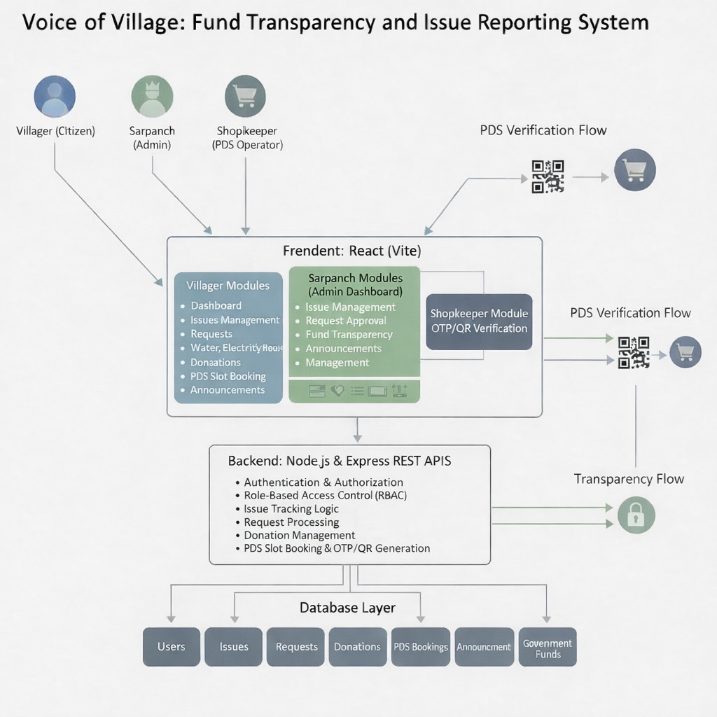
System Architecture

Slide 16
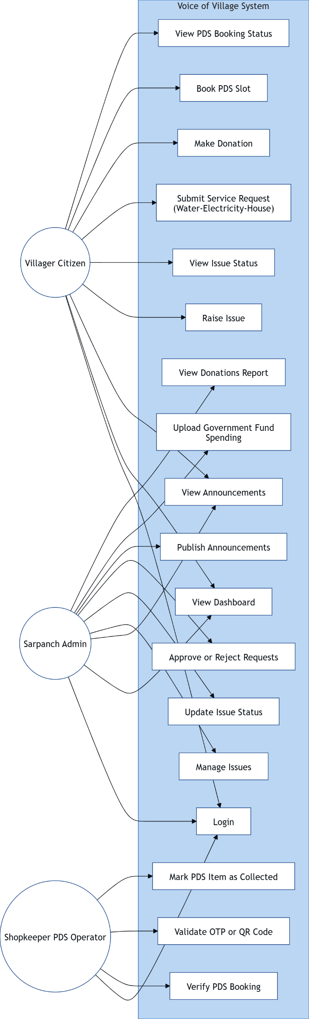
Detailed Design Diagrams
Use Case diagram :

Slide 17
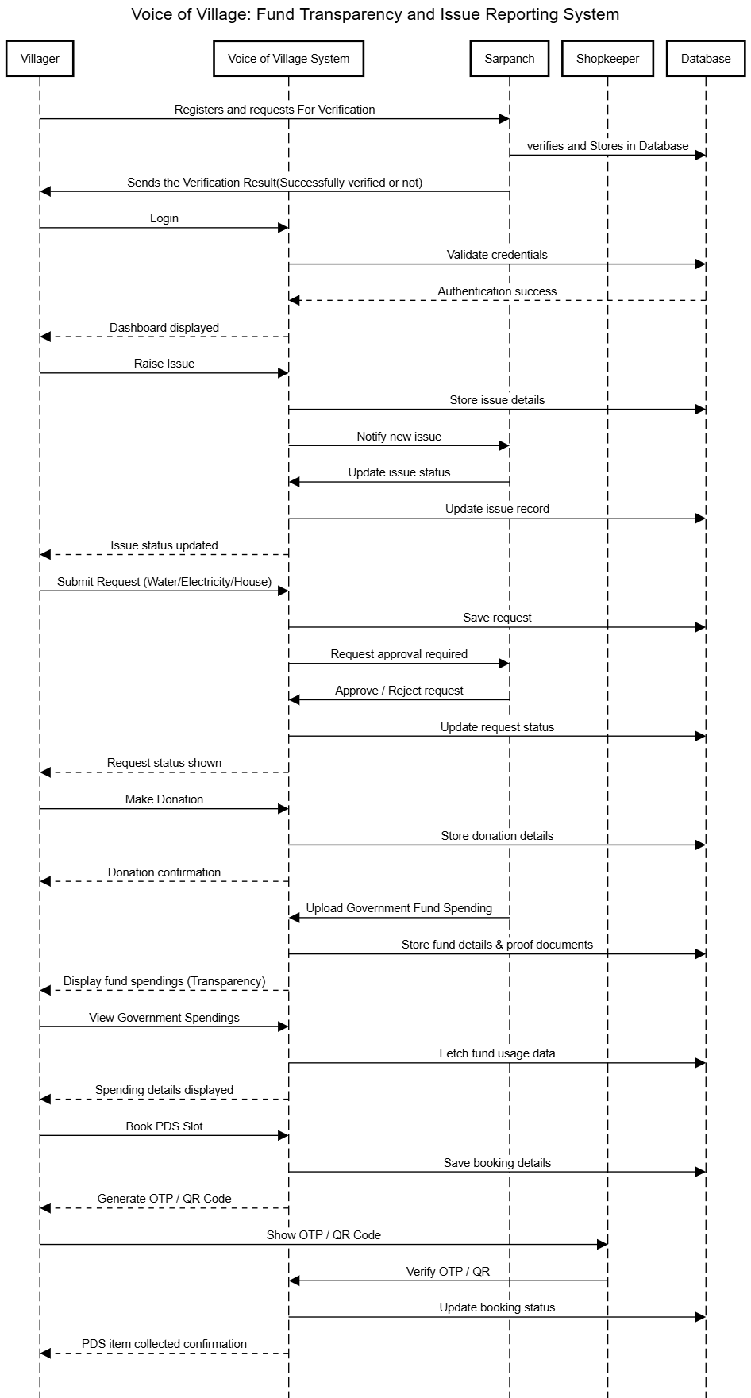
Detailed Design Diagrams
Sequence Diagram:

Slide 18
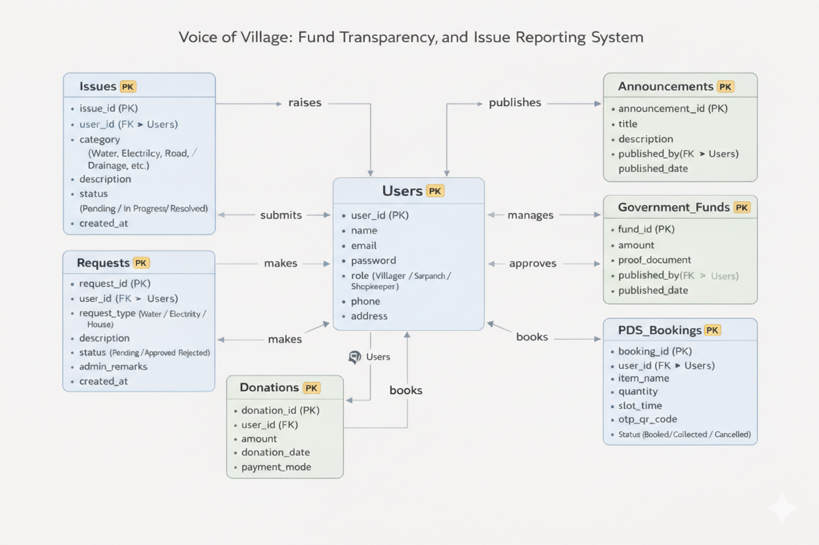
Data Design Or WorkFlow
ER Diagram :

Slide 19
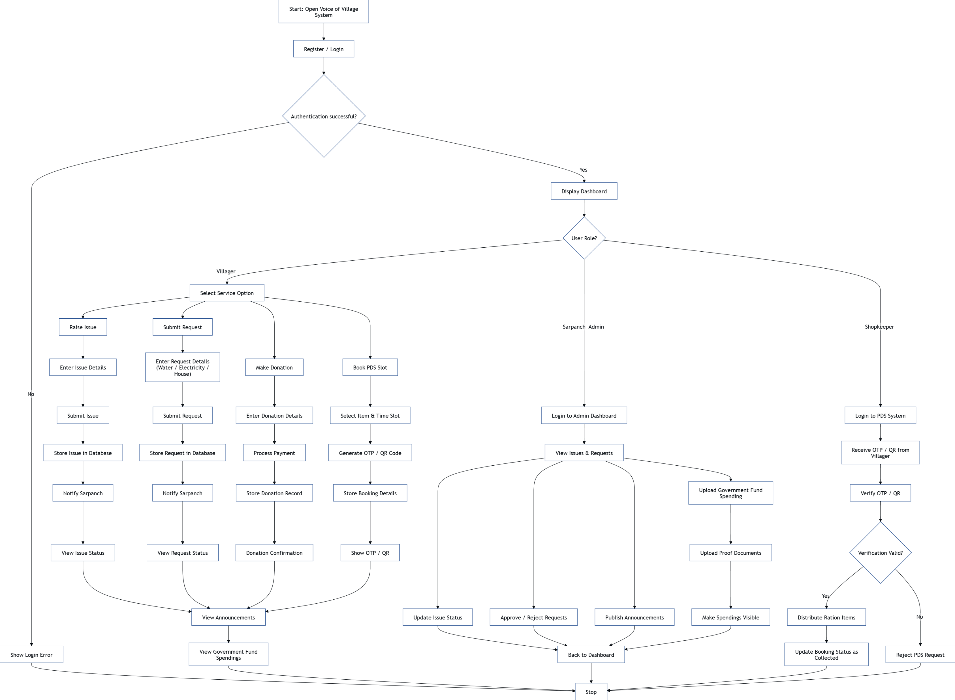
Data Design Or WorkFlow
Activity Diagram :

Slide 20
Technology stack & Justification
Layer | Technology Used | Justification for Selection
Frontend | React.js (Vite) | Provides fast rendering, component reusability, and better user experience
Styling | CSS / Tailwind CSS | Enables responsive, modern UI with minimal development effort
Backend | Node.js | Supports scalable, non-blocking server-side operations
Framework | Express.js | Simplifies API development and routing
Database | MySQL | Reliable relational database suitable for structured village data
Authentication | JWT | Ensures secure authentication and role-based access control
PDS Security | OTP / QR Code | Prevents fraud and ensures secure ration distribution
Version Control | Git & GitHub | Facilitates collaboration and code management
Development Tools | VS Code, Postman | Efficient development and API testing
Deployment (Optional) | AWS / Render / Vercel | Supports scalable and cloud-based hosting

Slide 21
Project Modules & Team Contribution
User Management Module Handles registration, login, authentication, and role-based access for Villagers, Sarpanch (Admin), and Shopkeeper.
Issue Reporting & Tracking Module Allows villagers to raise issues related to water, electricity, roads, etc., and enables the Sarpanch to update issue status and resolutions.
Service Request Management Module Manages water, electricity, and house requests submitted by villagers and processed through approval or rejection by the Sarpanch.
Fund Transparency & Donations Module Displays government fund allocation and spending with proof documents, and manages donations contributed by villagers.
PDS Slot Booking & Verification Module Enables villagers to book ration slots and receive OTP/QR codes, which are verified by the Shopkeeper during item distribution.
Announcements & Notifications Module Allows the Sarpanch to publish announcements and notify villagers about important updates.

Slide 22
Project Modules & Team Contribution
Member 1 – Design & Implementation Focus Contributed to UI design and web page development while also participating in backend API integration, database interactions, and testing of frontend–backend communication.
Member 2 – Backend & System Logic Focus Focused primarily on backend API development and database operations, while also contributing to frontend integration, debugging, and functional testing of the application.
Member 3 – Testing & Documentation Focus Led testing activities and documentation preparation, while also contributing to frontend enhancements, backend validation, and database verification.

Slide 23
Expected Outcomes & Future Work
Expected Outcomes
Improved transparency in village fund utilization through digital display of government spending with proof documents.
Efficient issue reporting and tracking system, enabling timely resolution of village-level problems.
Increased citizen participation and trust by providing a unified platform for services, donations, and announcements.
Secure and streamlined PDS slot booking and verification using OTP/QR codes.
Reduction in manual processes, delays, and data inconsistencies in village administration.
Future Work
Development of a mobile application to improve accessibility for villagers.
Integration with government portals for automated fund and scheme updates.
Extension of the system to support multiple villages or panchayats.
Advanced analytics and reporting dashboards for decision-making.
Incorporation of AI-based insights for issue prioritization and trend analysis.

Slide 24


