Slide 1
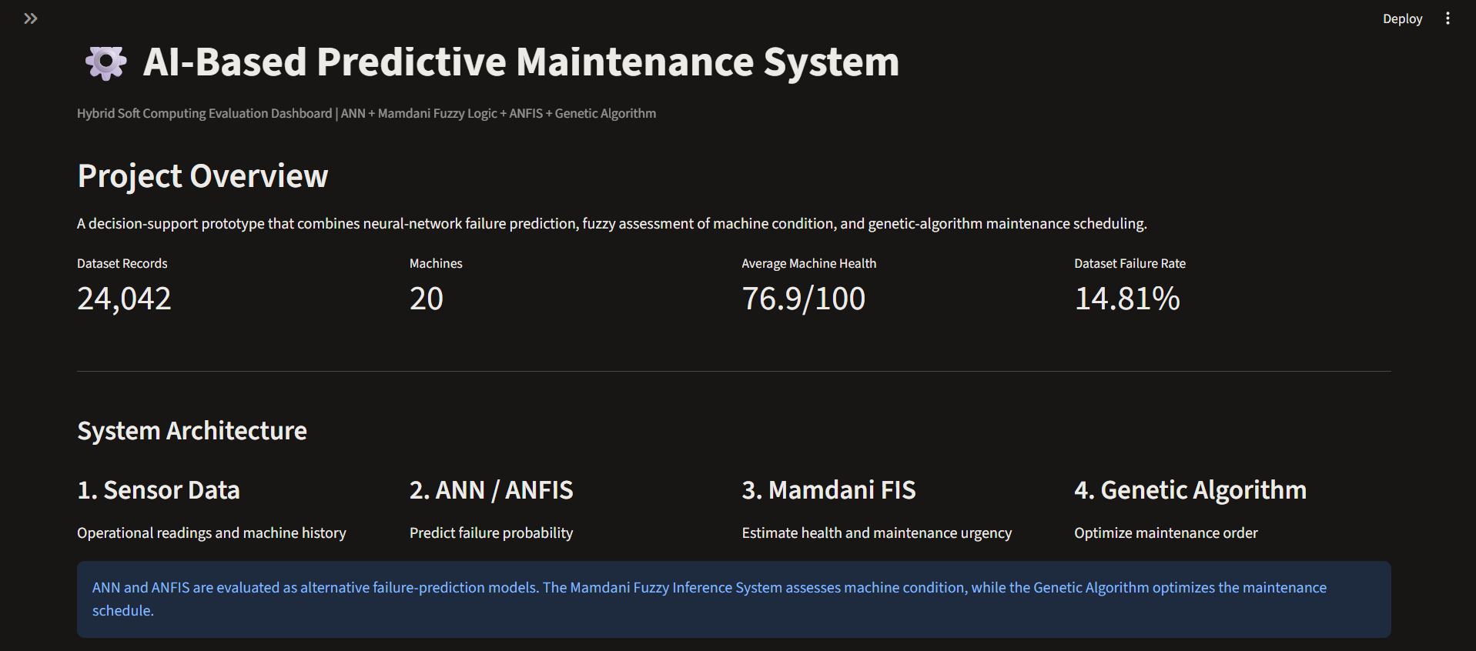
MAINZ AI | ACADEMIC PROJECT
AI-Based Predictive
Maintenance System
Failure prediction • fuzzy condition assessment • maintenance scheduling
ANN / ANFIS → Mamdani FIS → Genetic Algorithm
Authentic evidence from the checked-in project and supplied UI screenshots

Slide 2
PREDICTIVE MAINTENANCE | PROJECT REVIEW
Problem definition & objectives
•
Reactive maintenance can miss developing faults or schedule work inefficiently.
What the system answers
•
The prototype combines sensor history with failure-risk estimation and interpretable urgency.
Which machine looks risky?
How urgent is maintenance?
How can limited daily capacity be assigned?
•
Objective: compare prediction approaches, demonstrate machine assessment, and create a capacity-limited schedule.
•
Scope: academic decision support; no claim of deployment or validated factory savings.
MAINZ AI • Repository evidence and saved evaluation files • 10 Nov 2026

Slide 3
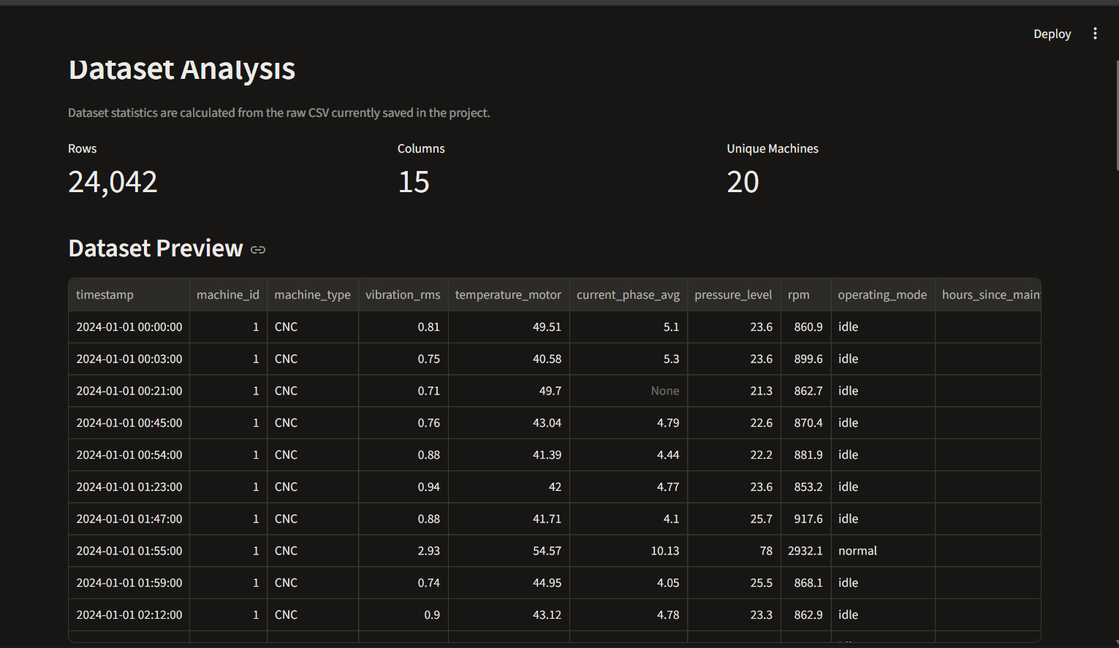
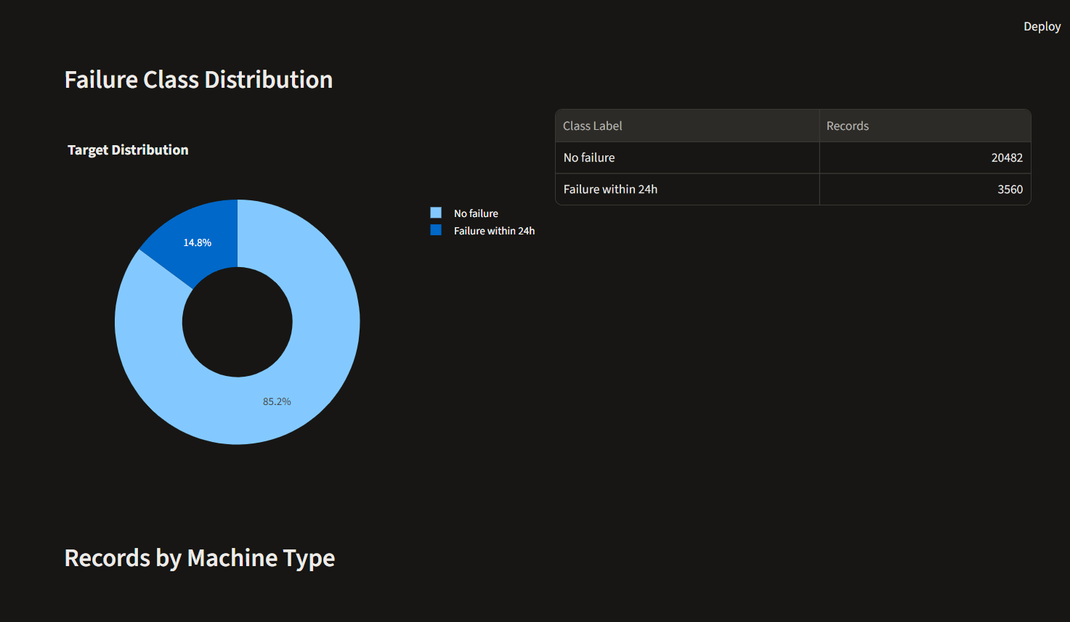
PREDICTIVE MAINTENANCE | PROJECT REVIEW
Dataset profile
•
24,042 observations • 20 machine IDs • 15 columns
•
3,560 positive records (14.81%); 20,482 negative records
•
Target: failure within 24 hours
•
Chronological split: 19,233 train / 4,809 test; test prevalence is 6.24%
MAINZ AI • Repository evidence and saved evaluation files • 10 Nov 2026

Slide 4
PREDICTIVE MAINTENANCE | PROJECT REVIEW
Literature context & research gap
•
ANNs learn nonlinear relationships for fault prediction; reported scores depend on leakage control and class balance.
Key evaluation question
•
ANFIS combines fuzzy rules with adaptive parameter learning (Jang, 1993).
Do machines in the test data also appear during training?
•
Mamdani inference represents linguistic condition rules (Mamdani & Assilian, 1975).
•
Gap addressed here: place alternative predictors beside interpretable urgency and capacity-constrained scheduling, then expose evaluation caveats.
MAINZ AI • Repository evidence and saved evaluation files • 10 Nov 2026

Slide 5
PREDICTIVE MAINTENANCE | PROJECT REVIEW
System design & data flow
Sensor records
ANN / ANFIS
Mamdani FIS
Genetic algorithm
→
→
→
24,042 rows
20 machines
Alternative failure
prediction models
Urgency + health
from condition inputs
Order jobs under
capacity constraint
Operational path: ANN probability → Mamdani urgency → GA schedule. ANFIS is evaluated as an alternative prediction model; it is not currently consumed by the scheduler.
MAINZ AI • Repository evidence and saved evaluation files • 10 Nov 2026

Slide 6
PREDICTIVE MAINTENANCE | PROJECT REVIEW
Implementation & preprocessing
•
Input features include sensor readings, machine type, operating mode, and maintenance history.
•
Pipelines handle numeric imputation/scaling and categorical imputation/encoding where configured.
•
Training-only oversampling is used in the balanced ANFIS experiment; test records remain untouched.
•
The dashboard reads saved local data, metrics, predictions, and schedule artifacts.
MAINZ AI • Repository evidence and saved evaluation files • 10 Nov 2026

Slide 7
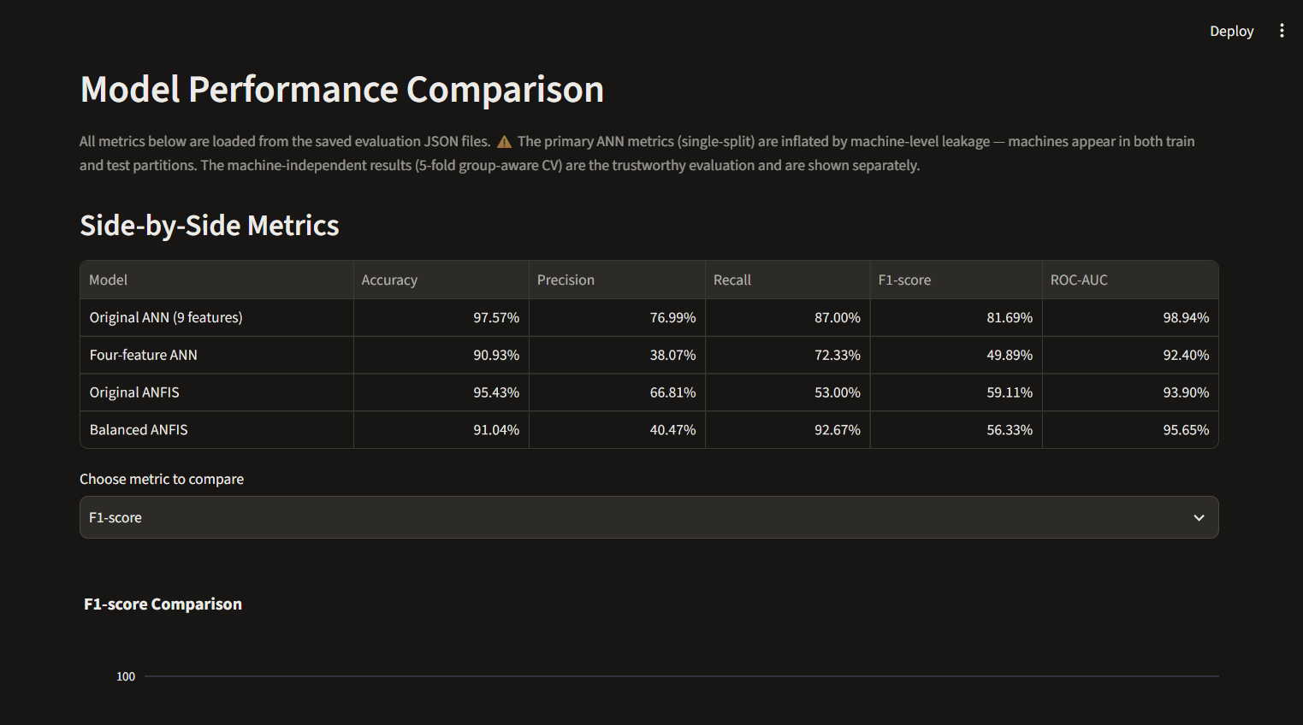
PREDICTIVE MAINTENANCE | PROJECT REVIEW
Prediction models: ANN and ANFIS
•
Original ANN: nine features; saved single chronological split metrics.
•
Four-feature ANN and ANFIS experiments provide a more comparable four-input setup.
•
Balanced ANFIS uses training-only oversampling to improve positive-class recall.
•
ANFIS configuration: four inputs, two Gaussian membership functions per input, 16 rules.
MAINZ AI • Repository evidence and saved evaluation files • 10 Nov 2026

Slide 8
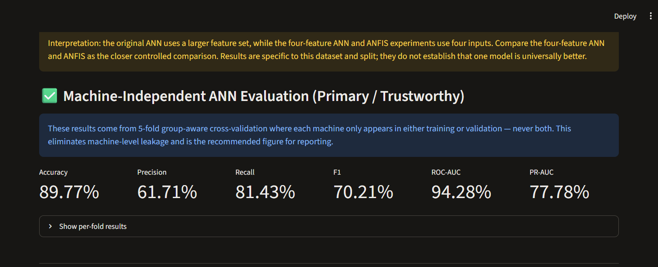
PREDICTIVE MAINTENANCE | PROJECT REVIEW
Primary evaluation: machine-independent ANN
5-fold StratifiedGroupKFold by machine ID: a machine appears in training or validation, never both.
Saved out-of-machine metrics
Accuracy 89.77%
Precision 61.71%
Recall 81.43%
F1-score 70.21%
ROC-AUC 94.28%
PR-AUC 77.78%
This grouped evaluation is the recommended ANN result. It holds out machine IDs, but mixes time and is not a forward-in-time test.
MAINZ AI • Repository evidence and saved evaluation files • 10 Nov 2026

Slide 9
PREDICTIVE MAINTENANCE | PROJECT REVIEW
Four-input model comparison
Saved chronological test results
Four-feature ANN F1 49.89% | Recall 72.33%
Original ANFIS F1 59.11% | Recall 53.00%
Balanced ANFIS F1 56.33% | Recall 92.67%
Balanced ANFIS: 278 / 300 positives detected; 22 missed; 409 false alarms.
The nine-feature ANN 97.57% accuracy is from a split with machine overlap and is not the primary generalization claim.
MAINZ AI • Repository evidence and saved evaluation files • 10 Nov 2026

Slide 10
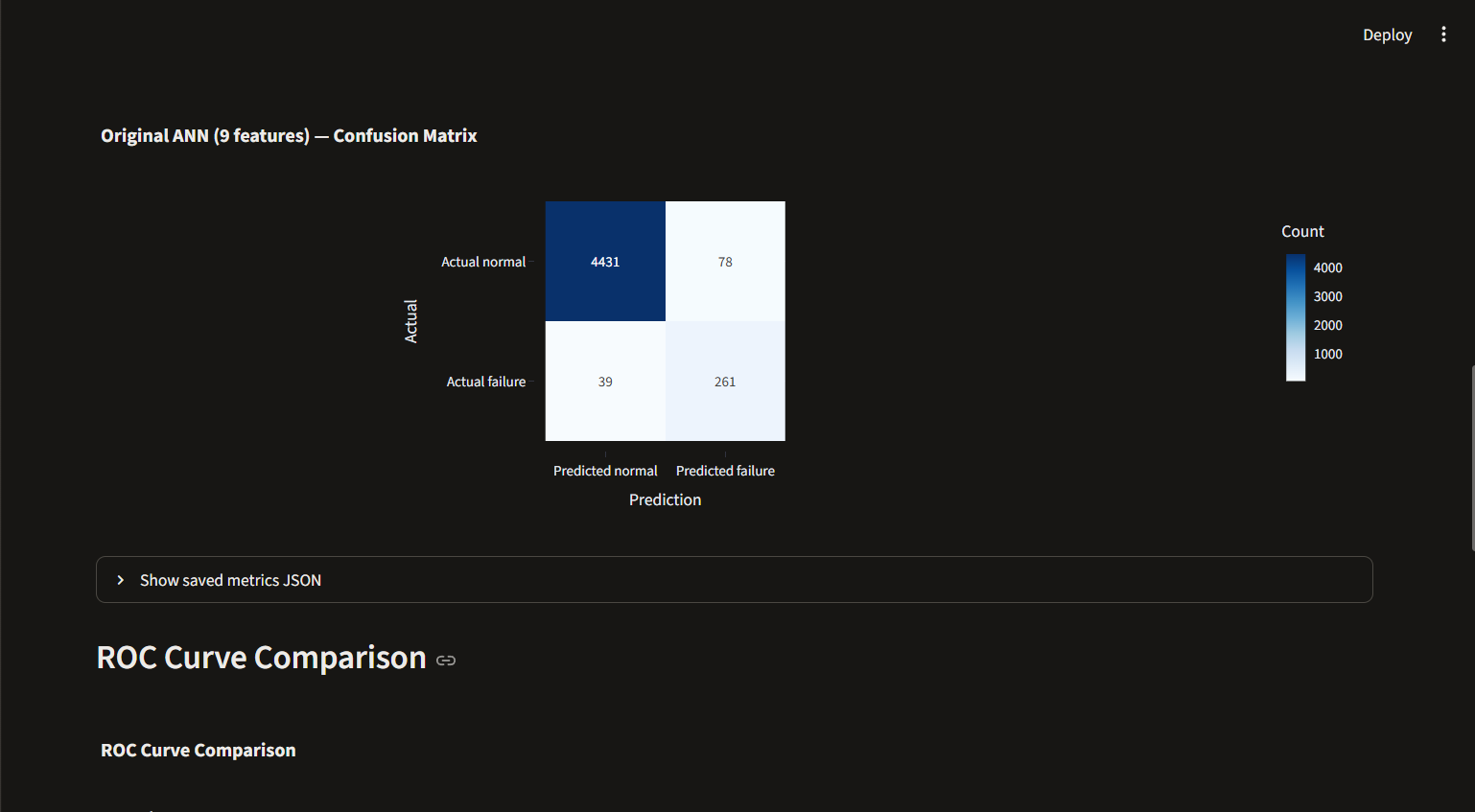
PREDICTIVE MAINTENANCE | PROJECT REVIEW
Operational trade-off: missed failures vs false alarms
Original ANN chronological split: TN 4,431 | FP 78 | FN 39 | TP 261.
Grouped ANN results are the main unseen-machine evaluation. Neither test is future-period validation.
MAINZ AI • Repository evidence and saved evaluation files • 10 Nov 2026

Slide 11
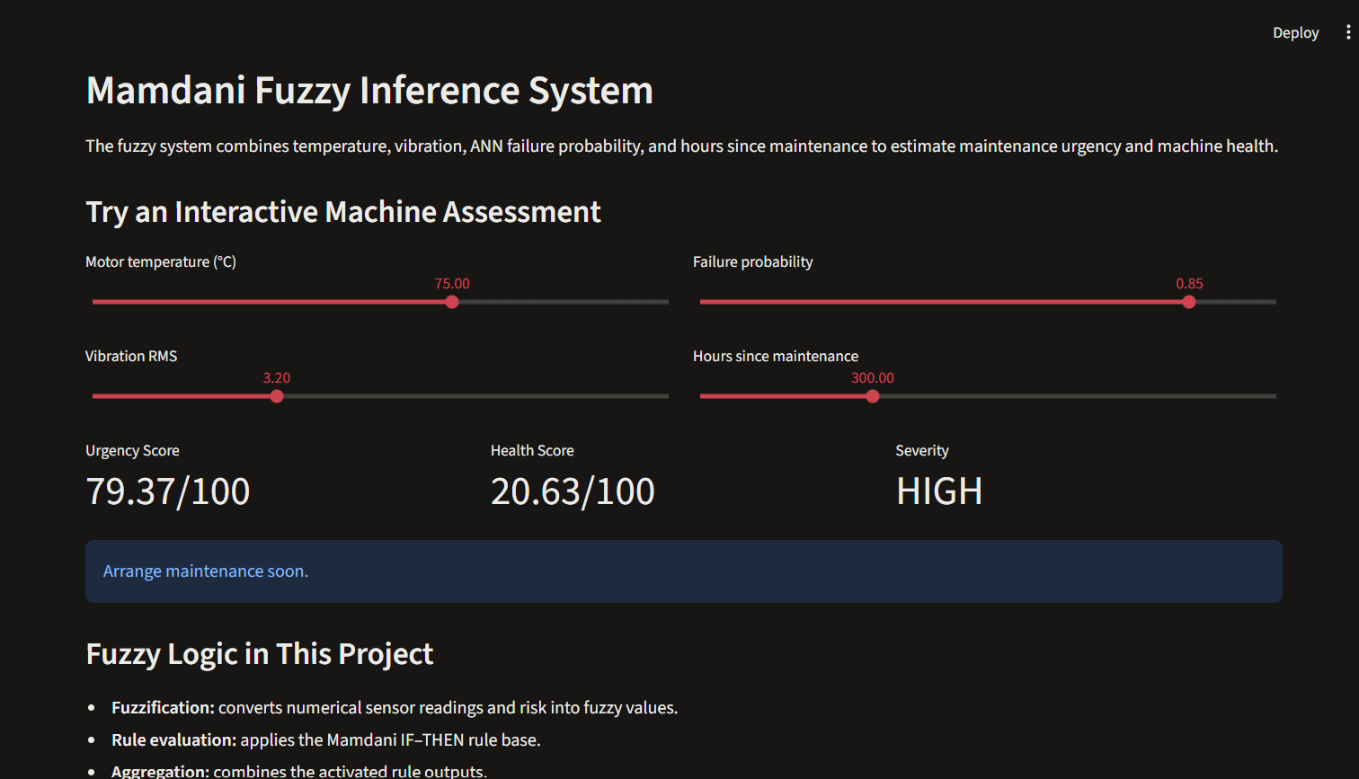
PREDICTIVE MAINTENANCE | PROJECT REVIEW
Mamdani fuzzy machine assessment
•
Inputs: motor temperature, vibration RMS, ANN failure probability, and hours since maintenance.
•
Fuzzification → rule evaluation → aggregation → centroid defuzzification.
•
Health score is implemented as 100 minus urgency.
•
Saved interactive example: urgency 79.37, health 20.63, severity HIGH; “Arrange maintenance soon.”
MAINZ AI • Repository evidence and saved evaluation files • 10 Nov 2026

Slide 12
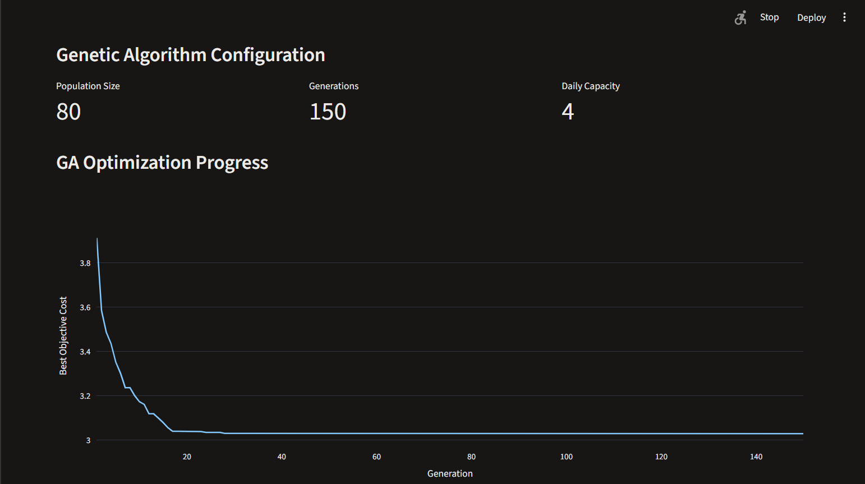
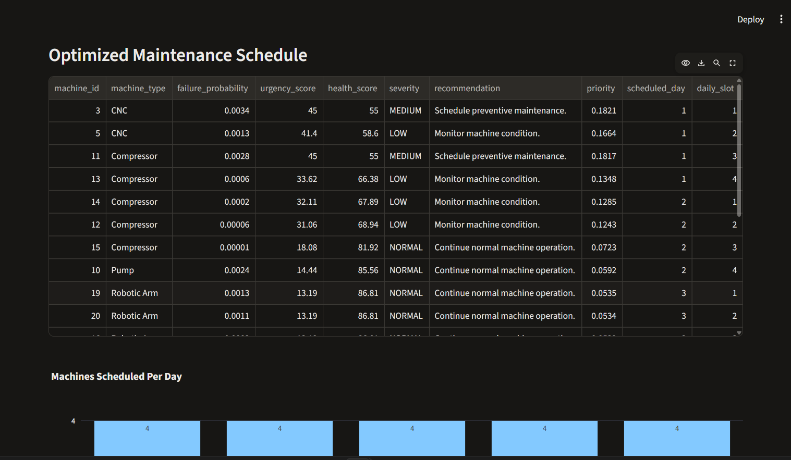
PREDICTIVE MAINTENANCE | PROJECT REVIEW
Genetic algorithm maintenance schedule
•
Saved configuration: population 80, 150 generations, capacity 4 jobs/day.
•
Objective balances urgency priority and machine-type changeover penalty.
•
Saved objective: FIFO 4.77585; priority order 3.15049; GA 3.02838.
•
GA improved the saved objective 3.88% vs priority and 36.59% vs FIFO. These are prototype units, not currency.
MAINZ AI • Repository evidence and saved evaluation files • 10 Nov 2026

Slide 13
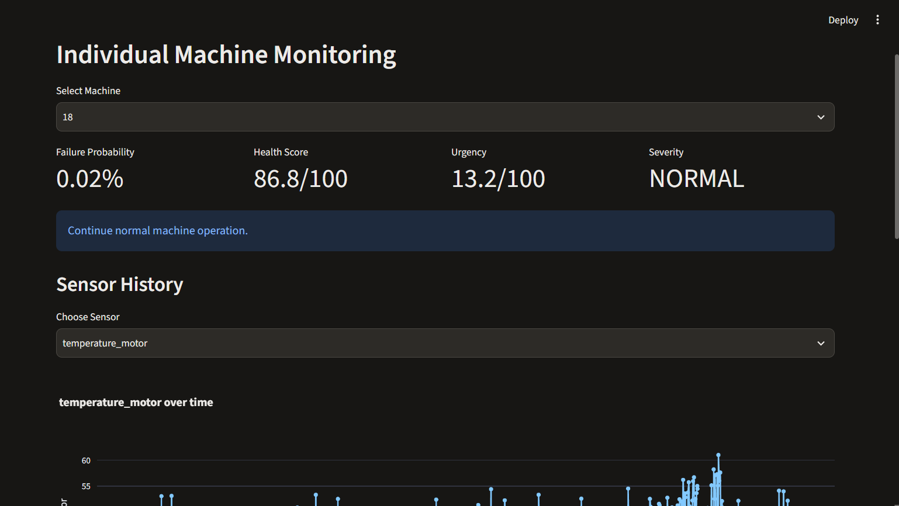
PREDICTIVE MAINTENANCE | PROJECT REVIEW
Dashboard: monitoring & analysis
MAINZ AI • Repository evidence and saved evaluation files • 10 Nov 2026

Slide 14
PREDICTIVE MAINTENANCE | PROJECT REVIEW
Verification, limitations & next steps
•
Existing verification suite: 8/8 sections passed; 16 Python modules compile; dashboard responds HTTP 200.
Evidence boundaries
•
No training, preprocessing, or threshold experiment was rerun while preparing these materials.
Scores describe saved runs on this dataset.
GA cost is a synthetic objective.
Prototype output requires human review.
•
Dataset source/license are undocumented; sample covers only 20 machines and a short time period.
•
Next: document data provenance, validate on later periods and unseen sites, calibrate alert thresholds with maintenance costs, and test scheduling assumptions with practitioners.
MAINZ AI • Repository evidence and saved evaluation files • 10 Nov 2026

Slide 15
PREDICTIVE MAINTENANCE | PROJECT REVIEW
References & reproducibility
Jang, J.-S. R. (1993). ANFIS: Adaptive-network-based fuzzy inference system. IEEE Transactions on Systems, Man, and Cybernetics, 23(3), 665–685.
Mamdani, E. H., & Assilian, S. (1975). An experiment in linguistic synthesis with a fuzzy logic controller. International Journal of Man-Machine Studies, 7(1), 1–13.
Susto, G. A., Schirru, A., Pampuri, S., McLoone, S., & Beghi, A. (2015). Machine learning for predictive maintenance: A multiple classifier approach. IEEE Transactions on Industrial Informatics, 11(3), 812–820.
Guidotti, R., Pandolfo, G., & Pulina, L. (2025). A survey of predictive maintenance: Systems, purposes and approaches. ACM Computing Surveys.
Project evidence: Satwik1428/Predictive-Maintenance repository, checked-in source and results; screenshots supplied by the project author. Full citation details and DOI/URLs are in the accompanying report.
Reproducibility note: results are transcribed from saved files; existing models and experiment artifacts were preserved.
MAINZ AI • Repository evidence and saved evaluation files • 10 Nov 2026

