Slide 1

SAI VIDYA INSTITUTE OF TECHNOLOGY
Department of Computer Science and Engineering
Rajanukunte, Bengaluru - 560064
Web Technology Laboratory with Mini Project (17CSL77)
ONLINE SHOPPING WEBSITE
By
SATWIK RAM K 1VA17CS047
SHAHBAZ KHAN Z 1VA17CS048
PAVAN KUMAR N1VA17CS028
Under the guidance of
Prof. Nagamahesh BS
Assistant Professor
Department of Computer Science & Engineering

Slide 2
Presentation Outline
Introduction
System Requirement Specification
System Architecture
Snapshots
Conclusion
References
Dept. of CSE, SVIT 2

Slide 3
Introduction
The main purpose of Online Shopping Website is to provide customers to buy and sell their products.
This software helps the admin to add products as well.
Admin can create, read, update and delete data as per the requirement.
On the home page itself the user can search for their products.
Once the order is places invoice will be mailed to user’s email.
Users can track the orders placed.
Dept. of CSE, SVIT 3

Slide 4
System Requirement Specification
Functional Requirements
User enters a URL in the browser
Browser sends a request to the web server
Web Server examines the request
It sends the response to the web client(browser)
Page the leads to home page where user can get information by entering subject.
Dept. of CSE, SVIT 4

Slide 5
System Requirement Specification
Non Functional Requirements
Usability: The system should have a user friendly and easy to use interface.
Security: The system should not allow unauthorized access to the data.
Reliability: The system should be reliable enough provide the users to the order data when requested.
Efficiency: The system should provide quick access to the information and facilitates efficient requirements.
Dept. of CSE, SVIT 5

Slide 6
System Requirement Specification
Software Requirements
Operating system : Windows, Linux
Applications Required : Any Web Browser
Programming Tool : Pycharm
Technologies Used : HTML, CSS, JavaScripts and Django
Dept. of CSE, SVIT 6

Slide 7
System Requirement Specification
Hardware Requirements
CPU : Pentium IV 2.4 GHz or above
Memory (Primary): 1 GB or above
Hard Disk : 40 GB or above
Monitor : 15 VGA color
Dept. of CSE, SVIT 7

Slide 8
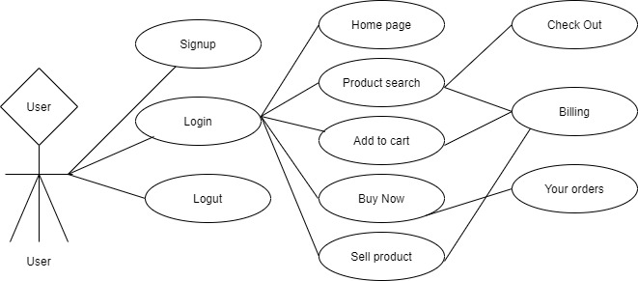
Website Design
Dept. of CSE, SVIT 8

Slide 9
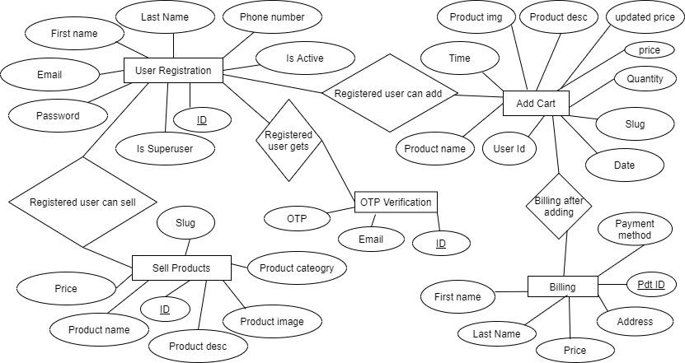
Database Architecture
Dept. of CSE, SVIT 9

Slide 10
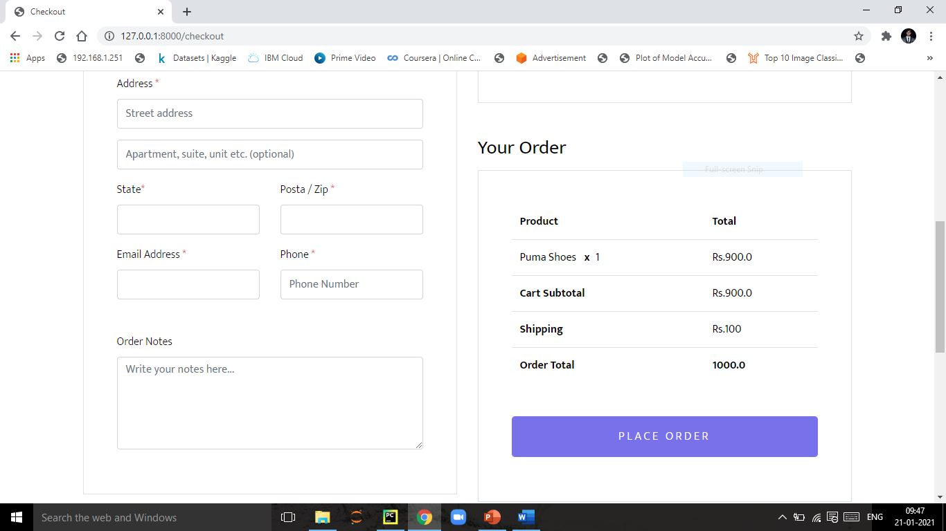
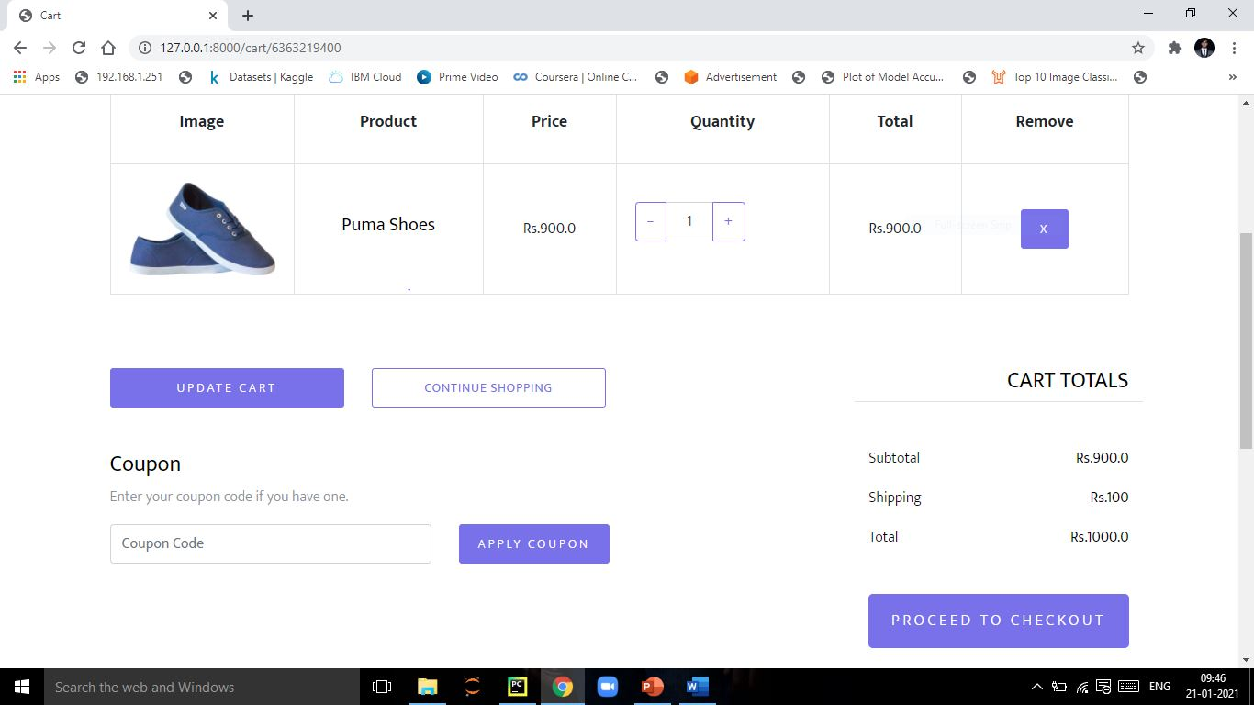
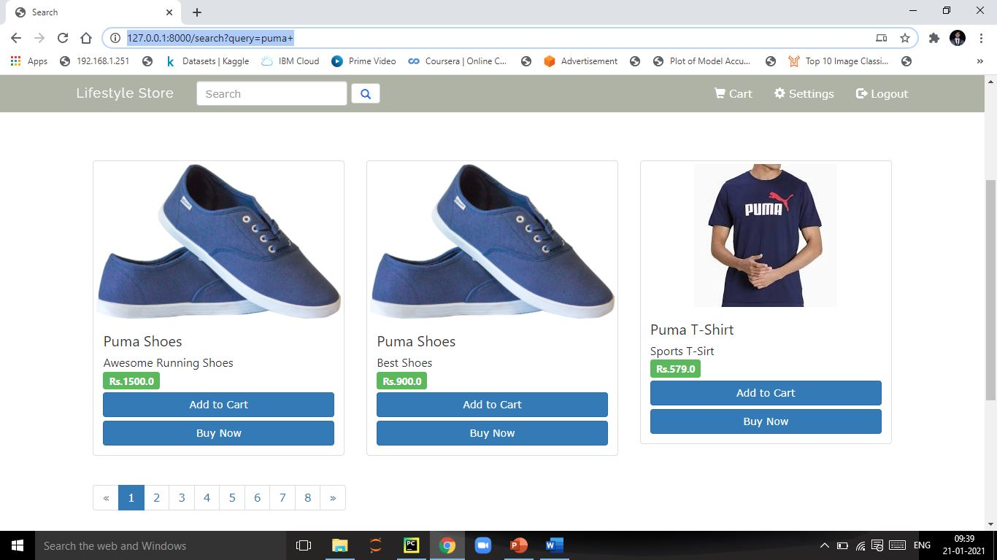
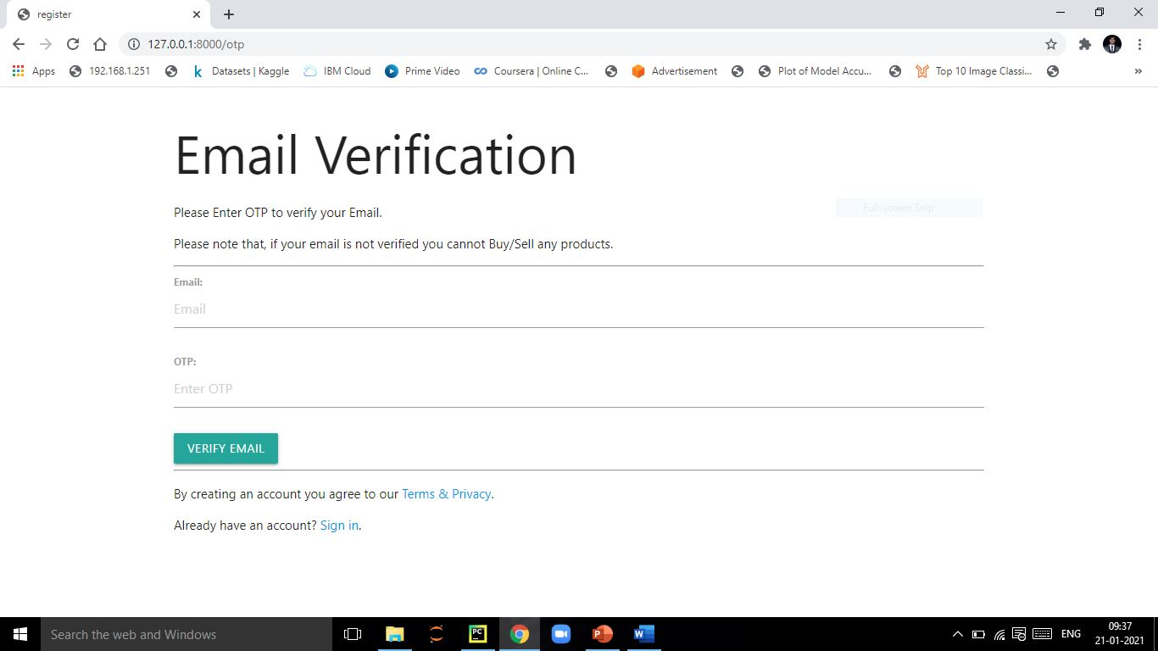
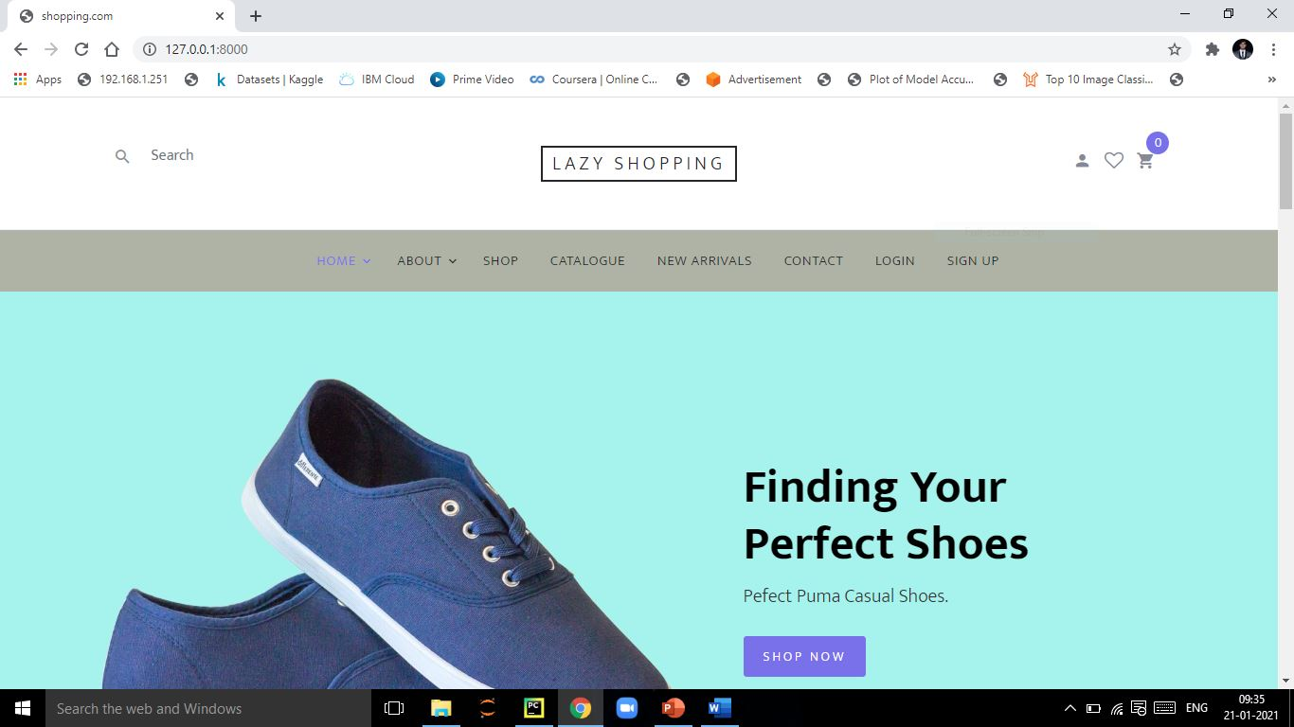
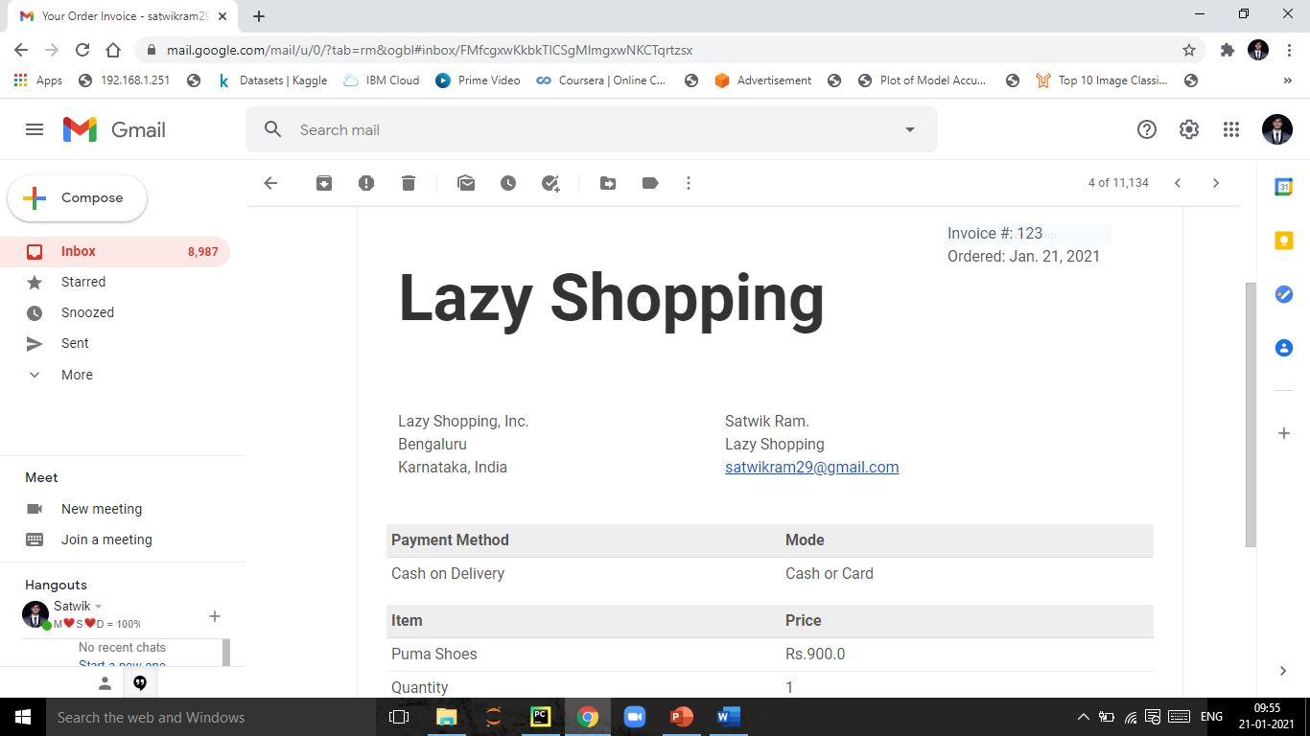
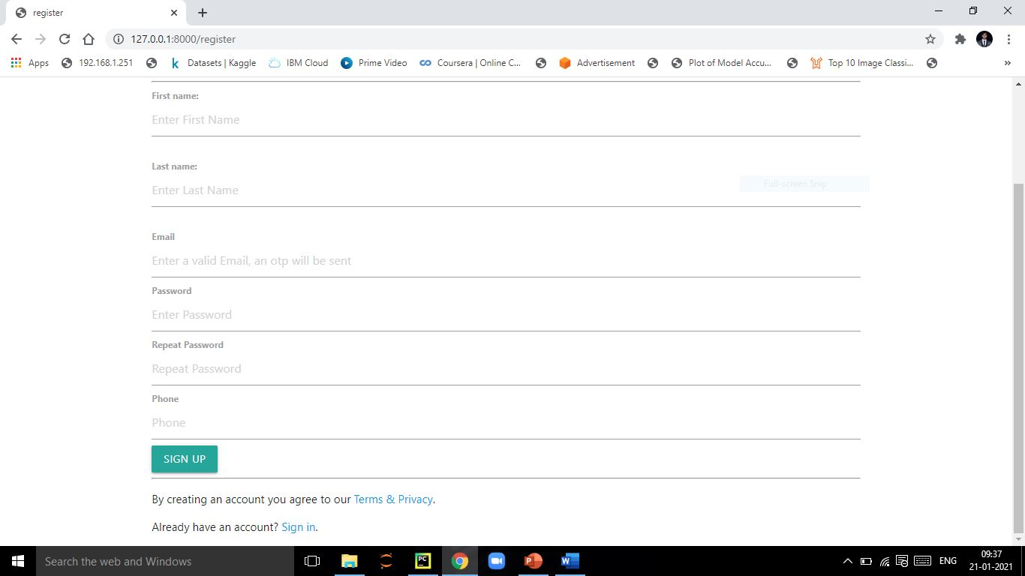
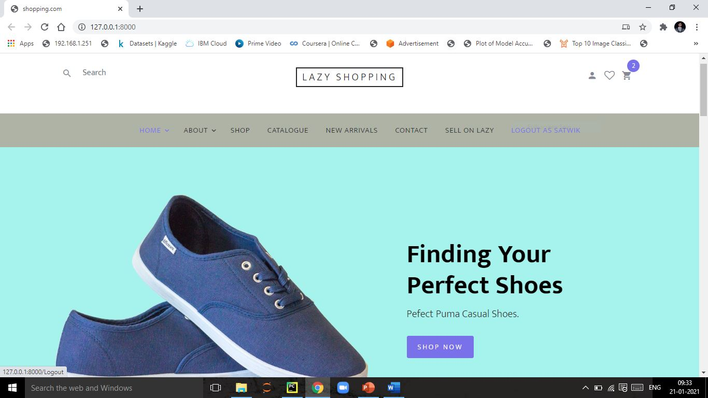
Snapshots
Dept. of CSE, SVIT 10

Slide 11
Conclusion
This system provides an easy solution for customers to buy the product
This system provides an easy solution for customers without going to the shop and also to shop owner to sale the product.
This proposed system can be used by any naïve users and it does not require any educational level,experience or technical expertise in computer field but it will be of good use
If user has the good knowledge of how to operate a computer.
Dept. of CSE, SVIT 11

Slide 12
References
W3 Schools
Django Documentation
Django Rest Frameworks Documentation
Geeks for Geeks
Dept. of CSE, SVIT 12

