Slide 1

SAI VIDYA INSTITUTE OF TECHNOLOGY
Department of Computer Science and Engineering
Rajanukunte, Bengaluru - 560064
Sign Language Recognition
By
SATWIK RAM K 1VA17CS047
N PAVAN KUMAR 1VA17CS028
Under the guidance of
Prof. Sunil G L
Assistant Professor,
Department of CSE

Slide 2
Introduction
Introduction
Neural Network is a series of algorithm which mimics human brain
Any kind of data can be transformed and sent to Neural Networks
Sign Language are language that uses the visual-manual modality to convey meaning
For Sign language Neural Networks is used to predict the gesture
Convolution Neural Network is used for model training and predictions.
Dept. of CSE, SVIT 2
Dept. of CSE, SVIT 2
Dept. of CSE, SVIT 2
Dept. of CSE, SVIT 2

Slide 3
Problem Statement
Problem Statement
The problem statement revolves around the idea of a camera­based sign language recognition system that would be in use for the deaf for converting sign language
Gestures to text and then text to speech.
Our objective is to design a solution that is intuitive and simple.
Communication for the majority of people is not difficult. It should be the same way for the deaf.
Dept. of CSE, SVIT 3

Slide 4
Related Work done
Related Works Done
Sign Language and Gesture Recognition using Matlab
Vision based sign language translation
K-nearest correlated neighbour classification for Indian sign language gesture recognition using feature extraction(by Bhumika Gupta, Pushkar Shukla and Ankush Mittal)
Dept. of CSE, SVIT 4

Slide 5
Proposed Model
Proposed Model
The problem statement revolves around the idea of a camera ­based sign language recognition system that would be in use for the deaf for converting sign language
We use CNN to train normal and pre-processed images
Gestures Recognition.
Dept. of CSE, SVIT 5

Slide 6
Methodology
Methodology
Train CNN model on both normal and pre-processed image.
Save the models
Load the models
Ensemble Predictions of models
Deploy the model in Django Web Frameworks
Gesture Recognition
Dept. of CSE, SVIT 6

Slide 7
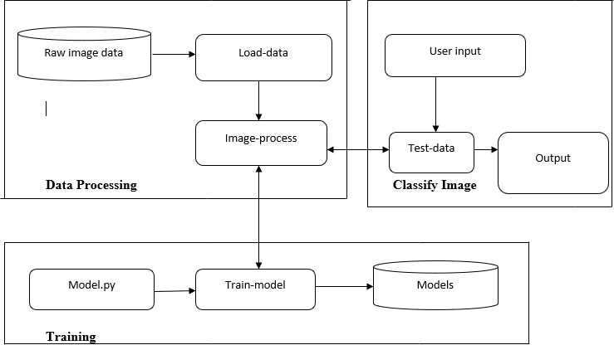
Proposed Model
Flow Chart
Dept. of CSE, SVIT 7

Slide 8
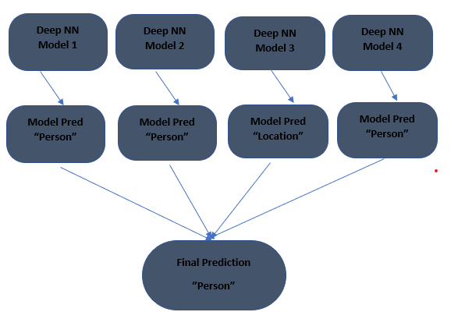
Proposed Model
Activity - Model Design
Dept. of CSE, SVIT 8

Slide 9
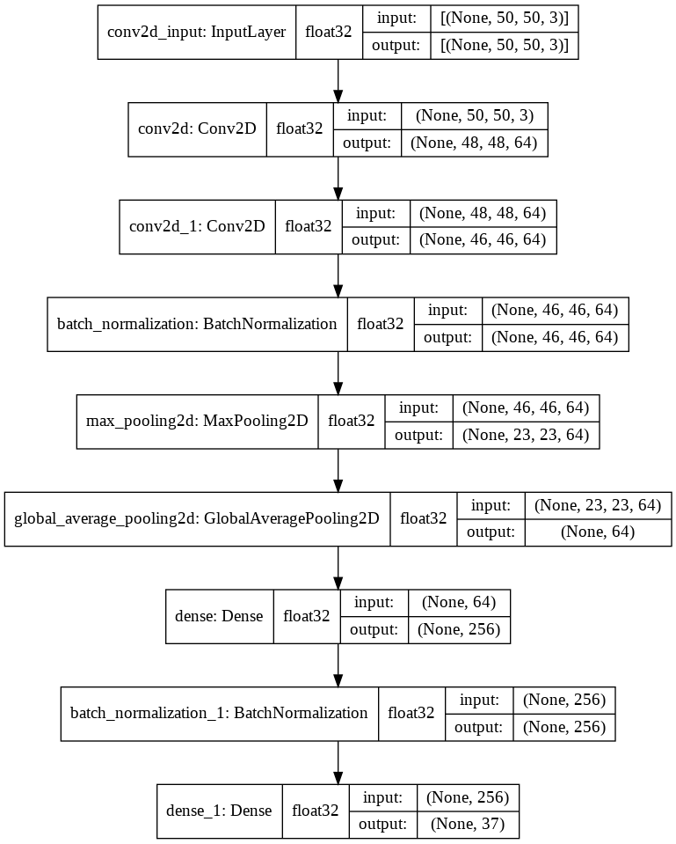
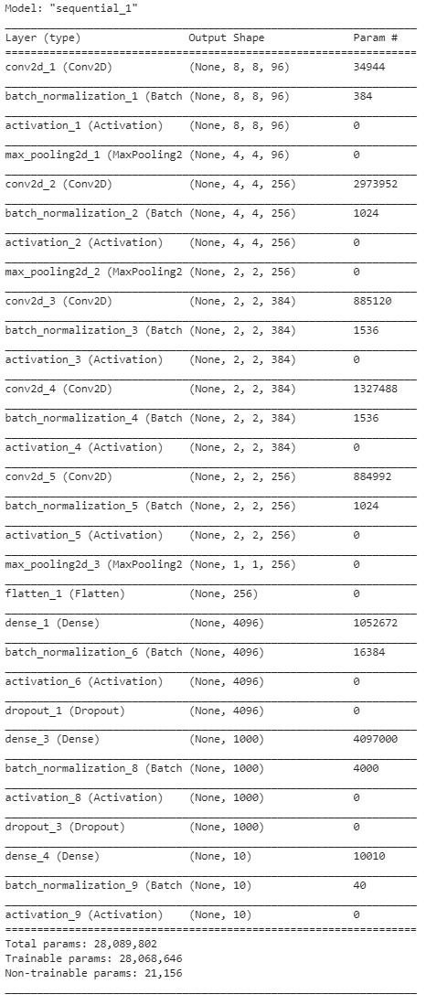
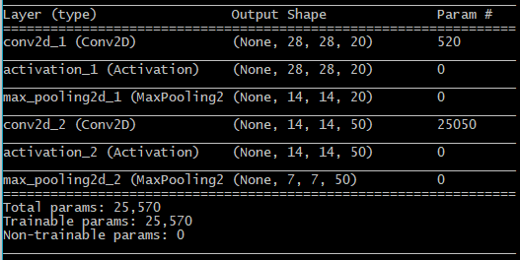
Proposed Model
Neural Networks Architectures
Dept. of CSE, SVIT 9

Slide 10
Proposed Model
Modules
Image Preprocessing
Model Prediction
Ensemble the Predictions
Response
Live Camera Prediction
Dept. of CSE, SVIT 10

Slide 11
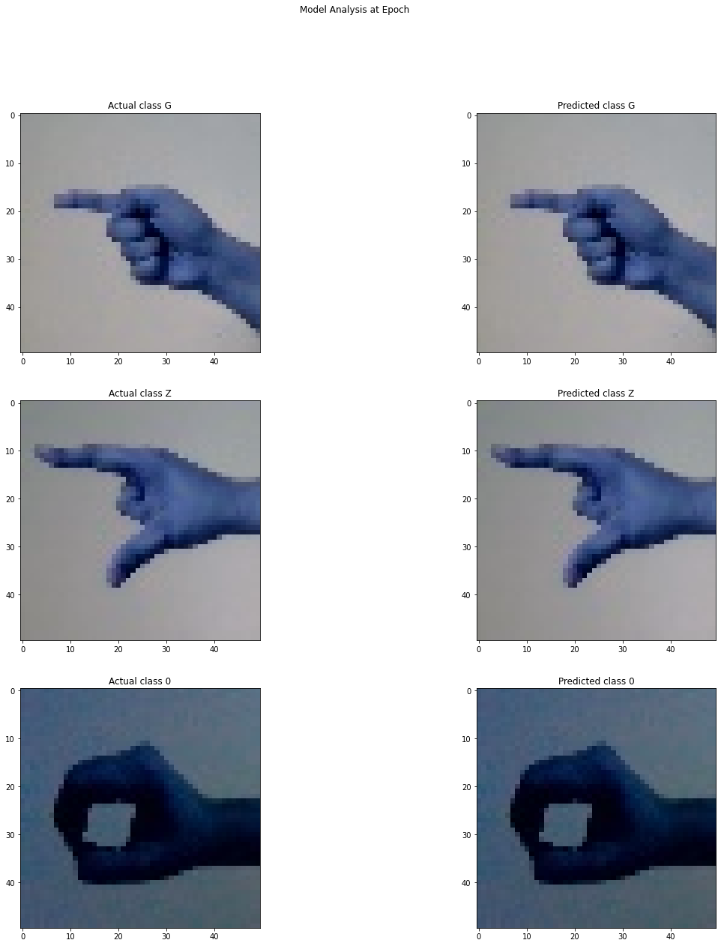
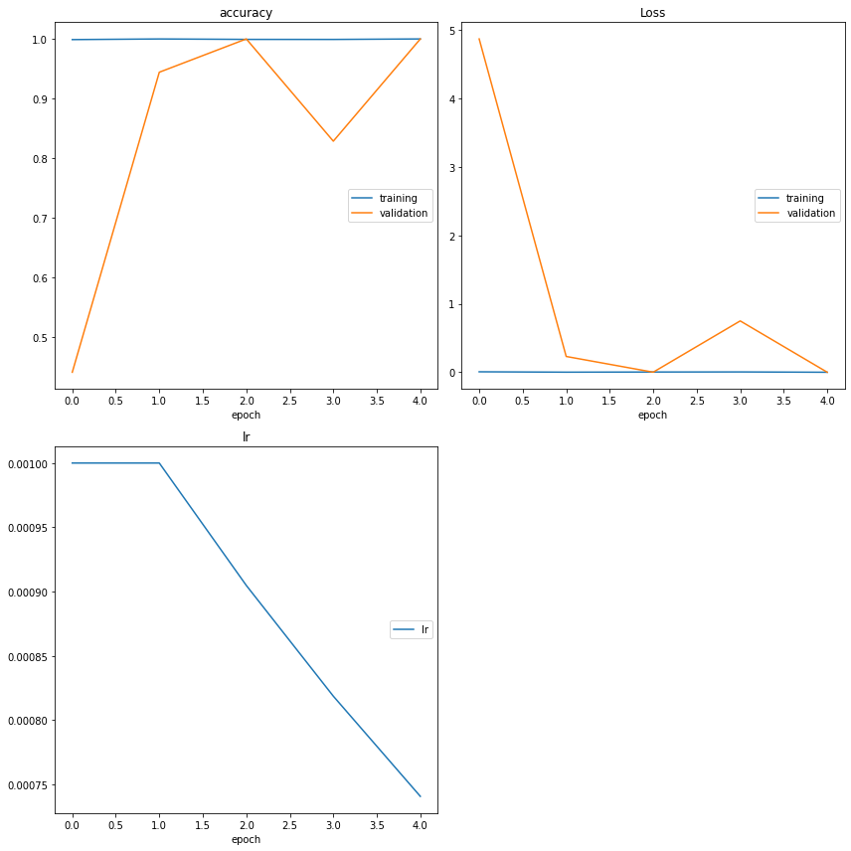
Results /Observation
Implementation
Dept. of CSE, SVIT 11

Slide 12
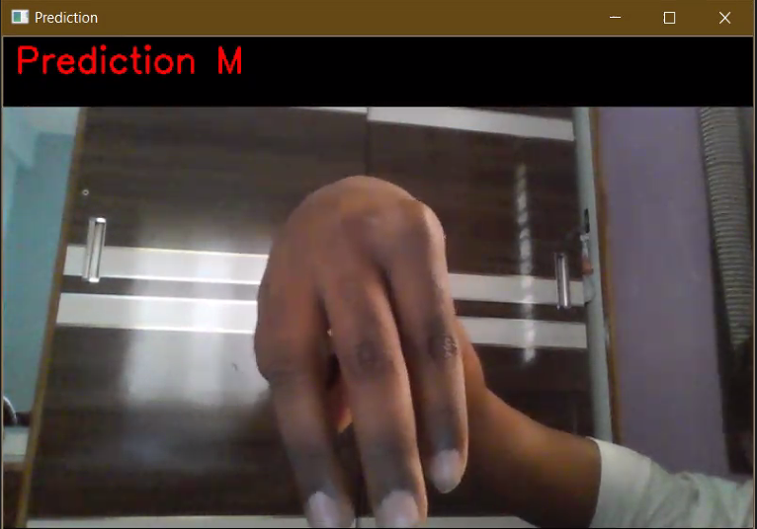
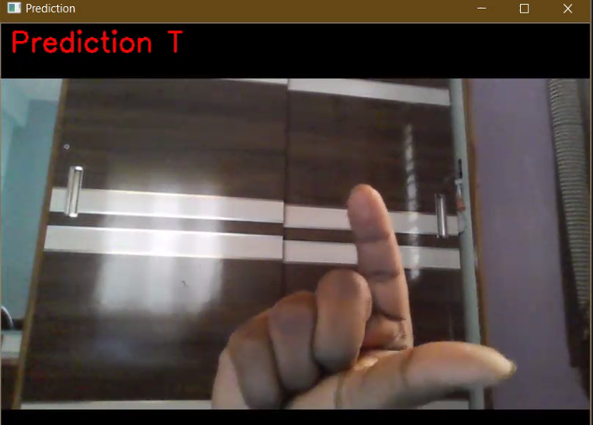
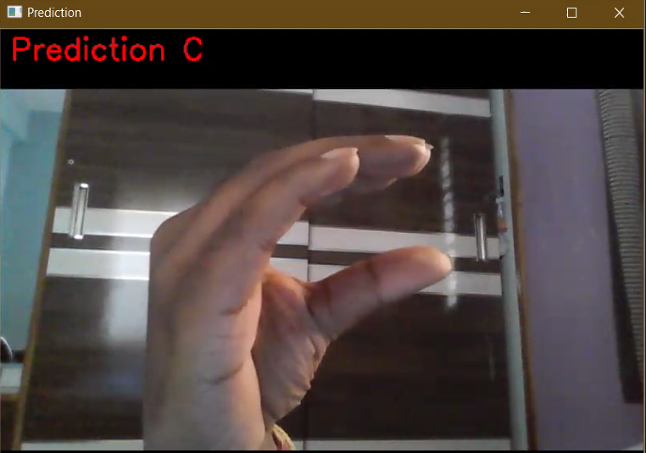
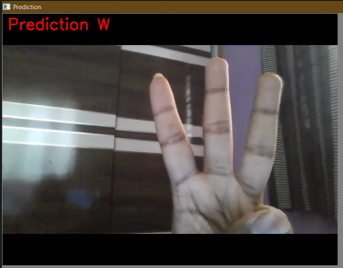
Results /Observation
Results
Dept. of CSE, SVIT 12

Slide 13
Conclusion
Conclusion
The majority of people do not know sign language yet.
Our project will be able to assist deaf people in managing sign language skills
It will improve the quality of life of deaf people by allowing them to use their sign language skills to navigate through the Xbox One with a way of using gesture to text to speech commands and helping them learn from mistakes if they mess up on a gesture.
Dept. of CSE, SVIT 13

Slide 14
Conclusion
Reference
TensorFlow Documentation
Django Rest Frameworks Documentation
CNN Research paper
L. K. Hansen and P. Salamon, "Neural network ensembles," in IEEE Transactions on Pattern Analysis and Machine Intelligence, vol. 12, no. 10, pp. 993-1001, Oct. 1990, doi: 10.1109/34.58871.
David H. Wolpert, Stacked generalization, Neural Networks, Volume 5, Issue 2, 1992, Pages 241-259, ISSN 0893-6080, https://doi.org/10.1016/S0893-6080(05)80023-1.
Y. Liu, X. Yao, Ensemble learning via negative correlation, Neural Networks, Volume 12, Issue 10,1999, Pages 1399-1404, ISSN 0893-6080, https://doi.org/10.1016/S0893-6080(99)00073-8.
MacKay D.J.C. (1995) Developments in Probabilistic Modelling with Neural Networks — Ensemble Learning. In: Kappen B., Gielen S. (eds) Neural Networks: Artificial Intelligence and Industrial Applications. Springer, London. https://doi.org/10.1007/978-1-4471-3087-1_37
Polikar R. (2012) Ensemble Learning. In: Zhang C., Ma Y. (eds) Ensemble Machine Learning. Springer, Boston, MA. https://doi.org/10.1007/978-1-4419-9326-7_1
Dept. of CSE, SVIT 14

