Slide 1


October 2020
Category review: Chips
Retail Analytics
1
Classification: Confidential

Slide 2
Our 17 year history assures best practice in privacy, security and the ethical use of data
We all have a responsibility to use data for good
Privacy
Security
Ethical use of data
Applies to all facets of our work, from the initiatives we take on, the information we use and how our solutions impact individuals, organisations and society.
We have built our business based on privacy by design principles for the past 17 years
Quantium has strict protocols around the receipt and storage of personal information
All information is de-identified using an irreversible tokenisation process with no ability to
re-identify individuals.
We are ISO27001 certified - internationally recognised for our ability to uphold best practice standards across information security
We use ‘bank grade’ security to store and process our data
Comply with 200+ security requirements from NAB, Woolworths and other data partners
All partner data is held in separate restricted environments
All access to partner data is limited to essential staff only
Security environment and processes regularly audited by our data partners.
Quantium believes in using data for progress, with great
care and responsibility. As such please respect the commercial in confidence nature
of this document.
2
Classification: Confidential

Slide 3
Analysis Summary
Customer Analytics
Budget – Older families, Mainstream – Young Singles/Couples and Mainstream Retirees, customer segments are the biggest consumer group of potato chips.
Sales are highest from 19th Dec for the days leading until 25th Dec i.e. Christmas.
Most preferred brand of chips for Mainstream – Young Singles/ Couples segment is Tyrells.
Most preferred pack size of chips for the same segment is 270gms. The products with this pack size are from Twisties.
Trial Layouts at Trial Stores
The trial layouts at trial stores 77, 86 & 88 have been successful in increasing customer footfalls significantly.
Trial store 86 shows increased Sales for only 1 trial month. To analyze & understand the disparity, more info such as such as offers or discounts (if applied during trial)/ returns/ bad product complains etc. is required.
Based on results of Trial store 77 & 88, Chips segment can implement the layout for other stores as well.

Slide 4
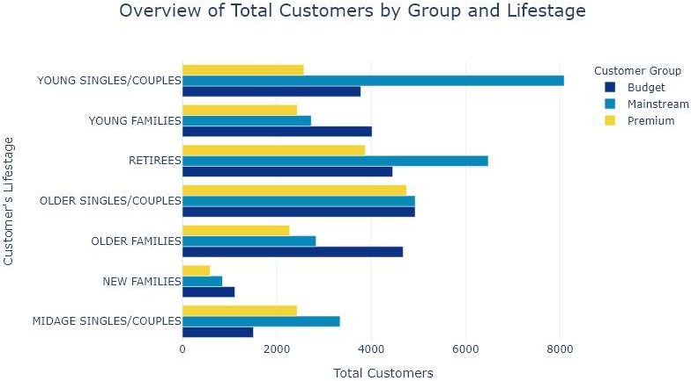
01
Customer Analytics

Slide 5
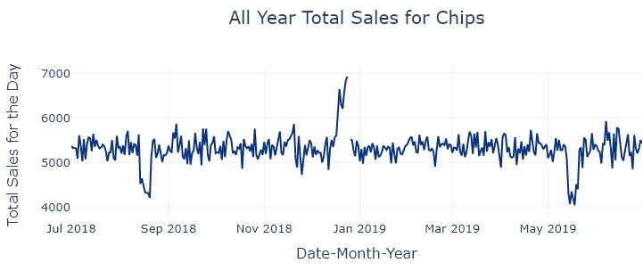
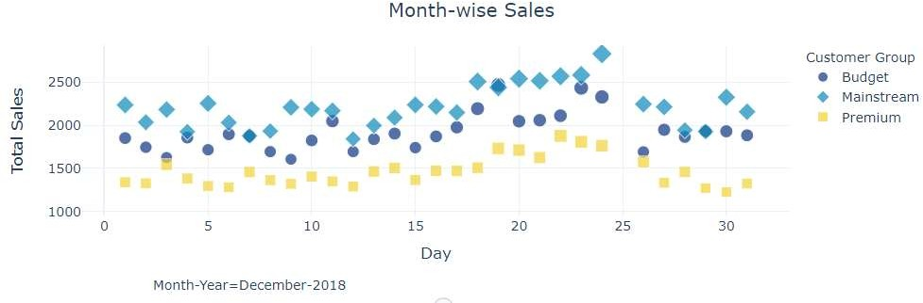
Chips are Sold throughout the Year except on Christmas
Total Sales for all segments for all days of the year from 01-July- 2018 to 31-Jun-2019
Customer segment wise total sales for Dec-2018 month – No sales for 25th Dec as retail is closed

Slide 6
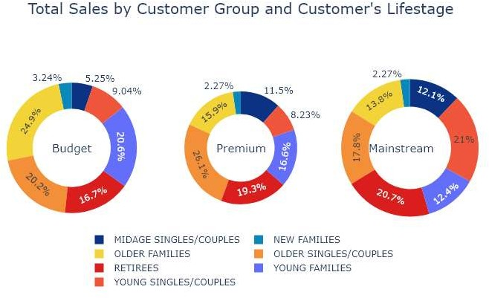
Chips are purchased No matter Consumer Affluence
Proportionately mainstream customers are maximum consumers of potato chips
Purchase Behavior Summary
Budget – Older Families and Mainstream Young Singles/Couples drive the sales higher
Older Singles/Couples make the highest buyers for Premium customer group

Slide 7
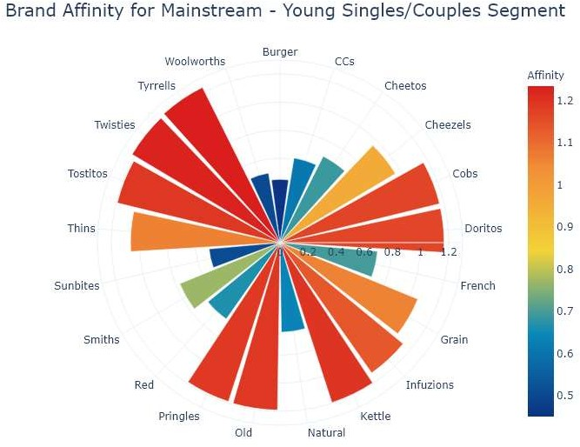
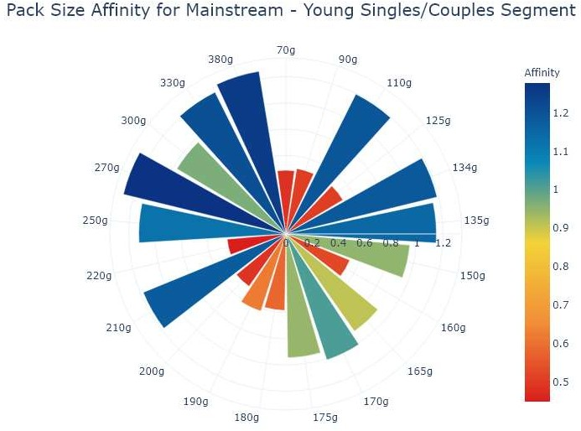
Chips Preferences
Mainstream – Young Single/ Couples Segment
Preferred Brand
Prefer chips from brands – Tyrells, Twisties & Kettle
Preferred Pack Size
270, 380 & 330

Slide 8
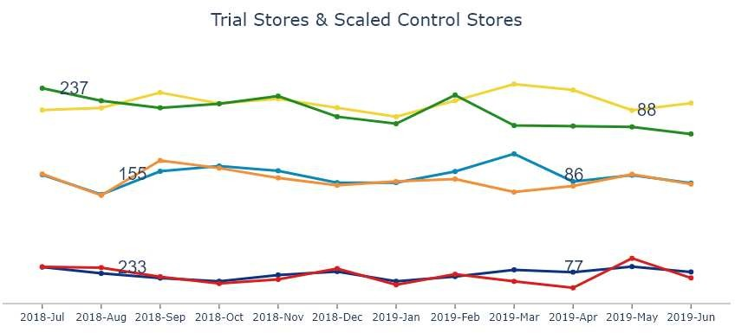
02
Trial Store Performance

Slide 9
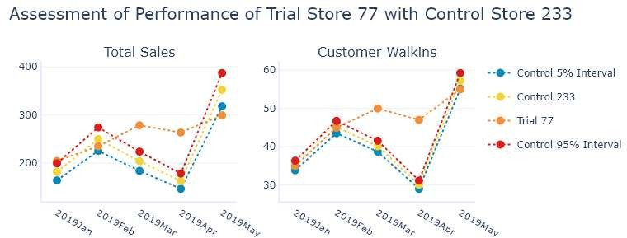
Store 77 - Success : 2 out of 3 months
Pre-Trial Performance
Store 233’s performance was most similar to trial store 77 before the trial months
Trial-Duration
Store 77 has registered higher sales as compared to scaled control store 233
No. of customers at store 77 also increased as compared to scaled control Store 233
Layout Result
Trial layout has been successful for Mar & Apr 2019

Slide 10
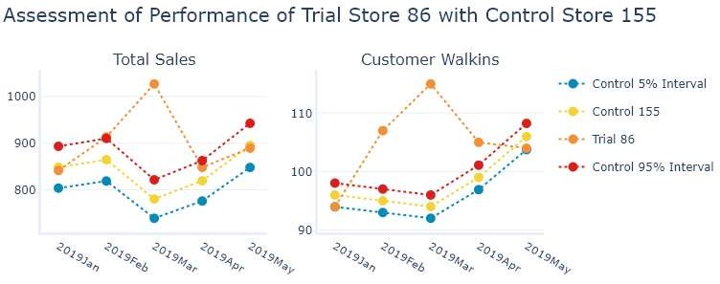
Store 86 - Success : 1 out of 3 months
Pre-Trial Performance
Store 155’s performance was most similar to trial store 86 before the trial months
Trial-Duration
Store 86 has registered higher sales as compared to scaled control store 155 for Feb 2019
No. of customers at store 86 increased for all 3 months of trial
Layout Result
Trial layout has been successful for Feb, Mar & Apr 2019 for attracting customers

Slide 11
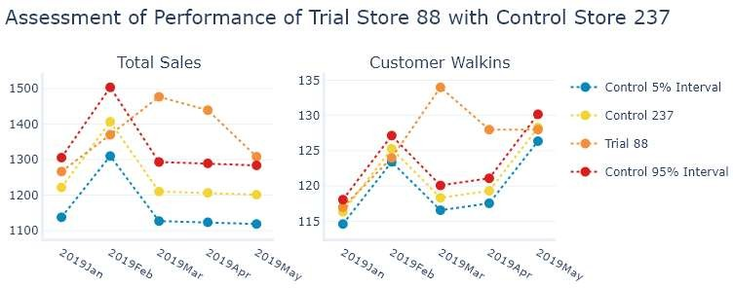
Store 88 - Success : 2 out of 3 months
Pre-Trial Performance
Store 237’s performance was most similar to trial store 88 before the trial months
Trial-Duration
Store 88 has registered higher sales as compared to scaled control store 237
No. of customers at store 88 also increased as compared to scaled control Store 237
Layout Result
Trial layout has been successful for Mar & Apr 2019

Slide 12
Disclaimer: This document comprises, and is the subject of intellectual property (including copyright) and confidentiality rights of one or multiple owners, including The Quantium Group Pty Limited and its affiliates (Quantium) and where applicable, its third-party data owners (Data Providers), together (IP Owners). The information contained in this document may have been prepared using raw data owned by the Data Providers. The Data Providers have not been involved in the analysis of the raw data, the preparation of, or the information contained in the document. The IP Owners do not make any representation (express or implied), nor give any guarantee or warranty in relation to the accuracy, completeness or appropriateness of the raw data, nor the analysis contained in this document. None of the IP Owners will have any liability for any use or disclosure by the recipient of any information contained in, or derived from this document. To the maximum extent permitted by law, the IP Owners expressly disclaim, take no responsibility for and have no liability for the preparation, contents, accuracy or completeness of this document, nor the analysis on which it is based. This document is provided in confidence, may only be used for the purpose provided, and may not be copied, reproduced, distributed, disclosed or made available to a third party in any way except strictly in accordance with the applicable
12
written terms and conditions between you and Quantium, or otherwise with Quantium’s prior written permission

