Slide 1




HARDWARE HACKATHON ROUND 1
-TITLE OF THE PROJECT-
TEAM ID: QXHH-36
TEAM NAME: CIRCUIT BREAKERS
NOTE: PPT to be named as- “teamID_teamname”

Slide 2


PROBLEM UNDERSTANDING & PROPOSED IDEA
In many hospitals, communication between patient rooms and the pharmacy is usually manual adopted system which is slow. This delay affects medicine delivery timings, especially during emergencies.
Proposed Solution: We propose a low-cost autonomous robot that follows a fixed path, detects requests from each room, and communicates them to the pharma station
Uniqueness:
• Low-cost and easy to implement
• Fully automated system
• Reduces human effort and delay
• Can be upgraded with AI in future

Slide 3

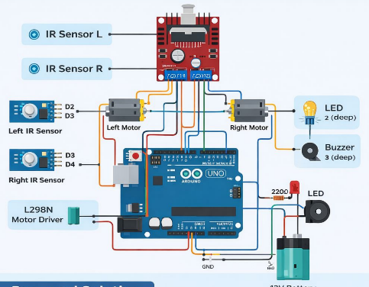
SYSTEM ARCHITECTURE/ WORKING
Step-by-Step Working:
1.Robot follows a predefined path using IR sensors
Stops at each room
Detects request (button/sensor)
Stores and counts requests
Moves to next room
Reaches pharmacy
Displays output using LED and buzzer

Slide 4


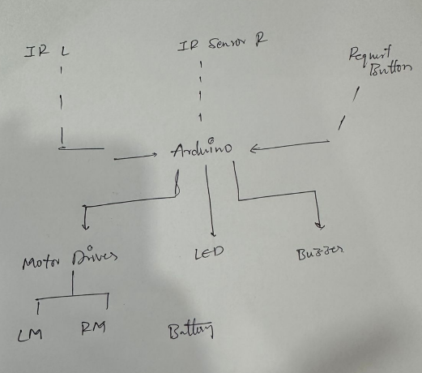
CIRCUIT DIAGRAM

Slide 5


INNOVATION, FEASIBILITY & OUTPUT
Innovation:
Smart hospital automation system
Real-time request detection
Can be extended with AI, IoT, voice control
Feasibility:
Uses low-cost components
Easy to build and deploy
Works without internet
Expected Output:
Robot moves autonomously
Detects requests accurately
LED blinks = number of requests
Buzzzer beeps = number of rooms

