Slide 1
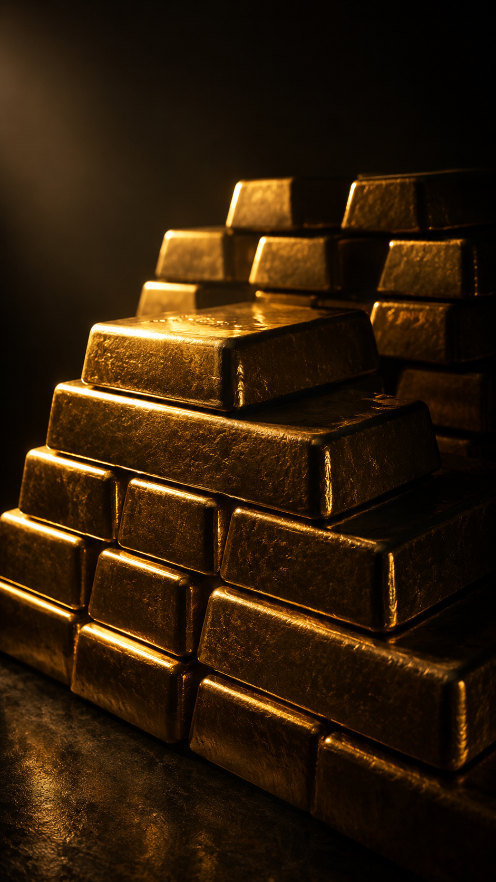
GOLD IN THE AGE OF CONFLICT
When Safe Havens Stop Being Safe
A Statistical Examination of Gold, the US Dollar, and Geopolitical Uncertainty — 2010 to 2026
195 Monthly Observations | 6 Data Sources | 5 Statistical Tests | 5 Original Visualisations
SATYA NARAYAN SAHOO
Independent Macro Research
June 2026
Data Sources: World Gold Council · Federal Reserve FRED · US Energy Information Administration

Slide 2
THE WORLD THAT SHAPED GOLD
A Decade of Crisis, Conflict & Capital Flight
Gold does not move on spreadsheets. It moves when people lose faith in currencies, in governments, in the stability of the system they depend on. Each event below left a measurable mark on the data.
2011 — AUGUST
US DEBT CEILING CRISIS — THE BIGGEST MONTHLY MOVE IN 16 YEARS
S&P downgraded US sovereign debt for the first time in history. Gold rose 11.6% in a single month — the largest move in the entire dataset. Gold's greatest fear is not war. It is the collapse of trust in the reserve currency itself.
2013 — MAY TO JUNE
FED TAPER TANTRUM — GOLD'S FIRST STRUCTURAL SHOCK
Ben Bernanke hinted the Fed might slow bond purchases. Gold crashed 6.8% and fell 25% over the following year. For the first time, monetary policy expectations — not geopolitics — became gold's primary driver.
2016 — NOVEMBER
TRUMP ELECTION — THE DOLLAR SURGE THAT BROKE THE SAFE-HAVEN TRADE
Markets expected chaos. Instead, they got a dollar surge. Gold fell 6.0% as DXY jumped sharply. The dollar and gold compete for the same fear trade — and the dollar won that month.
2020 — MARCH
COVID CRASH — WHEN EVEN GOLD WAS SOLD FOR CASH
Gold fell from $1,680 to $1,477 in two weeks as institutions sold everything liquid. By August, it surged to a then-ATH of $1,968 as the Fed pushed real rates to −1.19%. The crisis that should have been Gold’s finest hour nearly destroyed it first.
2022 — FEBRUARY
RUSSIA INVADES UKRAINE — THE SPIKE THAT FADED
Gold spiked to $2,040 on the day of the invasion. Within three months, it had given back every gain. The Fed's 525 basis-point rate hikes overwhelmed the safe-haven bid completely.
2022 — MARCH TO DECEMBER
FED HIKE CYCLE — WHEN THEORY SAID GOLD SHOULD CRASH BUT DIDN'T
Real rates went from −1.19% to +1.94%. Gold should have fallen to $1,200. Instead, it held above $1,800. China, India, Turkey and Poland were buying faster than Western investors were selling. A structural shift that the data captures precisely.
2024 TO 2025
DE-DOLLARISATION SURGE — GOLD'S NEW DEMAND DRIVER
Central banks bought gold at the fastest pace since the 1960s. After the freezing of Russian reserves proved dollar assets were a geopolitical weapon, BRICS nations accelerated de-dollarisation. Gold's average price reached $3,129 — 132% above Era 1 levels.
2026 — JANUARY TO MARCH
IRAN-ISRAEL-USA CONFLICT — THE PARADOX THIS REPORT INVESTIGATES
Gold hit an all-time high of $5,019 in February 2026. Six weeks later, with fighting intensifying, it had fallen to $3,900. The oil shock kept the Fed hawkish, strengthened the dollar, and pulled gold down. The conflict was simultaneously gold's biggest supporter and its biggest headwind.
Source: Author's analysis. World Gold Council, Federal Reserve FRED, EIA.

Slide 3
DATA AND METHODOLOGY:
How We Tested the Question
THE RESEARCH QUESTION
Why does gold fall during active geopolitical conflict — specifically, the Iran-Israel-USA war of 2025 to 2026 — when every conventional framework predicts the opposite? This report does not offer an opinion. It offers 195 months of data, five statistical tests, and four structural era classifications that together answer the question precisely.
THE DATASET — SIX VARIABLES, 195 MONTHLY OBSERVATIONS
All data runs from January 2010 to March 2026. Daily data was converted to monthly averages. Central bank demand for quarterly figures was forward-filled across months within each quarter.
Variable 1 — GOLD SPOT PRICE (USD per oz)
Source: World Gold Council — LBMA PM Fix benchmark. The most authoritative gold price series used by institutional investors globally.
Variable 2 — US DOLLAR INDEX (DXY)
Source: Federal Reserve FRED — Series DTWEXBGS. Tracks the dollar against a broad basket of currencies. The primary transmission channel between monetary policy and gold.
Variable 3 — 10-YEAR REAL INTEREST RATE
Source: Federal Reserve FRED — Series DFII10. Treasury Inflation-Protected Securities yield. Measures the true cost of holding gold versus risk-free assets after inflation.
Variable 4 — WTI CRUDE OIL (USD per barrel)
Source: US Energy Information Administration — Cushing, Oklahoma spot price. Included to test whether the Iranian oil shock directly or indirectly affects gold.
Variable 5 — 10-YEAR INFLATION EXPECTATIONS
Source: Federal Reserve FRED — Series T10YIE. The 10-year breakeven inflation rate. Measures what bond markets expect inflation to be over the next decade.
Variable 6 — CENTRAL BANK GOLD DEMAND (tonnes)
Source: World Gold Council Goldhub — Quarterly net purchases. Captures the structural institutional bid that traditional macro models miss entirely.
THE FIVE STATISTICAL TESTS
Test 1 — FULL PERIOD CORRELATION MATRIX
Pearson correlation coefficients across all five variables. 195 observations. Establishes the baseline relationships and immediately reveals the first counterintuitive finding: gold and the dollar moved in the same direction over the full period.
Test 2 — ERA BY ERA CORRELATION BREAKDOWN
The same correlation analysis was run separately for each of the four structurally defined macro periods. This is where the real story lives. Aggregate numbers hide regime changes. Breaking them apart reveals exactly when and how each relationship changed.
Test 3 — MULTIPLE LINEAR REGRESSION
The gold price is the dependent variable. DXY, real rate, WTI oil, and inflation expectations as independent variables. Output: R-squared, adjusted R-squared, coefficients, standard errors, t-statistics, and p-values for each variable. Tells us which variables actually predict gold and which are statistical noise.
Test 4 — ROLLING VOLATILITY ANALYSIS
12-month rolling standard deviation of monthly gold returns using STDEV.S methodology. Maps periods of elevated price instability against the geopolitical event timeline to test whether conflict genuinely increases gold volatility.
Test 5 — DESCRIPTIVE STATISTICS BY ERA
Mean, maximum, and minimum for all variables across each of the four eras. Builds the structural transformation picture — showing how every variable evolved from Era 1 baseline through to the conflict period.
THE FOUR ERA FRAMEWORK
Era 1 — PRE-COVID (January 2010 to February 2020) — 122 months
Stable macro baseline. Textbook relationships hold. Gold is range-bound between $1,068 and $1,772.
Era 2 — COVID RECOVERY (March 2020 to December 2021) — 22 months
Negative real rates reach −1.19%. The dollar collapses. Gold surges to then-ATH $1,968.
Era 3 — FED HIKE CYCLE (January 2022 to December 2023) — 24 months
525 basis points of rate hikes. The fastest tightening in 40 years. Gold holds — because central banks buy what Western investors sell.
Era 4 — BULL AND CONFLICT (January 2024 to March 2026) — 27 months
De-dollarisation demand drives gold to a new ATH of $5,019. Then the Iran conflict creates the paradox,this report investigates.
TOOLS AND LIMITATIONS
All statistical tests were conducted in Microsoft Excel using the Data Analysis ToolPak. Visualisations were built in Tableau Public and exported as high-resolution PNG files.
Limitation 1: Monthly average prices smooth intra-month volatility. The March 2020 COVID crash — gold fell from $1,680 to $1,477 intra-month then recovered — appears muted in monthly data.
Limitation 2: All correlations are Pearson linear coefficients and do not capture non-linear relationships.
Limitation 3: R-squared of 0.40 indicates significant unexplained variance. The remaining 60% is driven by central bank buying decisions, ETF flows, and sentiment — all of which are structural features of the modern gold market, not model failures.
Source: World Gold Council (gold.org) · Federal Reserve FRED (fred.stlouisfed.org) · US Energy Information Administration (eia.gov)

Slide 4
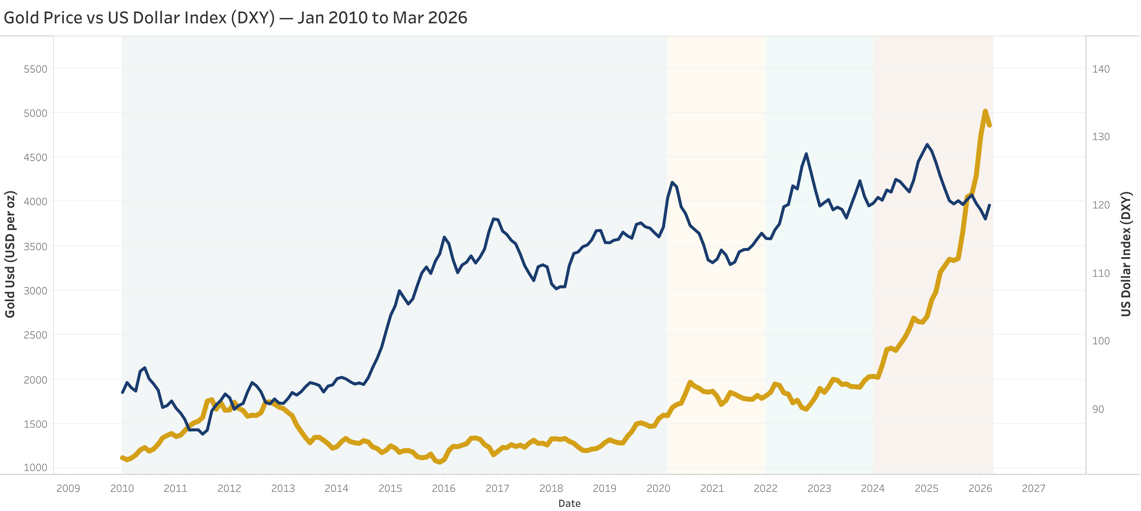
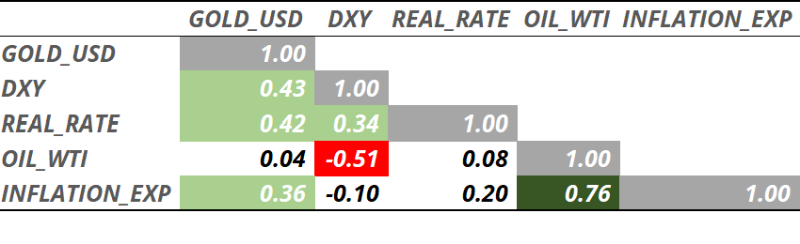
FINDING 1: GOLD AND THE DOLLAR BROKE THEIR HISTORIC RELATIONSHIP
THE DOLLAR PARADOX
The textbook says gold and the dollar move in opposite directions. Sixteen years of data says otherwise — the full-period correlation is +0.43. Here is why averaging four different eras into one number creates a misleading picture.
Chart 1: Gold Price vs US Dollar Index (DXY) — January 2010 to March 2026. Source: Author's analysis using Tableau Public.
Table 1: Pearson correlation matrix, n=195 monthly observations.
Source: Excel Data Analysis ToolPak|Master Sheet
Three things stand out: Gold vs Oil is nearly zero (+0.04) — oil does not move gold directly. Oil vs Inflation is the strongest pair in the matrix (+0.76) — oil moves gold only through the inflation channel. And both Gold vs DXY and Gold vs Real Rate are positive when theory predicts negative — a structural anomaly the era breakdown on the next slide explains in full.

Slide 5
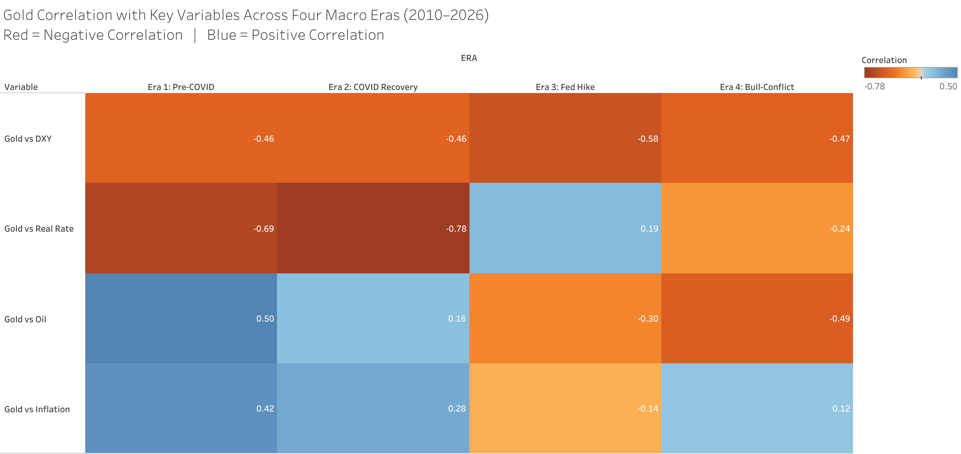
FINDING 2: WHY AGGREGATE NUMBERS LIE — THE FOUR ERAS
THE REGIME SHIFT
A single 16-year correlation number is an average of four structurally different worlds. Break it apart by macro regime, and the story changes completely — especially during the Fed's fastest hiking cycle in 40 years.
Chart 2: Gold Correlation Heatmap Across Four Macro Eras. Red = negative, Blue = positive. Source: Author's analysis using Tableau Public
ERA 1 — PRE-COVID (2010–2020): THE TEXTBOOK WORKS
Every relationship behaves as theory predicts. Gold vs DXY at −0.46 and Gold vs Real Rate at −0.69 confirm the standard macro playbook — when the dollar strengthens, or real yields rise, gold falls. This is gold's "normal" behaviour, the baseline against which everything else in this study is measured.
ERA 2 — COVID RECOVERY (2020–2021): THE RELATIONSHIP STRENGTHENS TO ITS LIMIT
Gold vs Real Rate reaches −0.78, the strongest reading anywhere in the dataset. Real rates collapsed to −1.19% as the Fed slashed rates to zero and launched unprecedented asset purchases. Gold responded exactly as theory predicts, surging to a then-record $1,968. This era is the purest confirmation of the traditional gold-rate relationship in the entire study.
ERA 3 — FED HIKE CYCLE (2022–2023): THE RELATIONSHIP BREAKS — ★ KEY FINDING
Gold vs Real Rate flips to +0.19. Real rates surged from negative territory to +1.5% as the Fed delivered 525 basis points of hikes — the fastest tightening cycle since the early 1980s. Standard theory says gold should have collapsed toward $1,200. It did not. China, India, Turkey, and Poland were buying gold at a record pace specifically because the freezing of Russian central bank reserves had demonstrated that dollar-denominated assets carry geopolitical risk. For the first time in the modern data series, structural institutional demand overwhelmed the interest rate signal entirely.
ERA 4 — BULL-CONFLICT (2024–2026): PARTIAL RECOVERY, NEW DECOUPLING
Gold vs Real Rate returns to negative territory at −0.24 but remains far weaker than the pre-2022 norm — confirming the relationship never fully recovered. Meanwhile, Gold vs Oil turns sharply negative at −0.49, the first time in the study these two assets moved in clearly opposite directions. When the Iran conflict pushed oil higher, gold fell — not because the relationship is direct, but because oil-driven inflation fear kept the Fed hawkish and the dollar strong.
What this era breakdown proves: gold's relationship with macro variables is not fixed — it is regime-dependent. Central bank structural demand, which barely existed as a market force before 2022, is now powerful enough to override the interest rate signal that drove gold for decades. Any forecast that ignores this structural shift will misread gold's behaviour going forward.

Slide 6
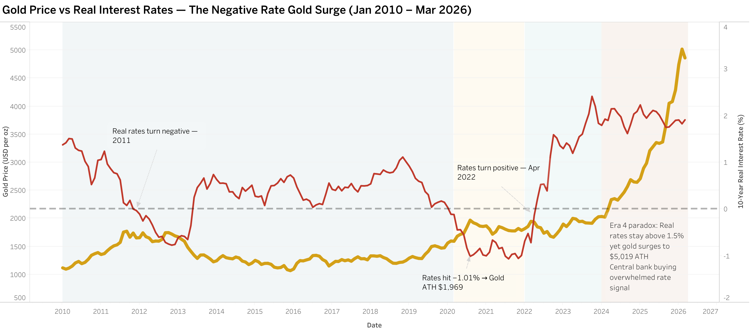
FINDING 3: REAL RATES WERE GOLD'S MASTER — UNTIL THEY WEREN’T
THE NEGATIVE RATE SURGE AND ITS LIMITS
Real interest rates measure the true cost of holding gold — an asset that pays no yield. For most of the last sixteen years, this single number explained more of gold's movement than anything else. Then in 2022, something changed.
Chart 3: Gold Price vs 10-Year Real Interest Rate — January 2010 to March 2026. Dashed line marks zero. Source: Author's analysis using Tableau Public.
WHY REAL RATES MATTER TO GOLD
Gold pays no interest, dividends, or coupons. Holding it means giving up the return available elsewhere — government bonds, savings accounts, money market funds. When real interest rates are positive, that opportunity cost is real, and gold becomes less attractive relative to yield-bearing alternatives. When real rates turn negative — meaning bonds pay less than inflation erodes — the calculation reverses. Holding cash or bonds guarantees a loss in real terms. Gold, which cannot be debased, becomes the more rational choice. This is why the zero line on the chart above is the most important reference point in the entire analysis.
PHASE ONE: THE NEGATIVE RATE ERA (AUGUST 2011 – APRIL 2022)
Real rates spent nearly eleven years below zero, troughing at −1.19% during the pandemic response. This sustained negative rate environment is the single longest period of "free money" relative to inflation in modern Federal Reserve history, and it coincides almost exactly with gold's structural rise from roughly $1,600 to its first all-time high above $2,000.
PHASE TWO: THE RECKONING (APRIL 2022 – DECEMBER 2023)
Real rates crossed back above zero for the first time in over a decade as the Fed delivered the fastest hiking cycle since the Volcker era. Real rates ultimately reached +1.94% — the highest level in this entire dataset. By every historical precedent, gold should have entered a multi-year bear market.
PHASE THREE: THE PARADOX (2024 – MARCH 2026)
Real rates remained elevated, never returning to negative territory. Yet gold did not fall — it surged to an all-time high of $5,019. This is the central puzzle this report set out to explain. The answer lies outside the rate mechanism entirely: structural central bank buying, accelerated by geopolitical de-dollarisation, created a demand floor that the traditional rate-driven model cannot capture.
The chart's right-hand section is the visual proof of this report's central thesis. Real rates stayed near two-decade highs throughout 2024–2026, yet gold rose anyway. A model built purely on interest rates would have missed the largest gold rally in this dataset.

Slide 7
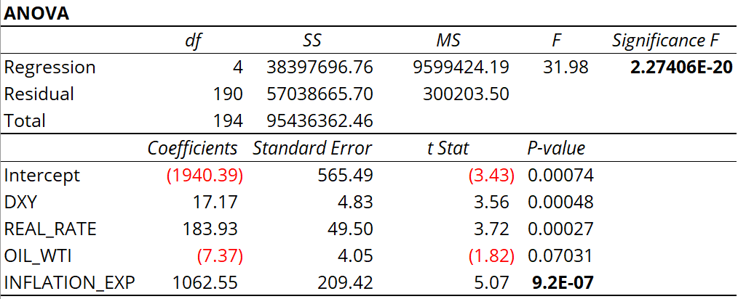
FINDING 4: WHAT ACTUALLY PREDICTS GOLD — THE REGRESSION EVIDENCE
INFLATION EXPECTATIONS DOMINATE — OIL DOES NOT MATTER
Correlation shows that two variables move together. Regression asks a sharper question: holding everything else constant, how much does each variable independently move the price of gold? The answer reshapes the entire narrative around the Iran conflict.
R² = 0.40 | Adjusted R² = 0.39 | F-Statistic = 31.98 | Significance F = 2.27 × 10⁻²⁰
Gold = −1,940.39 + 17.17(DXY) + 183.93(Real Rate) − 7.37(Oil WTI) + 1,062.55(Inflation Exp)
KEY FINDINGS:
INFLATION_EXP is the dominant predictor (coeff +1063, p<0.001)
OIL_WTI is NOT statistically significant (p=0.07) — oil drives gold only through the inflation expectations channel, not directly
Positive DXY and REAL_RATE coefficients confirm structural break — traditional inverse relationships reversed over 2022–2026
R²=0.40: 60% of gold movement driven by non-macro factors (central bank buying, ETF flows, de-dollarisation demand)
READING THE ANOVA TEST THROUGH A REAL EVENT
Consider August 2011, the month gold rose 11.6 per cent in a single move — the largest in this entire dataset. A naive forecaster with no model would have predicted the month’s gold price based solely on the historical average and would have been wrong by a wide margin. The ANOVA test essentially asks: across all 195 months, does a model built on DXY, real rates, oil, and inflation expectations predict gold more meaningfully than a naive average would? The answer, captured in the Regression Sum of Squares of 38.4 million against a Residual of 57 million, is yes — but not completely. The model explains roughly 40 per cent of the variation across the full period, leaving 60 per cent to forces it does not capture, among them the debt ceiling panic that drove August 2011's spike and the central bank buying that drove 2022 through 2026. The F-statistic of 31.98, with a Significance F of 2.27 times 10 to the negative 20, confirms that this 40 per cent is not a statistical accident — it would be virtually impossible to observe this level of explanatory power if the four variables had no real relationship with gold. The ANOVA test, in other words, does not tell us the model captures everything that moves gold. It tells us, with near certainty, that what it does capture is real.

Slide 8
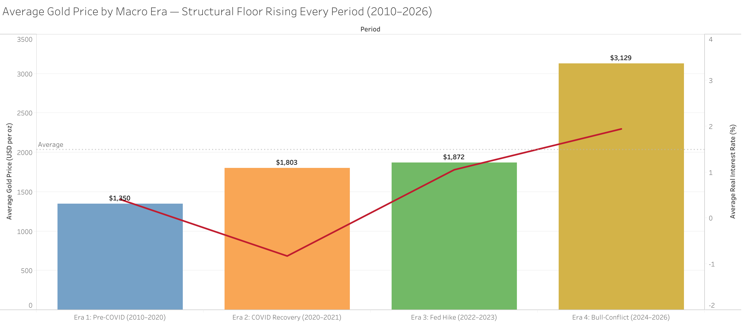
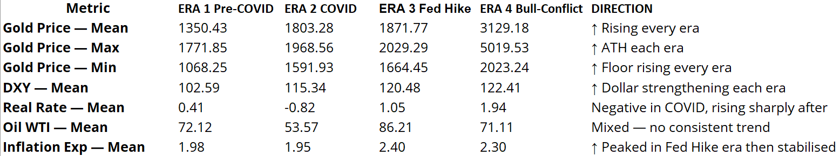
FINDING 5: GOLD'S STRUCTURAL FLOOR — RISING EVERY SINGLE ERA
THE COMPLETE MACRO PICTURE, 2010 TO 2026
Individual correlations tell you how variables move together. This slide steps back to show the complete transformation — how gold's average price, its floor, its ceiling, and every variable around it evolved across sixteen years and four distinct regimes.
THE FLOOR THAT NEVER FELL BACK
The most quietly important number in this entire study is the minimum gold price by era. It rose without exception — from $1,068 in Era 1, to $1,592 in Era 2, to $1,664 in Era 3, to $2,023 in Era 4. This means every single correction across sixteen years found buyers at a higher floor than the previous cycle's low point. Even at the worst moment of the 2026 Iran conflict crash, gold never traded below $2,023 — a level that would have represented an all-time high as recently as 2020. This is not noise. It is the signature of structural, price-insensitive demand — chiefly central bank accumulation — that did not exist in this market before 2020 and shows no sign of disappearing.
A SECOND ANOMALY: THE DOLLAR ROSE TOO
DXY's mean rose from 102.59 in Era 1 to 122.41 in Era 4 — the dollar index gained nearly 20 points across the study period. Under the textbook model, this alone should have suppressed gold significantly. Instead gold's mean rose 132 percent over the same span. Both the world's reserve currency and the asset meant to hedge against it strengthened together — direct evidence, drawn from averages rather than correlations, that the relationship this report set out to investigate has fundamentally changed.
This table is the data's own summary of the report: gold's price floor rose every era, the dollar strengthened rather than weakened, real rates swung from negative to the highest level in the dataset — and gold still rose 132 percent. No single variable explains this. Structural demand does.

Slide 9
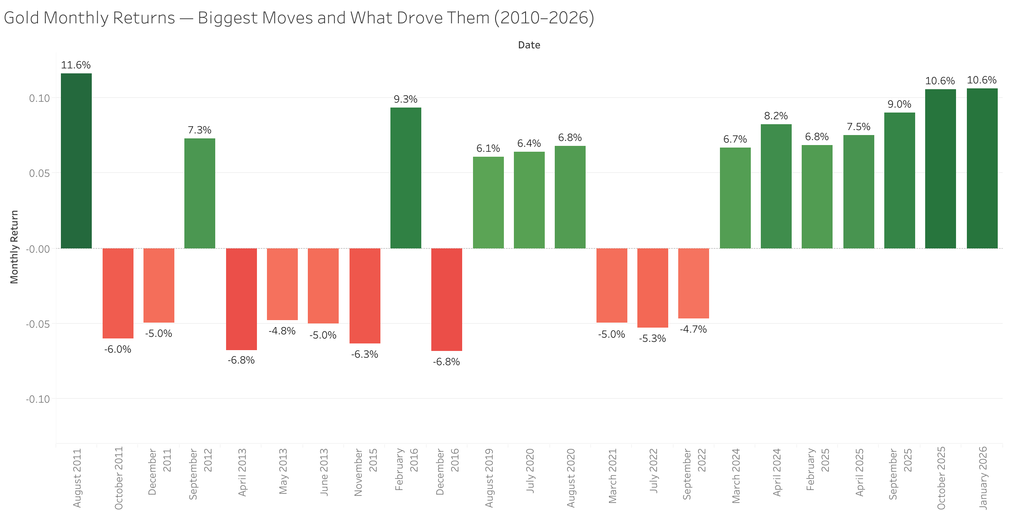
FINDING 6: WHAT ACTUALLY MOVES GOLD — THE BIGGEST MONTHLY MOVES
FISCAL CREDIBILITY MATTERS MORE THAN WAR
The largest single monthly move in sixteen years of gold data was not triggered by a war, a pandemic, or an oil shock. It was triggered by the United States nearly defaulting on its own debt. That single fact reframes everything about how gold responds to geopolitical events.
WHAT THE BIGGEST MOVES TELL US
Six of the ten largest positive monthly moves occurred in Era 4 (2024–2026), confirming that gold became structurally more active as de-dollarisation and geopolitical tension intensified. But the single largest move — August 2011 at +11.6 per cent — predates all of it. Standard and Poor's downgraded US sovereign debt, Congress came within days of default, and gold responded with the kind of move normally associated with an existential crisis. The lesson is precise: gold does not react to conflict alone. It reacts to threats against the monetary architecture that conflict exposes. The Iran war created uncertainty. The uncertainty raised the spectre of sustained inflation, Fed inaction, and dollar weakness. When those fears crystallised in January 2026, gold rose 10.6 per cent. When the Fed's response made clear those fears were being contained, gold fell. The conflict did not change. The monetary policy signal did.
This chart is the report's final exhibit. It shows that gold's largest moves are not random responses to headlines — they follow a consistent logic: threats to dollar credibility and monetary stability move gold more than any geopolitical event alone. The Iran conflict of 2026 is not an exception to this rule. It is its most recent confirmation.

Slide 10
CONCLUSION: ANSWERING THE ORIGINAL QUESTION
THREE STRUCTURAL SHIFTS AND WHAT THEY MEAN FOR GOLD IN 2026
In February 2026, gold hit an all-time high of $5,019. Six weeks later, with the Iran-Israel-USA conflict intensifying, it had fallen 22 percent. This report set out to answer one question: why does gold fall during geopolitical crisis? The data provides a precise answer — and it is not the one conventional wisdom offers.
STRUCTURAL SHIFT 1
STRUCTURAL SHIFT 2
STRUCTURAL SHIFT 3
Central Bank Buying Changed Gold's Floor Permanently
Before 2020, central bank demand was a marginal force. After Russia's reserves were frozen in 2022, it became the dominant structural driver. China, India, Turkey, and Poland have bought gold consistently regardless of price, rate, or dollar strength. This created a price floor that rose every single era in this study — and which no traditional macro model predicted or can fully explain.
Inflation Expectations Replaced Real Rates as Gold's Primary Lever
For decades, real interest rates were gold's master variable. This study's regression confirms that the relationship has been displaced- inflation expectations now carry a coefficient of $1,063 per percentage point, nearly six times larger than the real rate coefficient. Gold today is primarily an inflation hedge, not a rate-sensitivity trade. The Iranian oil shock raised inflation expectations, which should have lifted gold, but the Fed's hawkish response capped those expectations and strengthened the dollar instead.
Oil and Gold Have Decoupled — The Iran Conflict Proves It
Oil and gold carried a positive correlation of +0.50 in Era 1. By Era 4 that correlation had flipped to −0.49. The Iran conflict oil shock hurt gold — not directly, but through the chain reaction it triggered: oil drove inflation fears, which kept the Fed hawkish, which kept rates high, which kept the dollar strong, which suppressed gold. Understanding this transmission mechanism is the difference between reading the conflict correctly and misreading it entirely.
THE DATA'S VERDICT
Gold did not fall because the conflict was irrelevant to markets. Gold rose 10.6 percent in January 2026 precisely because of the conflict. It then fell because the oil shock that conflict triggered activated a chain reaction — through inflation expectations, Federal Reserve hawkishness, and dollar strength — that overwhelmed the initial safe-haven bid. The conflict is simultaneously gold's biggest supporter and its biggest headwind in 2026. Which force dominates in the second half of 2026 depends on one question: does the Fed pivot before the structural central bank bid exhausts itself at lower prices?
OUTLOOK: Goldman Sachs target $4,900 by Q4 2026. JP Morgan target $5,000. Both forecasts rest on Fed rate cuts reducing real yields and dollar pressure. Upside risk: faster-than-expected pivot. Downside risk: Iran conflict resolution reducing safe-haven demand before CB buying reasserts at lower prices.
This report is independently produced by Satya Narayan Sahoo as an original statistical analysis. All data sourced from publicly available databases. Statistical analysis conducted in Microsoft Excel with Data Analysis ToolPak. Visualisations built in Tableau Public. This report does not constitute investment advice.

