Slide 1
Git

Slide 2


Slide 3
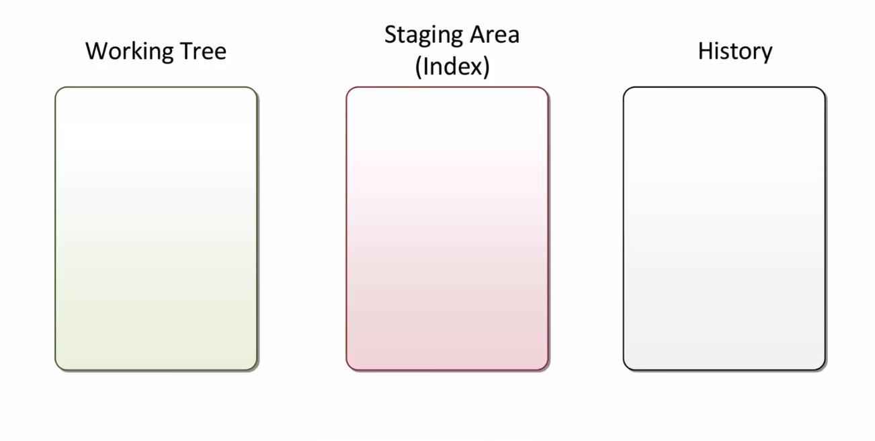

Slide 4
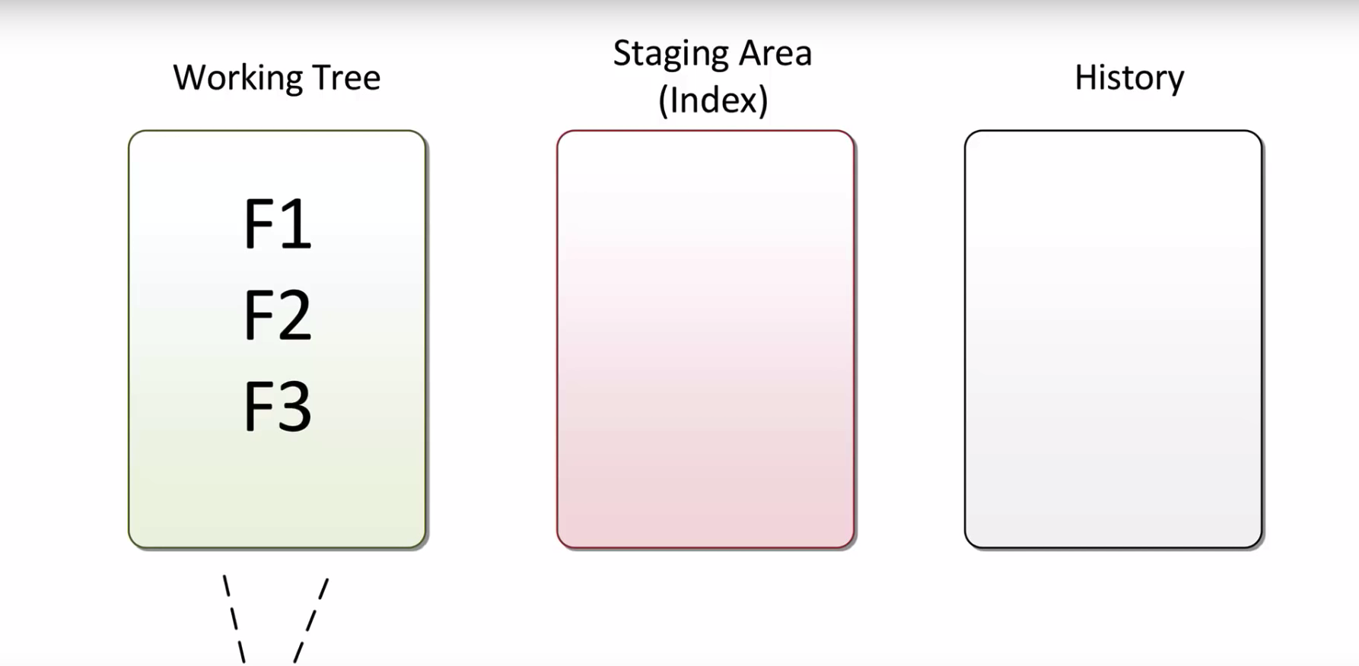

Slide 5
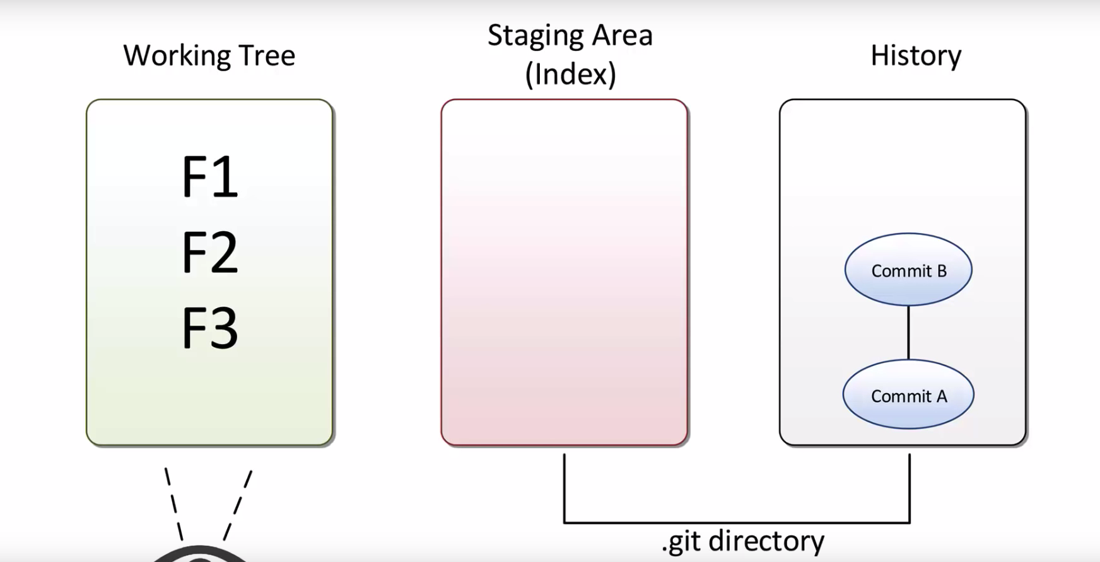

Slide 6
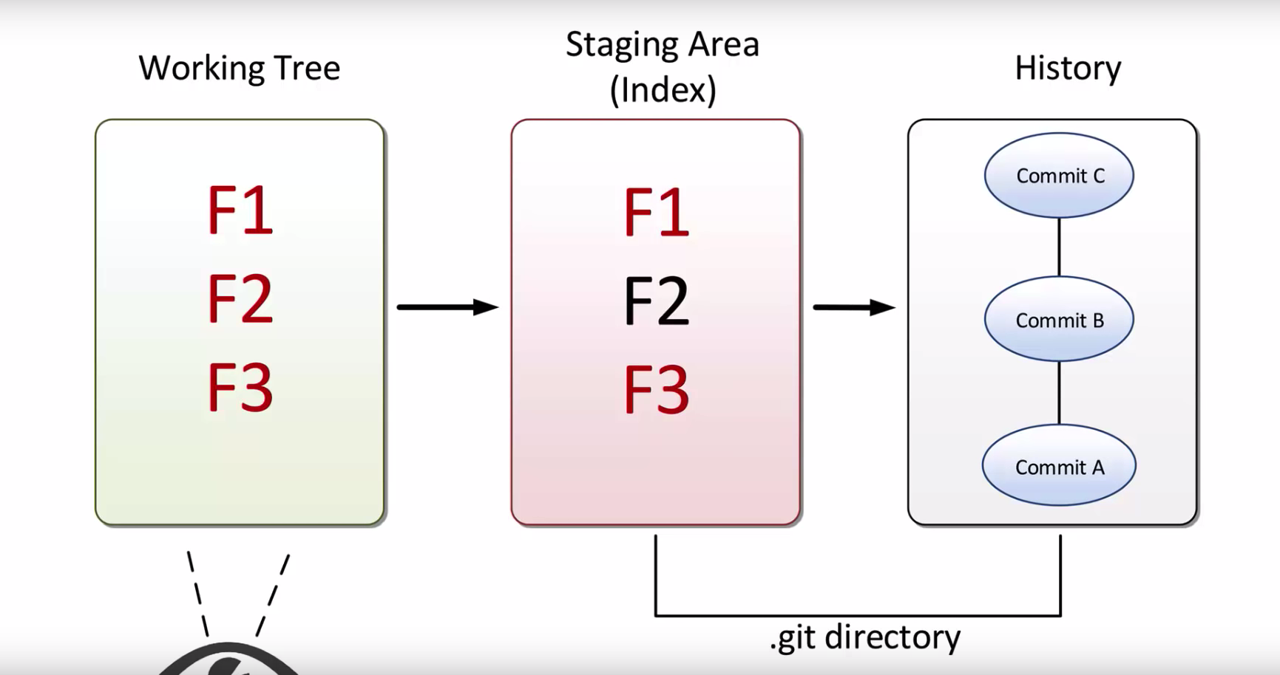

Slide 7
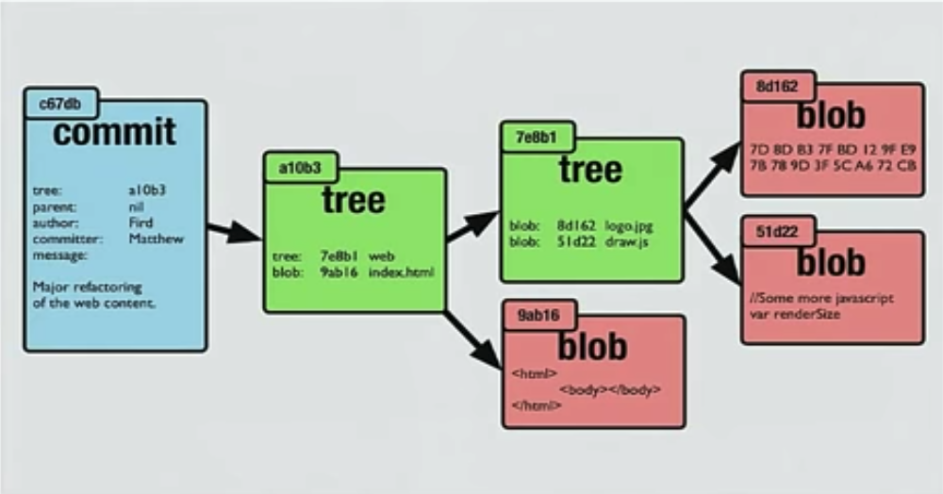

Slide 8
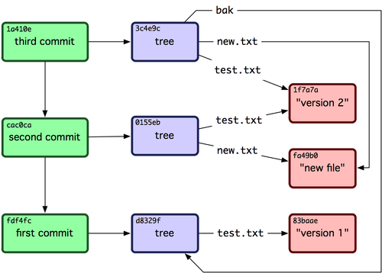

Slide 9
Contents of .git:
Sub-directories:
Hooks/
Info/ - for .gitignore
Objects/ -- all objects
Refes/ -- pointers to the commited objects
Files:
HEAD – current branch
Config – config options
Description
Index – index/staging area

Slide 10
Merging

Slide 11


Slide 12
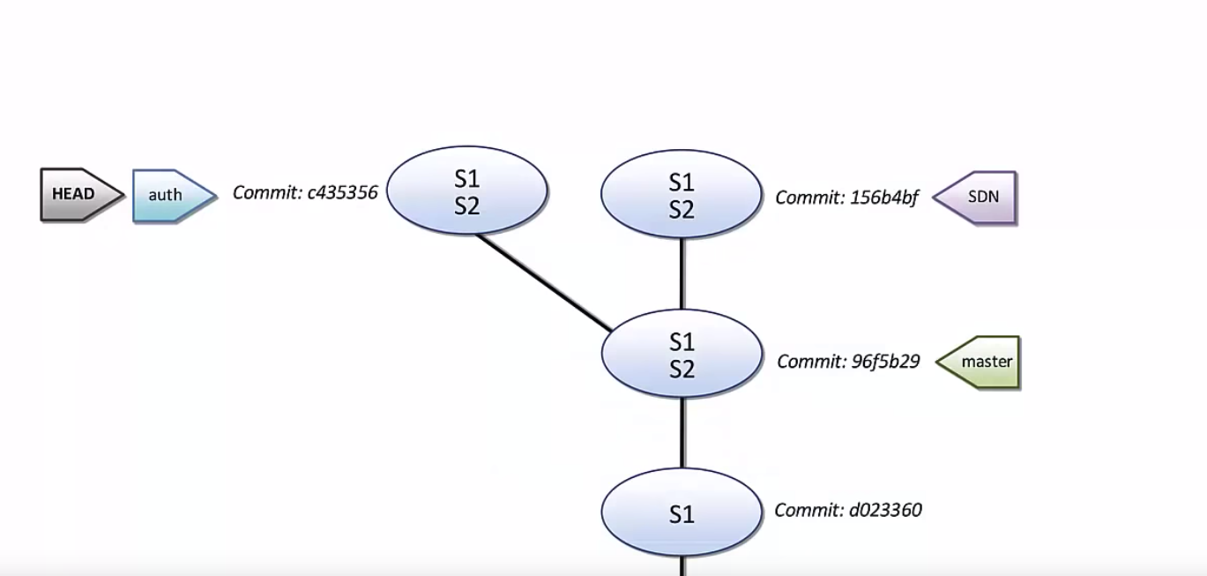

Slide 13
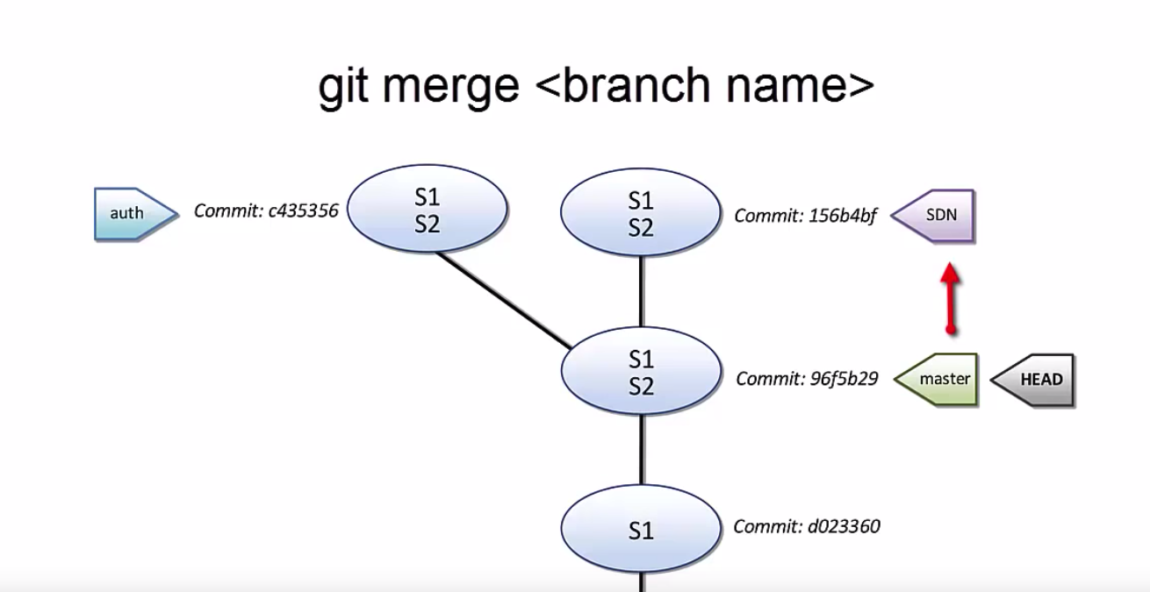

Slide 14
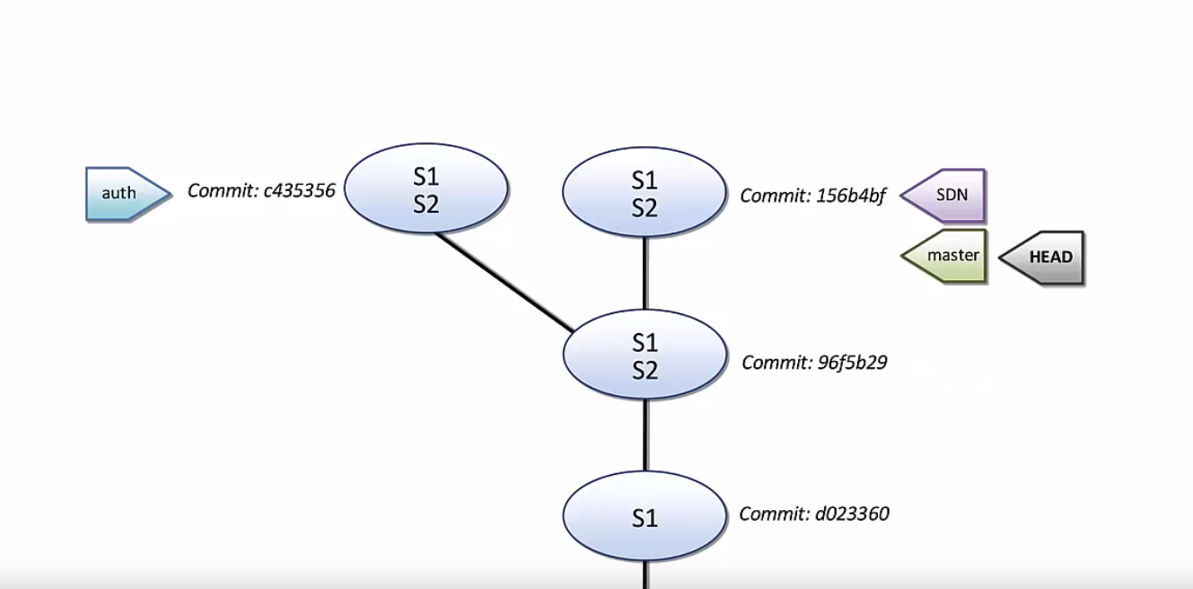

Slide 15


Slide 16
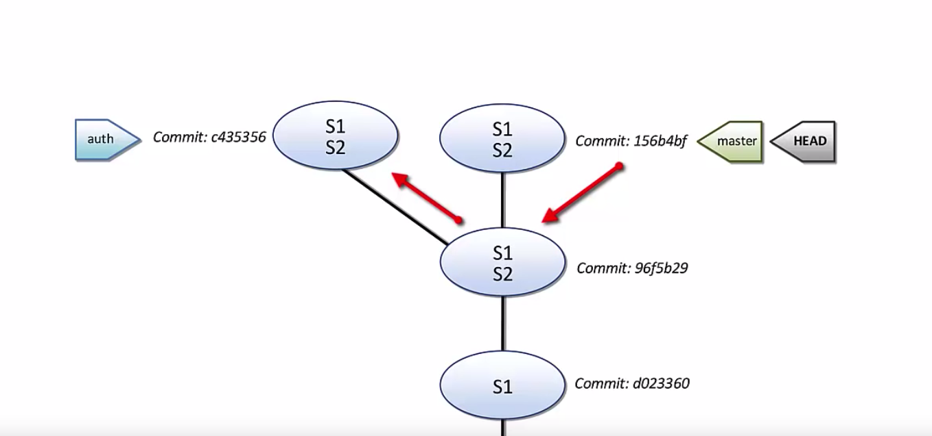

Slide 17
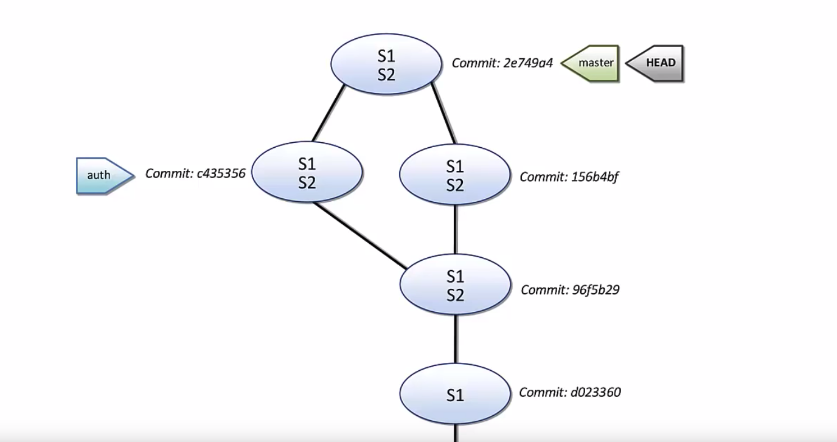

Slide 18
https://git-scm.com/book/en/v2/Git-Internals-Plumbing-and-Porcelain

