Slide 1




TICTACTOE
LET'S PLAY

Slide 2
ACKNOWLEDGEMENT
I extent my gratitude to the developers of Programming tools and libraries used in creating in Tic-Tac-Toe Game. Special Thanks to our trainer Mr. Chirandeep Bhattacharjee for their valuable feedback, appreciation goes to my Team Members for their support throughout the development process.

Slide 3
INTRODUCTION
Classic Game, Timeless Appeal:
Tic Tac Toe, also known as Noughts and Crosses
It is a timeless classic that has entertained generations across the globe.
Developed: (1300 BC)
Developed on a roofing tile in the Template of Seti I in Egypt.
Structure of Game:
3 x 3 Grid

Slide 4
RULES OF GAME
Tic Tac Toe is played on 3 x 3 Grid.
One player is assigned X and other player O.
The player with X goes first, placing in any empty cell.
If all cells are filled and no player has achieved a row of three, hence match draw
The game typically played until there is a winner or match draw (horizontally, vertically, diagonally)

Slide 5





DRAG THE XS AND OS TO THE SPACE OF YOUR CHOICE.
USER
COMPUTER
SINGLE PLAYER MODE

Slide 6



TICTACTOE CHAMPION
COMPUTER WON THE GAME

Slide 7

DRAG THE XS AND OS TO THE SPACE OF YOUR CHOICE.
USER 1
USER 2
MULTI PLAYER MODE

Slide 8
TICTACTOE CHAMPION
USER 1 WON THE GAME

Slide 9
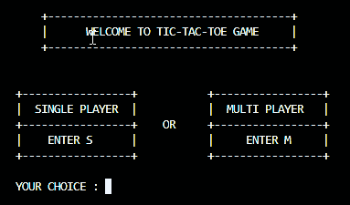
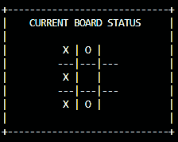
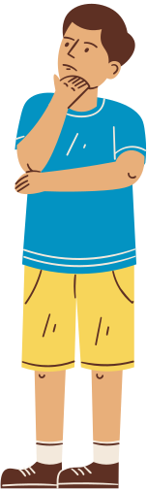
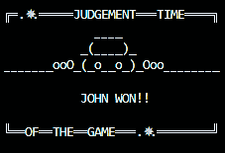
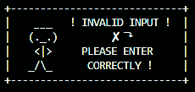
SCREENSHOTS

Slide 10
CONCLUSION
Creating this Tic-Tac-Toe Game has been a rewarding journey. Its not only horned by Programming skills but also taught me valuable lessons in user experience and feedback in corporation. As the games comes to fruition, i look forward to further improvements and hope that players find joy and entertainment in this simple yet classic experience.

Slide 11
THANK YOU FOR PLAYING!

