Slide 1

Learnathon
Name: Id no:
Sree prad 2200040153
P manjunaath 2200040173
Satyaprakash 2200040186

Slide 2
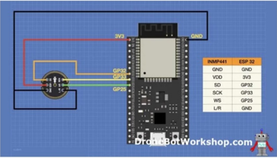
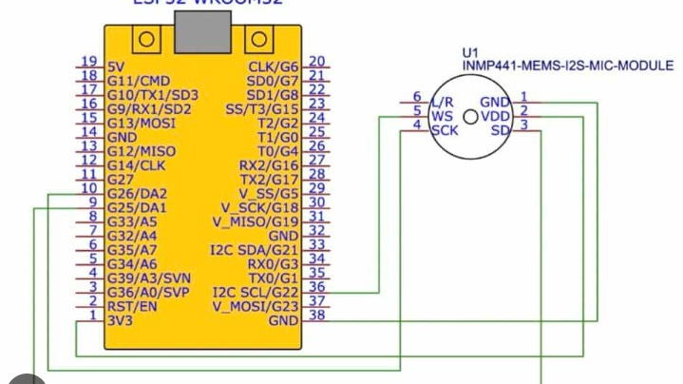
Task 1: interrupt based audio input from I2S microphone
Introduction:
interrupt-based audio input from I2S microphones is a cutting-edge technology revolutionizing real-time audio capture. By utilizing hardware interrupts, this method ensures efficient, low-latency processing, making it ideal for applications like voice recognition and audio streaming. Let's explore its benefits and implementation details.
Aim:
To explore the advantages and implementation intricacies of interrupt-based audio input from I2S microphones for real-time, low-latency audio processing.
Components required:
ESP 32
I2C Microphone
Bread Board
Jumper wires

Slide 3
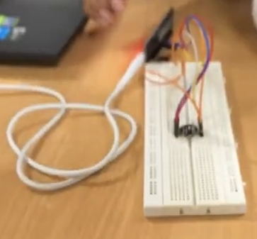
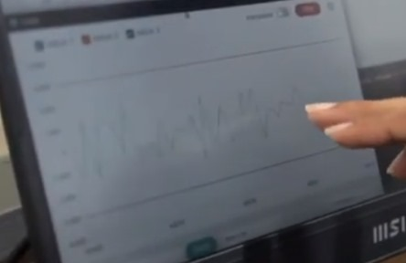
Benefits of this project:
Achieved through interrupt-driven input from I2S microphones.
Enables immediate processing of audio data, crucial for time-sensitive applications.
Utilizes hardware interrupts for optimized performance and minimal overhead.
Provides timely response for accurate recognition of spoken commands.
Enables rapid detection and processing of environmental sounds.
Facilitates smooth and uninterrupted audio streaming experiences.
Requires careful handling of interrupt routines and buffer management for seamless operation.
Conclusion:
In summary, interrupt-based audio input from I2S microphones revolutionizes real-time audio processing with minimal latency. Its efficient use of hardware interrupts ensures immediate response, making it ideal for applications like voice recognition and acoustic event detection. With careful implementation, this technology promises seamless audio streaming experiences and holds potential for further advancements in audio processing systems.

Slide 4
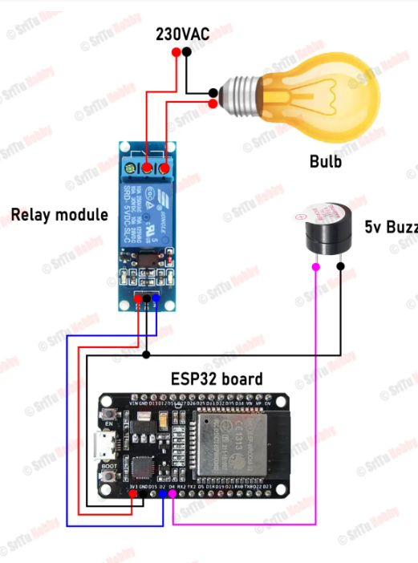
Task 2: Bluetooth Based Home Automation
Introduction: Bluetooth-based home automation is revolutionizing the way we interact with our living spaces. Leveraging the widespread adoption of Bluetooth technology, this innovation empowers users to seamlessly control and monitor household devices from their smartphones or tablets. From adjusting lighting and temperature to enhancing security, Bluetooth-based home automation offers unparalleled convenience and customization. Let's explore its advantages and implications for modern living.
Aim: This exploration aims to uncover the advantages and functionalities of Bluetooth-based home automation, highlighting its potential to enhance convenience, efficiency, and connectivity within modern homes.
Components required:
ESP32
Relay
Buzzer
Led
Jumper wires
Bread board
Sritu hobby app

Slide 5
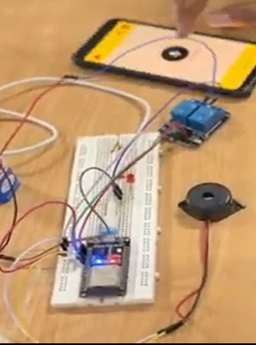
Benefits of this project:
Enables effortless communication between devices without complex wiring.
Remote management of appliances via smartphones or tablets for flexibility.
Supports a wide range of smart devices for integration, including appliances, lighting, and security systems.
Optimizes energy usage through remote monitoring and control, reducing utility bills.
Affordable Bluetooth-enabled devices make home automation accessible.
Simple pairing processes minimize setup time and effort.
Customized automation routines and schedules enhance user experience.
Encrypted Bluetooth connections ensure data protection.
Integration with other smart home platforms expands functionality.
Easily expandable setup with the addition of new devices over time.
Conclusion:
In summary, Bluetooth-based home automation offers a convenient, versatile, and cost-effective solution for modern living. Its seamless connectivity, easy installation, and scalability make it accessible to a wide range of users. With the ability to optimize energy usage, enhance security, and personalize routines, Bluetooth automation systems are poised to revolutionize the way we interact with our homes, providing greater comfort and convenience for users everywhere.

Slide 6
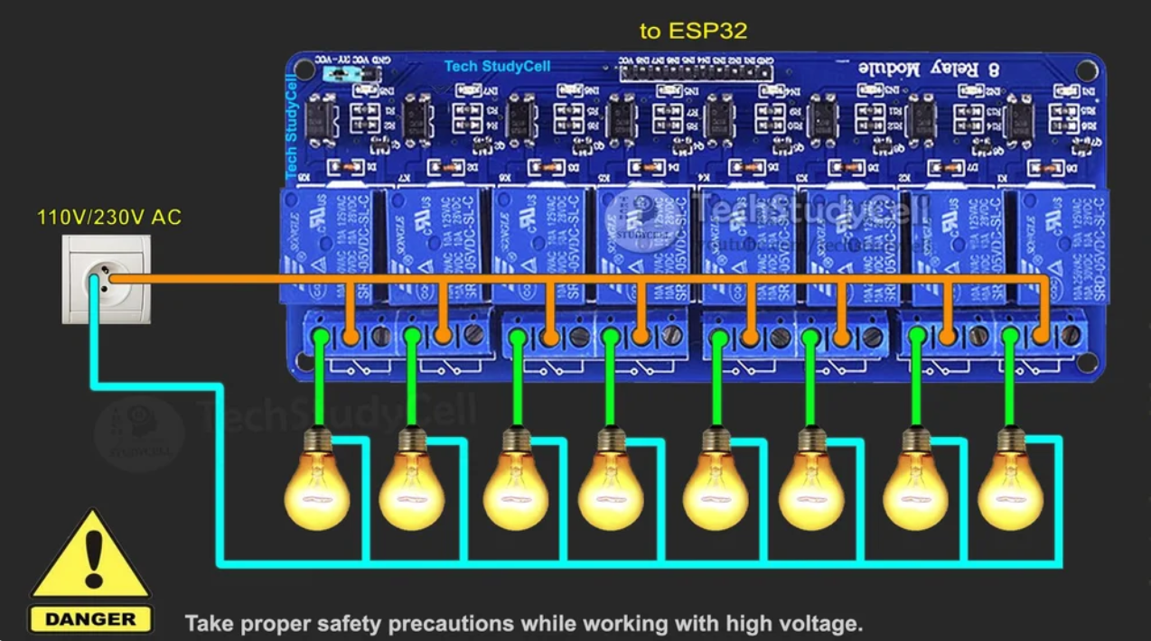
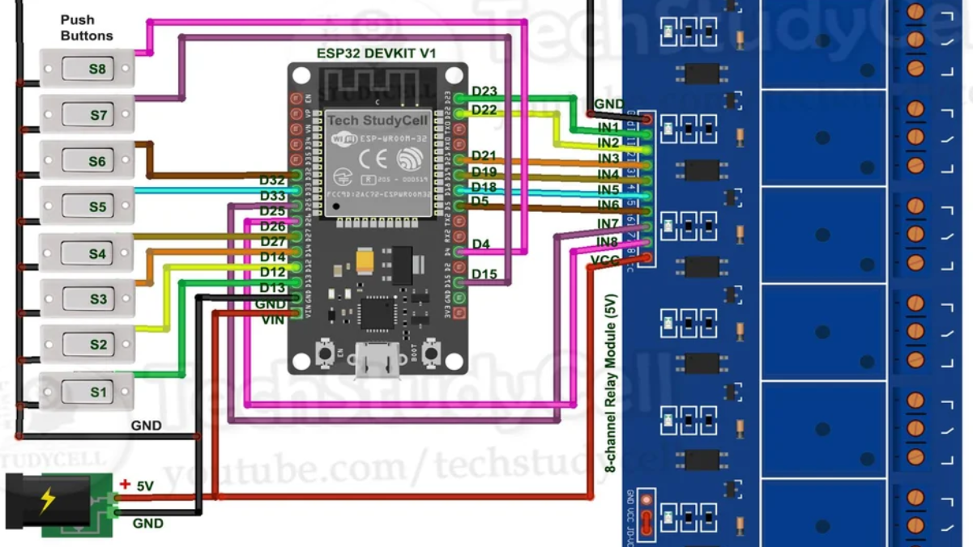
Task 3: WIFI Based Home Automation
Introduction: In the realm of modern living, home automation has emerged as a game-changer, reshaping how we interact with our spaces. WiFi-based home automation, utilizing ubiquitous networks, offers unparalleled convenience, flexibility, and efficiency. From remote device control to energy management, it heralds a new era of interconnected living. Let's explore its benefits and functionalities.
Aim: This exploration aims to unravel the benefits and functionalities of WiFi-based home automation, highlighting its potential to enhance convenience, efficiency, and connectivity in modern living environments.
Components required:
ESP32
9W Battery
Led’s
Relay’s
Bread board
Connecting wires
Blynk app

Slide 7
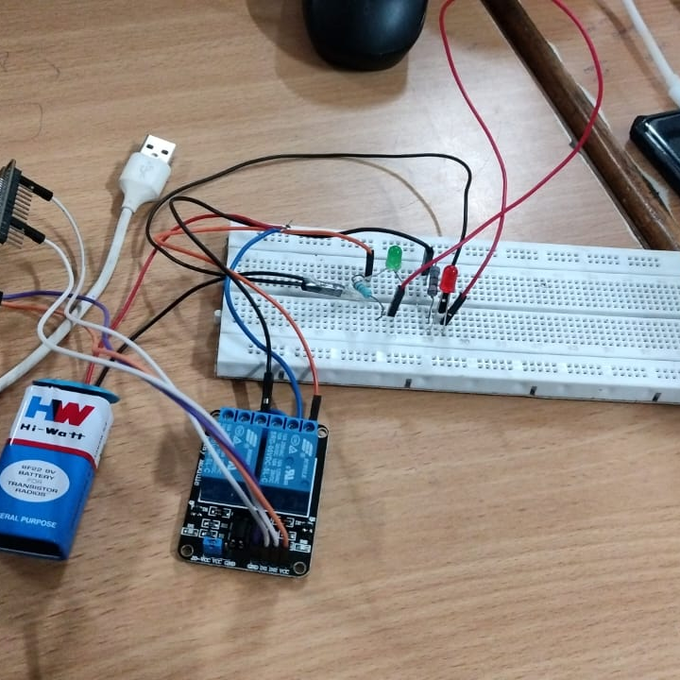
Benefits of this project:
Control devices remotely via smartphone.
Integrate various smart devices easily.
Expand system with minimal infrastructure changes.
Simple setup process through mobile apps.
Compatible with popular smart home platforms.
Monitor and control from anywhere with internet.
Personalize schedules and automation routines.
Optimize energy usage, reduce bills.
Employ encryption, authentication for data protection.
Affordable setup, especially for DIY enthusiasts.
Conclusion:
In summary, WiFi - based home automation offers unparalleled convenience, flexibility, and efficiency in modern living. Its seamless integration of devices enhances daily tasks, optimizes energy usage, and boosts security. As technology advances, embracing this transformative solution promises smarter, more connected homes for the future.

Slide 8
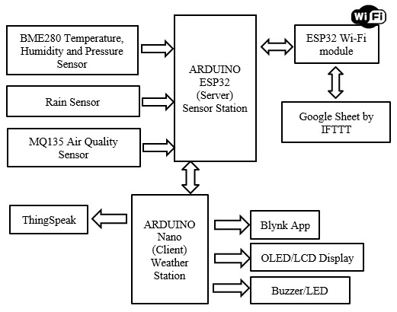
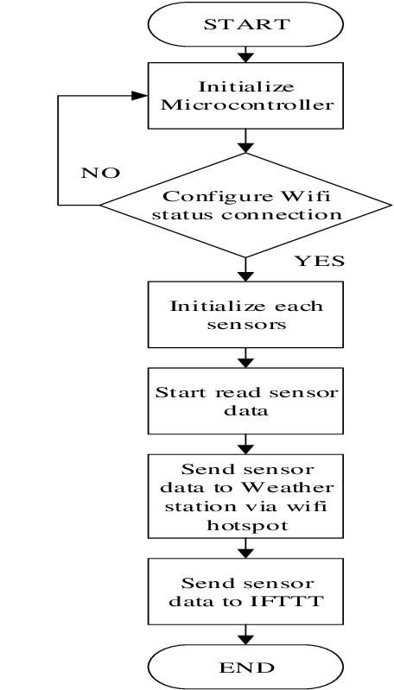
Task 4: Agricultural Monitoring Through Thingspeak
Introduction:
Agricultural monitoring through ThingSpeak revolutionizes farming practices by integrating IoT technology. Developed by MathWorks, ThingSpeak enables real-time data collection and analysis from sensors deployed in fields. This facilitates informed decision-making for farmers regarding soil conditions, environmental variables, and resource allocation. Let's delve into the transformative impact and applications of this innovative platform in modern agriculture.
Aim:
To explore the transformative impact, benefits, and applications of agricultural monitoring through ThingSpeak, emphasizing its role in modernizing farming practices and optimizing resource management.

Slide 9
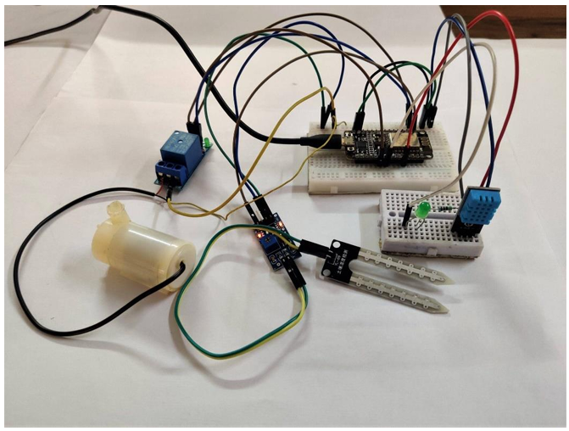
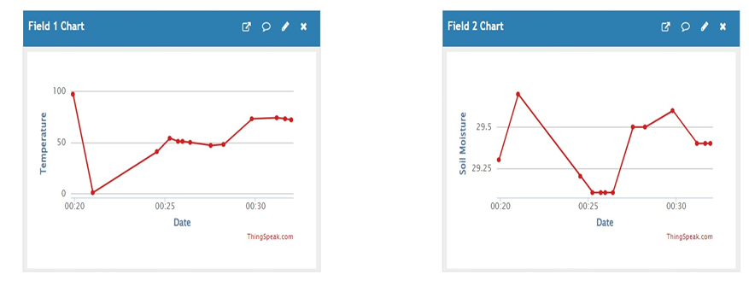
Components required:
ESP32
Bread Board
Jumper wires
Soli moisture sensor
DHT11 sensor
I2c module
Benefits of this project:
ThingSpeak revolutionizes farming by integrating IoT technology.
Enables continuous data collection from field sensors.
Provides actionable insights for optimizing resource allocation.
Facilitates targeted interventions to maximize crop yield and quality.
Helps conserve water, energy, and minimize chemical usage.
Allows for remote monitoring and management of field conditions.
Adaptable to farms of all sizes for widespread adoption.
Enables farmers to share insights and learn from each other.
Promotes environmentally-friendly farming practices.
Holds promise for further advancements in agricultural technology.
Conclusion:
In brief, ThingSpeak revolutionizes farming through IoT integration, enabling real-time monitoring, informed decision-making, and resource optimization. With its scalable and collaborative features, ThingSpeak holds promise for advancing productivity and sustainability in agriculture.

