Slide 1

Draft Overview of the Design:
Patient Onboarding System
A comprehensive guide to designing, developing, and implementing a multi-channel patient check-in and queue management system using OutSystems Developer Cloud platform

Slide 2

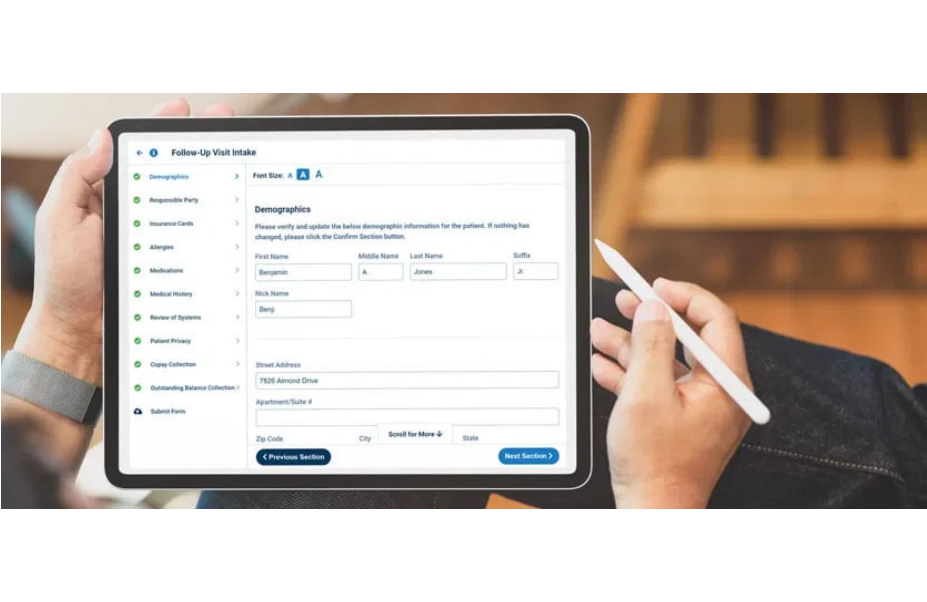



Application Overview
System Information
Application Name:
PatientOnboardingSystem
Type:
Reactive Web Application + Mobile App
Platform:
To be defined by the Sponsor
Target Audience:
Small to Medium Clinics
Purpose
Multi-channel patient check-in and queue management system designed to streamline clinic operations, reduce wait times, and enhance patient experience through digital transformation.
User Roles
Patients
Front Desk Staff
Doctors
Administrators

Slide 3














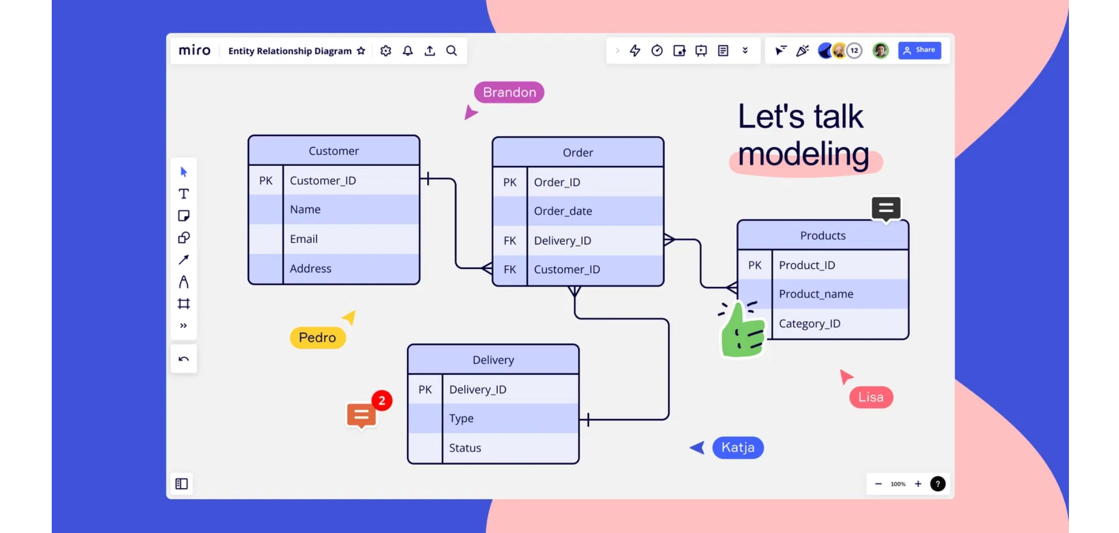
Data Model Architecture
Core Entities
Key Relationships
Visit
Patient
1:N
Patient
Visit
QueueTicket
Demographics & contact information
Check-in sessions tracking
Queue position & status
QueueTicket
Visit
1:1
Visit
Department
N:1
Department
Doctor
CheckInLog
Visit
Doctor
N:1
Clinic departments
Medical staff records
Audit trail logging
RFIDCard
Patient
N:1
SMSNotification
RFIDCard
QRCode
SMS messaging
RFID card management
QR code generation

Slide 4




Core Entities: Patient, Visit & Queue
Patient
Visit
QueueTicket
Stores patient demographics and contact information with unique identification
Tracks patient check-in sessions and visit details for each clinic appointment
Manages queue positions and status transitions for patient flow control
Attribute
Type
Status
Attribute
Type
Status
Attribute
Type
Status
PatientId
Identifier
PK
VisitId
Identifier
PK
QueueTicketId
Identifier
PK
PatientNumber
Text(20)
Unique
PatientId
Identifier
FK
VisitId
Identifier
FK
FullName
Text(200)
Required
VisitNumber
Text(20)
Auto-gen
TicketNumber
Text(20)
Unique
PhoneNumber
Phone(20)
Required
CheckInDateTime
DateTime
Required
QueueStatus
Text(20)
Required
DateOfBirth
Date
Required
DepartmentId
Identifier
Optional
QueuePosition
Integer
Auto
Email
Email(100)
Optional
DoctorId
Identifier
Optional
EstimatedWaitTime
Integer
Calculated
IsActive
Boolean
Default: True
VisitStatus
Text(20)
Default: Active
CalledOn
DateTime
Optional

Slide 5





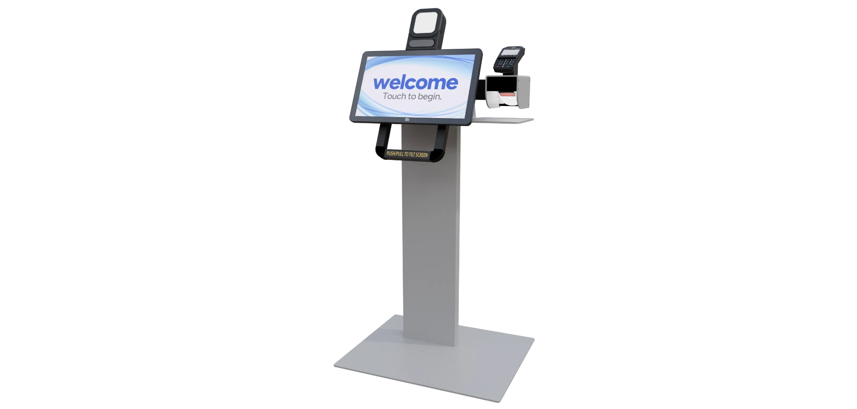


Supporting Entities & Multi-Channel Support
Supporting Entities
Check-In Methods
Department
SMS
Text message-based check-in for remote patients
Manages clinic departments with codes, names, and average service times
QR Code
Scan QR codes via mobile app or posters
Doctor
RFID
Stores doctor information, specialization, and availability status
Tap RFID card at kiosk for instant check-in
CheckInLog
Web
Browser-based check-in form on clinic website
Comprehensive audit trail of all check-in activities and methods
Mobile
Native mobile app for on-the-go check-in
SMSNotification
Tracks SMS messages sent to patients with delivery status
RFIDCard
Links RFID cards to patients for contactless check-in
QRCode
Generates and manages QR codes for quick mobile check-in

Slide 6

Server Actions: Business Logic Layer
1
CheckInPatient
2
GetQueueList
Universal check-in endpoint for all methods (SMS, QR, RFID, Web, Mobile). Validates patient, creates visit, generates ticket, and triggers notifications.
Retrieves current queue for dashboards with filters by department, doctor, and status. Returns patient details and wait times.
3
UpdateQueueStatus
4
CalculateETA
Updates ticket status through workflow (WAITING → CALLED → IN_PROGRESS → COMPLETED). Validates transitions and recalculates queue positions.
Calculates estimated wait time based on queue position, tickets ahead, and average service time per department.
5
GenerateTicketNumber
6
SendSMSNotification
Generates unique sequential ticket numbers with department code prefix (e.g., "FD-101"). Ensures uniqueness with retry logic.
Sends SMS to patients via external API (Twilio). Supports multiple message types: check-in confirmation, status updates, and call notifications.
7
ValidateRFIDCard
8
ValidateQRCode
Validates RFID card number, retrieves linked patient, updates last used timestamp, and returns patient details for check-in.
Validates QR code value, checks expiration for dynamic codes, increments usage count, and returns department information.
9
GetDashboardStats
10
GetPatientHistory
Retrieves real-time statistics for dashboards: total waiting, called, in-progress, completed today, and average wait time by department/doctor.
Retrieves patient's visit history with queue ticket details, ordered by check-in date. Supports pagination with configurable record limits.

Slide 7


Check-In Workflow & Logic
Input Parameters
CheckInPatient Server Action Flow
PhoneNumber
Mandatory
1
Validate input parameters
PatientName
Optional
2
Check if patient exists by PhoneNumber. If NOT exists: Create new Patient record. If exists: Retrieve existing Patient
DateOfBirth
Optional
CheckInMethod
Mandatory
3
Create new Visit record
DepartmentId
Optional
4
Generate unique TicketNumber (format: "FD-XXX")
RFIDCardNumber
Optional
QRCodeValue
Optional
5
Calculate queue position
6
Calculate estimated wait time
Output Parameters
Success (Boolean)
TicketNumber
7
Create QueueTicket record with status "WAITING"
PatientId
VisitId
8
Log check-in in CheckInLog
QueueTicketId
EstimatedWaitTime
9
Trigger SMS notification (async)
QueuePosition
ErrorMessage
10
Return success with ticket details

Slide 8





User Interface Modules
Module 1: Patient Check-In
Module 3: Administration
WebCheckIn
PatientManagement
Public-facing web check-in form with patient details and department selection
Admin patient records management with search, filters, and CRUD operations
QRCheckIn
QueueManagement
QR code landing page for quick check-in via mobile scan
Admin queue oversight with manual management, status changes, and export capabilities
SMSInstructions
Information page with SMS check-in instructions and examples
Reports
Analytics and reports with charts for check-ins, wait times, peak hours, and department utilization
RFIDAdmin
Admin interface to manage RFID cards and patient linkage
Module 2: Dashboard
FrontDeskDashboard
Queue management for front desk staff with real-time updates and action buttons
DoctorDashboard
Doctor's patient queue view with consultation status management
TVMonitorDisplay
Public waiting room display showing current and waiting tickets

Slide 9









Dashboard Screens & Real-Time Management
Front Desk Dashboard
Doctor Dashboard
Key Features
Key Features
Real-time queue list with patient details, ticket numbers, and wait times
Personalized queue filtered by logged-in doctor's assigned patients
Statistics cards showing total waiting, called, completed, and average wait time
Statistics cards: My Waiting count and Next Patient highlighted
Department filter and refresh button for queue management
Vertical card layout displaying ticket number, patient name, wait time, and check-in method
Action buttons: Call Patient, Mark In Progress, Complete
Call Next Patient button to notify and update queue status
Auto-refresh timer (10 seconds) for live updates
Start Consultation and Complete buttons for workflow management
Responsive table with sortable columns and pagination
View History link for patient visit records
Access Role
Screen Type
FrontDesk
Responsive Web
Access Role
Screen Type
Doctor
Responsive Web
WAITING
CALLED
IN_PROGRESS
COMPLETED

Slide 10






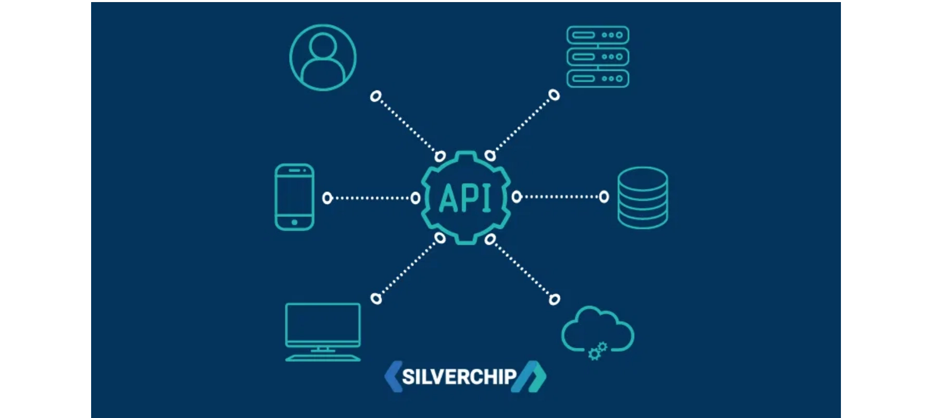
REST API Integration
API 1: External SMS Provider (Twilio)
POST
Integration Points
Send SMS notifications to patients for check-in confirmations and status updates
Create REST API in ODC Service Studio with proper authentication and error handling
Base URL:
https://api.twilio.com/2010-04-01/
Auth:
Basic Authentication (AccountSID, AuthToken)
Endpoint:
/Accounts/{AccountSID}/Messages.json
Log all API calls in SMSNotification entity for audit trail and troubleshooting
API 2: RFID Reader Webhook
POST
Validate API keys and implement rate limiting for exposed endpoints
Receive RFID card taps from external readers for contactless check-in
Type:
Exposed REST API
Auth:
API Key in header
Handle responses and errors gracefully with proper status codes and messages
Endpoint:
/api/rfid/checkin
Support JSON request and response formats for seamless integration
API 3: QR Code Check-in API
POST
Mobile app or external system check-in via QR code scanning
Type:
Exposed REST API
Endpoint:
/api/checkin/qr
API 4: Queue Status API
GET
Get current queue status for external displays and third-party integrations
Type:
Exposed REST API
Endpoint:
/api/queue/status
Parameters:
departmentId (optional), status (optional)

Slide 11














Implementation Benefits & Conclusion
System Capabilities
OutSystems ODC Advantages
Multi-channel patient check-in supporting SMS, QR code, RFID, web, and mobile platforms
Cloud-Native Architecture
Enabled
Real-time queue management with automated position calculation and estimated wait times
Rapid Development
Low-Code
Scalability
Auto-Scale
Comprehensive dashboards for front desk staff, doctors, and administrators with live updates
Microservices Support
Native
Automated SMS notifications for check-in confirmation and status updates via Twilio integration
Kubernetes Integration
Built-in
Public waiting room displays with animated ticket transitions and real-time queue status
Continuous Deployment
Automated
Security & Compliance
Enterprise-Grade
Analytics and reporting with insights on check-in methods, wait times, and department performance
API-First Design
REST APIs
The PatientOnboardingSystem demonstrates the power of OutSystems Developer Cloud in building comprehensive, enterprise-grade healthcare applications with minimal development time. The platform's cloud-native architecture, combined with low-code capabilities, enables rapid deployment of scalable solutions that enhance patient experience and streamline clinic operations.
Future Enhancements: Mobile app expansion, AI-powered wait time predictions, telemedicine integration, and multi-language support

