Slide 1
Introduction to Data Mining
Course: Data Mining & Data Warehousing
Program: BCA
Instructor: Aamir Mir
University: MIT-WPU

Slide 2
Lecture Agenda
Introduction to Data Mining
Importance and Evolution of Data Mining
Real-life Applications and Industry Use-Cases
Types of Data and Patterns in Data Mining
The KDD Process
Tools and Technologies Overview (Weka)
Summary, Discussion & Q/A

Slide 3
What is data?
Data is a collection of raw facts or figures that may not have meaning on their own.
It can be in the form of numbers, text, images, audio, or video.
Example: 85, 92, 76 (student marks) → These are just data.
Once processed and organized, data becomes meaningful — this is called information.
In data mining, data is the starting point to find useful patterns and insights.

Slide 4
What is Data Mining?
Data Mining means finding useful information from a large amount of data.
🔍 It is like searching for patterns or hidden facts inside a big collection of data.
🧠 Helps in making better decisions by understanding data more deeply.
🛒 Used by companies like Amazon, YouTube, Netflix to recommend products or videos.
🧰 It uses tools and techniques from AI, statistics, and machine learning.

Slide 5
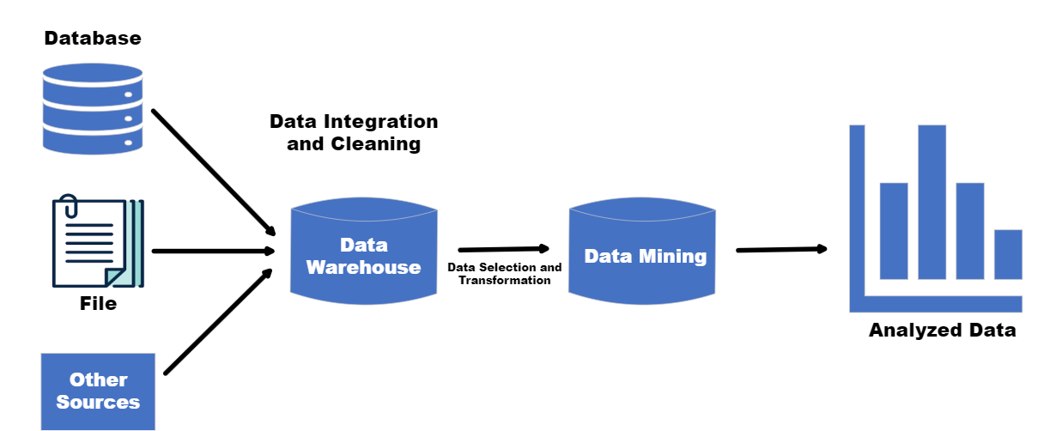

Slide 6
Step 1 – Data Sources
- Where data comes from: websites, apps, sensors, databases
Example: Amazon gets data from your searches, orders, and reviews

Slide 7
Step 2 – Data Cleaning
- Fix wrong or missing data
- Remove empty entries or spelling errors
- Clean data = better results

Slide 8
Step 3 – Data Integration
- Join data from different places
Example: Combine app data with website data
- One complete dataset

Slide 9
Step 4 – Data Selection
- Choose only the needed data
Example: Use this year’s sales data
- Focus on useful data only

Slide 10
Step 5 – Data Transformation
- Convert data into simple form
Example: 'Male/Female' → 1/0
- Computers understand better

Slide 11
Step 6 – Data Mining
- Use software to find patterns
Example: People who buy phones also buy covers
- Main part of the process

Slide 12
Step 7 – Pattern Evaluation
- Check which patterns are helpful
- Remove false or useless patterns
Example: Does it help with better decisions?

Slide 13
Step 8 – Knowledge Presentation
- Show results using charts or graphs
- Easy for people to understand
Tools: Excel, dashboards

Slide 14
Why Do We Need Data Mining?
• Huge volumes of complex data generated daily.
• Traditional analysis is insufficient.
• Enables pattern discovery, future prediction, fraud detection, and efficiency improvements.
• Example: Social media sentiment predicting product popularity.

Slide 15
Example 1: Supermarket – Market Basket Analysis
• Discovers items bought together: Bread & Butter, Shampoo & Conditioner.
• Business Use: Cross-selling, combo offers, shelf placement.
• Technique: Association Rule Mining (Apriori Algorithm).
• Metrics: Support, Confidence, Lift.

Slide 16
Example 2: Netflix – Recommendation System
• Analyzes viewing behavior using collaborative filtering.
• Clusters users and classifies content.
• Techniques: Clustering, Classification, Deep Learning.
• Result: Personalized experience, higher retention.

Slide 17
KDD Process (Knowledge Discovery in Databases)
1. Selection: Relevant data chosen.
2. Preprocessing: Noise & missing data removal.
3. Transformation: Normalization, encoding.
4. Data Mining: Algorithms applied (Apriori, k-means).
5. Evaluation: Insights visualized & interpreted.

Slide 18
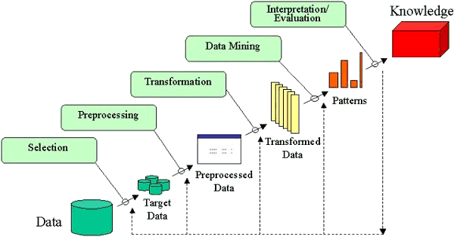

Slide 19
Applications of Data Mining
• E-commerce: Recommendations (Amazon)
• Healthcare: Diagnostics, disease prediction
• Banking: Credit scoring, fraud detection
• Education: Student analytics, dropout prediction
• Telecom: Churn analysis, fault detection

Slide 20
Tools – Introduction to Weka
• Open-source Java-based data mining tool
• GUI and CLI available
• Features: Classification, Clustering, Association
• Easy for students to explore
• Workflow: Load → Preprocess → Apply Algorithm → Analyze Results

Slide 21
Summary
- Data mining = finding hidden info in data
- 8 steps called KDD Process
- Used in shopping, banking, health, etc.
- Helps in better decisions

