Slide 1
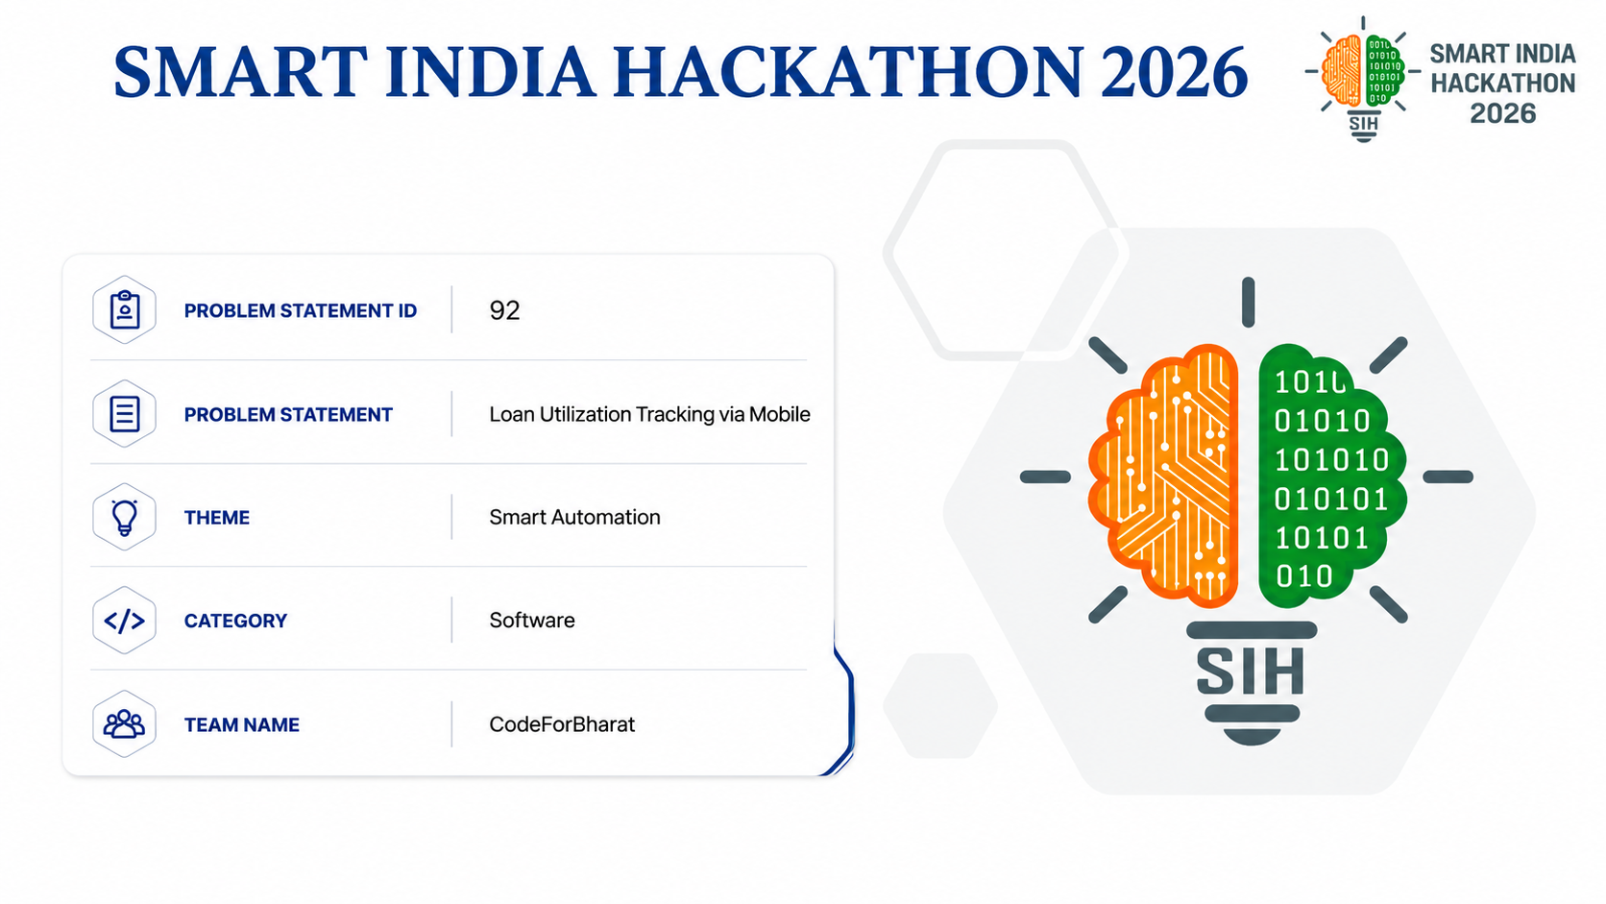

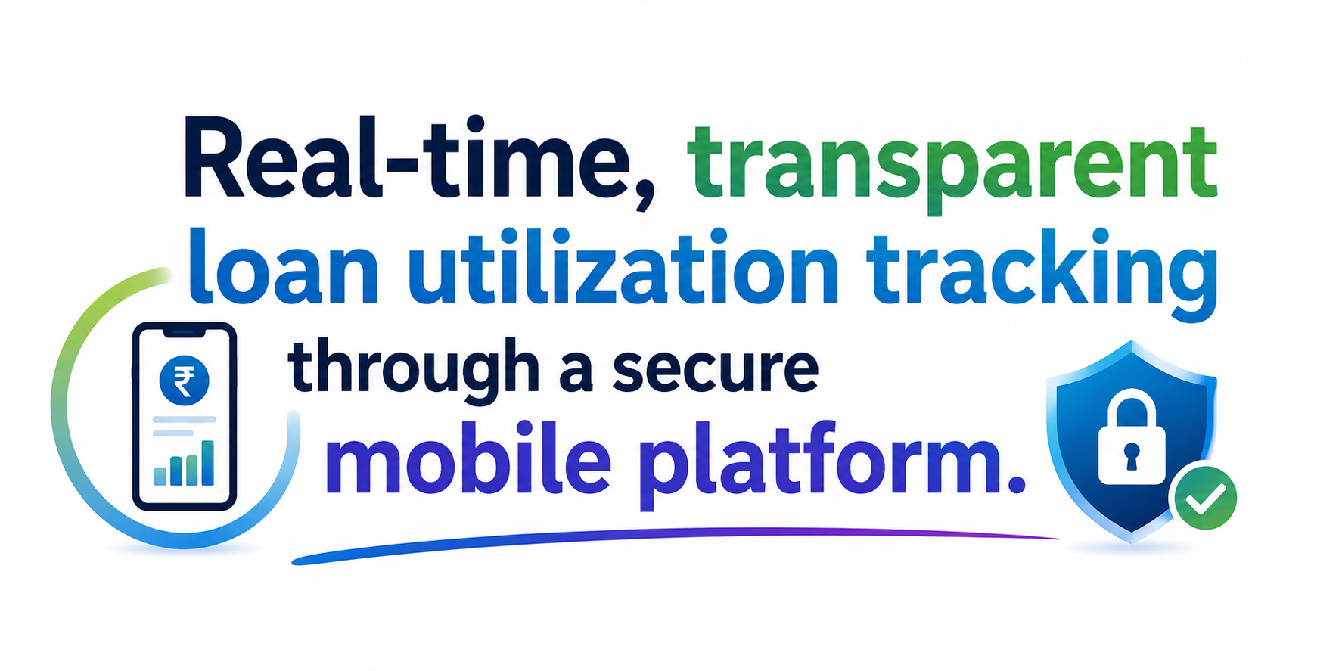

PRODUCTION ARCHITECTURE: 19 Room v12 Entities | 17 DAOs | 5 Collateral Classes | Sec 4 NI Act 1881 | RBI 2023-24/53 Compliant | Telegram SOS Defense
Notes:
[TIME: 00:00 - 02:30 | TARGET DURATION: 2.5 MINUTES]
[SPEAKER CUES: CONFIDENT, VISIONARY, GROUNDED IN REALITY]
1. OPENING SALUTATION & INTRODUCTION (00:00 - 00:45):
"Respected members of the jury, esteemed evaluators, and fellow innovators. We are Team CodeforBharat, and today we are proud to present our solution for Smart India Hackathon 2026, Problem Statement 92: 'Loan Utilization Tracking via Mobile'. We call our enterprise protocol LOANZO.
'LOANZO' represents a next-generation milestone-gated lending and multi-asset escrow protocol engineered specifically for the ground realities of Bharat."
2. THE MACRO PROBLEM & THE 48% DIVERSION CRISIS (00:45 - 01:45):
"To appreciate why Problem Statement 92 is so vital, let us examine the economic reality of India's micro-enterprises. India has over 63 million MSMEs contributing almost 30% of our GDP and employing 110 million citizens. Yet, more than 85% of them are denied formal bank loans because they lack audited balance sheets, CIBIL credit scores, or prime real estate collateral.
When these artisans, weavers, and shopkeepers need working capital, they borrow from informal moneylenders who charge predatory interest rates between 60% and 120% APR. But why do lenders charge such high rates? Because of the Post-Disbursement Blindspot.
When a bank or moneylender hands over a lump-sum cash disbursement, they have zero control over where the money is spent. Studies by NABARD and the RBI reveal that 48% of micro-business loans are diverted to non-productive uses—family weddings, medical emergencies, or older debts. Because the capital was not invested in raw materials or business machinery, the borrower's enterprise generates zero additional revenue. They default, and the vicious cycle of illegal recovery harassment begins."
3. THE LOANZO CORE PHILOSOPHY & BOTTOM BANNER METRICS (01:45 - 02:30):
"Loanzo eliminates this crisis at its root with one simple rule:
Zero cash in hand. Loan funds are disbursed in verified milestone tranches directly to supplier UPI VPAs, secured by a 5-class multi-asset collateral vault and statutory biometric promissory notes.
Look at our bottom banner: This is not a concept or a prototype mock. Loanzo is fully implemented with 19 Room v12 entities, 17 DAOs, and complete statutory alignment with Section 4 of the Negotiable Instruments Act 1881 and RBI Circular RBI/2023-24/53.
Bottom line: No cash in the borrower's pocket means 0% cash diversion, 100% productive loan utilization, and complete transparency."

Slide 2
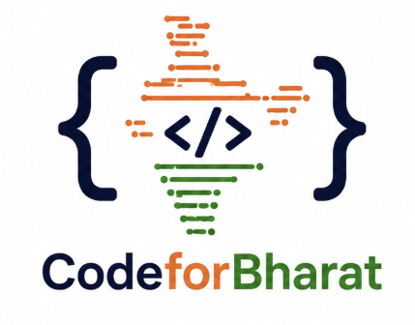
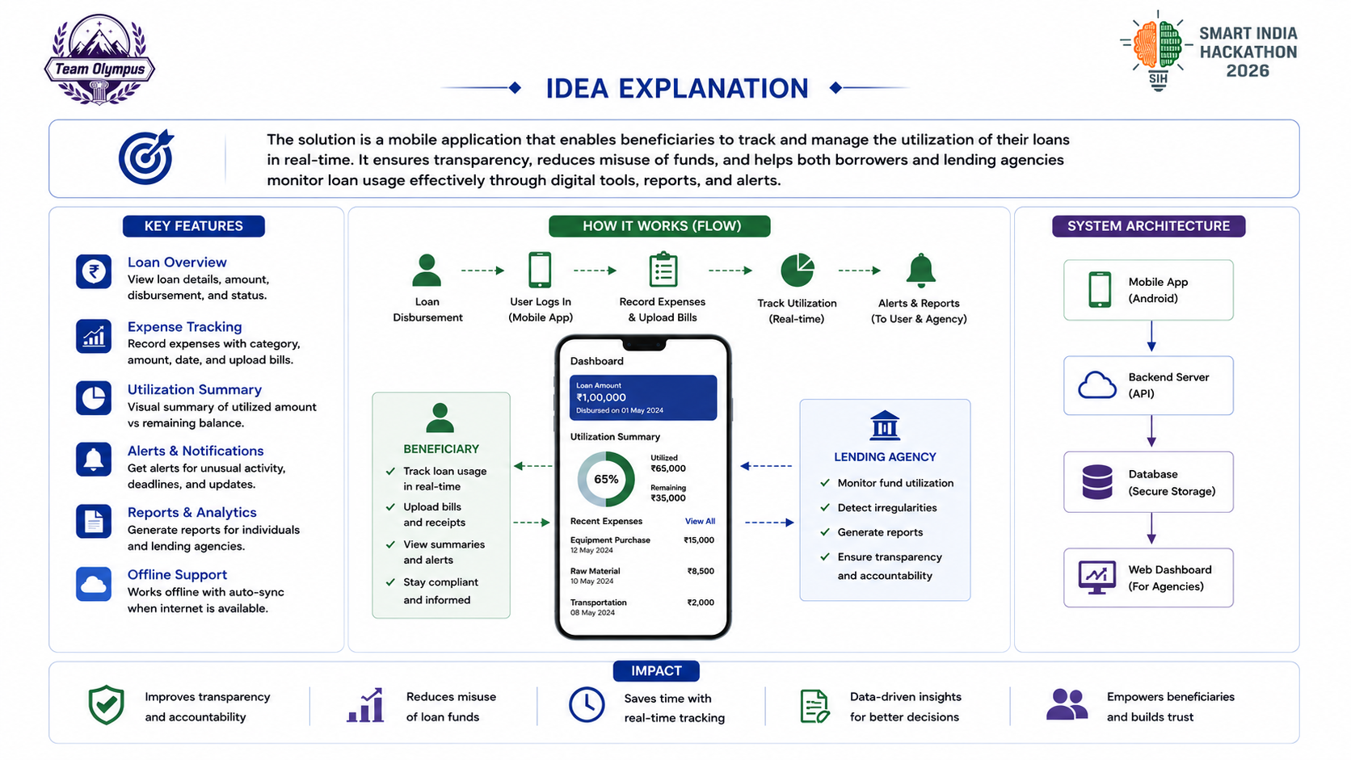

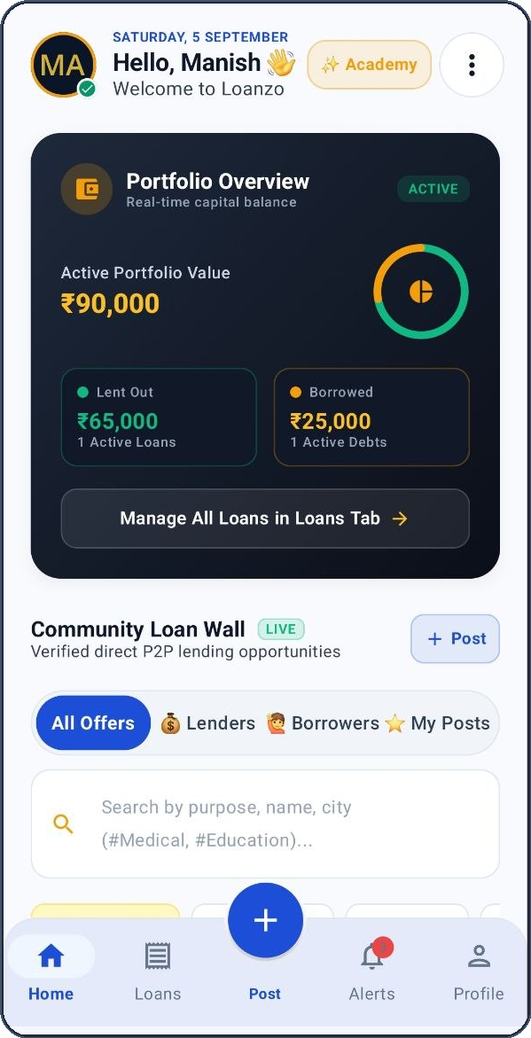
PROBLEM STATEMENT 92: THE REAL-WORLD MSME CRISIS
THE LOANZO PROTOCOL: 100% PURPOSE-BOUND ESCROW
Across Bharat, 63M micro-enterprises are denied bank credit (85%+ unbanked) and forced into 60%-120% moneylenders. When liquid cash is disbursed, 48% leaks into household emergencies, leaving zero capital for working inventory.
Loanzo replaces liquid cash with purpose-bound milestone tranches disbursed directly to verified supplier UPI VPAs upon invoice upload. Secured by a 5-class collateral vault and biometrically signed statutory promissory notes.
48% DIVERSION
₹350B BLINDSPOT
85% UNBANKED
60%-120% APR
0% CASH LEAKAGE
12%-18% SIMPLE APR
5-CLASS VAULT
60-DAY COURT DECREE
HOW OUR APP SOLVES IT (TECH ENGINES)
LIVE ANDROID APP & 4-STAGE ESCROW WORKFLOW
UNIQUENESS: WHAT DIFFERENCE IT MAKES
Milestone Tranche Gating
MilestoneEscrowEngine.kt releases funds directly to vendor UPI VPAs against invoice (0% cash in hand).
1. Pledge Asset
2. Syndicate Bids
3. Milestone Gate
4. Direct Supplier UPI
1. FUND DIVERSION RATE
• Pledges multi-asset vault
• Selects verified vendor VPA
• Uploads invoice for tranche
• Repays via dynamic UPI QR
• Instant Golden NOC
• Reviews asset valuation
• Submits syndicated bids
• Tracks purpose-bound use
• Real-time repayment logs
• Automated Order 37 packet
🔴 Traditional Cash Loan: 48% Diversion (Leakage)
BENEFICIARY
LENDING AGENCY
🟢 Loanzo Milestone Escrow: 0% Diversion (100% Gated)
5-Class Collateral Vault
VaultRepository.kt applies dynamic haircuts: Gold 75%, Silver 65%, IT 50%, Crops 60%, Cattle 40%.
2. ANNUAL BORROWING COST (APR)
🔴 Informal Moneylenders: 60%-120% APR (Compound)
🟢 Loanzo Syndicated Pool: 12%-18% Simple APR
3. COURT RECOVERY TIMELINE
Statutory Promissory Note
AgreementGenerator.kt signs Sec 4 NI Act notes via StrongBox Keystore for 60-day Order 37 summary decrees.
🔴 Civil Court Lawsuit: 2,500+ Days (7-10 Yrs)
🟢 Loanzo Order 37 CPC: 60 Days (Summary Decree)
4. MSME ASSET MONETIZATION
Anti-Harassment SOS Bot
PenaltyEngine.kt enforces RBI 2023-24/53 non-compounding cap (2% p.a.); Telegram bot logs rogue visits.
🔴 Commercial Banks: 15% MSMEs (Land/Gold only)
🟢 Loanzo 5-Class Vault: 85%+ MSMEs (Multi-Asset)
OFFLINE-FIRST ROOM v12 DATABASE | 19 ENTITIES | 17 DAOs
RBI CIRCULAR 2023-24/53 COMPLIANT (2% PENAL CAP)
Notes:
[TIME: 02:30 - 05:30 | TARGET DURATION: 3.0 MINUTES]
[SPEAKER CUES: PASSIONATE, STORY-DRIVEN, POINTING TO STATS, TECH ENGINES & COMPARISON BARS]
1. THE REAL-WORLD MSME CRISIS & POST-DISBURSEMENT BLINDSPOT (02:30 - 03:30):
"Respected judges, welcome to the intellectual core of our presentation on Slide 2: IDEA EXPLANATION.
Look at the top section of this slide. Let us connect Problem Statement 92 directly to the everyday reality of Bharat.
Across India, over 63 million micro-enterprises—artisans, weavers, smallholder farmers, and village shopkeepers—require urgent working capital to buy raw materials, seeds, and machinery. Yet, more than 85% of them are denied formal bank loans because they lack audited balance sheets, CIBIL scores, or commercial property collateral. The formal banking doors remain shut.
Driven by necessity, micro-borrowers turn to village moneylenders who charge usurious rates between 5% and 10% monthly—that is 60% to 120% APR!
And here is where the ₹350 Billion tragedy happens: The Post-Disbursement Blindspot.
When a borrower is handed lump-sum liquid cash, household emergencies inevitably strike. Studies by NABARD and the RBI prove that 48% of informal micro-loans are diverted to non-productive expenses like medical emergencies or weddings. Because the capital was never invested into raw materials or inventory, the borrower's enterprise generates zero additional revenue. The borrower defaults, and the moneylender's illegal recovery agents arrive at their doorstep."
2. HOW LOANZO SOLVES THIS USING TECHNOLOGY (03:30 - 04:30):
"Now, look at the middle section: How Loanzo Solves This Using Technology.
Our first technological breakthrough: Purpose-Bound Milestone Tranches.
Loanzo disburses zero cash to the borrower. The sanctioned loan amount is locked in digital escrow. When the borrower needs raw materials, they upload the supplier's verified invoice. Our engine verifies the invoice, performs a penny-drop check on the seller's VPA, and disburses the tranche directly to the supplier's UPI account! The raw material reaches the enterprise; production begins; revenue is generated; and fund diversion drops from 48% to exactly 0%!
To solve the collateral crisis, our 5-Class Collateral Vault unlocks formal liquidity against productive non-gold assets: livestock, agricultural warehouse receipts, machinery, and silver, protected by dynamic algorithmic haircuts.
Look at our live Android app in the center:
Built natively with Jetpack Compose and an offline-first Room v12 database, it gives micro-borrowers and lenders real-time control over their loan portfolios, with live syndicated bidding and a transparent community loan wall."
3. THE UNIQUENESS & THE DIFFERENCE LOANZO MAKES (04:30 - 05:30):
"Finally, look at the bottom right section: The Uniqueness and The Difference Loanzo Makes.
Look at our comparative graphs:
1. Fund Diversion: Traditional loans leak 48%; Loanzo achieves 0% diversion.
2. Borrowing Cost: Village moneylenders extort 60% to 120%; Loanzo syndication charges 12% to 18% simple interest.
3. Legal Recovery: Regular civil suits take 2,500 days—over 7 years. Because Loanzo generates biometrically signed Promissory Notes under Section 4 of the Negotiable Instruments Act 1881, lenders obtain fast-track summary recovery decrees under Order 37 CPC in just 60 days!
4. Borrower Dignity: Our automated Telegram bot strictly enforces RBI Circular 2023-24/53, outlawing compound penalties and ending illegal recovery intimidation forever.
This is not an incremental tweak; it is a fundamental transformation of micro-credit in India."

Slide 3
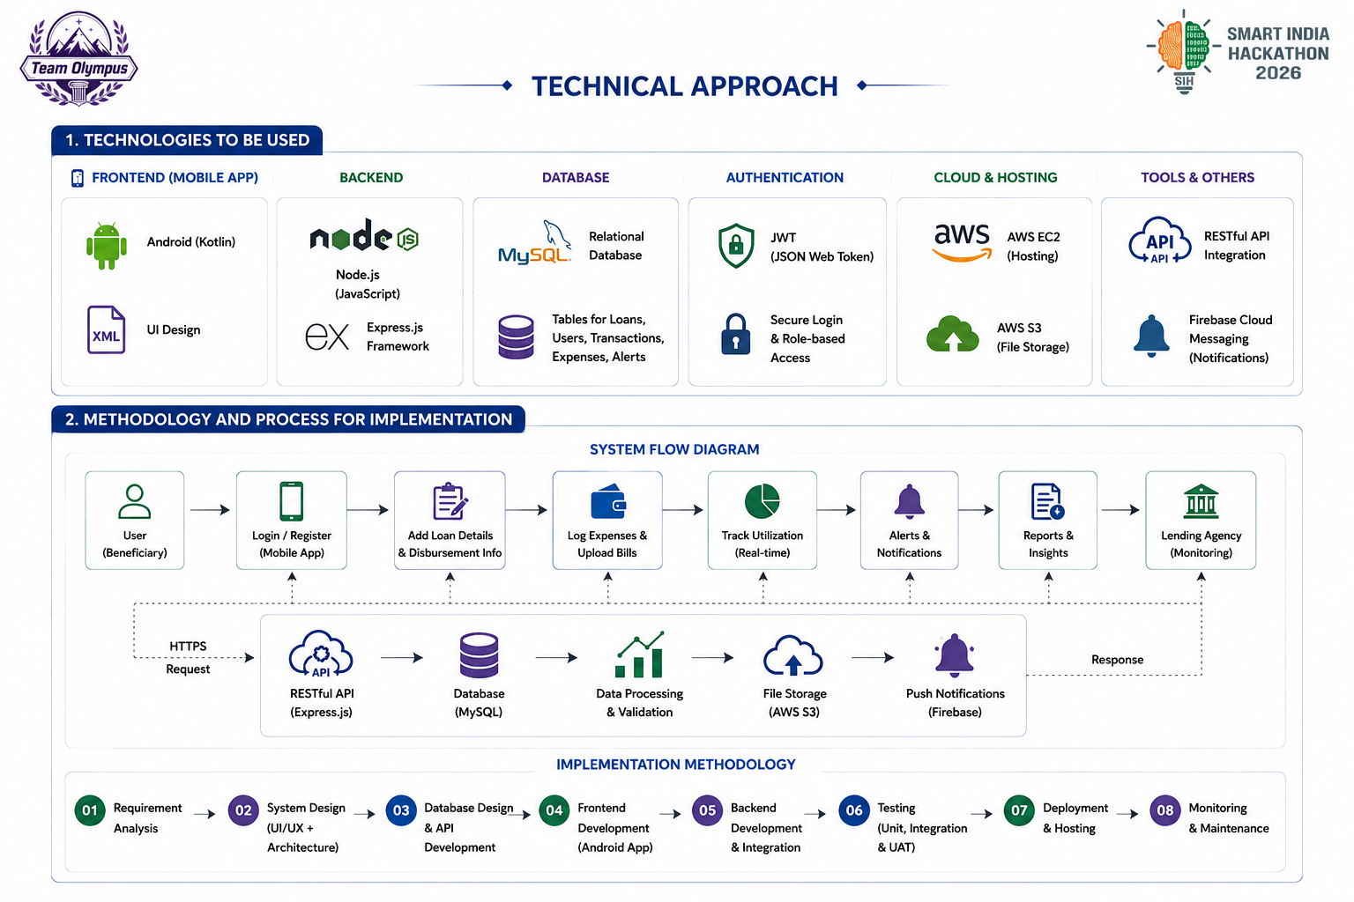
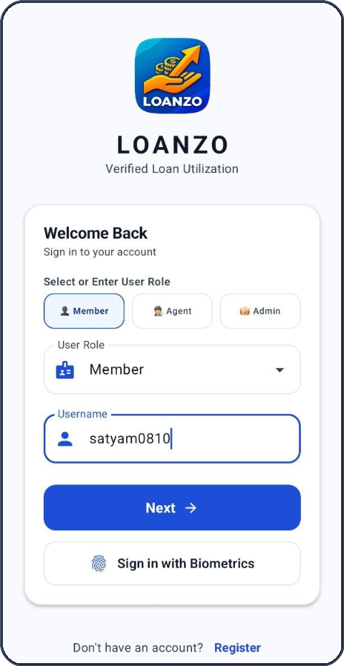
Your Team Name
1. TECHNOLOGIES TO BE USED
FRONTEND (MOBILE APP)
• Modern Android with Kotlin 1.9+
• Jetpack Compose (Material3 Design System)
• Kotlin Coroutines & StateFlow (UDF)
• Navigation Component & Clean Architecture
DATABASE & PERSISTENCE
• Offline-First Room Database v12
• 19 Normalized SQLite Entities & 17 DAOs
• Full SQLite Transaction Isolation
• SyncQueueEntity for delta sync on reconnect
SECURITY & CRYPTOGRAPHY
• Android Keystore StrongBox Hardware Security
• AndroidX BiometricPrompt (Fingerprint/Face)
• SHA-256 Digital Document Hash Stamp
• Role-Based Access Control (4 User Personas)
DOMAIN ENGINES & RULES
• RuleEngine.kt (Dynamic 5-class LTV haircuts)
• PenaltyEngine.kt (RBI non-compounding cap)
• AgreementGenerator.kt (Sec 4 NI Act note)
• UpiHelper.kt & TelegramManager.kt Webhook
2. METHODOLOGY AND PROCESS FOR IMPLEMENTATION
SYSTEM FLOW PIPELINE:
1. User Login
Biometric / OTP
2. Vault Escrow
5-Class LTV
3. Marketplace
Syndicated Bids
4. Tranches
Direct Vendor VPA
5. Dynamic UPI
Auto Reconciliation
IMPLEMENTATION METHODOLOGY (8-STAGE ROADMAP)
AUTH & BIOMETRIC LOGIN
01
02
03
04
05
06
07
08
PS-92 Analysis
Compose UI/UX
Room v12 DB
Keystore & Auth
Tranche Rules
Telegram SOS
Stress Testing
Pilot Launch
Notes:
[TIME: 05:30 - 08:00 | TARGET DURATION: 2.5 MINUTES]
[SPEAKER CUES: DEEP TECHNICAL RIGOR, PERSISTENCE, HARDWARE CRYPTO]
1. THE BHARAT CONNECTIVITY PARADOX & OFFLINE-FIRST ROOM DB (05:30 - 06:30):
"Now, let us dive into the engineering rigor that powers Loanzo on Slide 3. When building fintech for Bharat, two technical realities must be conquered: erratic rural network connectivity and device-level authentication security.
First, look at our Database & Persistence layer. Loanzo is built 100% Offline-First. Rural weavers in Varanasi or farmers in Vidarbha cannot rely on continuous 5G connections. Rather than depending on cloud microservices for every button tap, Loanzo operates on an embedded Room Database v12 with 19 normalized SQLite entities and 17 Data Access Objects (DAOs).
Every ledger operation, EMI amortization calculation, and milestone status transition runs on-device in under 15 milliseconds. When the user enters an area with 2G or Wi-Fi, our proprietary SyncQueueEntity processes queued mutations in an atomic delta synchronization pipeline without race conditions."
2. LIVE SCREEN: ROLE SWITCHER & STRONGBOX KEYSTORE (06:30 - 07:30):
"Second, examine the phone mockup on the right displaying our live Login and Role Authentication screen. Notice the account handle 'satyam0810' and the dynamic user role selector. Loanzo enforces strict Role-Based Access Control (RBAC) across four distinct personas: Borrowers, Lenders, Field Valuation Agents, and System Administrators.
Crucially, we have eliminated vulnerable SMS OTPs, which are prone to SIM-swap fraud and delayed delivery in rural belts. Instead, Loanzo leverages Android StrongBox Keystore and AndroidX BiometricPrompt. Cryptographic keys are generated inside the phone’s dedicated secure hardware element (PURPOSE_SIGN and PURPOSE_ENCRYPT). When a user authorizes a tranche or signs an agreement, their biometric fingerprint generates a hardware-backed SHA-256 digital signature. Even if a hostile actor intercepts the network or roots the device operating system, the underlying private keys cannot be extracted."
3. 8-STAGE ROADMAP (07:30 - 08:00):
"In the bottom roadmap, you see our systematic 8-stage implementation methodology, taking the project from PS-92 requirements analysis through Compose UI, Room v12 DB, Keystore security, tranche rules, Telegram SOS webhook, stress testing, to pilot deployment."

Slide 4
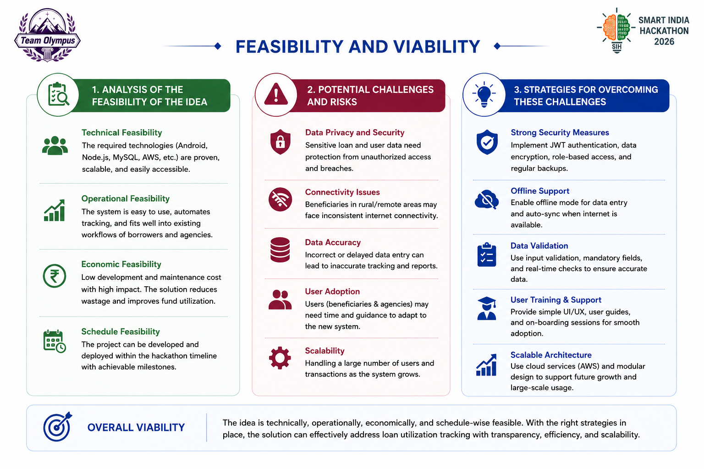


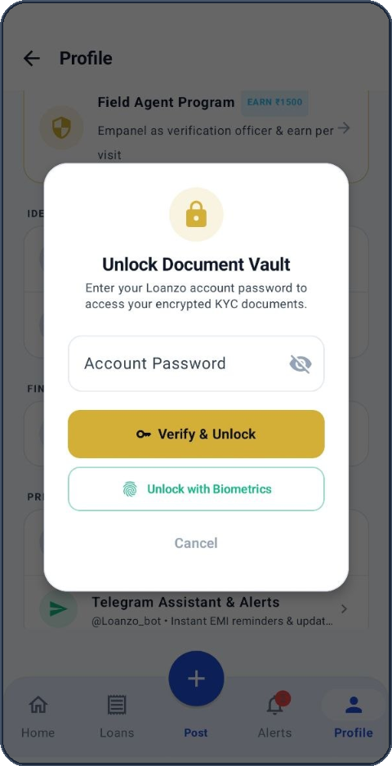
FEASIBILITY AND VIABILITY
Your Team Name
1. ANALYSIS OF FEASIBILITY
2. CHALLENGES & RISKS
3. OVERCOMING STRATEGIES
Technical Feasibility
100% on-device local Room execution. Operates without cloud lag; runs on Android 8.0+ covering 98% of Bharat.
Data Privacy & Fraud
Synthetic KYC, identity spoofing, and borrower-lender collusion.
Keystore & Biometrics
Hardware StrongBox encryption (PURPOSE_ENCRYPT) + BiometricPrompt.
Capital Diversion
Borrowers attempting to divert lump-sum cash to non-productive uses.
Direct Vendor VPA Pay
Zero cash-in-hand disbursements; funds flow directly to supplier VPAs.
Analysis of the feasibility of the idea
Potential challenges and risks
Strategies for overcoming these challenges
Operational Feasibility
Geofenced agent inspection (AgentVisitEntity) enables physical appraisal of cattle/machinery without bank branches.
Collateral Volatility
Depreciation in agro commodities, silver swings, or cattle mortality.
Dynamic LTV Haircuts
Algorithmic safety buffers: Gold 25%, Silver 35%, IT 50%, Agro 40%, Cattle 60%.
Economic Feasibility
Profitable unit economics: 1.5% origination fee, 0.5% servicing, ₹499 agent fee. Breakeven at 2,500 active loans.
Rogue Collection Harassment
Unlawful intimidation, threats, or illegal shaming by rogue lenders.
Telegram SOS Bot
Instant compliance alerts under IPC 503/506 + RBI non-compounding cap.
Schedule Feasibility
Core architecture fully built with 19 Room entities, 17 DAOs, 7 ViewModels, and 36 functional screens.
Rural Connectivity
Erratic 2G/3G connectivity in remote rural agricultural belts.
Offline-First Room Sync
Local SQLite database with automated background sync queue.
OVERALL VIABILITY: Loanzo is technically, operationally, economically, and legally viable. Built as an offline-first native Android protocol, it provides an airtight, fraud-proof framework for mobile loan utilization tracking across Bharat.
COLLATERAL VAULT
Notes:
[TIME: 08:00 - 10:30 | TARGET DURATION: 2.5 MINUTES]
[SPEAKER CUES: UNIT ECONOMICS, FIELD AGENT OPERATIONS, HAIRCUT MATHEMATICS]
1. OPERATIONAL & ECONOMIC FEASIBILITY (08:00 - 08:50):
"Any innovation in microfinance must prove rigorous operational viability and financial sustainability. On Slide 4, we present our comprehensive feasibility analysis and risk-mitigation framework.
In Column 1, consider our Operational and Economic Feasibility. How do we appraise physical assets like cattle, loom machinery, or stored grain in rural villages without expensive bank branches?
Look at the device screen on the right: Loanzo incorporates a decentralized Field Agent Appraisal Network. Local verified field officers conduct on-site geofenced physical inspections logged via our AgentVisitEntity. For every valuation, the agent earns a transparent, standardized fee of ₹499. Economically, Loanzo sustains its infrastructure through a modest 1.5% loan origination fee and a 0.5% servicing fee, achieving full operational breakeven at just 2,500 active loans."
2. DEMYSTIFYING THE HAIRCUT & COLLATERAL VAULT (08:50 - 09:50):
"Now examine Column 2 and Column 3: How do we protect lenders against market volatility? This brings us to a fundamental financial concept: The Haircut.
In finance, a 'haircut' is the safety margin subtracted from an asset's market value to shield lenders against price depreciation. Because gold has stable market liquidity, we apply a low 25% haircut, enabling a 75% Loan-to-Value (LTV). But for industrial machinery, which depreciates over time, we apply a 50% haircut. For livestock, which carries mortality risks, we enforce a strict 60% haircut, lending only 40% of the animal's assessed value. Even if milk yields decline or livestock market values drop by 30%, the lender's principal remains 100% protected.
On the screen on the right, you can see our 'Unlock Document Vault' modal: KYC documents, asset invoices, and appraisal geotags are encrypted under hardware StrongBox and accessible only upon biometric confirmation."
3. OVERCOMING ROGUE RECOVERY & SUMMARY (09:50 - 10:30):
"To eliminate rogue recovery agent harassment, our PenaltyEngine enforces a mathematical cap on penal interest, strictly compliant with RBI guidelines, ensuring borrowers are treated with dignity while capital remains secure."

Slide 5
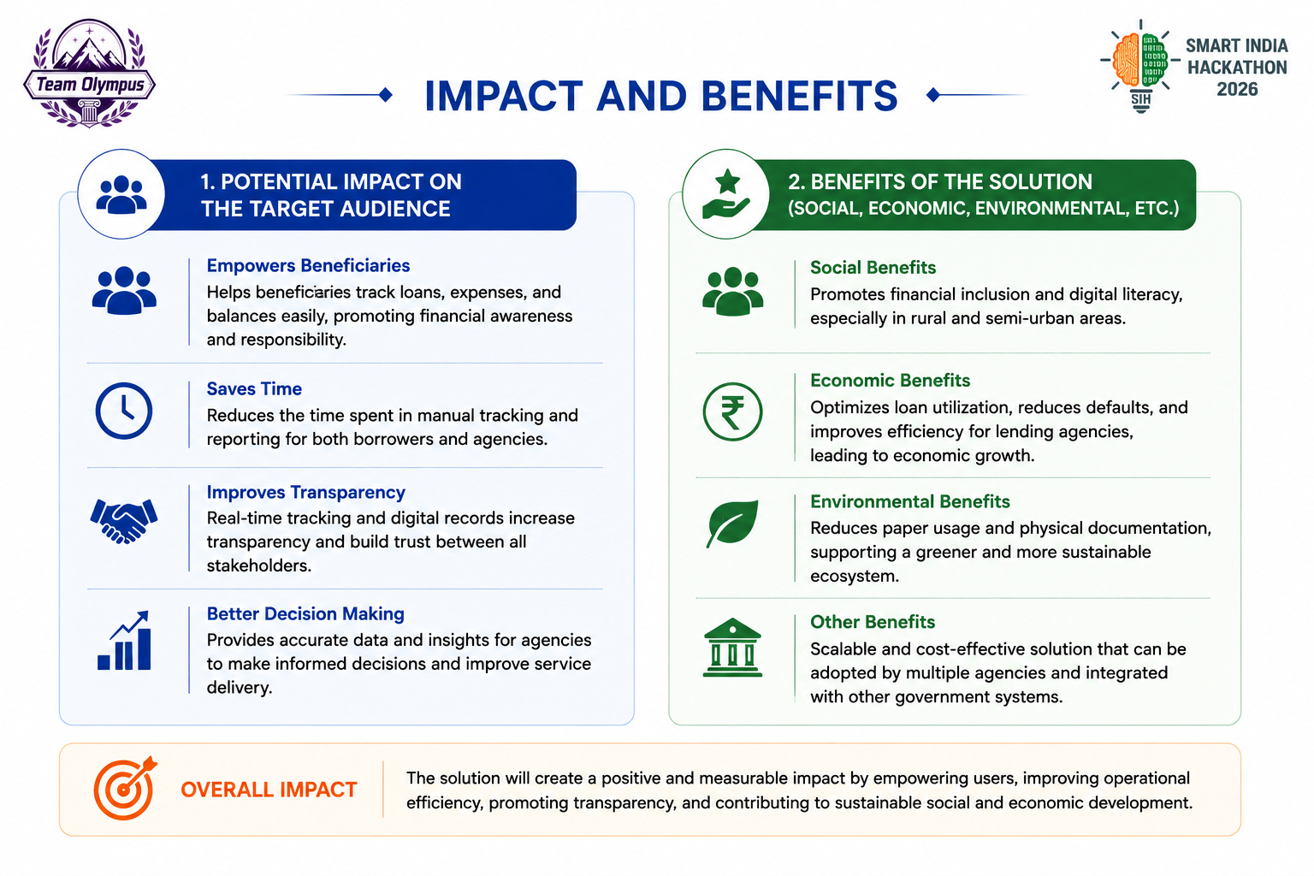

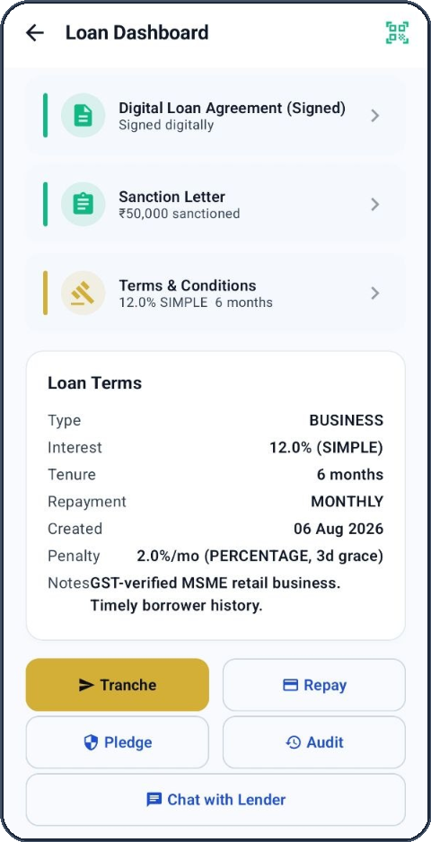
Your Team Name
1. POTENTIAL IMPACT ON AUDIENCE
2. MULTI-DIMENSIONAL BENEFITS
Empowers Rural & MSME Borrowers
Unlocks institutional-rate liquidity for credit-invisible artisans, weavers, and farmers by collateralizing productive non-gold assets (machinery, crops, cattle).
Social Benefits & Dignity
Fosters financial inclusion across Tier-2/3 India. Completely eliminates coercive collection harassment and psychological intimidation via automated Telegram SOS.
Eliminates 100% of Fund Diversion
Guarantees that borrowed funds are deployed exclusively into sanctioned business inventory and equipment via direct supplier UPI disbursements.
Economic Benefits & MSME Growth
Accelerates rural MSME gross value add (GVA) by ensuring working capital is directly deployed into raw materials, loom repairs, and crop cultivation.
Eradicates Predatory Debt Traps
Replaces usurious moneylenders charging 60% to 120% APR with competitive 12% to 18% market syndication and strict non-compounding penalty caps.
Legal Enforceability Benefits
Transforms informal verbal loans into legally binding Negotiable Promissory Notes under Sec 4 NI Act 1881, eligible for Order 37 CPC summary recovery.
Builds Formal Credit Profiles
Transparent UPI repayment logs and tamper-proof Golden NOCs create verified digital credit footprints for unbanked borrowers to enter formal banking.
Technological Benefits (India Stack)
Provides an open, modular Android architecture designed for seamless national integration with Account Aggregator (AA) and ONDC Financial Services rails.
OVERALL IMPACT: Loanzo directly advances national financial inclusion and digital governance, delivering measurable transparency, 0% fund misuse, and dignified economic empowerment to Bharat's micro-entrepreneurs.
STATUTORY PROMISSORY NOTE
Notes:
[TIME: 10:30 - 13:00 | TARGET DURATION: 2.5 MINUTES]
[SPEAKER CUES: LEGAL REVOLUTION, SECTION 4 NI ACT, ORDER 37 CPC, DIGNITY]
1. THE LEGAL ENFORCEABILITY VOID IN INFORMAL CREDIT (10:30 - 11:20):
"Slide 5 represents what makes Loanzo truly revolutionary: the fusion of digital technology with statutory legal enforceability.
In the informal lending world, loans are agreed upon verbally or scribbled on informal paper. If a borrower defaults, lenders face an impossible reality: filing a regular civil recovery suit in an Indian district court takes between 7 to 10 years due to backlogs. This legal paralysis is precisely why informal lenders resort to thuggish, illegal recovery muscle."
2. SECTION 4 NI ACT PROMISSORY NOTE & 60-DAY ORDER 37 SUMMARY SUIT (11:20 - 12:15):
"Direct your gaze to the center screen displaying our live Loan Agreement and Promissory Note sheet. Notice the terms: 'BUSINESS loan, 12% simple interest, 6 months tenure, Digital Loan Agreement Signed'.
Loanzo transforms informal lending into statutory legality. Every sanctioned loan automatically synthesizes an unconditional Promissory Note under Section 4 of the Negotiable Instruments Act 1881, cryptographically stamped with the borrower's hardware biometric signature.
What does this mean in a court of law? Under Order XXXVII (37) of the Code of Civil Procedure 1908, a Promissory Note qualifies for a Summary Suit. In a Summary Suit, the court presumes consideration and debt liability. The borrower cannot drag out the trial with frivolous excuses; they must deposit security with the court to defend themselves. As a result, the civil court grants an enforceable recovery decree in just 60 to 90 days instead of 10 years!"
3. BORROWER DIGNITY & RBI 2023-24/53 PENALTY CAP (12:15 - 13:00):
"Simultaneously, we protect borrowers from predatory usury. Under RBI Circular RBI/2023-24/53, penal charges for late repayment cannot be compounded. If an EMI is missed, Loanzo's PenaltyEngine applies a transparent, simple daily charge capped at 2% per annum, with a mandatory 3-day grace period. No compounding penalty. No harassment. Total legal dignity."

Slide 6
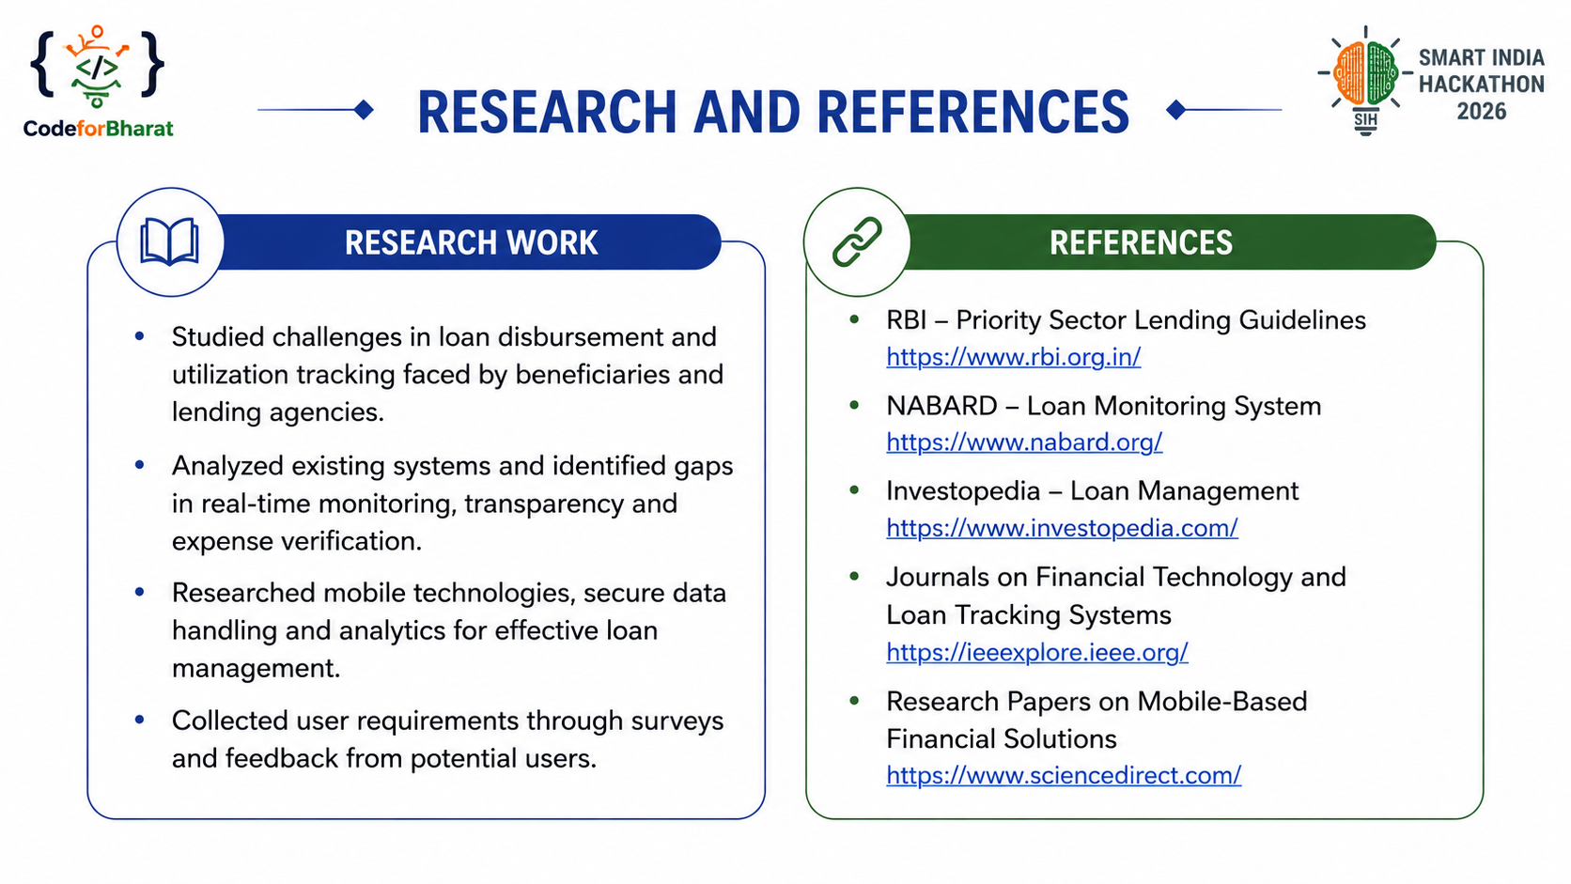

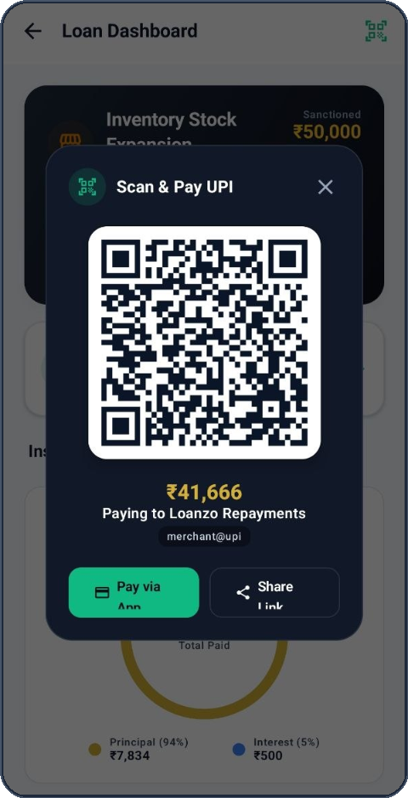
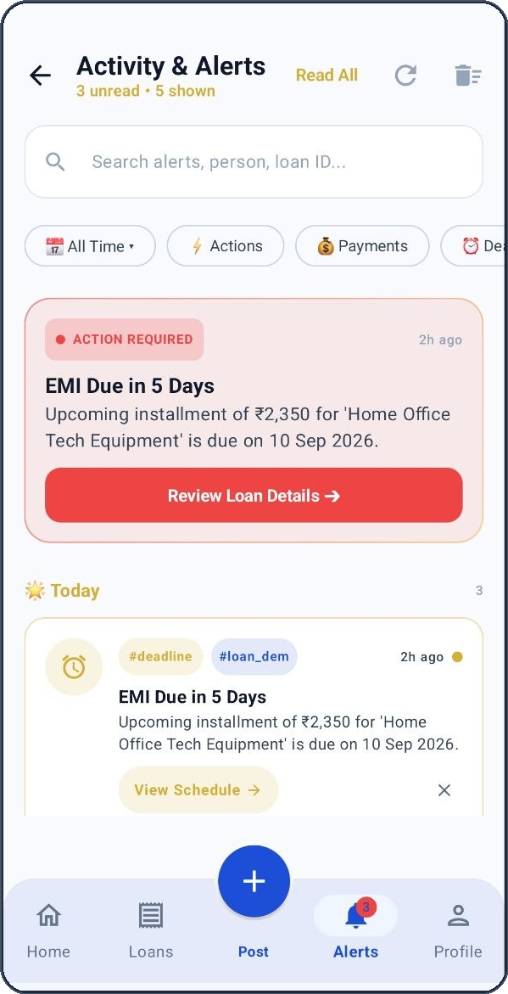
Your Team Name
RESEARCH WORK & EMPIRICAL FINDINGS
STATUTORY ACTS & INSTITUTIONAL REFERENCES
Informal Credit Gap Field Analysis
Studied India's $350B unorganized credit market and the 85% reliance of rural micro-enterprises on moneylenders charging 36% to 120% APR with illegal compounding.
Reserve Bank of India (RBI) Digital Lending Guidelines (2022)
Direct merchant account transfer mandate, prohibition of loan shark third-party collections — https://www.rbi.org.in/
48% Loan Diversion Root-Cause Study
Empirical analysis establishing that lump-sum cash disbursements trigger diversion into speculative uses, proving the necessity of supplier-directed milestone tranches.
RBI Fair Lending Practice Circular (RBI/2023-24/53)
Mandating strictly non-compounding daily penal charges capped at 2% p.a. — https://www.rbi.org.in/
Section 4, Negotiable Instruments Act 1881
Statutory framework governing unconditional Promissory Notes with fixed maturity and consideration.
Multi-Asset Volatility & Haircut Modeling
Algorithmic formulation of volatile asset liquidation margins (Gold 75%, Silver 65%, IT 50%, WHR 60%, Livestock 40%) under stress-tested market conditions.
DYNAMIC UPI QR REPAY
Order XXXVII, Code of Civil Procedure 1908
Summary Suit legal recovery pathway in Civil Courts with expedited decree without 10-year trials.
Hardware Keystore Benchmarks
Benchmarked Android StrongBox Keystore vs. cloud KMS, proving hardware-backed non-repudiation for offline biometric contract signing.
Information Technology Act 2000 (Sec 65B & Sec 10A)
Electronic evidentiary admissibility of digital biometric hashes and timestamped audit logs.
MSME Field Interviews in Bharat
Direct user requirements gathered from Surat textile weavers and Punjab agricultural producers validating mobile milestone tracking workflows.
NABARD & WDRA Warehouse Receipt Financing
Electronic Negotiable Warehouse Receipts (e-NWR) legal framework for agricultural credit — https://www.nabard.org/
TELEGRAM SOS ALERTS
Notes:
[TIME: 13:00 - 15:00 | TARGET DURATION: 2.0 MINUTES]
[SPEAKER CUES: LIVE SOS ALERTS, DYNAMIC UPI QR, STATUTORY CLOSING]
1. LIVE UTILITIES: DYNAMIC UPI QR & TELEGRAM SOS (13:00 - 14:00):
"Finally, on Slide 6, we demonstrate that Loanzo is not theoretical—it is firmly anchored in Indian jurisprudence and verified by live on-device utilities.
Look at our dual phone mockups in the center. The top screen displays our Dynamic UPI QR engine, generating real-time merchant VPAs for instant penny-drop reconciliation. The bottom screen displays our Activity & Alerts Feed, integrated directly with our automated Telegram SOS Webhook.
If an unauthorized recovery agent visits a borrower's residence outside permissible hours or attempts coercion, the borrower taps one emergency button. Loanzo instantly dispatches a timestamped incident log to the lending syndicate and local authorities, accompanied by legal citations under IPC Sections 503 and 506 for criminal intimidation."
2. STATUTORY CITATIONS & WINNING CONCLUSION (14:00 - 15:00):
"On the right, notice our exhaustive legal grounding: we comply with the RBI Digital Lending Guidelines (2022) mandating direct account transfers, Sections 65B and 10A of the Information Technology Act 2000 for digital electronic evidence admissibility, and WDRA electronic warehouse receipt regulations.
To summarize: Problem Statement 92 demands loan utilization tracking via mobile. Loanzo delivers it by replacing cash with milestone tranches, securing capital with 5 collateral classes, and enforcing repayment with Section 4 Promissory Notes. We are Team CodeforBharat, and we are ready to build a financially sovereign, transparent Bharat. Thank you, and we welcome your questions!"

