Slide 1
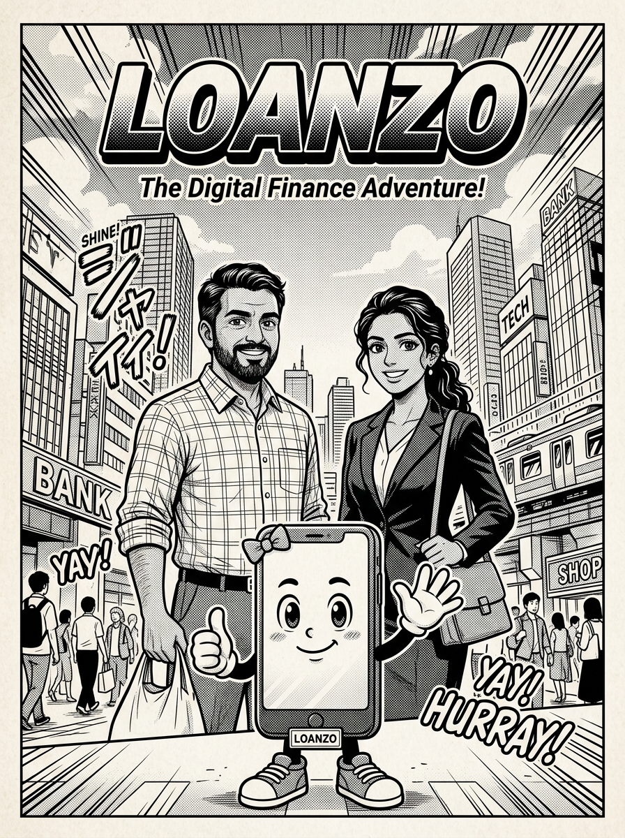
LOANZO
THE 23-SCENE TRUST LEDGER
Complete Executive Presentation • 16:9 Widescreen
• 100% Asset-Backed Secured P2P Lending • Physical 22K Gold Collateral in Bank Locker 237 • Section 128 ICA Verified Co-Borrowers • Reverse Auction Marketplace (8.2% Net Yield) • Direct Wholesaler Payee Tranches (Zero Diversion) • Automated ₹41,000 Profit Realization & Compounding
Notes:
LOANZO: THE TRUST LEDGER (Volume 1)
A 23-Scene Master Comic & P2P Finance Journey.
Characters: Mascot Loanzo, Rohan Sharma (Borrower), Priya Sharma (Co-Borrower), Aisha Khan (Investor/Lender), Vikram Rao (Certified Valuer).

Slide 2
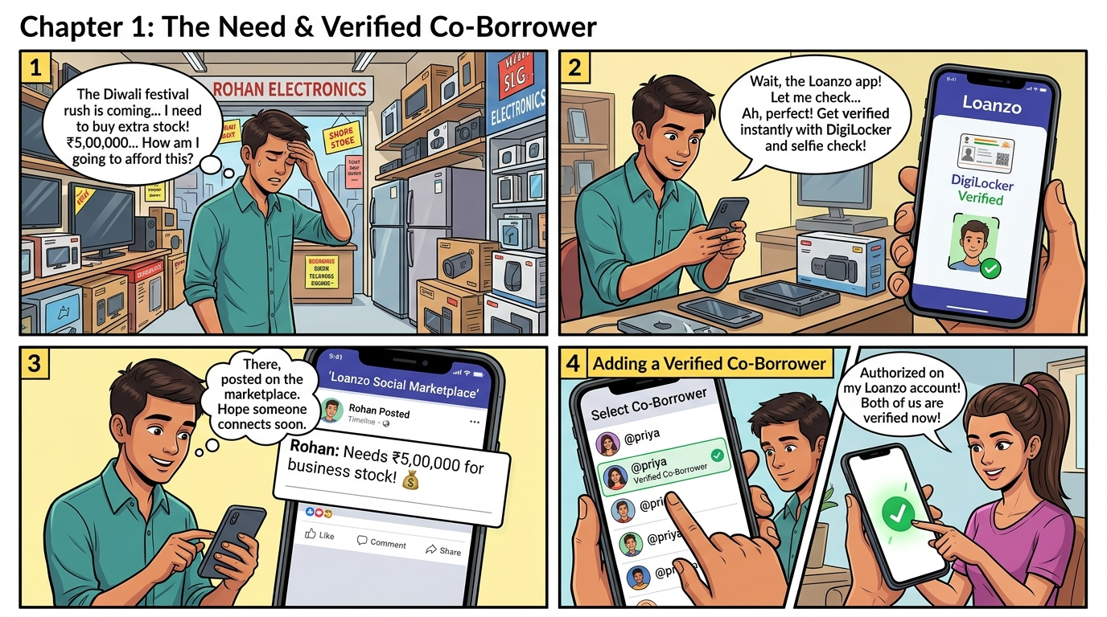
Notes:
ACT I: NEED & TRUST (Scenes 1 to 5)
1. Festival crunch at Rohan Electronics: ₹5,00,000 needed for Diwali inventory; moneylender demands 24% interest.
2. Mascot Loanzo guides Rohan through 30-sec DigiLocker KYC (Aadhaar/PAN) & CameraX liveness check.
3. Social Timeline pitch published: ₹5,00,000 @ 8.5% for 12 months with 50g gold collateral.
4. Priya's In-App Co-Borrower Handshake: Authorized with biometric fingerprint under Section 128 ICA 1872.
5. 18 Community Vouches (⭐ 4.9) from neighboring Laxmi Road merchants act as social collateral.

Slide 3
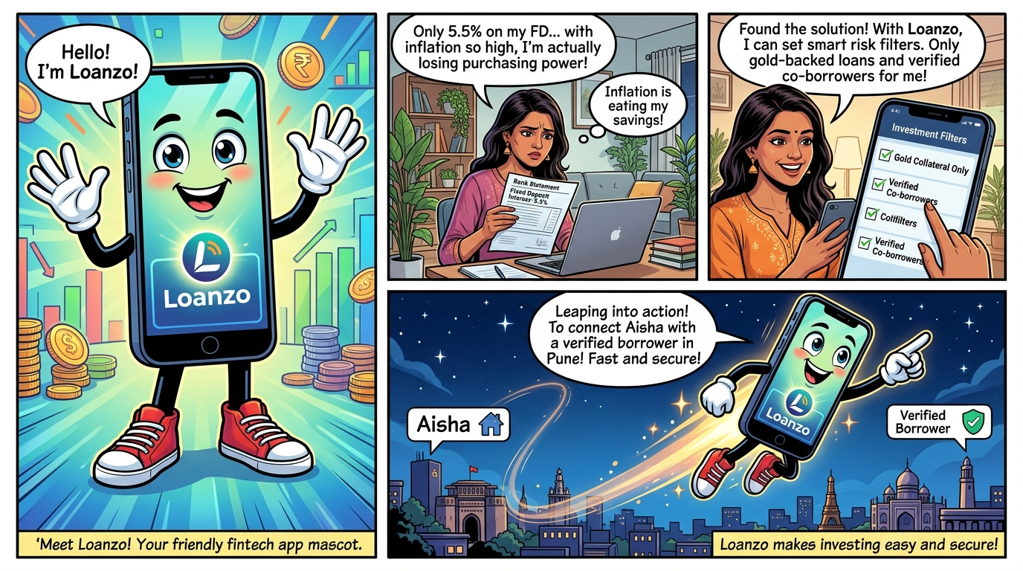
Notes:
ACT II: THE LENDER — SCENE 6: THE IDLE SAVINGS DILEMMA
• Location: Aisha's apartment, Hinjewadi, Pune.
• The Problem: ₹10,00,000 idle cash in 5.5% taxable FD yields only 3.85% post-tax.
• With 6.0% inflation, real purchasing power drops by -2.15% every year!
• Unsecured P2P has 12% default rates.
• Mascot Loanzo leaps in: 'Meet Loanzo — 100% asset-backed P2P secured by physical gold vaulted in banks!'

Slide 4
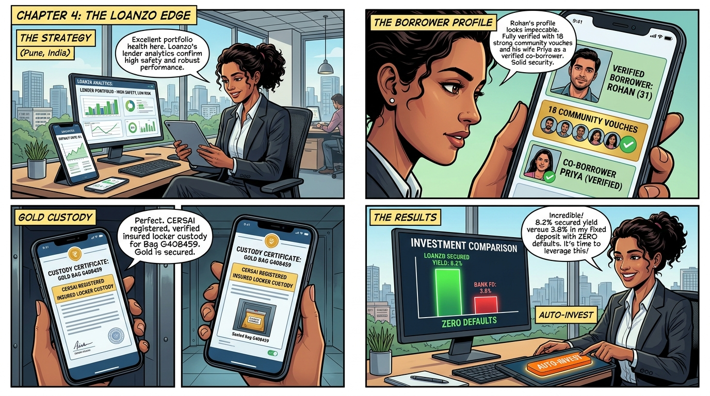
Notes:
ACT II: SCENES 7 & 8: STRATEGY & REVERSE AUCTION
• Aisha configures smart filters: Physical gold only (max 75% LTV), verified co-borrowers, direct wholesaler tranches.
• Audits Rohan's profile: 18 vouches, Priya bound as co-borrower, CERSAI vault custody certificate.
• Reverse Auction Bidding War: Axis bids 9.0%, Kotak bids 8.5%. Aisha bids winning 8.2%!
• Outcome: Aisha earns ₹41,000 pure profit while beating all institutional rivals.

Slide 5
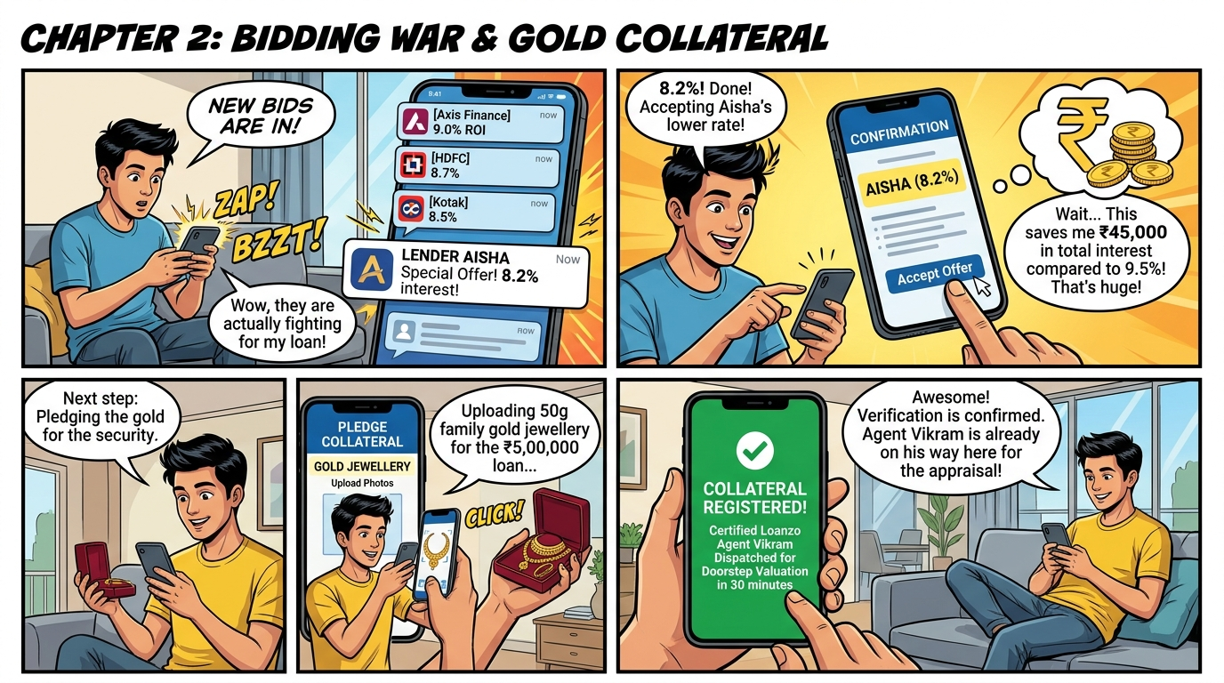
Notes:
ACT II: SCENES 9 & 10: RATE LOCK & COLLATERAL PLEDGE
• Rohan accepts Aisha's 8.2% offer, saving ₹45,000 in interest vs 9.5% bank loans.
• Uploads purchase bill and photos of 50g 22K ancestral family gold jewellery.
• Loanzo engine dispatches Certified Valuer Agent Vikram Rao with 20-min ETA.
• Aisha tracks Vikram's scooter route via live GPS.

Slide 6
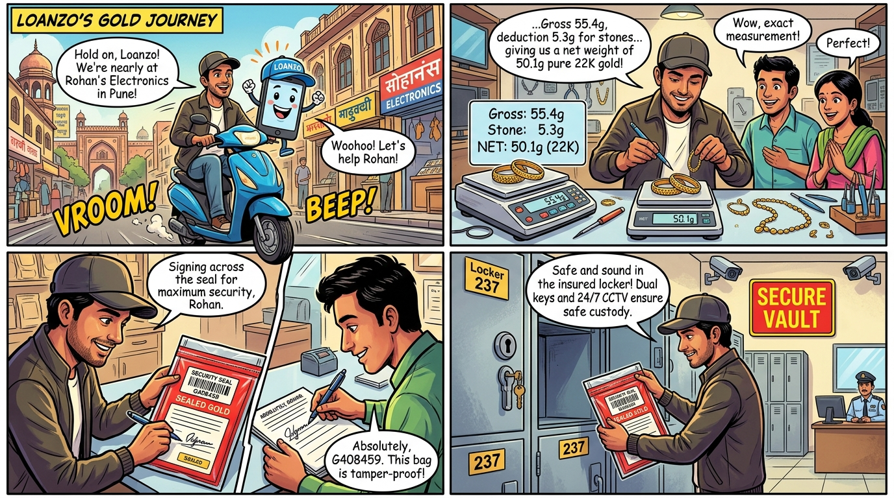
Notes:
ACT III: SCENES 11 TO 14: DOORSTEP ASSAYING & VAULTING
• Vikram arrives on scooter; tests touchstone 22K purity.
• Precision Scale: Gross 55.4g - 5.3g stone deduction = 50.1g net pure gold!
• IBJA live API rate match: ₹3,50,700 valuation; 75% LTV strictly locked.
• Gold sealed in tamper-evident barcode bag #G408459 with VOID tape.
• Deposited in partner bank safe deposit vault (Locker 237, dual keys, transit insurance).

Slide 7
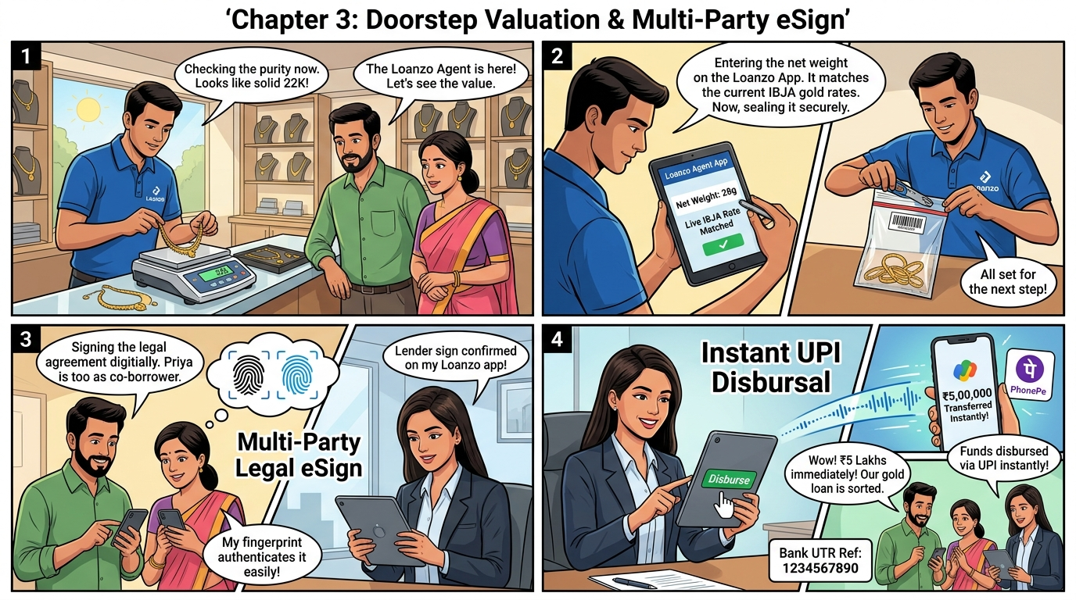
Notes:
ACT IV: SCENES 15 & 16: MULTI-PARTY eSIGN & DISBURSAL
• Tripartite Multi-Party Agreement under Section 128 Indian Contract Act.
• Rohan and Priya sign simultaneously on mobile via on-device fingerprint biometrics.
• Aisha countersigns on her tablet; contract sealed with SHA-256 hash.
• Instant UPI Disbursal: ₹2,00,000 transferred straight to wholesale distributor Raj Electronics with Bank UTR: 1234567890.

Slide 8
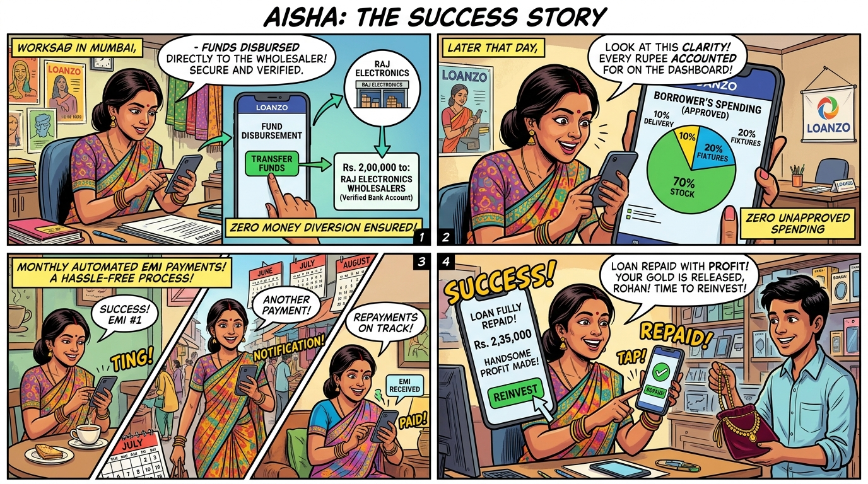
Notes:
ACT IV: SCENES 17 & 18: DONUT AUDIT & RETAIL BOOM
• Aisha's Live Donut Audit Dashboard: 70% Inventory (Wholesaler Raj), 20% Fixtures, 10% Delivery. 0% cash diversion!
• Delivery truck unloads 50 smart TVs at Rohan Electronics.
• Record Diwali sales boom: ₹18,50,000 festive revenue!
• Monthly automated EMIs paid on time via UPI auto-debit.

Slide 9
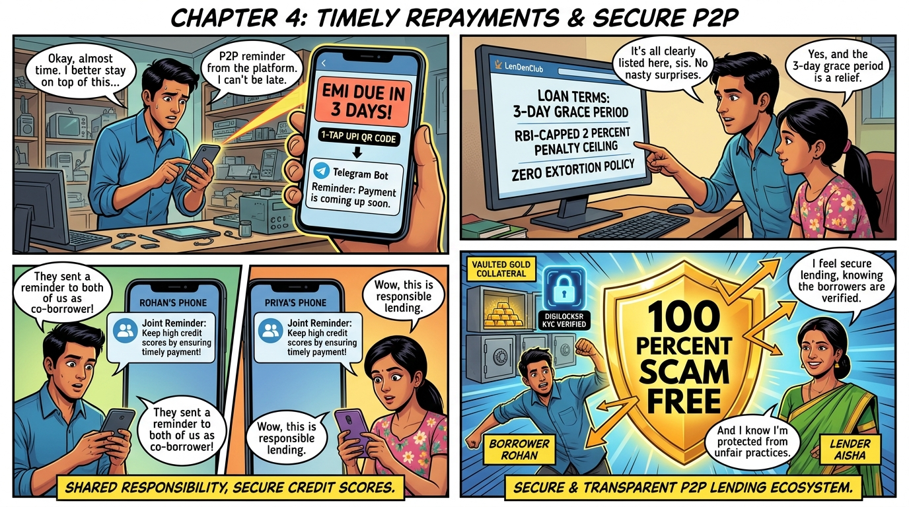
Notes:
ACT V: SCENES 19 TO 21: SAFEGUARDS & THE SCAM-FREE SHIELD
• Automated reminders from Telegram Bot (@Loanzo_bot) with dynamic 1-tap UPI QR codes.
• Regulatory Default Engine: 3-day grace period (0% fee); penal fee capped at RBI 2% monthly ceiling.
• Dual-Sided 100% Scam-Free Shield Matrix:
- Lender: Vaulted gold, verified co-borrower joint liability, direct wholesaler tranches.
- Borrower: Capped fees, reverse auction rates, zero loan shark extortion, guaranteed gold return.

Slide 10
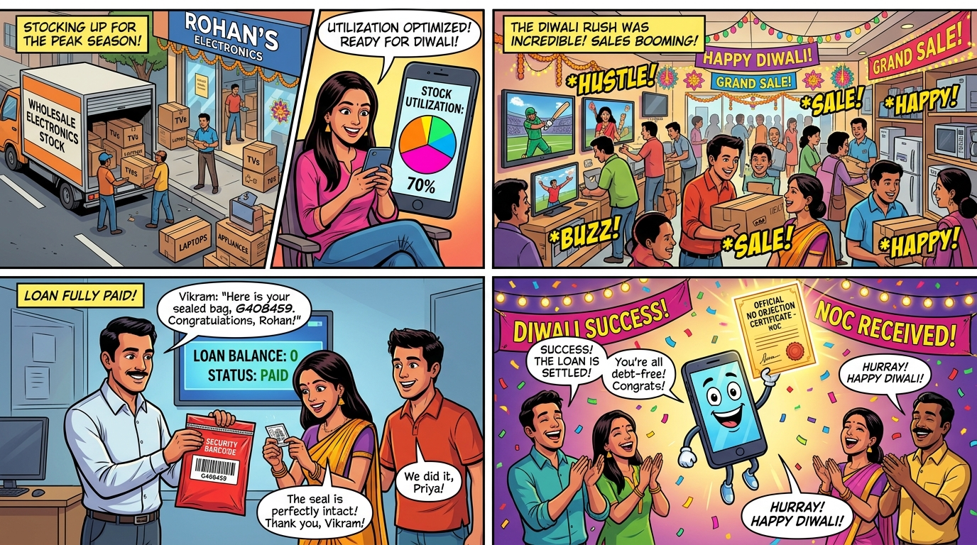
Notes:
ACT V: SCENE 22: GRAND FINALE & GOLD RETURN
• Final EMI cleared: Balance ₹0.00! Automated de-hypothecation triggered.
• Doorstep Restitution: Vikram returns barcode security bag #G408459 from Locker 237.
• Priya verifies VOID tape: 'Untouched, pristine, and perfectly intact!'
• Mascot Loanzo awards the golden Official No Objection Certificate (NOC).
• Confetti explodes as Rohan, Priya, Aisha, and Vikram celebrate: 'ZERO DEFAULT, ZERO EXTORTION, 100% TRUST!'

Slide 11
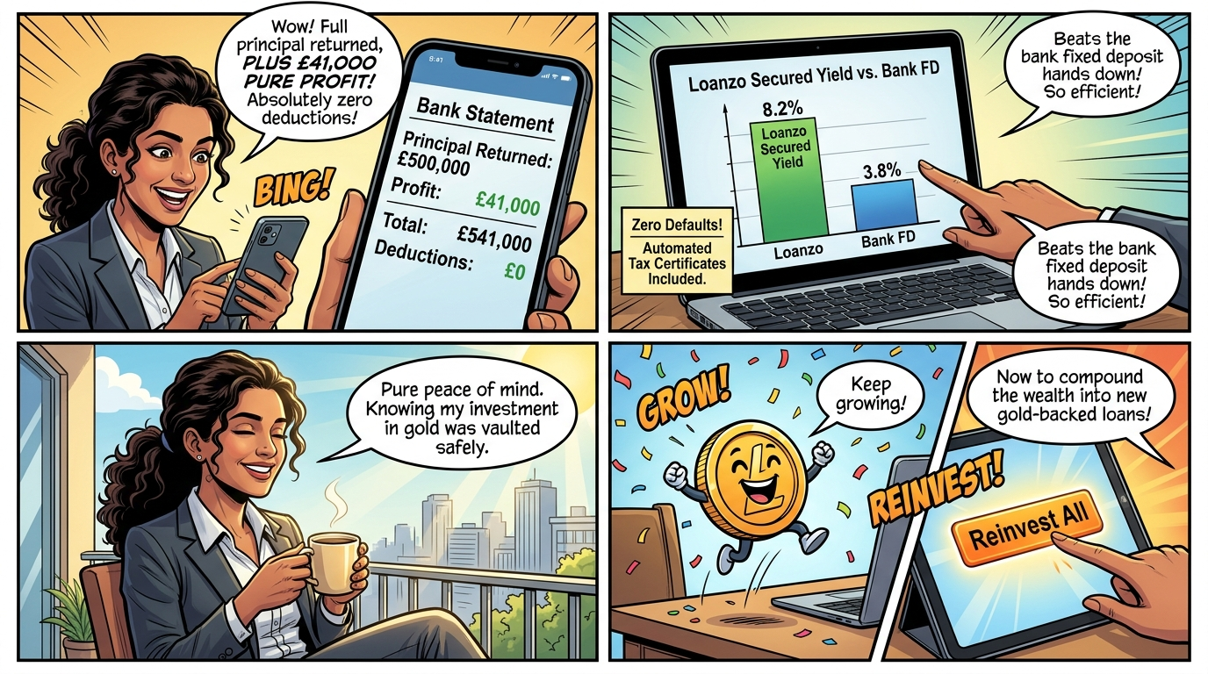
Notes:
EPILOGUE: SCENE 23: AISHA'S WEALTH TRIUMPH
• Verified bank statement: ₹5,00,000 principal returned + ₹41,000 PURE PROFIT! Total received: ₹5,41,000.
• Comparison chart: 8.2% secured yield beats bank FDs by 49% with zero defaults.
• Total peace of mind: Morning coffee on sunny balcony.
• 1-Tap Reinvestment: Aisha taps [Reinvest All] to compound her ₹5,41,000 into new gold-backed loans!

