Slide 1
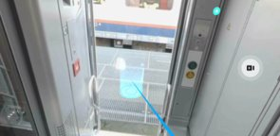


Bmx door :
Exit not possible

Slide 2
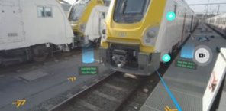
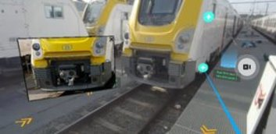
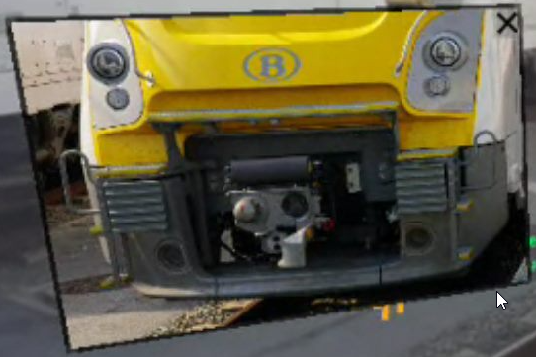

Please move the detailed picture nearer to the action button +
There is an unwanted interaction with the cross to shut and the moving cylinder behind it.

Slide 3
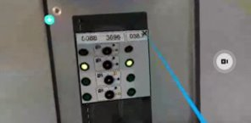

Best practice
Picture is displayed within the field of view
A cross placed at the top right of the image allows you to close it

Slide 4
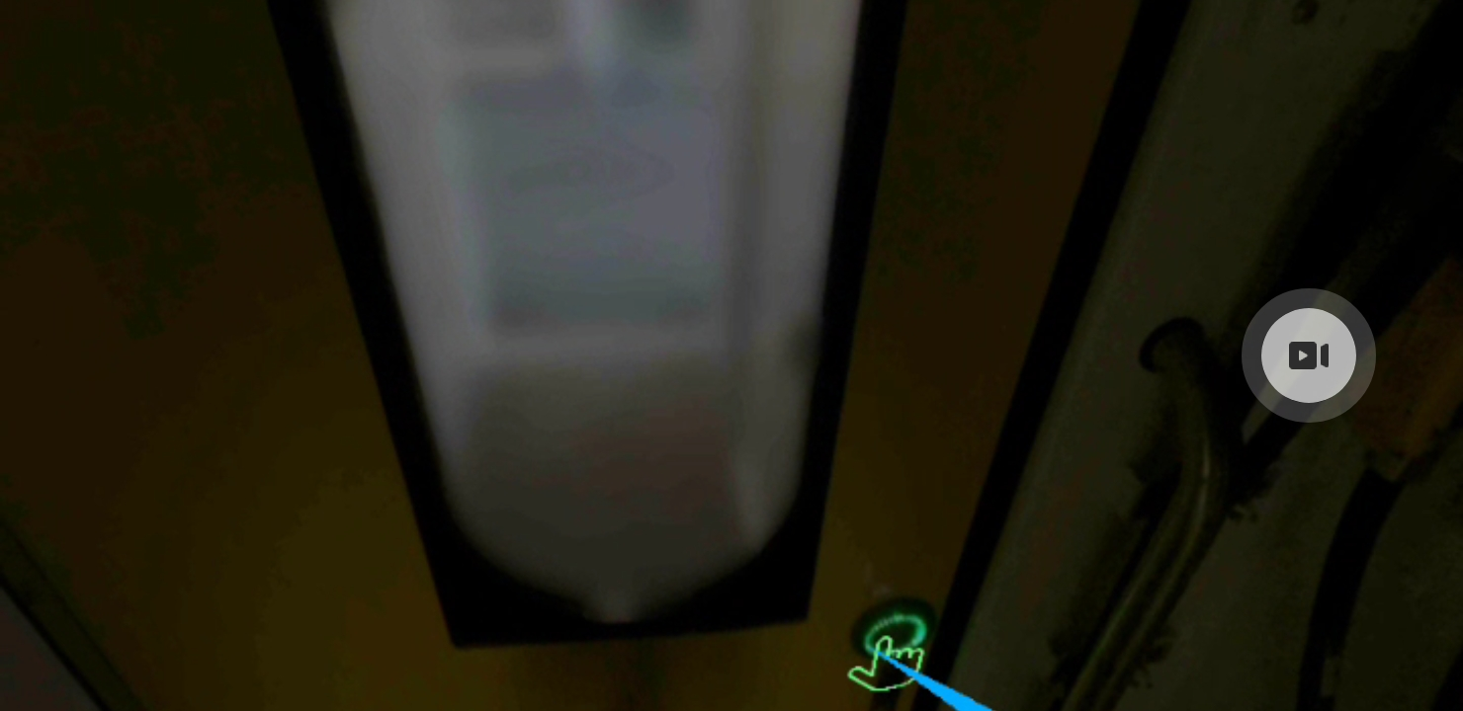
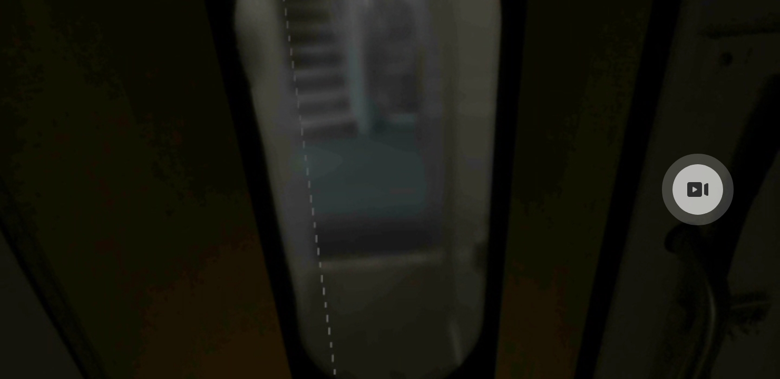
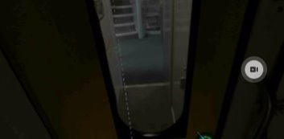
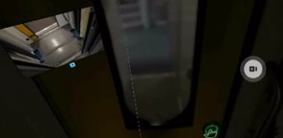
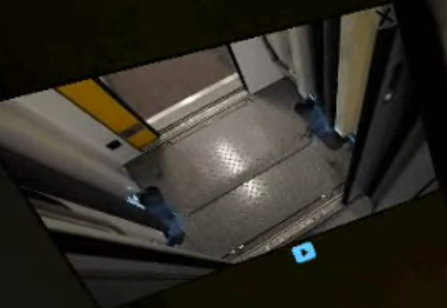


Place a box with a reference to the coach we are entering when going through that door -> if unknown, place a digit for further reference (see example)
Place the jpg picture nearer the + button it refers to (within the field of view), here much lower in the 360 picture

Slide 5
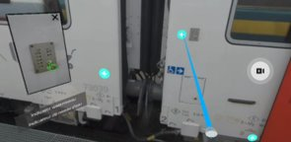
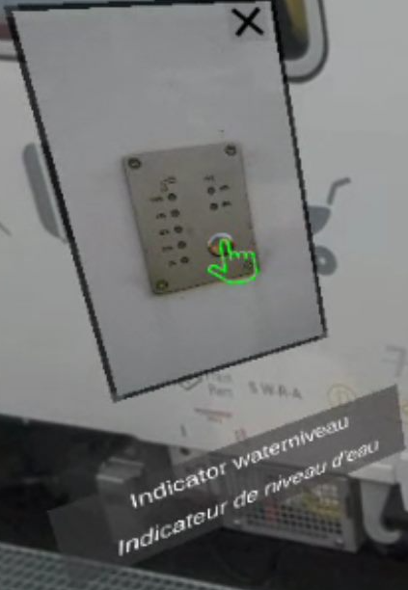



Picture should be displayed within the field of view​

Slide 6
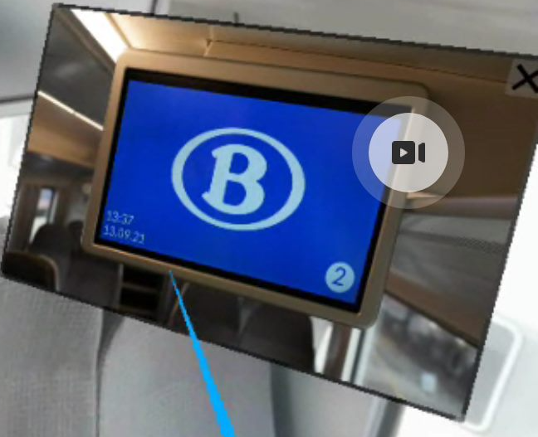
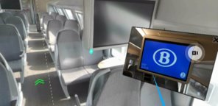



Picture should be displayed within the real screen

Slide 7
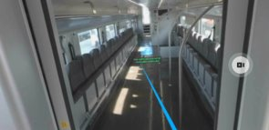


Text is either too far away either too small

Slide 8
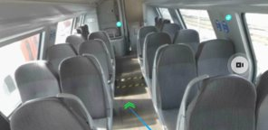


Direction should be mentioned near the green arrows:
"Naar de stuurpost.
Vers le poste de conduite"

Slide 9
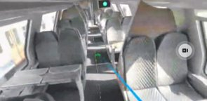
Direction should be mentioned near the green arrows:​
"Naar de platform deur 3-4.​
Vers plateforme porte 3-4."​

Slide 10
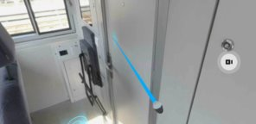

Handle should be near the real handle (on the same level)

Slide 11
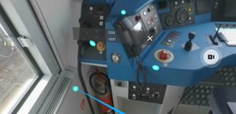
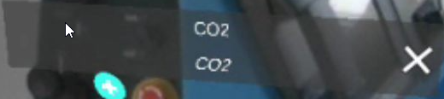


Text should be displayed nearer the fire extinguisher and should mention:
"Brandblusser CO2.
Extincteur CO2."

Slide 12
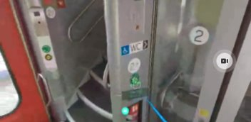

Text should be:
"Naar multifonctionele ruimte.
Vers espace multifonction.

Slide 13
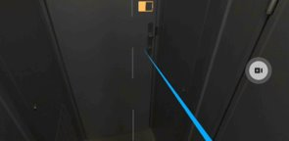

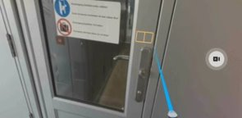





Button to open should be a green coloured key or the same as the BDX system to open the driver cabin door:

Slide 14
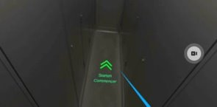


Text should be:
"Naar platform deuren 1-2.
Vers plateforme portes 1-2."
Not Starten Commencer

Slide 15
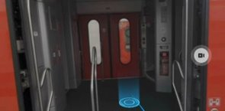
Unable to enter AB coach from outside door 4 (not sure, please check).

Slide 16
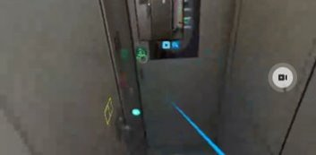
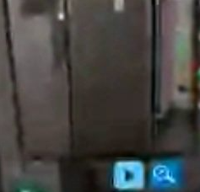
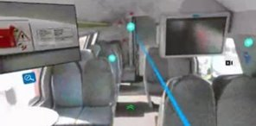





1. When clicking on the +, the image should be displayed nearer the field of view.
2. The shutting button should be a cross on the top right of the picture (see best practice)

Slide 17
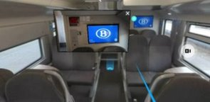
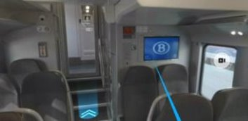





The jpg image used refers to the screen on the opposite side of the Bmx coach.
Please move the action button to the opposite side of the picture along with the jpg.

Slide 18
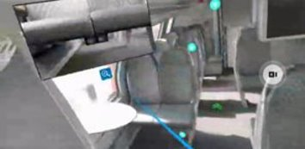
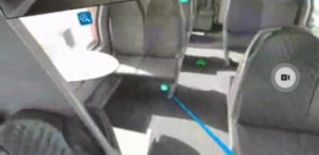
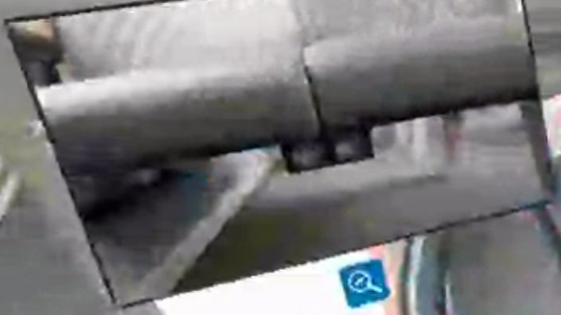
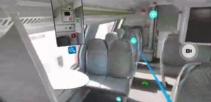




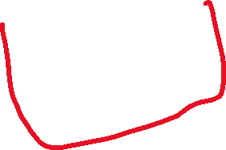


Please move the detailed picture nearer to the action button +​
and
Change the shutting button to a cross on the top right of the picture (see best practice)

Slide 19
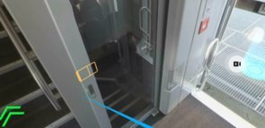
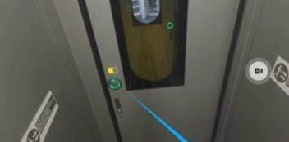





Please remove yellow slider and replace with green hand pointing to the almost invisible button on the same level as the handle on the door.

Slide 20
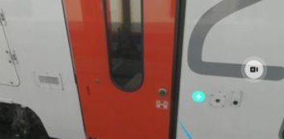

I should be able to access the inside of the coach Bmx from that place (outside Bmx door 1)

Slide 21
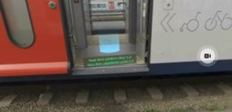


Slide 22
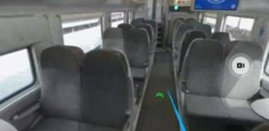

Naar deur 1-2.
Vers portes 1-2

