Slide 1
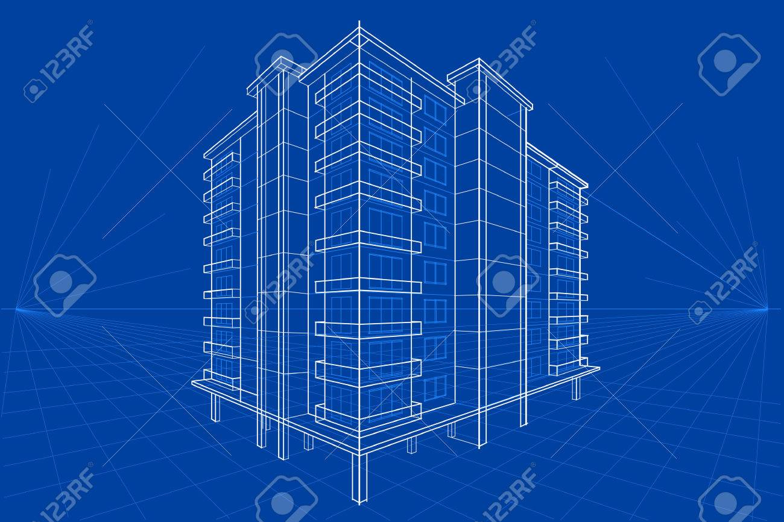
Class & Object
A class is a user defined blueprint or prototype from which objects are created.
A class is a collection of fields , methods and constructor.

Slide 2
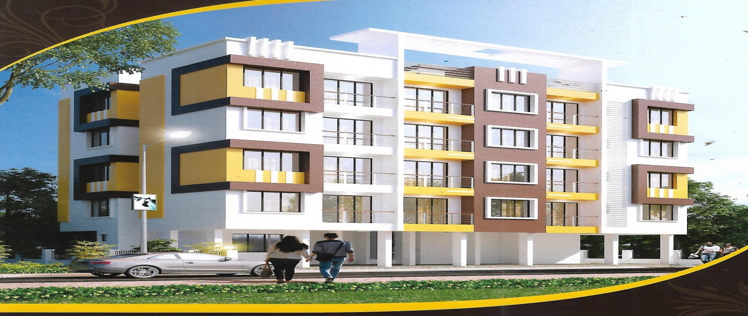
Object …
It is a basic unit of Object Oriented Programming and represents the real life entities.
When an object of a class is created, the class is said to be instantiated.

Slide 3
Constructor
Object creation syntax:-
Test t = new Test();
Test → class Name
t → Reference variables
= → assignment operator
new → keyword used to create object
Test () --→ constructor
; --→ statement terminator
When we create new instance (Object) of a class using new keyword, a constructor for that class is called.
Constructors are used to initialize the instance variables of a class.

Slide 4
Rules to declare Constructor
1) Constructor name class name must be same.
2) Constructor is able to take parameters.
3) Constructor not allowed explicit return type (return type declaration not possible).

Slide 5
Types of Constructor
1) Default Constructor (provided by compiler).
2) User defined Constructor (provided by user) or parameterized constructor.

Slide 6
Default Constructor
1) If we don’t write constructor for a class then compiler generates one constructor for you that constructor is called default constructor, And it is not visible in code.
2) Compiler generates Default constructor inside the class when we are not providing any type of constructor (0-arg or parameterized).
3) The compiler generated default constructor is always 0-argumnetconstructor with empty implementation (empty body).

Slide 7
User Defined Constructor
Inside the class if we are declaring at least one constructor that is called user defined constructor.
The main objective of constructor is initialize some values to instance variables during object creation time.
Constructors are used to write the functionality of project that functionality is executed during object creation.
Inside the class it is possible to declare multiple constructors.

Slide 8
Two Formats of Object creation.
Eager Object creation
Lazy Object creation.
Example:
//Eager object creation approach
Test t = new Test();
t.m1();
//lazy object creation approach
Test t1;
t1=new Test();
t1.m1();

Slide 9
Constructor Chaining
Calling a constructor inside a constructor is possible
Constructor call should be the first statement
this can be used to access the current class variables , methods and the constructors.
Constructor creation restriction
Singleton design pattern and its usages in real time with example.
Mandatory variables creation via constructor

