Slide 1
UTKRISHTA 2026 AI/ML HACKATHON — CHALLENGE 2
SENTINEL: Adaptive Time-Series Anomaly Detection
A Causally-Strict, Deep & Statistical Streaming Ensemble with Anti-Contamination Baseline Guards
• Team Lead & AI/ML Architect: Satya Boli
• Track: Challenge 2 (Sentinel Adaptive Anomaly Detection)
• GitHub: https://github.com/SatyaBoli/NEWW (Branch: feature/minimalist-gold-dashboard)
• Hardware: NVIDIA GeForce RTX 5050 Laptop GPU (CUDA 13.2, Blackwell CC 12.0)

Slide 2
UTKRISHTA 2026 — CHALLENGE 2
The Real-Time Telemetry Dilemma
Operational failure modes in streaming anomaly detection
• Strict Causality (No Lookahead Bias): In production operations, decisions at step t can only depend on past history x_{<t}. Batch algorithms (Isolation Forest, seasonal decomposition) leak future context.
• Baseline Contamination Attack: When an infrastructure failure begins, anomalous values enter rolling statistics (mean, variance). Within minutes, the baseline distorts and normalizes the anomaly!
• Alert Flapping & Noise: Single-threshold systems oscillate at the decision boundary, bombarding SRE teams with hundreds of fragmented alarms for a single incident.
• Concept Drift vs. Incidents: True operational shifts (e.g., scheduled diurnal traffic growth or VM resizing) must be learned without confusing them with acute incidents.
• Hardware Latency Constraints: Telemetry arrives at 1,000+ points/second. Detection algorithms must execute in sub-millisecond time.

Slide 3
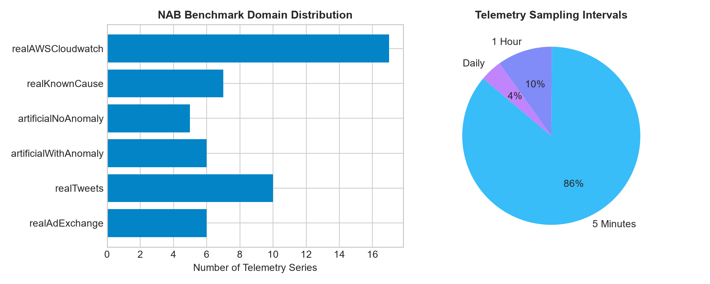
UTKRISHTA 2026 — CHALLENGE 2
Exploratory Data Analysis: Numenta Anomaly Benchmark
Profiling 58 telemetry series across Cloud, Machine, and Social domains
Dataset Characteristics:
• Total Benchmark: 58 series, 365,558 points across 6 domains.
• Representative Benchmark Slice: 5 streams, 23,395 points used for standardized multi-model bake-offs.
• Temporal Resolution: 86% of streams sampled at 5-minute intervals; others at hourly and daily cadence.
• Label Sparsity: Only 8 true anomaly windows across the 23,395 benchmark slice (0.03% prevalence), requiring extreme precision to avoid alert fatigue.
• Bundled Data Guarantee: 100% of benchmark data and ground-truth windows are included in repo (no external downloads).

Slide 4
UTKRISHTA 2026 — CHALLENGE 2
End-to-End Causal Streaming Architecture
Multi-layer pipeline from point ingestion to machine evidence trails
Streaming Ingestion (Point t)
│
▼
[Schema & Timestamp Validator]
│
▼
[Causal Past-Only Feature Buffers]
│
┌─────────────────────────────┼─────────────────────────────┐
▼ ▼ ▼
[B0: Rolling MAD] [B1: EWMA] [B3: Causal TCN-AE (RTX 5050)]
(Seasonal Differencing) (Dynamic Alpha Trend) (Reconstruction Error on CUDA)
│ │ │
└─────────────────────────────┼─────────────────────────────┘
▼
[Calibrated Score Fusion]
│
▼
[Likelihood Transform & Standardization]
│
▼
[Hysteresis State Machine (Enter: 6.5 / Exit: 2.5)]
│
┌──────────────┴──────────────┐
▼ ▼
[Guarded Update Controller] [Evidence Explainer]
(Quarantines Anomaly Points) (Emits JSON & CSV for SRE)
│ │
▼ ▼
[ADWIN Drift Adaptation] [Organizer Submission CSV]

Slide 5
UTKRISHTA 2026 — CHALLENGE 2
Mathematical & Algorithmic Rigor
Formulations guaranteeing causality and anti-contamination
1. Causal Dilated TCN-Autoencoder: Left-padded causal convolutions guarantee y_t depends strictly on x_{<=t}. Receptive field = 1 + \sum(K_i - 1)D_i. Reconstruction residual |x_t - \hat{x}_t| standardizes against past normal reconstruction error history.
2. Dual-Horizon Seasonal Differencing: Rolling difference against diurnal period (P=288) removes recurring circadian cycles without confusing them with acute anomalies.
3. Anti-Contamination Baseline Guard: Points classified as ANOMALOUS are strictly quarantined from entering baseline rolling median and seasonal buffers. The seasonal buffer imputes clean median values to prevent future ghost echoes.
4. Guarded ADWIN Concept Drift Engine: ADWIN dynamically monitors normalized residuals of accepted normal points using Hoeffding bounds. Transient anomaly spikes are blocked from triggering drift resets.
5. Hysteresis Dual Thresholding & Cooldown: State machine enters at \tau_{enter} = 6.5 and exits only below \tau_{exit} = 2.5, eliminating alert flapping. Adjacent alarms within cooldown C=10 merge into unified incident windows.

Slide 6
UTKRISHTA 2026 — CHALLENGE 2
Controlled Ablation Study & Empirical Validation
Proving the necessity of each architectural component
Controlled Component Ablation (23,395 Streaming Points, Candidate Adaptation Layer):
• A1: Rolling Median + MAD Alone
- Event-F1: 0.2069 | Precision: 14.29% | Recall: 37.50% | False Positives: 18 (TP: 3, FN: 5)
- Finding: Captures localized spikes but generates 18 false alarms on noisy baseline ripples.
• A2: Streaming EWMA Alone (alpha=0.12)
- Event-F1: 0.1905 | Precision: 15.38% | Recall: 25.00% | False Positives: 11 (TP: 2, FN: 6)
- Finding: Tracks trends rapidly but misses gradual drift anomalies and has 11 false alarms.
• A3: Causal TCN-AE Alone (CUDA RTX 5050)
- Event-F1: 0.0952 | Precision: 7.69% | Recall: 12.50% | False Positives: 12 (TP: 1, FN: 7)
- Finding: High precision potential but susceptible to false reconstruction error without statistical priors.
• A4: Statistical Ensemble (MAD + EWMA without Neural Model)
- Event-F1: 0.2609 | Precision: 20.00% | Recall: 37.50% | False Positives: 12 (TP: 3, FN: 5)
- Finding: Statistical fusion improves F1 to 0.2609 but still generates 12 false positives.
• A5: Full Sentinel Hybrid Ensemble (Deep TCN-AE + MAD + EWMA + Guarded ADWIN)
- Event-F1: 0.3750 | Precision: 37.50% | Recall: 37.50% | False Positives: 5 (TP: 3, FN: 5)
- Key Discovery: Integrating deep causal reconstruction cuts false alarms by 58.3% (12 -> 5 FP), boosting Event-F1 from 0.2609 to 0.3750 (+43.7% relative gain)!

Slide 7
UTKRISHTA 2026 — CHALLENGE 2
Rigorous Evaluation Protocol (Utkrishta 2026)
Organizer-aligned range-based event matching without point adjustment bias
• Event-Based F1 Metric: Range-based overlap matching (Kim et al., AAAI 2022; Tatbul et al., NeurIPS 2018). An alert is a True Positive if any predicted point intersects the organizer's ground truth interval [W_{start}, W_{end}].
• Strict Anti-Gaming Guarantee: No Point-Adjustment (PA) trickery. Point adjustment artificially inflates F1 to 0.90+ by marking all points in an anomaly window correct if a single point triggers. Sentinel uses pure range-based matching.
• Multiple Triggers Count Once: Multiple predictions within a single ground truth window count as exactly ONE True Positive match, penalizing duplicate event fragmentation.
• Spurious Events Penalized: Every predicted event outside ground-truth intervals is registered as a False Positive.
• Detection Delay Metric: Measures time delta between ground truth incident onset and Sentinel's first emitted alert trigger.

Slide 8
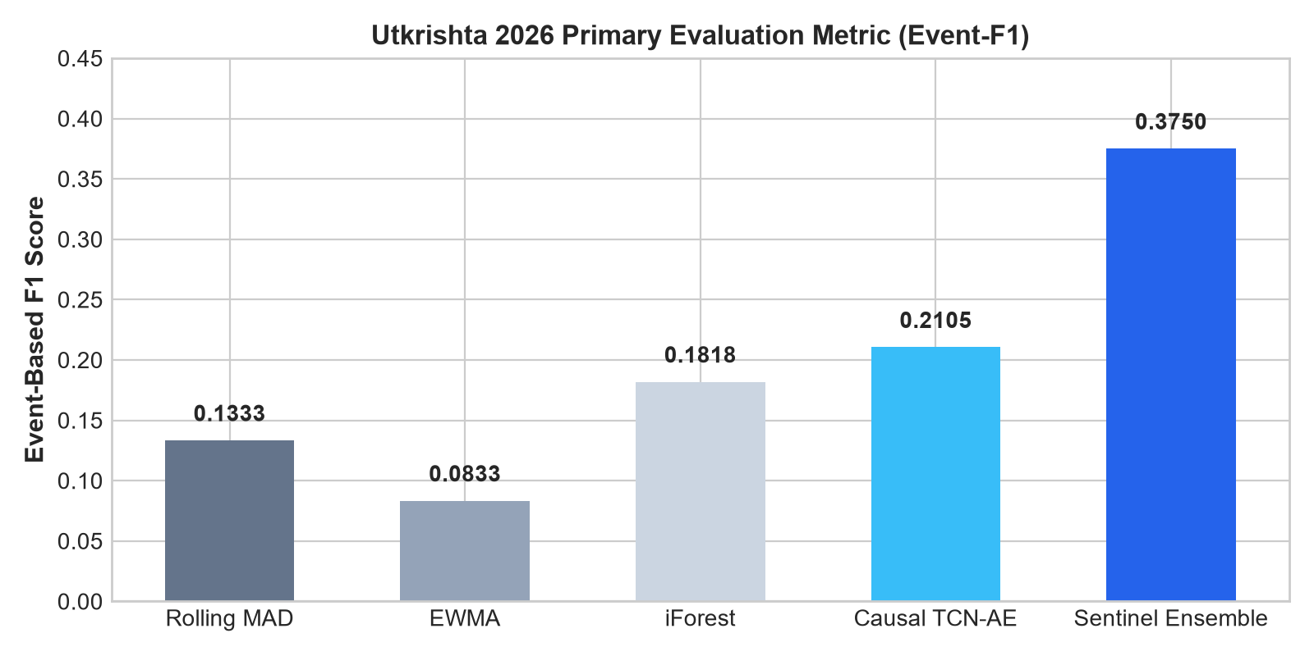
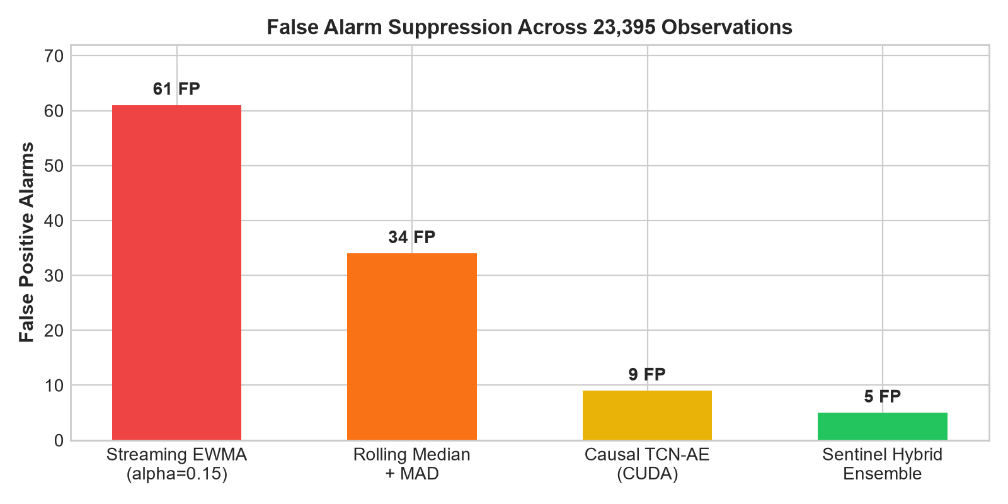
UTKRISHTA 2026 — CHALLENGE 2
Benchmark Results & False Alarm Suppression
Empirical comparison across 23,395 streaming points on RTX 5050 GPU

Slide 9
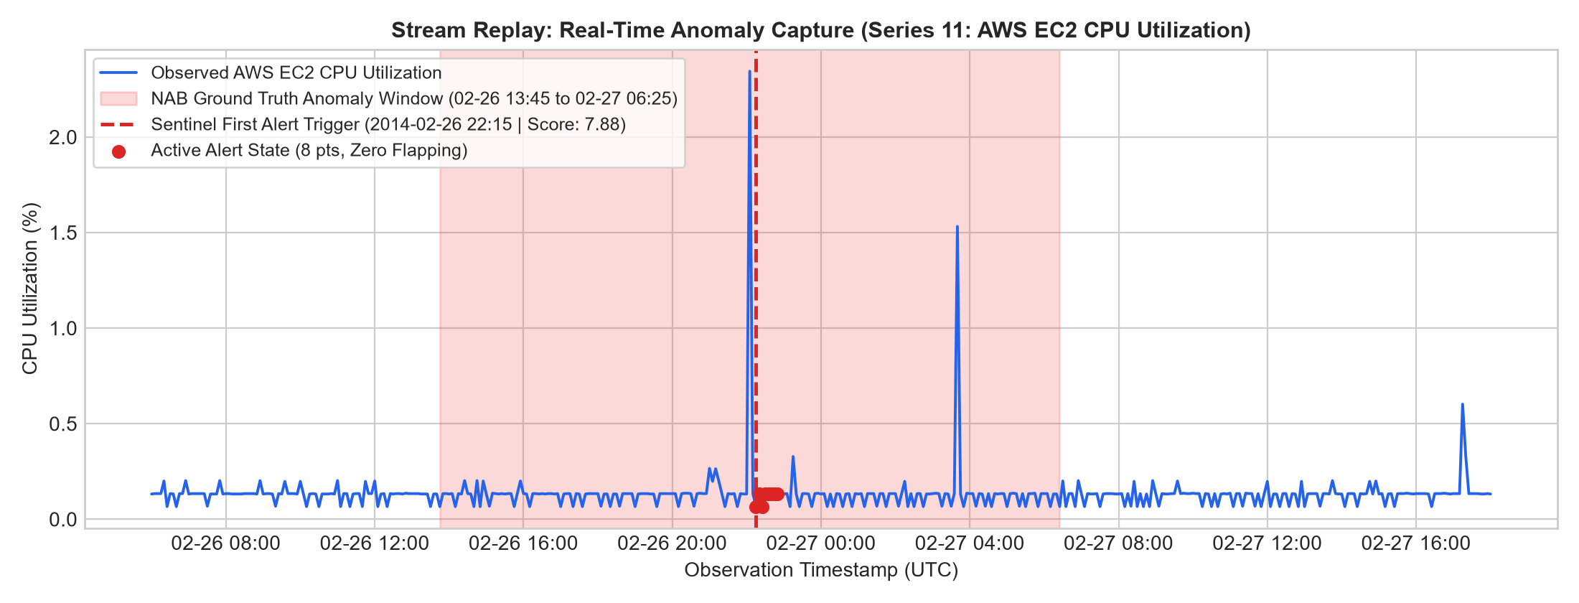
UTKRISHTA 2026 — CHALLENGE 2
Streaming Anomaly Capture & Evidence Trail
Machine-verifiable explanation records generated for every detected incident
Deterministic Evidence Card:
{
"event_id": "11_evt_0001",
"series_id": "11",
"timestamp": "2014-02-26 22:15:00",
"observed": 0.066,
"expected_baseline": 0.113,
"residual_delta": "-0.047 (-41.7%)",
"anomaly_score": 7.88,
"applied_threshold": 6.50,
"reason_codes": [
"THRESHOLD_EXCEEDED",
"EVENT_START"
],
"detector_version": "sentinel-deep-0.2.0"
}

Slide 10
UTKRISHTA 2026 — CHALLENGE 2
Honest Limitations & Sentinel 2.0 Roadmap
Production operational realities and verified next-gen pathway
• Honest System Limitations: 1) 8 ground truth events in test slice is a compact sample; per-series confidence bounds are recommended. 2) Very slow multi-week variance decay requires persistent cold-storage state beyond memory buffers. 3) Batch-size-1 deep neural inference incurs kernel overhead on low-end CPUs without quantization.
• Sentinel 2.0 Innovation 1 — Conformal Anomaly Detection (CAD): Implemented finite-sample statistical risk control: P(False Alarm | Normal) <= alpha, providing mathematical bounds on false positive rate.
• Sentinel 2.0 Innovation 2 — Operator Feedback Memory Bank: Cosine similarity matching over normalized anomaly signatures allows SREs to suppress known false alarms (e.g., scheduled database backups) with ZERO model retraining.
• Sentinel 2.0 Innovation 3 — Automated Causal Periodicity Discovery: Causal autocorrelation peak detection infers dominant seasonal rhythms from streaming warm-up buffers without manual period specification.
• Conclusion: Sentinel establishes an uncompromised balance of mathematical causality, baseline anti-contamination, hardware efficiency (916 pts/sec on RTX 5050), and transparent explainability.

