Slide 1

CROWDFUNDING
By:
SATYA NARAYANA REDDY KOTTAM
SARIKA SHAIKH
SUSHMA SWARAJ
ARVIND DAS
SHIVAM SHEKHAR
SANDESH PATIL

Slide 2

PROJECT OVERVIEW
This Project tell us about the actionable insights regarding the crowdfunding platforms and their impact on the individual projects following the different parameters. It aims at the analysis of key performance indicator and give the data driven insights to take critical business decisions.

Slide 3










PROJECT DEVELOPMENT FLOW
Client discussion
Understand business need
Set Up Project Deadlines
Data Extraction
Develop Models
Data cleaning/transformation
Manage Relationships
KPI Visuals
Dashboard Development
Final Submission

Slide 4
DATA CLEANING AND TRANSFORMATION
Raw data is in Excel format containing 365893 rows including the header and 25 columns.
We did the data cleaning using Power Query Editor like identifying the Null values, replacing name errors, adding related columns.
Identified the common column to build the relationship model with the different tables.
Transformed the epoch time to natural time using add column in power Query Editor.
Created data model using Power Pivot in Ms Excel and used joins to join different tables in SQL.
Created data model by joining like columns in star schema model in Power BI.

Slide 5
KEY PERFORMACE INDICATORS (KPI)
Total Number of Projects based on outcome
Total Number of Projects based on Locations
Total Number of Projects based on Category
Total Number of Projects created by Year , Quarter , Month
Amount Raised
Number of Backers
Avg. Number of Days for successful projects
Top Successful Projects : Based on No. of backers and Amount raised
Percentage of Successful Projects overall
Percentage of Successful Projects by Category
Percentage of Successful Projects by Year , Month
Percentage of Successful projects by Goal Range

Slide 6
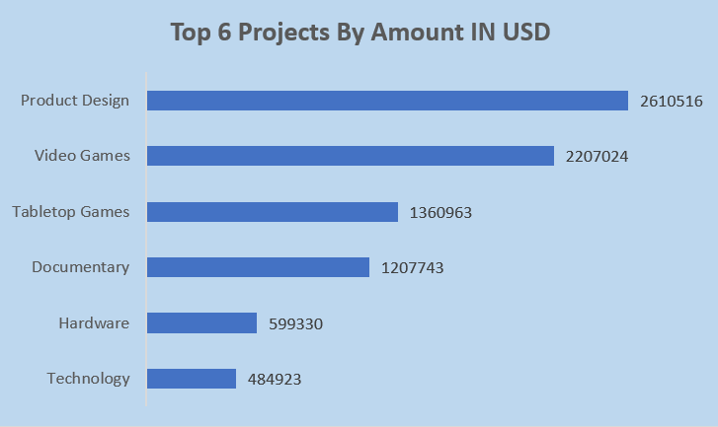
KPI : TOP SUCESSFUL PROJECT BY AMOUNT
Analysis: After analysing the top 6 successful project by amount in USD, we observe that Product Design is contributing highest followed by video games on second highest and the least contribution is from Technology.

Slide 7

KPI: SUCCESSFUL PROJECT BASED ON NUMBER OF BACKERS
It refers to the total number of backers who have funded the project and the project got successful. According to the analysis, we got that 39.97 million backers invested in successful project.

Slide 8
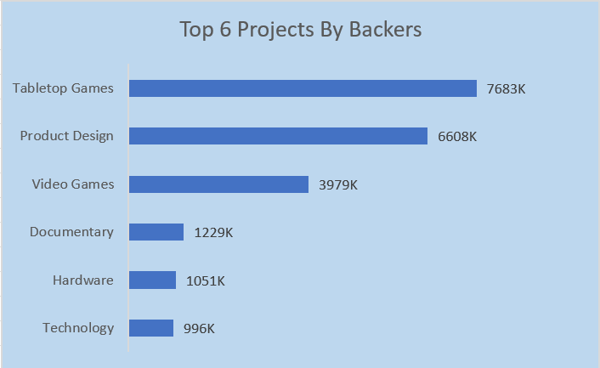
KPI: TOP SUCCESSFUL PROJECT BY BACKERS
Analysis: Upon analysing top 6 successful project by backers count, we can observe that Tabletop Games is the project category with highest count of backers

Slide 9
KPI: TOTAL NUMBER OF PROJECTS BASED ON OUTCOME
Key Takeaways:
Majority Outcome: Failure (188.24K) is the most common outcome, indicating a need for improved processes, planning, or resources to increase the likelihood of success.
Room for Improvement: With nearly 38.34% of projects being successful, there’s substantial room to enhance project outcomes by analysing and replicating successful project practices.
Smaller Categories: Categories like "cancelled," "live," "suspended," and "purged" collectively account for 10.22%, which are minor but could provide insights into project stoppages and ongoing trends.

Slide 10
KPI: TOTAL NUMBER OF PROJECTS BASED ON LOCATIONS
United States (US):
Total Projects: 268K
Proportion: Likely over 90% of the total projects, indicating that the majority of project activity occurs in the US.
Reason for Dominance: This could be attributed to factors like:
Higher market penetration of the platform or dataset in the US.
Better infrastructure, funding opportunities, and awareness about project-based initiatives.
Large population and economic activity concentrated in this region.

Slide 11
KPI: TOTAL NUMBER OF PROJECTS BASED ON CATEGORY
Highest Category: Product Design
Total Projects: 22K
Position: Product Design is the leading category, indicating significant interest or activity in this area.
Potential Reasons:
Broad appeal and applicability across industries.
High demand for innovative and custom-designed products.
Possible alignment with platforms or organizations promoting creative design projects.

Slide 12
KPI: TOTAL NUMBER OF PROJECTS CREATED BY YEAR,QUARTER,MONTH
In July -2014 Quarter-2 is having highest total projects by Category
The number of projects fluctuates significantly from year to year.
There's a general trend of higher project completion in the second quarter (July-September) and lower completion in the fourth quarter (January-March).

Slide 13
KPI: PERCENTAGE OF SUCCESSFUL PROJECTS OVERALL
Analysis:
Upon analyzing the overall successful projects, the success rate is 38.35%. Out of a total of 3,65,865 projects in our database, 1,40,301 projects are successful. This indicates that more than one-third of the projects achieve their intended goals.

Slide 14
KPI: PERCENTAGE OF SUCCESSFUL PROJECT BY CATEGORY
Analysis:
Upon analyzing the percentage of the top 6 successful projects by category, we observe that "Tabletop Games" is the project category with the highest success ratio, which is 26.99%, followed by "Product Design" at 24.98%.

Slide 15
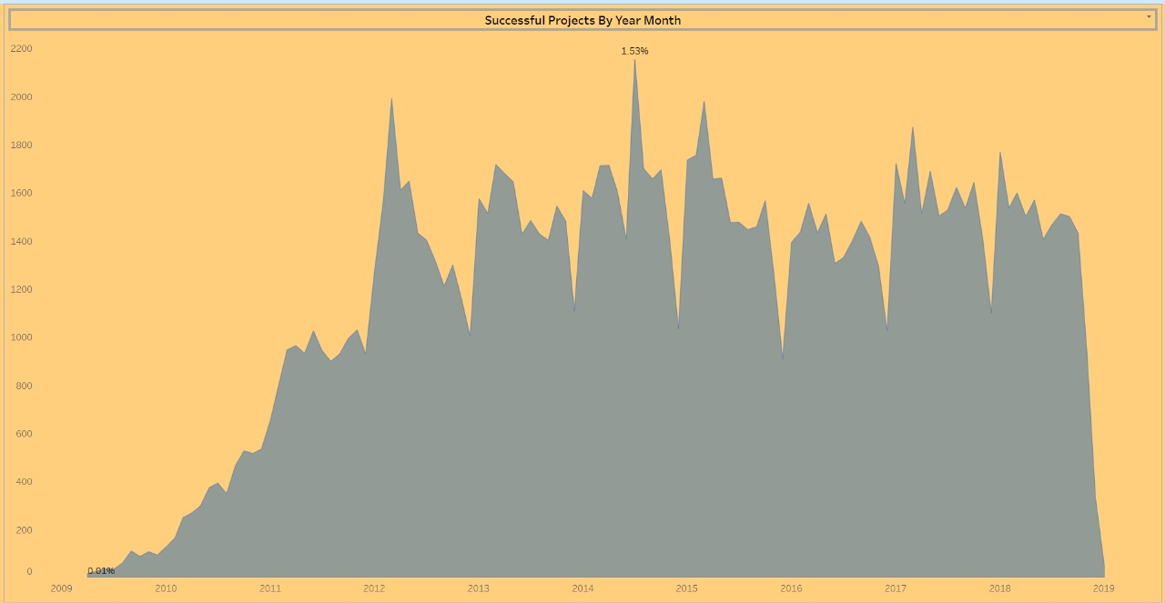
KPI: PERCENTAGE OF SUCCESFUL PROJECT BY YEAR , MONTH
It is observed that in the year 2014, the highest amount of successful projects were present with completion percentage of 1.53% and the crowdfunding peak engagement was at that period only.
Major growth period is observed between 2009 to 2013.
Post 2015, there were subsequent fluctuations in the successful project.

Slide 16
KPI: PERCENTAGE OF SUCCESSFUL PROJECTS BY GOAL RANGE
Analysis:-
We categorized the goal ranges as follows: below 25 lakh is "low," 25-50 lakh is "medium," 50-75 lakh is "high," and above 75 lakh is "very high."
A large majority of projects (99.84%) fall under the "low" goal category, while only 0.16% of projects fall under the "medium," "high," and "very high" goal categories combined.
Regarding successful projects by goal range, 99.99% of successful projects come from the "low" goal category, and only 0.01% of successful projects belong to the other goal ranges.

Slide 17
KPI: AMOUNT RAISED IN USD
Total Amount Raised In USD:
This is the most straightforward KPI, representing the cumulative sum of all funds received.
In this case, it's $3,856.12 million USD . Tracking this KPI helps assess the overall fundraising performance and compare it with targets or previous campaigns.

Slide 18
KPI: NUMBER OF BACKERS
Number of Backers:44.52 Million
Massive Support: A staggering 44.52 million backers signifies an unprecedented level of support and engagement for the project or initiative. This indicates a massive community rallying behind the endeavour.

Slide 19
KPI: AVG NUMBER OF DAYS FOR SUCCESSFUL PROJECTS
Avg Number of Days for Successful Projects: 524 Days
Project Duration: This KPI represents the average duration, in days, for projects to achieve success. In this case, the average time taken for successful projects is 524 days.

Slide 20
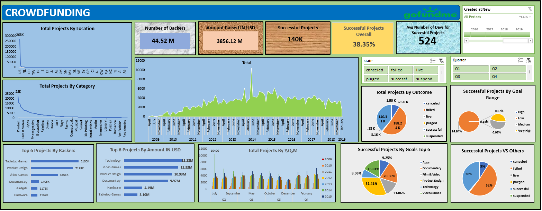
EXCEL DASHBOARD

Slide 21
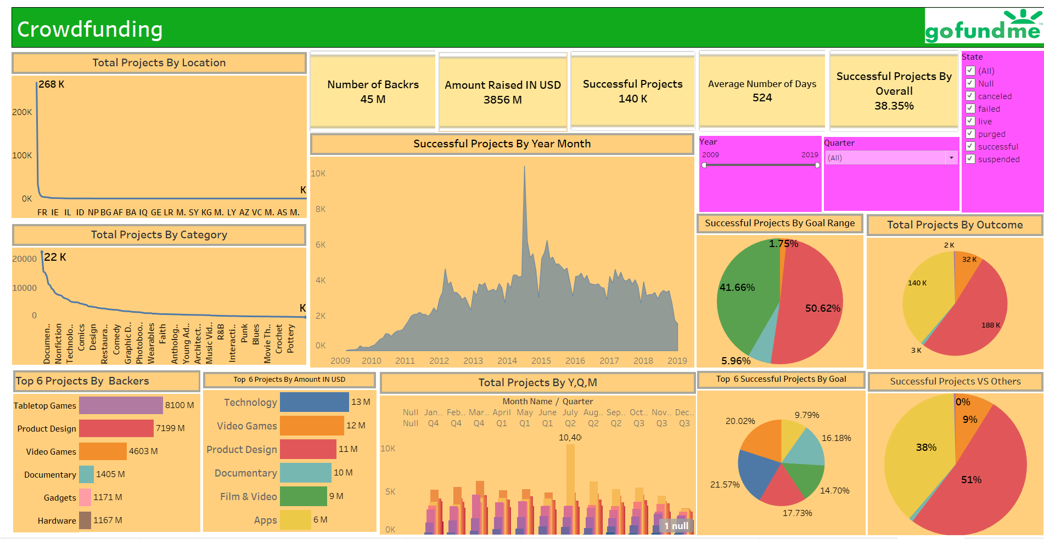
TABLEAU DASHBOARD

Slide 22
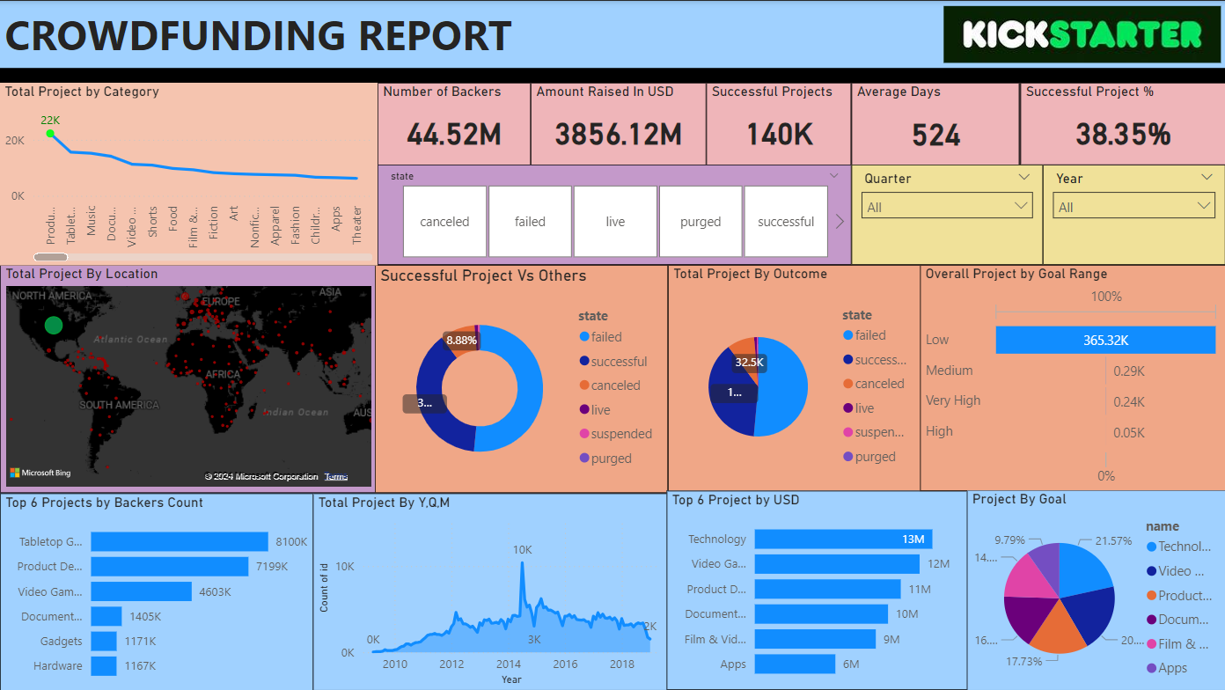
POWER BI DASHBOARD

Slide 23
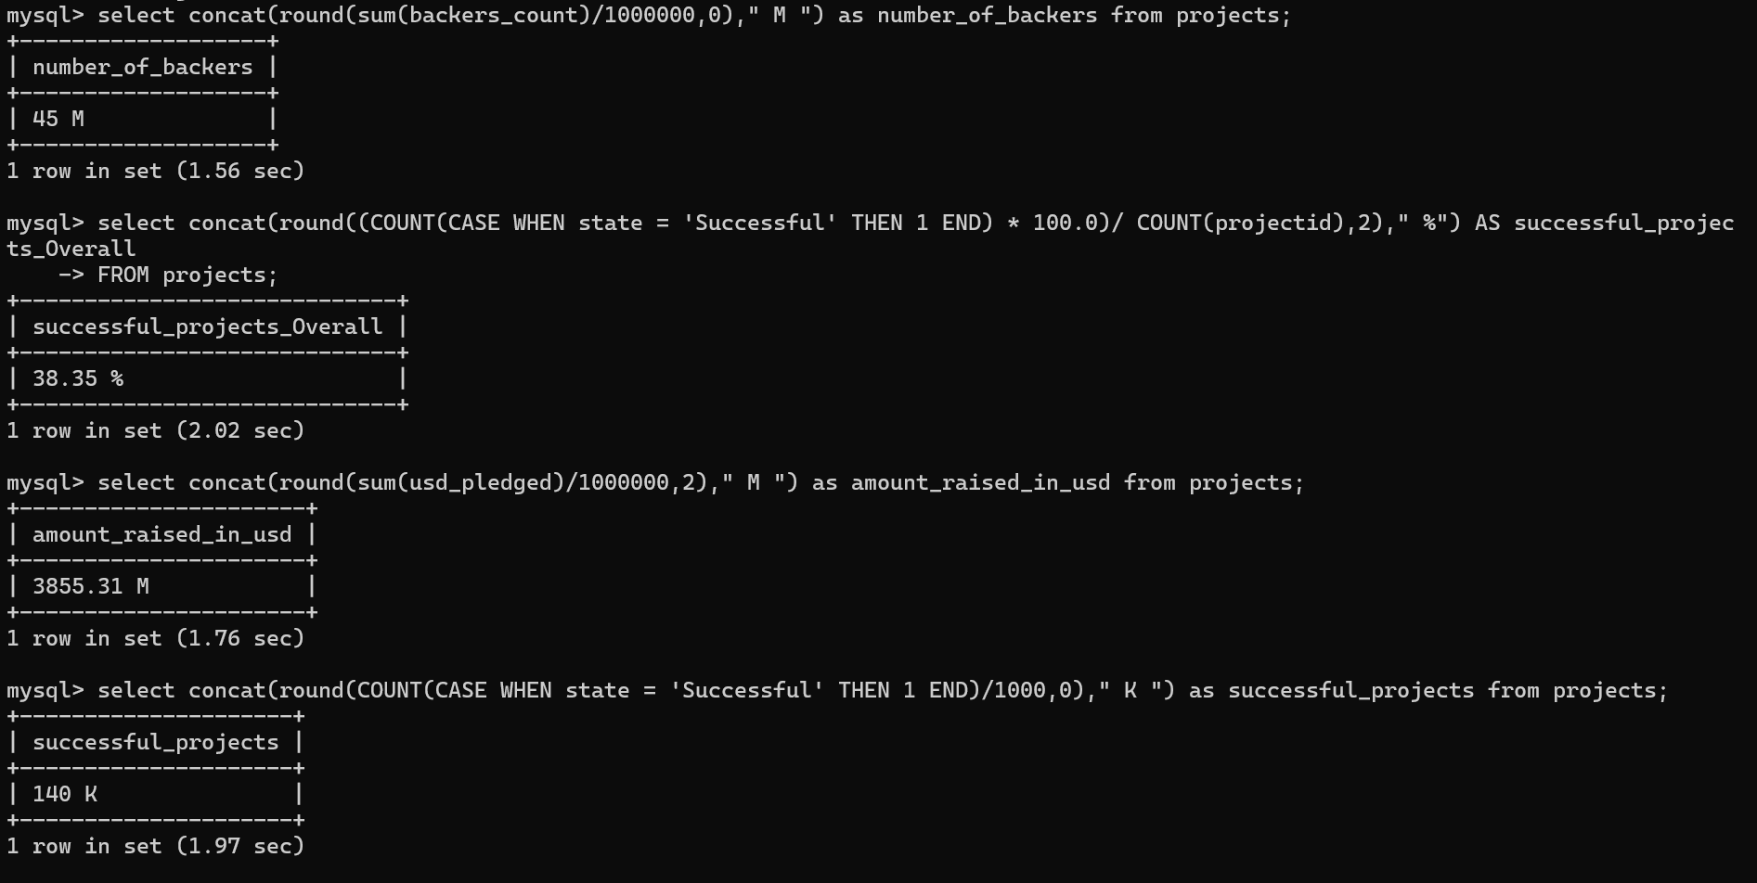
SQL QUERIES AND RESULTS

Slide 24
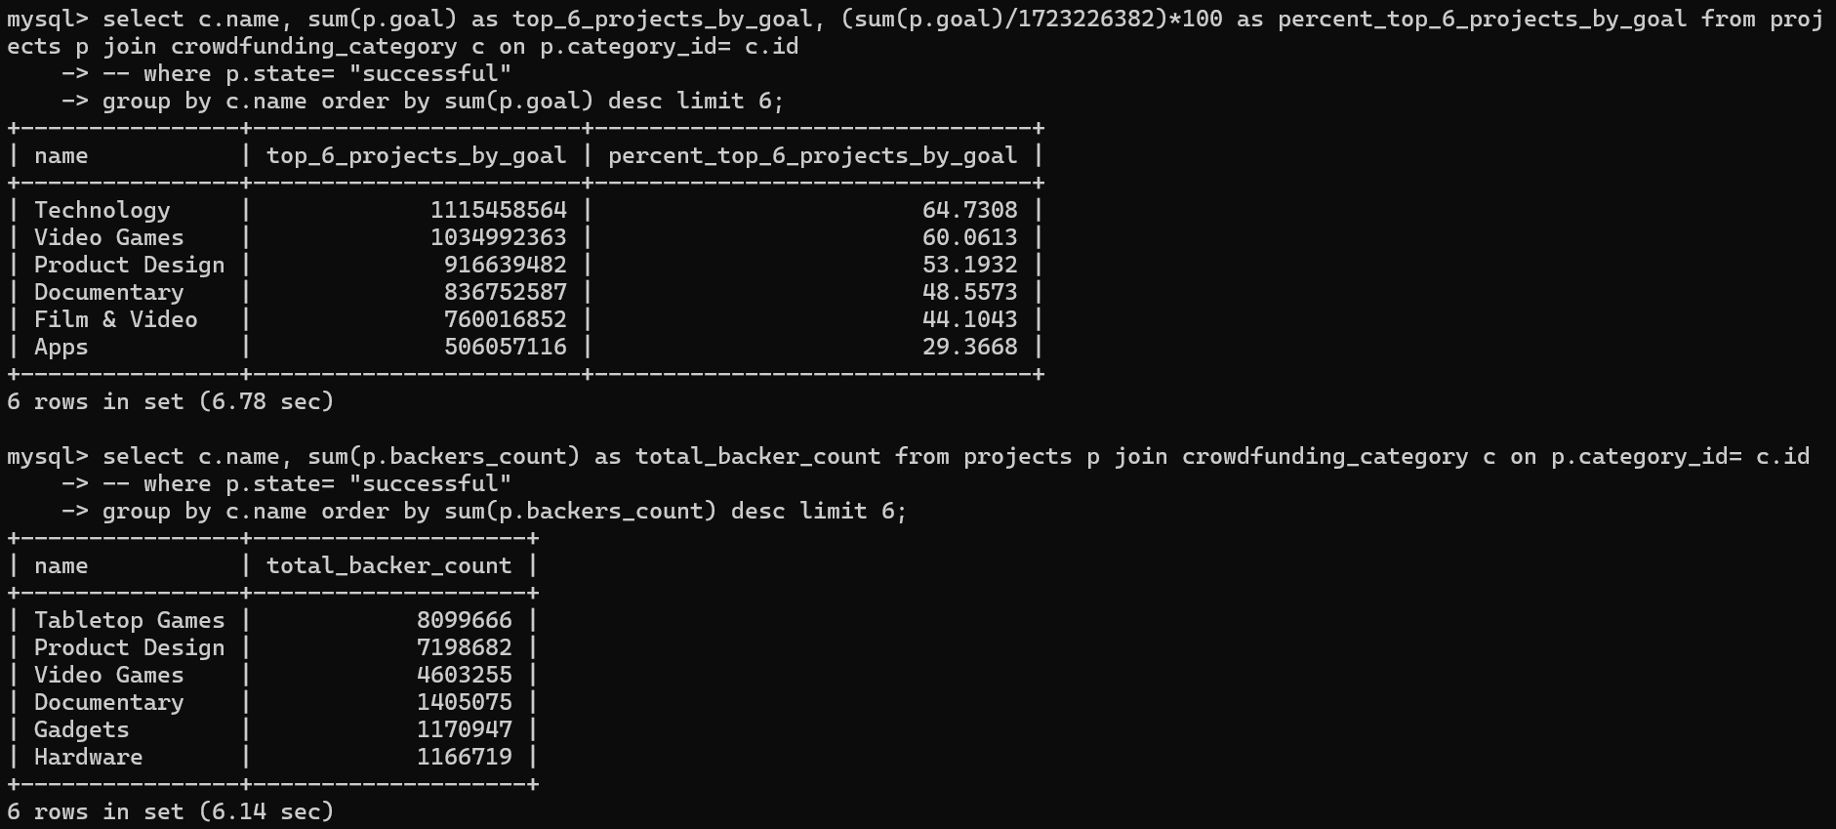
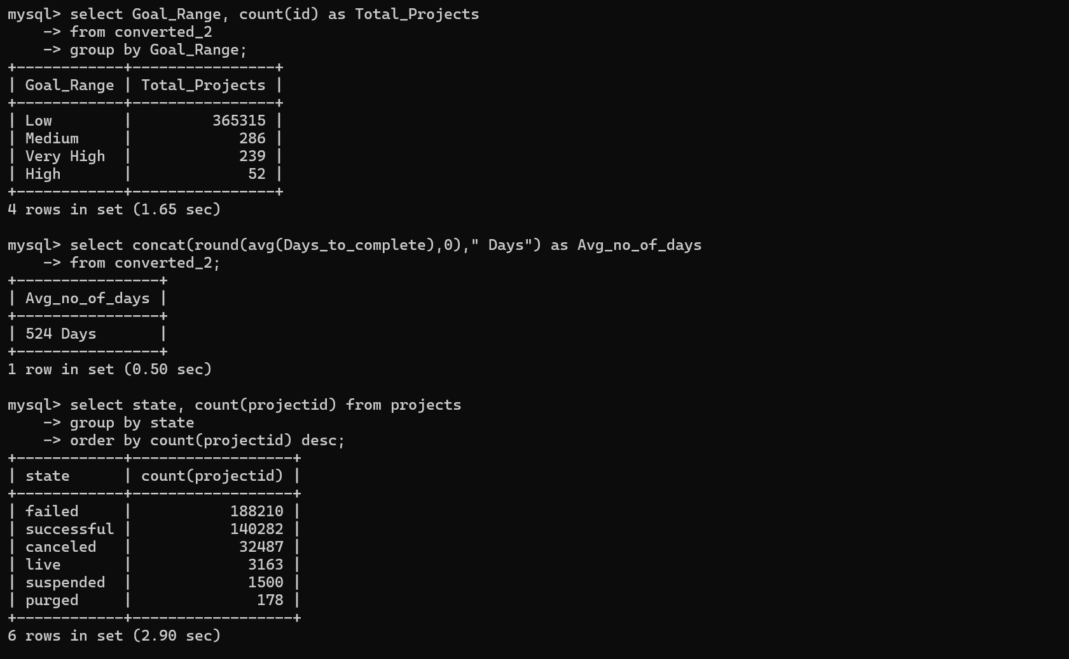

Slide 25
CHALLENGES FACED AND POTENTIAL SOLUTIONS
While data cleaning in Power Query Editor we faced 72 name errors and replaced the errors with null values and it reduced to 27 errors.
While adding KPI Card in excel dashboard, KPI data got removed after saving and closing the file on dashboard and we created manual KPI cards. However, we used barcharts to resolve the issue.
While visualization in Power BI, showing the highest value was a challenge. However, we resolved this challenge by applying DAX iterator function along with conditional formatting.
Importing large records table in SQL was bit challenging as it took almost 5 hours to import 3 Lakh records.

Slide 26
BUSINESS STRATEGIES AND RECOMMENDATIONS
Focus on Key Categories: It is observed that product categories like Product design, Video games, Technology stands on a top categories. That means, creator and backers should collaborate more and develop a strong marketing plan for their project.
Geographical Inclusion: It is observed that most of the projects are concentrated towards US region. Thus, there is a huge demand in penetrating to other countries like UK, Canada.
Improvement of Project Success Rate: Overall success rate is 38.35% with significant failing project. Thus, collaboration with backers and creators should be strong enough to provide basic resources like workshops, templates and effective training for creators to prepare their campaigning plans.
Address Peak times: Peak in project creation and success occurs at a specific months and quarters. Thus, we should run promotional events at high traffic time to scale up the funding activity and enhance platform engagements.
Backers Retention: Although we observe that 45 million backer are engaged with the projects, retention of the backers are the major aspect to project completion. Creation of loyalty programs, access to premium project and frequent communication with the top backers will help achieve backers retention.

Slide 27
THANK YOU

