Slide 1
GRAPHS
DATA STRUCTURES
1

Slide 2
Graph Data Stucture
A graph data structure is a collection of nodes that have data and are connected to other nodes.
Let's try to understand this through an example. On facebook, everything is a node. That includes User, Photo, Album, Event, Group, Page, Comment, Story, Video, Link, Note...anything that has data is a node.
Every relationship is an edge from one node to another. Whether you post a photo, join a group, like a page, etc., a new edge is created for that relationship.

Slide 3









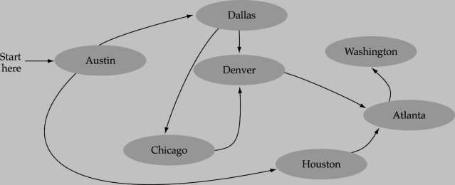
WHAT IS A GRAPH?
A data structure that consists of a set of nodes (vertices) and a set of edges that relate the nodes to each other
The set of edges describes relationships among the vertices
3

Slide 4
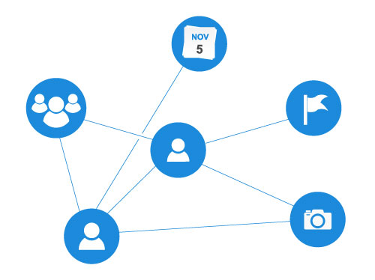
Example of graph data structure
All of facebook is then a collection of these nodes and edges. This is because facebook uses a graph data structure to store its data.

Slide 5
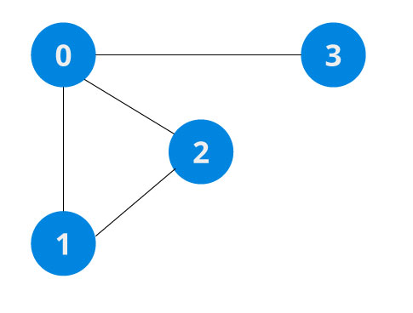
Example of graph data structure
More precisely, a graph is a data structure (V, E) that consists of
A collection of vertices V
A collection of edges E, represented as ordered pairs of vertices (u,v)
In the graph,
V = {0, 1, 2, 3}
E = {(0,1), (0,2), (0,3), (1,2)}
G = {V, E}
Vertices and edges

Slide 6










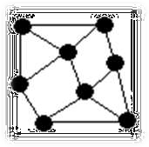
FORMAL DEFINITION OF GRAPHS
A graph G is defined as follows:
G=(V,E)
V(G): a finite, nonempty set of vertices
E(G): a set of edges (pairs of vertices)
6

Slide 7
Graph Terminology
Adjacency: A vertex is said to be adjacent to another vertex if there is an edge connecting them. Vertices 2 and 3 are not adjacent because there is no edge between them.
Path: A sequence of edges that allows you to go from vertex A to vertex B is called a path. 0-1, 1-2 and 0-2 are paths from vertex 0 to vertex 2.
Directed Graph: A graph in which an edge (u,v) doesn't necessarily mean that there is an edge (v, u) as well. The edges in such a graph are represented by arrows to show the direction of the edge.

Slide 8
Graph Representation
Graphs are commonly represented in two ways:
1. Adjacency Matrix
An adjacency matrix is a 2D array of V x V vertices. Each row and column represent a vertex.
If the value of any element a[i][j] is 1, it represents that there is an edge connecting vertex i and vertex j.
The adjacency matrix for the graph we created above is

Slide 9
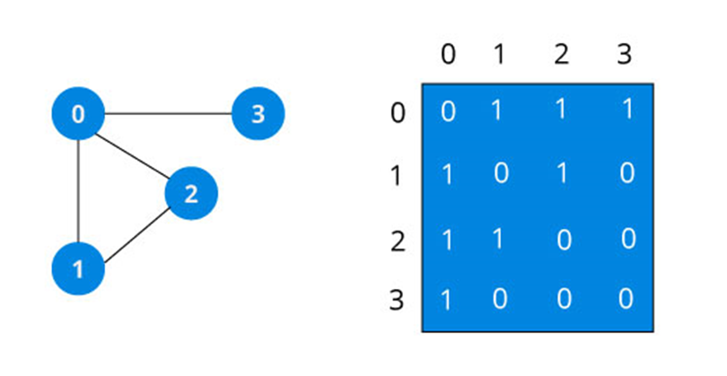
Graph Representation
Graph adjacency matrix
Since it is an undirected graph, for edge (0,2), we also need to mark edge (2,0); making the adjacency matrix symmetric about the diagonal.
Edge lookup(checking if an edge exists between vertex A and vertex B) is extremely fast in adjacency matrix representation but we have to reserve space for every possible link between all vertices(V x V), so it requires more space.

Slide 10
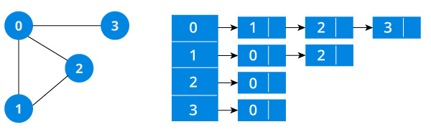
2. Adjacency List
An adjacency list is efficient in terms of storage because we only need to store the values for the edges. For a graph with millions of vertices, this can mean a lot of saved space.

Slide 11






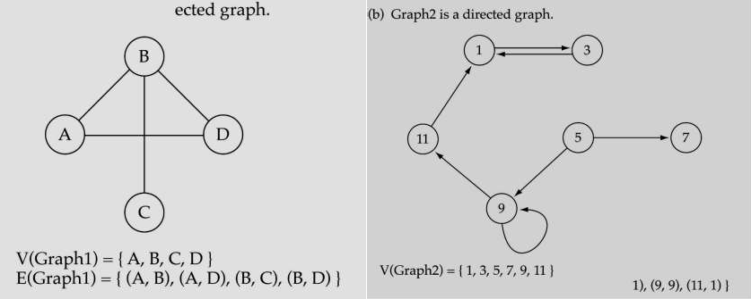
DIRECTED VS. UNDIRECTED GRAPHS
When the edges in a graph have no direction, the graph is called undirected.
When the edges in a graph have a direction, the graph is called directed (or digraph)
4
E(Graph2) = {(1,3) (3,1) (5,9) (9,11)

Slide 12

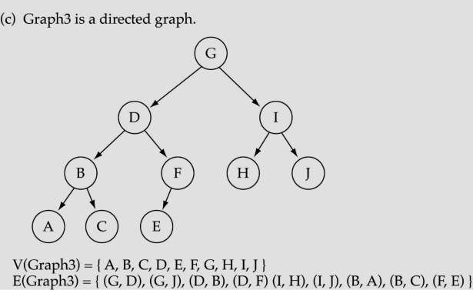
TREES VS. GRAPHS
Trees are special cases of graphs!!
5

Slide 13

GRAPH TERMINOLOGY
Adjacent nodes: two nodes are adjacent if they are connected
by an
edge
5 is adjacent to 7
7 is adjacent from 5
Path: a sequence of vertices that connect two nodes in a graph
Complete graph: a graph in which every vertex is directly
connected to every other vertex
Degree of a vertex: The degree of a vertex in a graph is the number of edges that touch it.
The Size of a Graph: The size of a graph is the number of
vertices that it has.
6

Slide 14
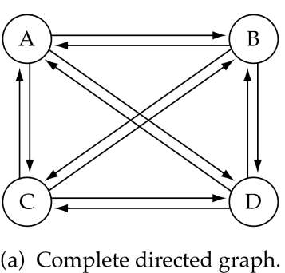
GRAPH TERMINOLOGY (CONT.)
What is the number of edges in a complete directed graph with N vertices? N * (N-1) =O(N ² )

Slide 15


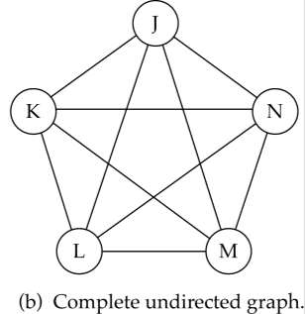

GRAPH TERMINOLOGY (CONT.)
What is the number of edges in a complete undirected graph with N vertices?
N * (N-1) / 2 =O(N ² )

Slide 16
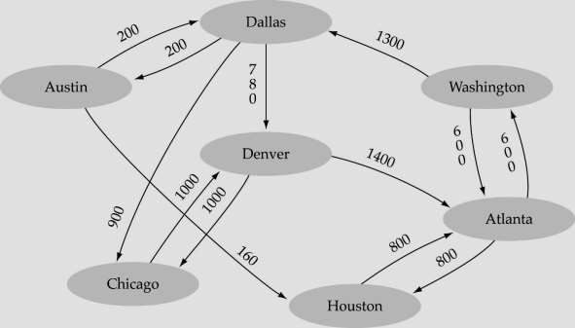
GRAPH TERMINOLOGY (CONT.)
Weighted graph: a graph in which each edge carries a value

Slide 17






GRAPH IMPLEMENTATION
Array-based implementation
A 1D array is used to represent the vertices
A 2D array (adjacency matrix) is used to represent
the edges

Slide 18

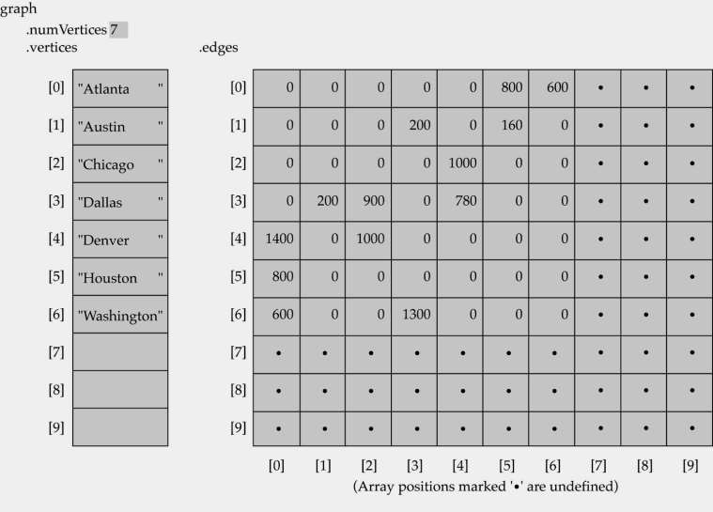
ARRAY-BASED IMPLEMENTATION
11

Slide 19













GRAPH IMPLEMENTATION (CONT.)
Linked-list implementation
A 1D array is used to represent the vertices
A list is used for each vertex v which contains the vertices which are adjacent fr
om v (adjacency list)

Slide 20
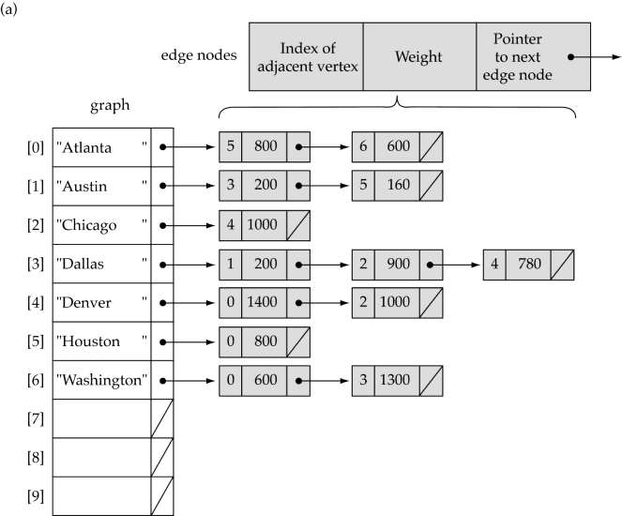
LINKED-LIST IMPLEMENTATION

Slide 21













ADJACENCY MATRIX VS.
ADJACENCY LIST REPRESENTATION
Adjacency matrix
Good for dense graphs --|E|~O(|V|²)
Memory requirements: O(|V| + |E| ) = O(|V|² )
Connectivity between two vertices can be tested quickly
Adjacency list
Good for sparse graphs -- |E|~O(|V|)
Memory requirements: O(|V| + |E|)=O(|V|)
Vertices adjacent to another vertex can be found quickly

Slide 22
Graph Operations
The most common graph operations are:
Check if the element is present in the graph
Graph Traversal
Add elements(vertex, edges) to graph
Finding the path from one vertex to another

Slide 23










GRAPH SEARCHING
Problem: find a path between two nodes of the graph (e.g., Austin and Washington)
Methods: Depth-First-Search (DFS) or Breadth- First-Search (BFS)

Slide 24
GRAPH SEARCHING
What is BFS Algorithm (Breadth-First Search)?
Breadth-first search (BFS) is an algorithm that is used to graph data or searching tree or traversing structures. The full form of BFS is the Breadth-first search.
The algorithm efficiently visits and marks all the key nodes in a graph in an accurate breadthwise fashion. This algorithm selects a single node (initial or source point) in a graph and then visits all the nodes adjacent to the selected node. Remember, BFS accesses these nodes one by one.
Once the algorithm visits and marks the starting node, then it moves towards the nearest unvisited nodes and analyses them. Once visited, all nodes are marked. These iterations continue until all the nodes of the graph have been successfully visited and marked.

Slide 25
What is Graph traversals?
A graph traversal is a commonly used methodology for locating the vertex position in the graph. It is an advanced search algorithm that can analyze the graph with speed and precision along with marking the sequence of the visited vertices. This process enables you to quickly visit each node in a graph without being locked in an infinite loop.

Slide 26
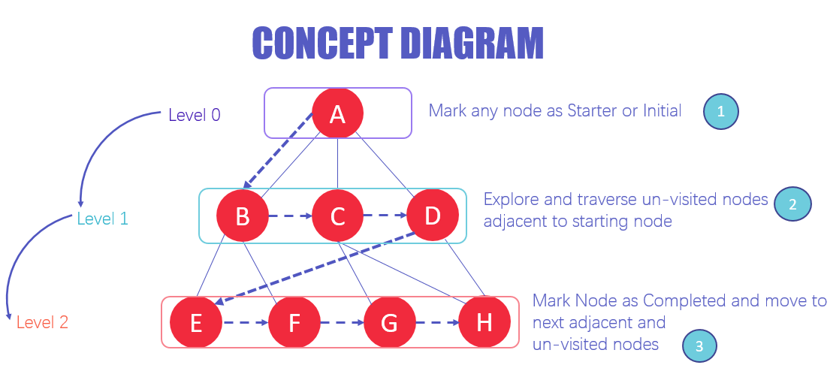
The architecture of BFS algorithm

Slide 27
BFS Algorithm (Breadth-First Search)
In the various levels of the data, you can mark any node as the starting or initial node to begin traversing. The BFS will visit the node and mark it as visited and places it in the queue.
Now the BFS will visit the nearest and un-visited nodes and marks them. These values are also added to the queue. The queue works on the FIFO model.
In a similar manner, the remaining nearest and un-visited nodes on the graph are analyzed marked and added to the queue. These items are deleted from the queue as receive and printed as the result.

Slide 28
Why do we need BFS Algorithm?
There are numerous reasons to utilize the BFS Algorithm to use as searching for your dataset. Some of the most vital aspects that make this algorithm your first choice are:
BFS is useful for analyzing the nodes in a graph and constructing the shortest path of traversing through these.
BFS can traverse through a graph in the smallest number of iterations.
The architecture of the BFS algorithm is simple and robust.
The result of the BFS algorithm holds a high level of accuracy in comparison to other algorithms.
BFS iterations are seamless, and there is no possibility of this algorithm getting caught up in an infinite loop problem.

Slide 29
How does BFS Algorithm Work?
Graph traversal requires the algorithm to visit, check, and/or update every single un-visited node in a tree-like structure. Graph traversals are categorized by the order in which they visit the nodes on the graph.
BFS algorithm starts the operation from the first or starting node in a graph and traverses it thoroughly. Once it successfully traverses the initial node, then the next non-traversed vertex in the graph is visited and marked.
Hence, you can say that all the nodes adjacent to the current vertex are visited and traversed in the first iteration. A simple queue methodology is utilized to implement the working of a BFS algorithm, and it consists of the following steps:

Slide 30
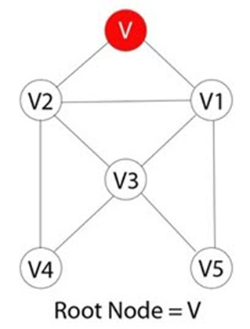
How does BFS Algorithm Work?
Step 1)
Each vertex or node in the graph is known. For instance, you can mark the node as V.

Slide 31
How does BFS Algorithm Work?
in case the vertex V is not accessed then add the vertex V into the BFS Queue

Slide 32
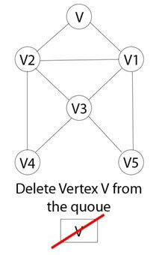
How does BFS Algorithm Work?
Step 3)
Start the BFS search, and after completion, Mark vertex V as visited.

Slide 33
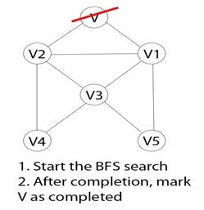
How does BFS Algorithm Work?
Step 4)
The BFS queue is still not empty, hence remove the vertex V of the graph from the queue.

Slide 34
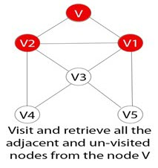
How does BFS Algorithm Work?
Step 5)
Retrieve all the remaining vertices on the graph that are adjacent to the vertex V

Slide 35
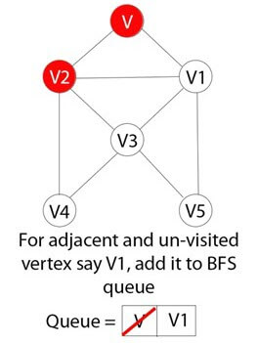
How does BFS Algorithm Work?
Step 6)
For each adjacent vertex let's say V1, in case it is not visited yet then add V1 to the BFS queue

Slide 36
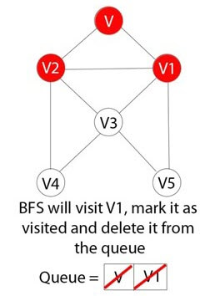
How does BFS Algorithm Work?
Step 7)
BFS will visit V1 and mark it as visited and delete it from the queue.

Slide 37
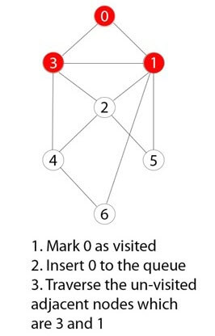
Example BFS Algorithm
Step 1)
You have a graph of seven numbers ranging from 0 – 6.

Slide 38
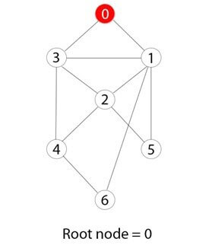
Example BFS Algorithm
Step 2)
0 or zero has been marked as a root node.

Slide 39
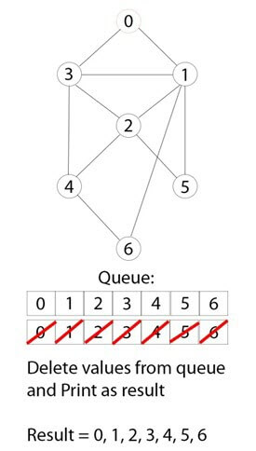
Example BFS Algorithm
Step 3)
0 is visited, marked, and inserted into the queue data structure.

Slide 40
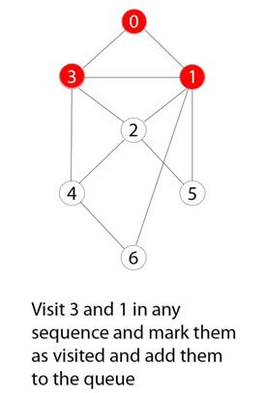
Example BFS Algorithm
Step 4)
Remaining 0 adjacent and unvisited nodes are visited, marked, and inserted into the queue.

Slide 41
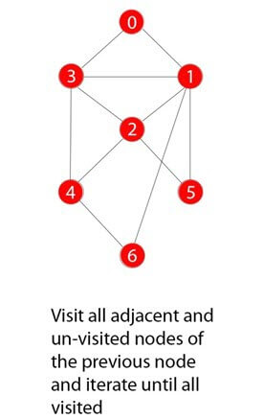
Example BFS Algorithm
Step 5)
Traversing iterations are repeated until all nodes are visited.

Slide 42
Rules of BFS Algorithm
Here, are important rules for using BFS algorithm:
A queue (FIFO-First in First Out) data structure is used by BFS.
You mark any node in the graph as root and start traversing the data from it.
BFS traverses all the nodes in the graph and keeps dropping them as completed.
BFS visits an adjacent unvisited node, marks it as done, and inserts it into a queue.
Removes the previous vertex from the queue in case no adjacent vertex is found.
BFS algorithm iterates until all the vertices in the graph are successfully traversed and marked as completed.
There are no loops caused by BFS during the traversing of data from any node.

Slide 43
BFS pseudocode
create a queue Q
mark v as visited and put v into Q
while Q is non-empty
remove the head u of Q
mark and enqueue all (unvisited) neighbours of u

Slide 44
BFS Algorithm Complexity
The time complexity of the BFS algorithm is represented in the form of O(V + E), where V is the number of nodes and E is the number of edges.
The space complexity of the algorithm is O(V).

Slide 45
BFS Algorithm Applications
To build index by search index
For GPS navigation
Path finding algorithms
In Ford-Fulkerson algorithm to find maximum flow in a network
Cycle detection in an undirected graph
In minimum Spanning Tree

