Slide 1
Breadth first search
Traversal means visiting all the nodes of a graph. Breadth first traversal or Breadth first Search is a recursive algorithm for searching all the vertices of a graph or tree data structure.
BFS algorithm
A standard BFS implementation puts each vertex of the graph into one of two categories:
Visited
Not Visited
The purpose of the algorithm is to mark each vertex as visited while avoiding cycles.

Slide 2
Breadth First Search
Breadth first search is used for traversing a finite graph.
It visits the neighbor vertices before visiting the child vertices.
BFS uses a queue for search process and gets the next vertex to start a search when a dead end occurs in any iteration.
It traverses a graph in a breadth-ward motion.
It is used to find the shortest path from one vertex to another.
The main purpose of BFS is to traverse the graph as close as possible to the root node.
BFS is a different approach for traversing the graph nodes.

Slide 3
Breadth first search
The algorithm works as follows:
Start by putting any one of the graph's vertices at the back of a queue.
Take the front item of the queue and add it to the visited list.
Create a list of that vertex's adjacent nodes. Add the ones which aren't in the visited list to the back of the queue.
Keep repeating steps 2 and 3 until the queue is empty.
The graph might have two different disconnected parts so to make sure that we cover every vertex, we can also run the BFS algorithm on every node

Slide 4
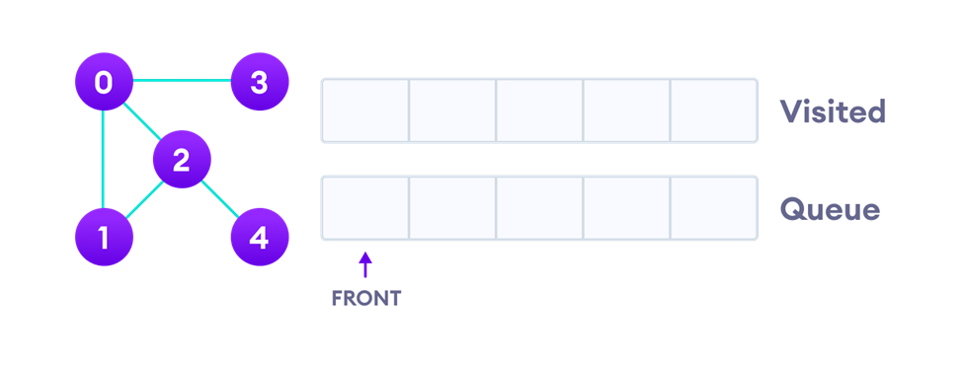
BFS example
Let's see how the Breadth First Search algorithm works with an example. We use an undirected graph with 5 vertices.
Undirected Graph with 5 vertices

Slide 5
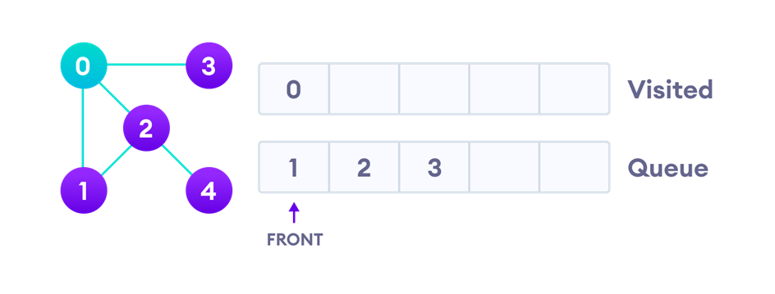
BFS example
We start from vertex 0, the BFS algorithm starts by putting it in the Visited list and putting all its adjacent vertices in the Queue.
Visit start vertex and add its adjacent vertices to queue

Slide 6
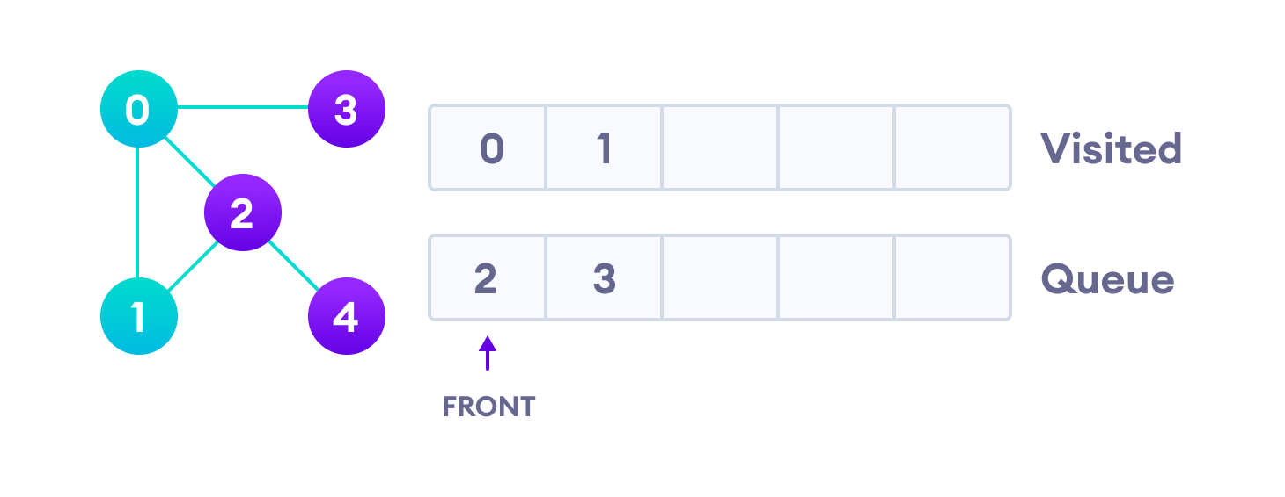
BFS example
Next, we visit the element at the front of queue i.e. 1 and go to its adjacent nodes. Since 0 has already been visited, we visit 2 instead.
The first neighbour of start node 0, which is 1

Slide 7
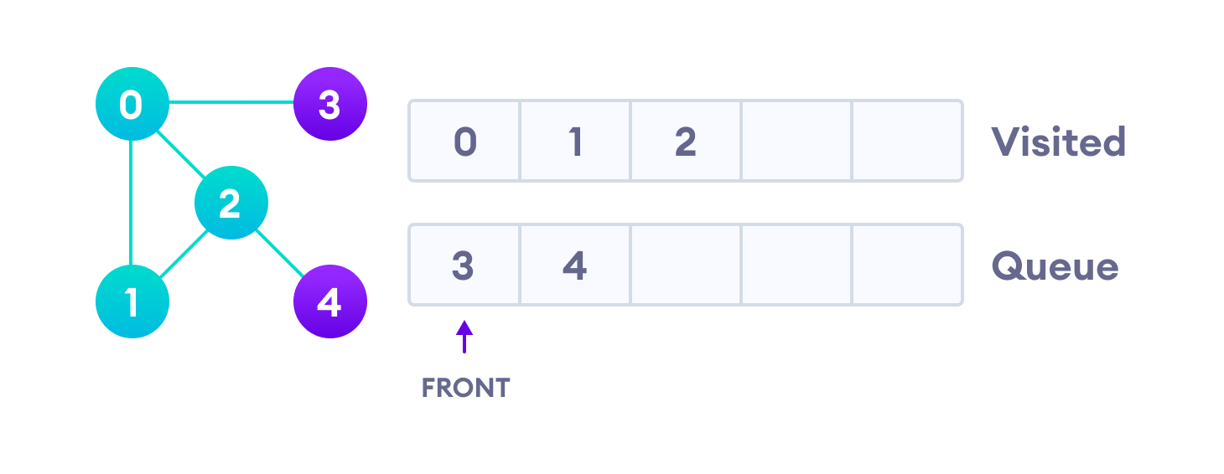
BFS example
Vertex 2 has an unvisited adjacent vertex in 4, so we add that to the back of the queue and visit 3, which is at the front of the queue.
Visit 2 which was added to queue earlier to add its neighb

Slide 8
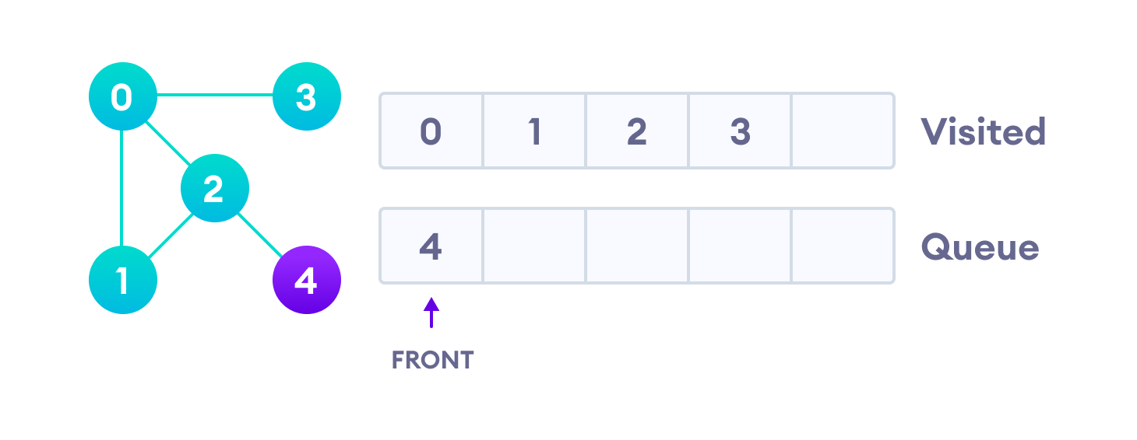
BFS example
4 remains in the queue

Slide 9
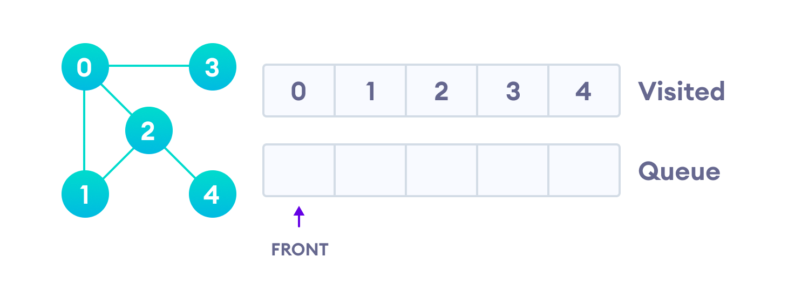
BFS example
Only 4 remains in the queue since the only adjacent node of 3 i.e. 0 is already visited. We visit it.
Visit last remaining item in stack to check if it has unvisited
neighbours
Since the queue is empty, we have completed the Breadth First Traversal of the graph.

Slide 10
BFS pseudocode
Set all nodes to "not visited";
q = new Queue();
q.enqueue(initial node);
while ( q ≠ empty ) do
{
x = q.dequeue();
if ( x has not been visited )
{
visited[x] = true; // Visit node x !
for ( every edge (x, y) /* we are using all edges ! */ ) if ( y has not been visited )
q.enqueue(y); // Use the edge (x,y) !!!
}
}

Slide 11




BREADTH FIRST SEARCH(BFS)
Expand shallowest unexpanded node
Implementation:
fringe = FIFO queue, i.e., New successors go at end
Properties of DFS
Complete: Yes(if b is finite)
Time: 1+b+b²+b³+… +b^{d} + b(b^{d}-1) = O(b^{d+1})
Space: O(b^{d+1}) (keeps every node in memory)
Imagine searching a tree with branching factor 8 and depth 10. Assume a node requires just 8 bytes of storage. The breadth first search might require up to:
= (8)¹⁰ nodes
= (2³)¹⁰ X 2³ ⁼ 2³³ bytes
= 8,000 Mbytes
= 8 Gbytes
Optimal: Yes (if cost = 1 per step)
38

Slide 12

BFS: EXAMPLE
S
A
B
C
D
E
F
G
H
 | Q | Visited
1
2
3
4
5

Slide 13
BFS: EXAMPLE
S
A
B
C
D
E
F
G
H
 | Q | Visited
1 | S | S
2
3
4
5

Slide 14
BFS: EXAMPLE
S
A
B
C
D
E
F
G
H
 | Q | Visited
1 | S | S
2 | A,B | S,A,B
3
4
5

Slide 15
BFS: EXAMPLE
S
A
B
C
D
E
F
G
H
 | Q | Visited
1 | S | S
2 | A,B | S,A,B
3 | B,C,D | S,A,B,C,D
4
5

Slide 16
BFS: EXAMPLE
S
A
B
C
D
E
F
G
H
 | Q | Visited
1 | S | S
2 | A,B | S,A,B
3 | B,C,D | S,A,B,C,D
4
5

Slide 17
BFS: EXAMPLE
S
A
B
C
D
E
F
G
H
 | Q | Visited
1 | S | S
2 | A,B | S,A,B
3 | B,C,D | S,A,B,C,D
4 | C,D,E,F | S,A,B,C,D,E,F
5

Slide 18
BFS: EXAMPLE
S
A
B
C
D
E
F
G
H
 | Q | Visited
2 | A,B | S,A,B
3 | B,C,D | S,A,B,C,D
4 | C,D,E,F | S,A,B,C,D,E,F
5 | D,E,F,G,H | S,A,B,C,D,E,F,G,H
6

Slide 19
BFS: EXAMPLE
S
A
B
C
D
E
F
G
H
 | Q | Visited
3 | B,C,D | S,A,B,C,D
4 | C,D,E,F | S,A,B,C,D,E,F
5 | D,E,F,G,H | S,A,B,C,D,E,F,G,H
6 | E,F,G,H | S,A,B,C,D,E,F,G,H
7

Slide 20
BFS: EXAMPLE
S
A
B
C
D
E
F
G
H
 | Q | Visited
4 | C,D,E,F | S,A,B,C,D,E,F
5 | D,E,F,G,H | S,A,B,C,D,E,F,G,H
6 | E,F,G,H | S,A,B,C,D,E,F,G,H
7 | F,G,H | S,A,B,C,D,E,F,G,H
8

Slide 21
BFS: EXAMPLE
S
A
B
C
D
E
F
G
H
 | Q | Visited
5 | D,E,F,G,H | S,A,B,C,D,E,F,G,H
6 | E,F,G,H | S,A,B,C,D,E,F,G,H
7 | F,G,H | S,A,B,C,D,E,F,G,H
8 | G,H | S,A,B,C,D,E,F,G,H
9

Slide 22
BFS: EXAMPLE
S
A
B
C
D
E
F
G
H
 | Q | Visited
6 | E,F,G,H | S,A,B,C,D,E,F,G,H
7 | F,G,H | S,A,B,C,D,E,F,G,H
8 | G,H | S,A,B,C,D,E,F,G,H
9 | H | S,A,B,C,D,E,F,G,H
10

Slide 23
BFS: EXAMPLE
S
A
B
C
D
E
F
G
H
 | Q | Visited
6 | E,F,G,H | S,A,B,C,D,E,F,G,H
7 | F,G,H | S,A,B,C,D,E,F,G,H
8 | G,H | S,A,B,C,D,E,F,G,H
9 |  | S,A,B,C,D,E,F,G,H
10 |  | S,A,B,C,D,E,F,G,H

Slide 24
BFS: EXAMPLE
 | Q | Visited
1 | S | S
2 | A,B | S,A,B
3 | B,C,D | S,A,B,C,D
4 | C,D,E,F | S,A,B,C,D,E,F
5 | D,E,F,G,H | S,A,B,C,D,E,F,G,H
6 | E,F,G,H | S,A,B,C,D,E,F,G,H
7 | F,G,H | S,A,B,C,D,E,F,G,H
8 | G,H | S,A,B,C,D,E,F,G,H
9 | H | S,A,B,C,D,E,F,G,H
10 |  | S,A,B,C,D,E,F,G,H
S
A
B
C
D
E
F
G
H

Slide 25
BFS Algorithm Complexity
The time complexity of the BFS algorithm is represented in the form of O(V + E), where V is the number of nodes and E is the number of edges.
The space complexity of the algorithm is O(V).
BFS Algorithm Applications
To build index by search index
For GPS navigation
Path finding algorithms
In Ford-Fulkerson algorithm to find maximum flow in a network
Cycle detection in an undirected graph
In minimum spanning tree

Slide 26
DFS algorithm
Traversal means visiting all the nodes of a graph. Depth first traversal or Depth first Search is a recursive algorithm for searching all the vertices of a graph or tree data structure.
DFS algorithm
A standard DFS implementation puts each vertex of the graph into one of two categories:
1. Visited
2. Not Visited
The purpose of the algorithm is to mark each vertex as visited while avoiding cycles.

Slide 27
DFS algorithm
The DFS algorithm works as follows:
Start by putting any one of the graph's vertices on top of a stack.
Take the top item of the stack and add it to the visited list.
Create a list of that vertex's adjacent nodes. Add the ones which aren't in the visited list to the top of the stack.
Keep repeating steps 2 and 3 until the stack is empty.

Slide 28
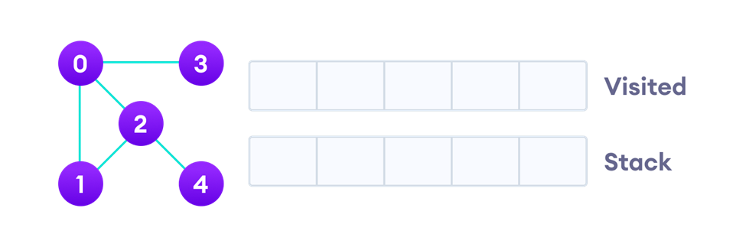
DFS algorithm example
Let's see how the Depth First Search algorithm works with an example. We use an undirected graph with 5 vertices.
We start from vertex 0, the DFS algorithm starts by putting it in the Visited list and putting all its adjacent vertices in the stack.

Slide 29
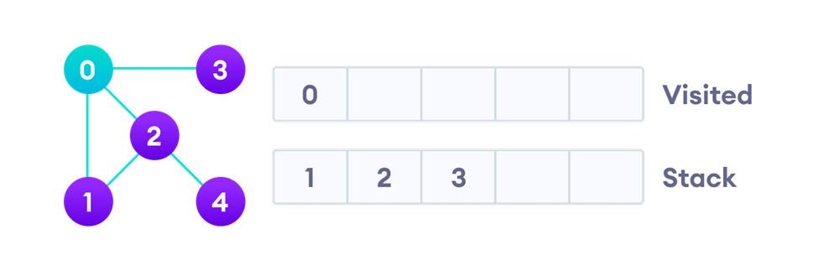
DFS algorithm example
Visit the element and put it in the visited. And all its adjacent vertices are pushed on to the stackst

Slide 30
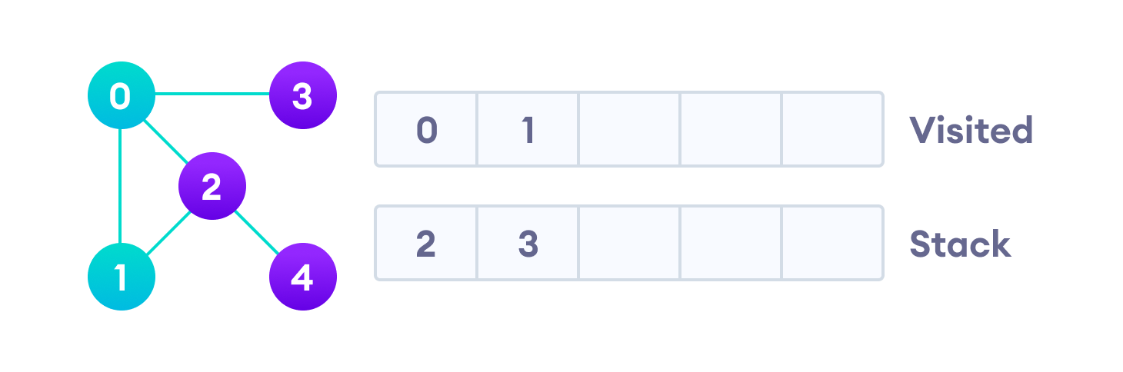
DFS algorithm example
Next, we visit the element at the top of stack i.e. 1 and go to its adjacent nodes. Since 0 has already been visited, we visit 2 instead.
Visit the element at the top of stack

Slide 31

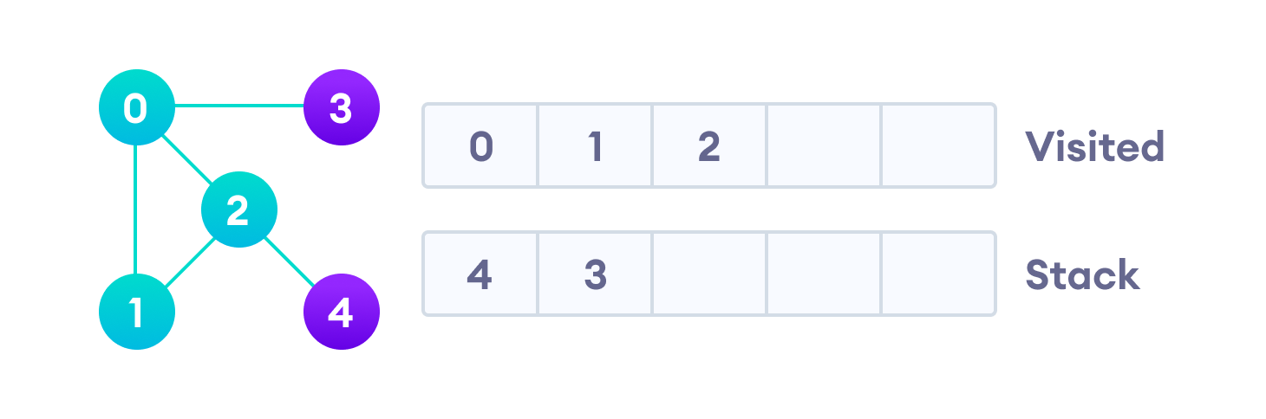
Vertex 2 has an unvisited adjacent vertex in 4, so we add that to the top of the stack and visit it.

Slide 32
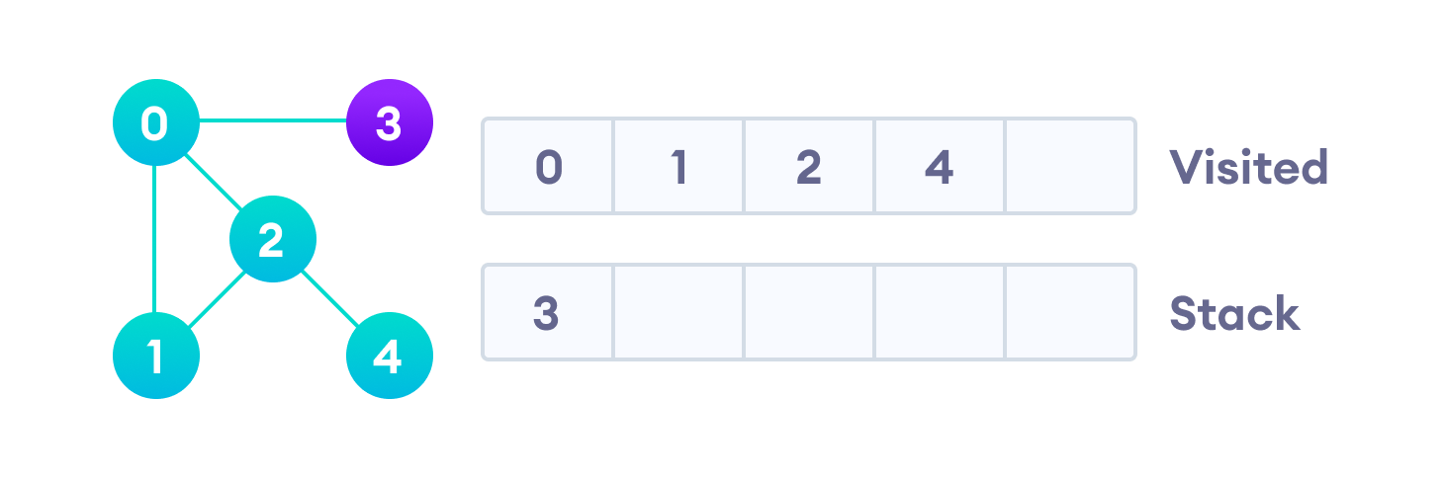
After we visit the last element 3, it doesn't have any unvisited adjacent nodes, so we have completed the Depth First Traversal of the graph.

Slide 33
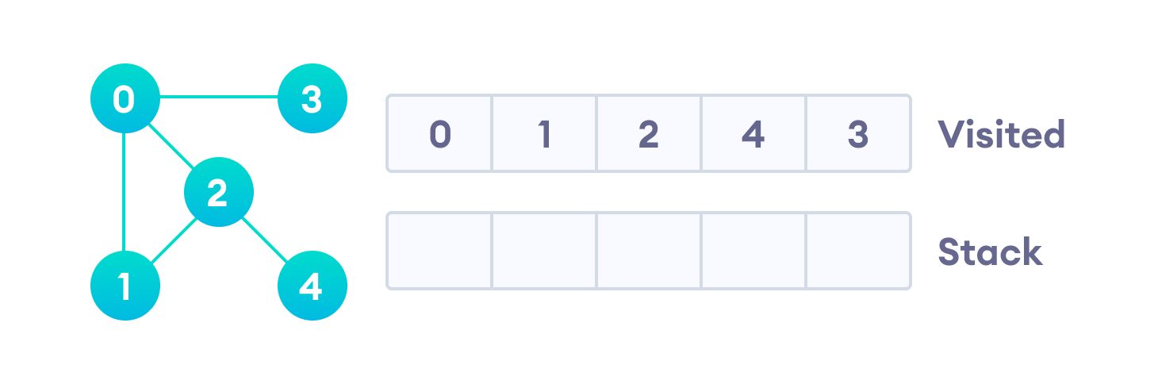
After we visit the last element 3, it doesn't have any unvisited adjacent nodes, so we have completed the Depth First Traversal of the graph.

Slide 34













DEPTH-FIRST-SEARCH (DFS)
What is the idea behind DFS?
Travel as far as you can down a path
Back up as little as possible when you reach a "dead end" (i.e., next vertex has been "marked" or there is no next vertex)
DFS can be implemented efficiently using a
stack

Slide 35
DFS pseudocode (recursive implementation)
The pseudocode for DFS is shown below. In the init() function, notice that we run the DFS function on every node. This is because the graph might have two different disconnected parts so to make sure that we cover every vertex, we can also run the DFS algorithm on every node.

Slide 36
DFS Algorithm Complexity
The time complexity of the BFS algorithm is represented in the form of O(V + E), where V is the number of nodes and E is the number of edges.
The space complexity of the algorithm is O(V).
DFS Algorithm Applications
For finding the path
To test if the graph is bipartite
For finding the strongly connected components of a graph
4. For detecting cycles in a graph

Slide 37




















DEPTH FIRST SEARCH(DFS)
Expand deepest unexpanded node
Implementation:
fringe = Stack, i.e., put successors at front
Properties of DFS
Complete: No, fails in infinite-depth spaces, spaces with loops
Modify to avoid repeated states along path
Complete in finite spaces
Time: O(b^{m}): terrible if m is much larger than d
but if solutions are dense, may be much faster than
breadth-first
Space: O(bm), i.e., linear space!
Optimal: No
29

Slide 38
Depth First Search
Depth first search (DFS) is used for traversing a finite graph.
DFS traverses the depth of any particular path before exploring its breadth.
It explores one subtree before returning to the current node and then exploring the other subtree.
DFS uses stack instead of queue.
It traverses a graph in a depth-ward motion and gets the next vertex to start a search when a dead end occurs in any iteration.

Slide 39
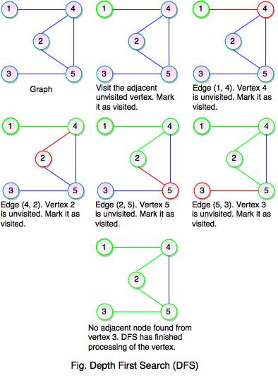

Slide 40

DFS: EXAMPLE
S
A
B
C
D
E
F
G
H
 | Stack | Visited
1
2
3
4
5

Slide 41
DFS: EXAMPLE
S
A
B
C
D
E
F
G
H
 | Stack | Visited
1 | S | S
2
3
4
5

Slide 42
DFS: EXAMPLE
S
A
B
C
D
E
F
G
H
 | Stack | Visited
1 | S | S
2 | A,B | S,A,B
3
4
5

Slide 43
DFS: EXAMPLE
S
A
B
C
D
E
F
G
H
 | stack | Visited
1 | S | S
2 | A,B | S,A,B
3 | C,D,B | S,A,B,C,D
4
5

Slide 44
DFS: EXAMPLE
S
A
B
C
D
E
F
G
H
 | stack | Visited
1 | S | S
2 | A,B | S,A,B
3 | C,D,B | S,A,B,C,D
4 | G,H,D,B | S,A,B,C,D,G,H
5

Slide 45
DFS: EXAMPLE
S
A
B
C
D
E
F
G
H
 | Stack | Visited
1 | S | S
2 | A,B | S,A,B
3 | C,D,B | S,A,B,C,D
4 | G,H,D,B | S,A,B,C,D,G,H
5 | H,D,B | S,A,B,C,D,G,H

Slide 46
DFS: EXAMPLE
S
A
B
C
D
E
F
G
H
 | Stack | Visited
1 | S | S
2 | A,B | S,A,B
3 | C,D,B | S,A,B,C,D
4 | G,H,D,B | S,A,B,C,D,G,H
5 | H,D,B | S,A,B,C,D,G,H
6 | D,B | S,A,B,C,D,G,H

Slide 47
DFS: EXAMPLE
S
A
B
C
D
E
F
G
H
 | Stack | Visited
1 | S | S
2 | A,B | S,A,B
3 | C,D,B | S,A,B,C,D
4 | G,H,D,B | S,A,B,C,D,G,H
5 | H,D,B | S,A,B,C,D,G,H
6 | D,B | S,A,B,C,D,G,H

