Slide 1
CSS
CSS stands for “Cascading Style Sheets”
Cascading: refers to the procedure that determines which style will apply to a certain section, if you have more than one style rule.
Style: how you want a certain part of your page to look. You can set things like color, margins, font, etc for things like tables, paragraphs, and headings.
Sheets: the “sheets” are like templates, or a set of rules, for determining how the webpage will look.
So, CSS (all together) is a styling language – a set of rules to tell browsers how your webpage should look.

Slide 2
What is “Style”
“Style” is a command that you set to tell the browser how a certain section of your webpage should look.
You can use style on many HTML “elements”
(like <p> <h1> <table> etc)

Slide 3
Advantages of Style Sheets
Saves time
Easy to change
Keep consistency
Give you more control over layout
Use styles with JavaScript => DHTML
Make it easy to create a common format for all the Web pages

Slide 4
Applying a single style sheet to multiple documents

Slide 5
Syntax of a Style
The CSS syntax is made up of 5 parts: i) selector, ii) property/value iii) declaration
iv) declaration block v) curly braces
Selector {declaration;}
Declaration = {property: value;}
Property: what aspect you want to change
ex: color, font, margins, etc.
Value: the exact setting for that aspect.
ex: red, italic, 40px, etc.

Slide 6
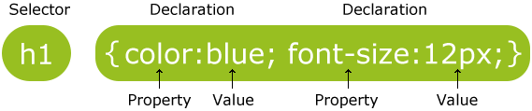
Selector
Definition: identifies the HTML elements that the rule will be applied to, identified by the actual element name, e.g. <body>, or by other means such as class attribute values.
Example:
*The selector is normally the HTML element you want to style

Slide 7
Property & Value
Definition: The property is the style attribute you want to change. Each property has a value.
*Properties are separated from their respective values by colons :
*Pairs are separated from each other by semicolons ;

Slide 8
Declaration
Definition: Each CSS line that includes property and value
*Each declaration consists of a property and a value.

Slide 9
Declaration Block
Definition: multiple declaration lines including the curly braces

Slide 10
Curly Braces
Definition: the curly braces contain the properties of the element you want to manipulate, and the values that you want to change them to. The curly braces plus their content is called a declaration block.
Example:

Slide 11
Each declaration or definition contains:
A property
A colon
A value
A semicolon to separate two or more values
Can include one or more values
h1 {color:blue; font-size:12px}

Slide 12
Different ways of Style
Inline styles
Embedded styles / Internal styles
External style sheet

Slide 13
Inline Style Sheet
Inline styles
Add styles to each tag within the HTML file
Use it when you need to format just a single section in a web page.
Syntax:
<h1 style=“color:red; font-family: sans-serif”> Welcome to CSS</h1>
Example: inline.html

Slide 14
Embedded / Internal Style Sheets
Embedded or internal styles
A style is applied to the entire HTML file
Use it when you need to modify all instances of particular element (e.g., h1) in a web page.
Syntax:
<style>
p {color:green; font-size:30px}
</style>
Example: embedded.html

Slide 15
Creating an Embedded Style Sheet
<head>
<title>Embedded Example</title>
<style type=“text/css”>
Style declarations
</style>
</head>
A style declaration:
Selector {attribute1:value1; attribute2:value2; …}
Selector = an element in a document (e.g., a header or paragraph)

Slide 16
External Style Sheets
External style sheets
An external style sheet is a text file containing the style definition (declaration)
Use it when you need to control the style for an entire web site.
Syntax:
h1, h2, p {color:red; font-family:sans-serif}
Example: external.html

Slide 17
Creating an External Style Sheet
Open a new blank document in Notepad
Type style declarations
h1 {color:red; font-family:sans-serif;}
Do not include <style> tags
Save the document as filename.css

Slide 18
Linking to Style Sheets
Open an HTML file
Between <head> and </head> add
<link href=URL rel=“relation_type” type=“link_type”>
URL is the file.css
Relation_type=“stylesheet”
Link_type=“text/css”
Save this file and the .css file in the same web server directory

Slide 19
An example of an external style sheet with an original html file
<head>
<title>External Style Sheet</title>
<link href=“external.css” rel=“stylesheet” type=“text/css” />
</head>
h1{color:red; font-family:sans-serief;}
h2{color:green;}
p{font-size:20px; color:blue;}
external.html file
external.css file

Slide 20
Conflicting Styles
Styles may be defined by a user, an author or a user agent (e.g., a web browser).
user is a person viewing your web page.
an author- the person who writes the document.
user agent is the program used to render and display the document.
Styles “cascade,” or flow together, such that the ultimate appearance of elements on a page results from combining styles defined in several ways.
Styles defined by the user take precedence over styles defined by the user agent, and styles defined by authors take precedence over styles defined by the user.

Slide 21
Most styles defined for parent elements are also inherited by child (nested) elements.
While it makes sense to inherit most styles, such as font properties, there are certain properties that we don’t want to be inherited.
Properties defined for child and descendant elements have a greater specificity than properties defined for parent and ancestor elements.
Conflicts are resolved in favor of properties with a higher specificity
Examples:
conflicts.html conflicts1.html conflicts2.html

Slide 22
Style Sheet Strategies
Wherever possible, place your styles in external style sheets
Take advantage of the power of CSS to have control over an entire Web site.
At the top level of your web site: define a default global.css style sheet
Refine styles at sublevels with a section.css style sheet
Try to avoid using styles in tags

Slide 23
Attribute Selectors
Create an attribute selector to select an element based on the element’s attributes.

Slide 24
Using IDs and Classes
Use an id to distinguish something, like a paragraph, from the others in a document.
For example, to identify a paragraph as “head”, use the code:
<p id=“head”>… </p>

Slide 25
Working With Ids
To create an ID for a specific tag, use the property:
<tag ID=id_name>
To apply a style to a specific ID, use:
#id_name {style attributes and values}

Slide 26
Classes
HTML and XHTML require each id be unique– therefore an id value can only be used once in a document.
You can mark a group of elements with a common identifier using the class attribute.
<element class=“class”> … </element>

Slide 27
Applying a style to a class
Example: classes.html

Slide 28
Working With Classes
To create a class, enter the following in the HTML tag:
<tag CLASS=class_name>
<h1 CLASS=FirstHeader>IU</h1>
class_name is a name to identify this class of tags
To apply a style to a class of tags, use:
tag.class_name {style attributes} or
.class_name {style attributes}

Slide 29
Working With Classes and Ids
The difference between the Class property and the ID property is that the value of the ID property must be unique:
you can’t have more than one tag with the same ID value
You can apply the same Class value to multiple document tags

Slide 30
Positioning – what is it?
Positioning refers to the layout of the items on your page.
It also refers to the “position” descriptor in CSS rules.

Slide 31
Normal Flow – no “positioning”
Left to Right, Top to Bottom

Slide 32
Normal Flow – no “positioning”
Top left of the page = (0,0)
Left to Right, Top to Bottom

Slide 33
Normal Flow
The yellow box is the container (more on this)
This is a paragraph to which I have set the width.
If the next paragraph fits next to it on the right, it will line up.

Slide 34
Normal Flow
This is a paragraph to which I have set the width.
However, if the second paragraph is too wide to fit the container, it will shift down.

Slide 35
Normal Flow
This is a paragraph to which I have set the width.
However, if the second paragraph is too wide to fit the container, it will shift down.
This is the basic principle of Normal Flow

Slide 36
Positioning Elements
Absolute positioning
z-index attribute
Layer overlapping elements properly
Relative positioning
Elements are positioned relative to other elements.
Example: absolute.html relative.html

Slide 37
Backgrounds
background-image
Specifies the image URL
background-position
Places the image on the page
background-repeat
Controls the tiling of the background image
background-attachment
fixed
scroll
font-weight
Specify the “boldness” of text
Example: background.html

Slide 38
Element Dimensions
CSS rules can specify the actual dimensions of each page element.
Example: dimensions.html

Slide 39
The CSS Box Model
Every CSS box is divided into regions, consisting of:
Content
Padding
Border
Margins

Slide 40
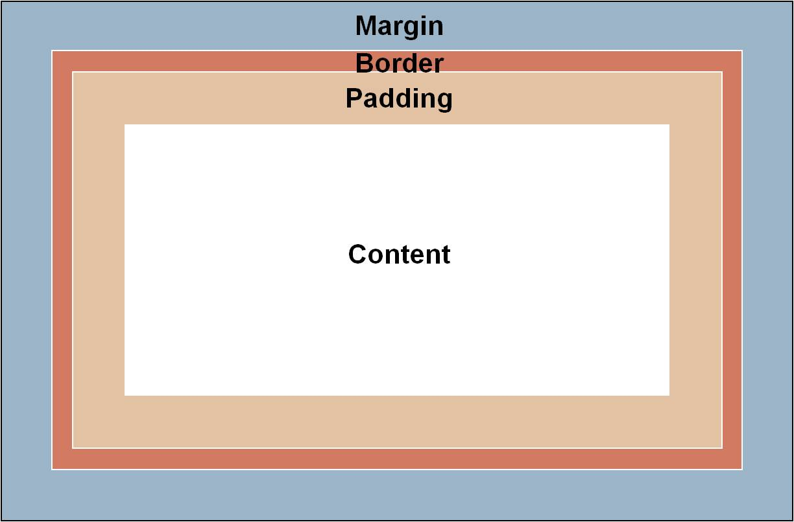

Slide 41
Introducing the <div> tag:
The <div> tag is our basic building block when laying out a page design. By defining the height and width of the <div>, we are "reserving" that amount of space on the screen for whatever content we wish to place there.
The actual content will go inside the opening <div> and closing </div> tags.

Slide 42
Example <div>:
<head>
<style type="text/css">
.box300 {
width:300px;
height:300px;
border:1px solid black;
}
</style>
</head>
This is a 300 by 300 pixel box with a 1 px border.
<div class="box300">
This is a 300 by 300 pixel box
with a 1px border.
</div>
This is outside the box.
This is outside the box.
By establishing the box dimensions, we can leave it there as a placeholder until we have our content ready. In the meantime, the rest of the page can be built out with our other content.

Slide 43
Adding padding:
<head>
<style type="text/css">
.box300 {
width:300px;
height:300px;
border:1px solid black;
padding:10px;
}
</style>
</head>
This is a 300 by 300 pixel box with a 1px border and 10px padding.
<div class="box300">
This is a 300 by 300 pixel box
with a 1px border and 10px
padding.
</div>
<p>This is outside the box.</p>
This is outside the box.
By adding 10px of padding on all four sides of the content, we have effectively made our box 320px by 320px (321px by 321px with the border).

Slide 44
Setting the Padding Size
To define padding, use:
padding: value
where value = a length value or a percentage (a padding proportional to the element’s width)

Slide 45
Setting the Padding Size
To set margins on a side, use:
padding-top
padding-right
padding-bottom
padding-left

Slide 46
Adding margin:
<head>
<style type="text/css">
.box300 {
width:300px;
height:300px;
border:1px solid black;
padding:10px;
margin:10px;
}
</style>
</head>
This is a 300 by 300 pixel box with a 1px border and 10px padding and 10px margin.
The dotted line here shows where the margin is but it will not show on the actual page.
This is outside the box.
<div class="box300">
This is a 300 by 300 pixel box
with a 1px border and 10px
Padding and 10px margin.
</div>
<p>This is outside the box.</p>
By adding 10px of margin on all four sides of the border, we have now made our box 341px by 341px overall.

Slide 47
Controlling the Margins
To define the margins of an element, use:
margin:value
where value = a length value (“em” is often used), a percentage (a margin proportional to the element’s width, or auto

Slide 48
Controlling the Margins
To set margins on a side, use:
margin-top
margin-right
margin-bottom
margin-left
E.g., LI {margin-left:2em; margin-right:2em; margin-top:1em; margin-bottom:1em}

Slide 49
Formatting the Border
Border can be set in three ways:
border-width
border-style
border-color

Slide 50
Formatting the Border
To set the border, use:
border:width_value style color
To set borders on a side, use:
border-top
border-bottom
border-left
border-right
Example: boxmodel.html

Slide 51
Text Flow
Floating
Move an element to one side of the screen
Example: floating.html

Slide 52
CSS media types
CSS media types allow a programmer to decide what a page should look like depending on the kind of media being used to display the page.
The most common media type for a web page is the screen media type, which is a standard computer screen. Other media types in CSS 2 include handheld, Braille, aural and print.
The handheld medium is designed for mobile Internet devices, while Braille is for machines that can read or print web pages in Braille. aural styles allow the programmer to give a speech-synthesizing web browser more information about the content of the web page.
The print media type affects a web page’s appearance when it is printed.
Example: mediatypes.html

Slide 53
CSS Drop-Down Menu
Drop-down menus are a good way to provide navigation links on a website without using a lot of screen space.
In this section, we take a second look at the :hover pseudoclass and introduce the display property to create a drop-down menu using CSS and XHTML.
We will use this feature in a more advanced way to cause a menu to appear when the mouse hovers over a menu button.
The other important property we need is the display property.
This allows a programmer to decide whether an element is rendered on the page or not. Possible values include block, inline and none.
The block and inline values display the element as a block element or an inline element, while none stops the element from being rendered.
Example: dropdown.html

Slide 54
User Style Sheets
Format pages based on preferences

Slide 55
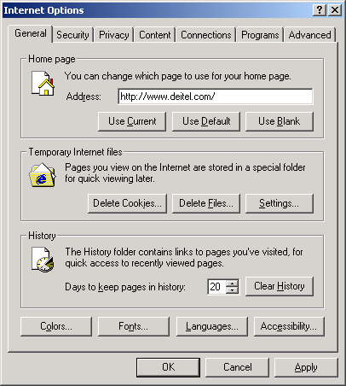
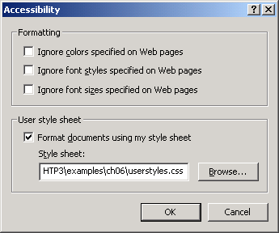
User Style Sheets
User style sheet in Internet Explorer.

