Slide 1
Topics
DOM: Collections and Event Handling.
XML and RSS: Introduction, XML Basics, Structuring Data, XML Namespaces, Document Type Definitions(DTDs), W3C XML Schema Documents, XML Vocabularies Extensible Style sheet Language and XSL Transformations, Document Object Model (DOM), RSS.

Slide 2
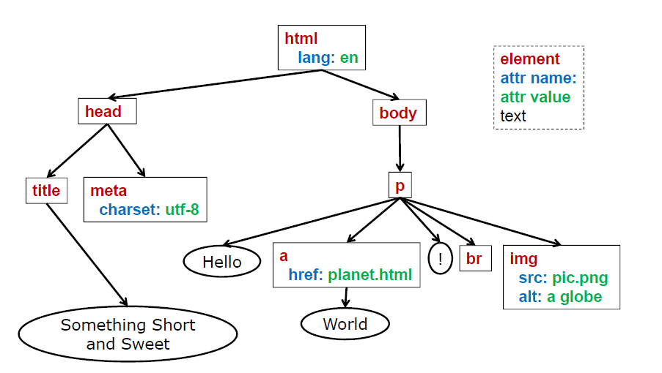
Document is a Tree

Slide 3
DOM tree
The backbone of an HTML document are tags.
According to Document Object Model (DOM), every HTML-tag is an object. Nested tags are called “children” of the enclosing one.
The text inside a tag it is an object as well.
All these objects are accessible using JavaScript.

Slide 4
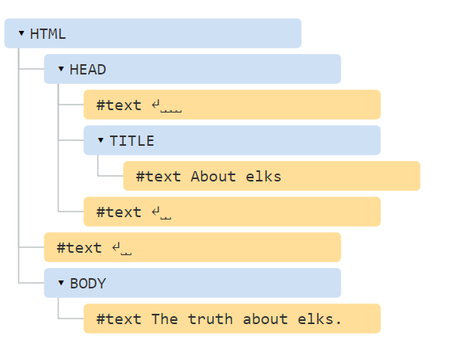
Example
<html>
<head>
<title>About elks</title> </head>
<body> The truth about elks. </body>
</html>

Slide 5
Tags are called element nodes (or just elements). Nested tags become children of the enclosing ones.
<html> is at the root, then <head> and <body>are its children, etc.

Slide 6
DOM is a language-neutral API for working with HTML (and XML) documents
DOM hierarchy
Rooted at window.document
Follows HTML document structure
window.document.head
window.document.body

Slide 7
DOM Collections
Link
Anchor
Child
Img

