Slide 1
HTML FORMS

Slide 2
Forms are the best way of adding interactivity of element in a web page.
HTML forms are used to pass data to a server.
They are usually used to let the user to send information back to the server but can also be used to simplify navigation on complex web sites.
The tags that use to implement forms are as follows.
<form action=”URL” method = “post” |“get”>
…….
</form>

Slide 3
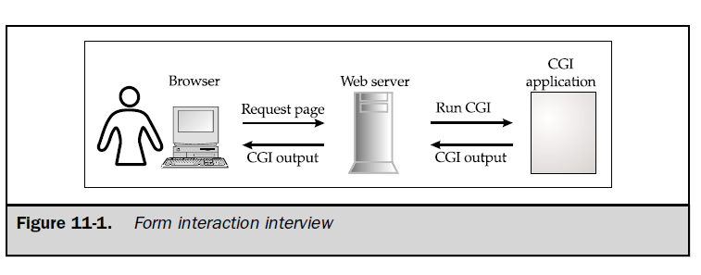

Slide 4
A form in HTML is enclosed between the <FORM> and </FORM> tags.
The form itself contains regular text; other HTML elements such as tables; and form elements such as check boxes, pull-down menus, and text fields.
Once the user has finished filling out the form, it must be submitted for processing.
Completed forms are generally passed to a remote program that handles the data.

Slide 5
To make the form work, you must specify two things, and potentially two other important features.
First, specify the address of the program that will handle the form contents using ACTION. Next, specify the method in which the form data will be passed using the METHOD attribute.
<FORM ACTION=http://www.bigcompany.com/cgi-bin/post-query METHOD="POST">

Slide 6
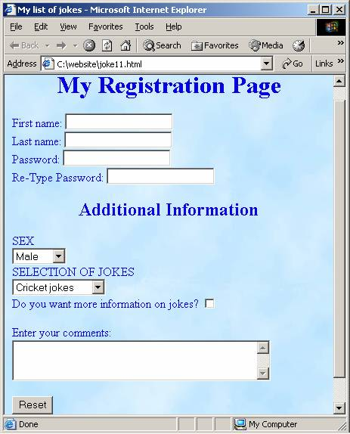
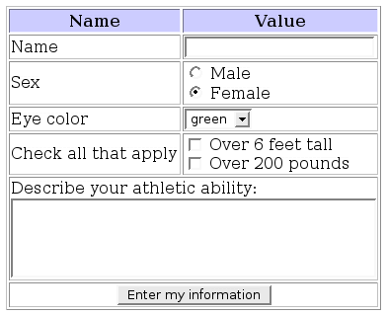
Examples :

Slide 7
HTML Forms - The Input Element
The most important form element is the <input> element.
The <input> element is used to select user information.
An <input> element can vary in many ways, depending on the type attribute.
An <input> element can be of type text field, checkbox, password, radio button, submit button, and more.

Slide 8
Text Fields
<input type="text"> defines a one-line input field that a user can enter text into:
<form> First name: <input type="text" name="firstname"><br> Last name: <input type="text" name="lastname"> </form>
note that the default width of a text field is 20 characters.

Slide 9

output

Slide 10
Password Field
<input type="password"> defines a password field:
<form> Password: <input type="password" name="pwd"> </form>
The characters in a password field are masked (shown as asterisks or circles).

Slide 11


Slide 12
Radio Buttons
<input type="radio"> defines a radio button. Radio buttons let a user select ONLY ONE of a limited number of choices:
<form> <input type="radio" name="sex" value="male">Male<br> <input type="radio" name="sex" value="female">Female </form>

Slide 13


Slide 14

Checkboxes
<input type="checkbox"> defines a checkbox.
Checkboxes let a user select ZERO or MORE options of a limited number of choices.

Slide 15
Submit Button
<input type="submit"> defines a submit button.
A submit button is used to send form data to a server.
The data is sent to the page specified in the form's action attribute. The file defined in the action attribute usually does something with the received input:

Slide 16

<form name="input" action="demo_form_action.asp" method="get"> Username: <input type="text" name="user"> <input type="submit" value="Submit"> </form>

Slide 17
Drop-down Menu(Pull-down Menu)L
The <select> element is used to create a drop-down list.
The <option> tags inside the <select> element define the available options in the list.
<select> <option value="volvo">Volvo</option> <option value="saab">Saab</option> <option value="mercedes">Mercedes</option> <option value="audi">Audi</option> </select>

