Slide 1
Introduction to World Wide Web and HTML Basics

Slide 2
What is the WWW?
A distributed document delivery system
Uses a client-server model
Main presentation language is HTML

Slide 3
Client-Server Model
Two processes (possibly networked):
  The client
    Sends requests to the server
    Blocks until reply is received
  The server
    Processes requests from clients
    Never blocks
    Can reply to several clients simultaneously

Slide 4
HTML
Hypertext Markup Language
Intended to be maximally portable
  Logical markup
  Graceful degradation of presentation
An ideal promoted by early WWW
  Used to be more honoured in the breach
  Is it getting better now?

Slide 5
Markup Languages
Markup:
  Embedded codes in documents
  Codes are called `tags’
  Codes
    Describe the structure documents
    Include instructions for processing
Markup language:
  Computer language for describing syntax of tags
  May be used with other tools to specify rendering

Slide 6
Logical Markup
Logical markup:
  Describes parts of document
  Does not specify how to render
Example:
  This is <strong>very</strong> important
  This is very important

Slide 7
Logical Markup
Presentation is client’s `decision’
When client cannot present then there is graceful degradation
  <img alt=“image description”
  src=“foo.gif”>
  Object example from Cougar

Slide 8
Some history
Gopher & the Internet Superhighway
SGML
  GML + Charles Goldfarb = SGML
  eXtensible Markup Language
HTML
XML and XHTML

Slide 9
Why HTML became XHTML
HTML was originally a SGML application
  Tags described the syntax
  A DTD could check the syntax
  Informal mapping from syntax to rendering
Multiple incompatible versions arose
  IETF moves at ’net speed not web $peed
  Tag abuse was rampant in the ’net
  They were a plague unto the users

Slide 10
Why HTML became XHTML (2)
If you think IMG is bad …
Big vendors (M$ and N$ mostly) agreed
  To start over
  To use eXtensible Markup Language
    A re-write of SGML emphasizing simplicity
    Carefully planned by CS savvy folks
    Includes hooks for future development

Slide 11
XHTML Basics
Very few real changes from HTML
But more strict
All tags are in lowercase
All tags must be closed
  Empty tags
  Paired tags

Slide 12
XHTML Basics
3 Parts to an XHTML or HTML document
  DOCTYPE
    What DTD are you using
  Head
    Meta information
    Only <title> is required
  Body
    Text to render

Slide 13
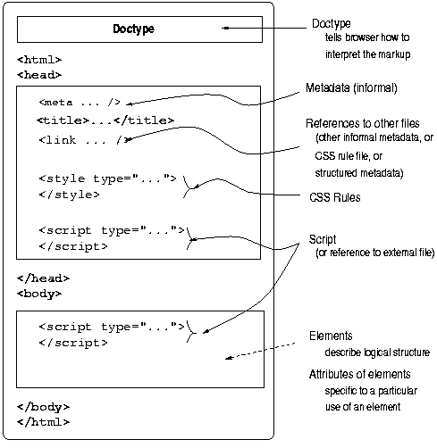
XHTML Document Structure

Slide 14
XHTML Basics
Tags
  Elements
  Attributes
Entities
  <,>,&,‘ ’
  Ö,ð,÷,©, etc.
  See example at CS4173 website
Comments
Notes:
‘ ’s is &nbsp; (the non-breaking space)

Slide 15
XHTML Tags vs. Elements
Tag is markup to represent an element
Logical vs. Presentation Elements
  TT ≈ CODE, KBD, PRE?
  B/IT/U ≈ EM/STRONG
Lists
  UL/OL
  DL

Slide 16
XHTML Tags vs. Elements
Block-level and in-line elements
  TABLE, P, BLOCKQUOTE, DIV, etc.
  CODE, Q, H1, SPAN, etc.
Grouping Elements
  DIV
  SPAN
One-part elements
  BR, etc.

Slide 17
XHTML Tags vs. Elements
Browser-specific tags
  MARQUEE, BLINK, etc.
What happens when a browser doesn't recognize a tag?

Slide 18
XHTML Basics
Tags may be nested but
Tags may not overlap

Slide 19
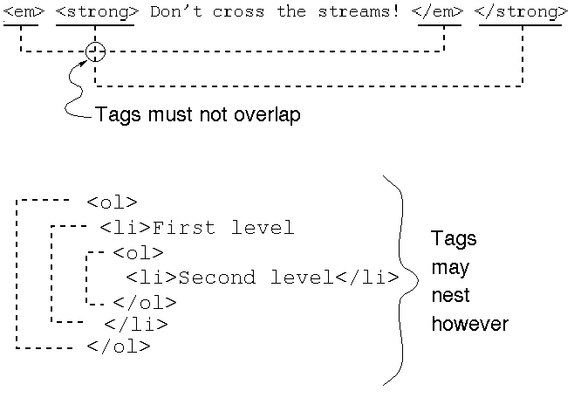
Overlap versus Nesting

Slide 20
Links — Why The WWW Is HT
‘A’ element
  HREF
  NAME
  CLASS
  REL
  TYPE
URIs and URLs
RFCs
  TITLE
  ID
  STYLE
  Anchor Text
  TABINDEX

Slide 21
Where are the tools?
HTML Tidy
  /opt/bin/tidy on borg
The validator
  http://validator.w3.org/
  http://www.cs.dal.ca/validator?
  http://www.cs.dal.ca/validate?
  http://www.cs.dal.ca:81?

Slide 22
XHTML/HTML Examples
XHTML element sampler
XHTML sample template
  Both in the examples section of the website

Slide 23
For More About HTML
RFC 1866 (HTML 2.0) (at faqs.org)
  Explains some of the philosophy behind HTML
HTML 4.01 (at W3C)
  Last version of HTML
XHTML 1.1 (at W3C)
  Modularized XHTML
  So many choices!…

Slide 24
Which Standard to Follow?
Minimal standard for this course is HTML 4.01 Transitional
Preferred standard is XHTML 1.0 or 1.1
See Picking a Rendering Mode
  By Eric Meyer
  In the Readings part of the Resources

Slide 25
Here endeth the lesson

Slide 26
HTML: HyperText Markup Language
HTML documents are simply text documents with a specific form
  Documents comprised of content and markup tags
  Content: actual information being conveyed
  The markup tags tell the Web browser how to display the page
  An HTML file must have an htm or html file extension
  An HTML file can be created using a simple text editor

Slide 27
Our First Example
If you are running Windows, start Notepad
If you are on a Mac, start SimpleText
If you telnet to csupomona.edu, use “pico”
Type in the following:
Open this file using a browser, and you will see…
<html>
<head>
<title>Title of page</title>
</head>
<body>
This is my first homepage. <b>This text is bold</b>
</body>
</html>

Slide 28
HTML Tags
HTML tags are used to mark-up HTML elements
  Surrounded by angle brackets < and >
  HTML tags normally come in pairs, like <tagname> (start tag) and </tagname> (end tag)
  The text between the start and end tags is the element content
  Not case-sensitive
  Follow the latest web standards:
    Use lowercase tags

Slide 29
Tag Attributes
Tags can have attributes that provide additional information to an HTML element
  Attributes always come in name/value pairs like: name=“value”
  Attributes are always specified in the start tag
  Attribute values should always be enclosed in quotes. Double quotes are most common.
  Also case-insensitive: however, lowercase is recommended
  <tagname a1=“v1” a2=“v2”></tagname>
  For example, <table border=“0”> is a start tag that defines a table that has no borders

Slide 30
HTML Document Structure
Entire document enclosed within <html> and </html> tags
Two subparts:
  Head
    Enclosed within <head> and </head>
    Within the head, more tags can be used to specify title of the page, meta-information, etc.
  Body
    Enclosed within <body> and </body>
    Within the body, content is to be displayed
    Other tags can be embedded in the body

Slide 31
We’ll Study…
HTML Basics (http://www.w3schools.com/html/html_intro.asp):
  HTML Elements
  HTML Headings
  HTML Paragraphs
  HTML Formatting
  HTML Styles
  HTML Images
  HTML Tables
  HTML Lists
  HTML Forms
  HTML Colors

Slide 32
More Basic Examples
Using basic tags: http://www.csupomona.edu/~ftang/www/courses/CS299-S09/examples/ex1.html
Text formatting: http://www.csupomona.edu/~ftang/www/courses/CS299-S09/examples/ex2.html
HTML links: http://www.csupomona.edu/~ftang/www/courses/CS299-S09/examples/ex3.html

Slide 33
HTML Layout
One common way is to use HTML tables to format the layout of an HTML page
  The trick is to use a table without borders, and maybe a little extra cell-padding
Other tips:
  Keep screen resolution in mind
  Use color to define spaces
  Align your images
  Balance the graphics and text on a page
  Think about text width – scan length 7 – 11 words
  Centering text is inadvisable
  Here is the link: http://webdesign.about.com/od/layout/a/aa062104.htm

Slide 34
HTML Frames
HTML frames are a means of having several browser windows open within a single larger window
Each HTML document is called a frame
Disadvantages:
  Must keep track of more HTML documents
  Difficult to print the entire page
Example of using frame
  http://www.csupomona.edu/~ftang/www/courses/CS299-S09/examples/frame.html
  http://www.w3schools.com/html/html_frames.asp

Slide 35
HTML Advanced

Slide 36
Topics Covered
From HTML tutorial on w3schools.com
  HTML CSS
  HTML Entities
  HTML Head
  HTML Meta
  HTML URLs
  HTML Scripts
  HTML Attributes
  HTML Events
  HTML URL Encode
  HTML Webserver

Slide 37
Script Examples
Add scripts to HTML pages can make them more dynamic and interactive
Examples from W3schools
Our simple example:
  http://www.csupomona.edu/~ftang/www/courses/CS299-S09/examples/jscript.html

Slide 38
HTML and XHTML Full References
Full Reference from W3schools:
  http://www.w3schools.com/tags/
Test your HTML
  http://www.w3schools.com/html/html_whyusehtml4.asp

Slide 39
XHTML
http://www.w3schools.com/xhtml/

Slide 40
What is XHTML?
XHTML is a stricter and cleaner version of HTML
  EXtensible HyperText Markup Language
  aimed to replace HTML
  identical to HTML 4.01
  combination of HTML and XML (EXtensible Markup Lanuage)
  W3C Recommendation

Slide 41
Why XHTML?
Many pages contain “bad” HTML
  <html>
  <head> <title>This is bad HTML</title>
  <body> <h1>Bad HTML </body>
XML is a markup language where everything has to be marked up correctly, which results in “well-formed” documents
Different browser technologies require “good” markup language
XHTML combines the strengths of HTML and XML

Slide 42
Most Important Differences From HTML
XHTML elements must be properly nested
XHTML elements must always be closed
XHTML elements must be in lowercase
XHTML documents must have one root element
Examples
  http://www.w3schools.com/xhtml/xhtml_html.asp

Slide 43
XHTML Syntax
More XHMTL Syntax Rules
  Attribute names must be in lower case
  Attribute values must be quoted
  Attribute minimization is forbidden
  The id attribute replaces the name attribute
  Mandatory elements
Examples
  http://www.w3schools.com/xhtml/xhtml_syntax.asp
Test your XHTML with the W3C Validator

