Slide 1
JavaScript Events
Dr.A.Srinagesh

Slide 2
Event?
User actions cause events.
An event is some notable action occurring inside the browser to which a script can respond.
A JavaScript can be executed when an event occurs, like when a user clicks on an HTML element.
Events are a part of the Document Object Model (DOM) and every HTML element contains a set of events which can trigger JavaScript Code.

Slide 3
Types of Events
<body> and <frameset> Level Events
Attribute | Value | Description
onload | script | Script runs when a HTML document loads
onunload | script | Script runs when a HTML document unloads

Slide 4
<form> Level Events
Attribute | Value | Description
onchange | script | Script runs when the element changes
onsubmit | script | Script runs when the form is submitted
onreset | script | Script runs when the form is reset
onselect | script | Script runs when the element is selected
onblur | script | Script runs when the element loses focus
onfocus | script | Script runs when the element gets focus

Slide 5
Keyboard Events
Attribute | Value | Description
onkeydown | script | Script runs when key is pressed
onkeypress | script | Script runs when key is pressed and released
onkeyup | script | Script runs when key is released

Slide 6
Mouse Events
Attribute | Value | Description
onclick | script | Script runs when a mouse click
ondblclick | script | Script runs when a mouse double-click
onmousedown | script | Script runs when mouse button is pressed
onmousemove | script | Script runs when mouse pointer moves
onmouseout | script | Script runs when mouse pointer moves out of an element
onmouseover | script | Script runs when mouse pointer moves over an element
onmouseup | script | Script runs when mouse button is released

Slide 7
Event Bubbling
When an event happens on an element, it first runs the handlers on it, then on its parent, then all the way up on other ancestors.
or
Event bubbling directs an event to its intended target, it works like this: A button is clicked and the event is directed to the button.
If an event handler is set for that object, the event is triggered. If no event handler is set for that object, the event bubbles up (like a bubble in water) to the objects parent.
The term event propagation is often used as a synonym of event bubbling.

Slide 8
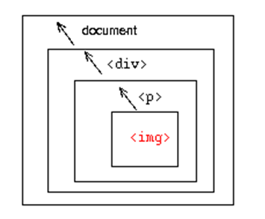
Event Bubbling

Slide 9
Why event bubbling?
The concept of event bubbling was introduced to deal with situations where a single event, such as a mouse click, may be handled by two or more event handlers defined at different levels of the Document Object Model (DOM) hierarchy.

Slide 10
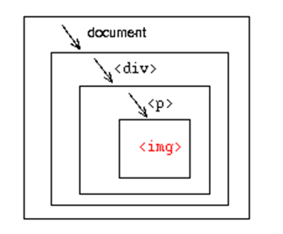
Event Capture
Event capturing is the opposite of bubbling (events are handled at higher levels first, then sink down to individual elements at lower levels).
Event capturing is supported in fewer browsers and rarely used.

