Slide 1
INTRODUCTION
TO
JAVASCRIPT

Slide 2
JAVASCRIPT
JavaScript is used in millions of Web pages to improve the design, validate forms, detect browsers, create cookies, and much more.
JavaScript is the most popular scripting language on the internet, and works in all major browsers, such as Internet Explorer, Mozilla, Firefox, Netscape, Opera.

Slide 3
scripting language
A scripting language or script language is a programming language that supports scripts, programs written for a special run-time environment that can interpret (rather than compile) and automate the execution of tasks that could alternatively be executed one-by-one by a human operator.

Slide 4
Some of the most widely used scripting languages are
JavaScript,
VBScript,
PHP, Perl, Python, Ruby, ASP and Tcl.

Slide 5
Distinction between a scripting language and Traditional Programming languages programming language is typically compiled first before allowed to run, scripting languages are interpreted from source code or bytecode one command at a time.
Although scripts are employed anywhere in the programming world, they have recently become more associated with the World Wide Web where they have been used extensively to create dynamic web pages.
While technically there are many client-side scripting languages that can be used on the web, in practice it means using JavaScript.

Slide 6
WHAT IS JAVASCRIPT?
JavaScript was designed to add interactivity to HTML pages
JavaScript is a scripting language (a scripting language is a lightweight programming language)
A JavaScript consists of lines of executable computer code
A JavaScript is usually embedded directly into HTML pages
JavaScript is an interpreted language (means that scripts execute without preliminary compilation)
Everyone can use JavaScript without purchasing a license

Slide 7
Are Java and JavaScript the Same?
NO!
Java and JavaScript are two completely different languages in both concept and design!
Java is pure OOP where as JavaScript is an Object based language.
JavaScript is loosely typed while Java is strongly typed.

Slide 8
How is JavaScript different from Java?
The JavaScript programming language, developed by Netscape, Inc., is not part of the Java platform.
JavaScript does not create applets or stand-alone applications.
In its most common form, JavaScript resides inside HTML documents, and can provide levels of interactivity to web pages that are not achievable with simple HTML.

Slide 9
Advantages of JavaScript
• Less server interaction: You can validate user input before sending the page off to the server. This saves server traffic, which means less load on your server.
• Immediate feedback to the visitors: They don't have to wait for a page reload to see if they have forgotten to enter something.
• Increased interactivity: You can create interfaces that react when the user hovers over them with a mouse or activates them via the keyboard.
• Richer interfaces: You can use JavaScript to include such items as drag-and-drop components and sliders to give a Rich Interface to your site visitors.

Slide 10
Limitations of JavaScript
• Client-side JavaScript does not allow the reading or writing of files. This has been kept for security reason.
• JavaScript cannot be used for networking applications because there is no such support available.
• JavaScript doesn't have any multithreading or multiprocessor capabilities.

Slide 11
JAVASCRIPT – SYNTAX
<script ...>
JavaScript code
</script>
We can place Script code either in head section or body section.
but it is normally recommended that you should keep it within the <head> tags.

Slide 12
The script tag takes two important attributes:
<script language="javascript" type="text/javascript">
JavaScript code
</script>

Slide 13
First JavaScript Code
<html>
<body>
<script language="javascript" type="text/javascript">
document.write ("Hello World!")
</script>
</body>
</html>

Slide 14
Comments in JavaScript
JavaScript supports both C-style and C++-style comments.
• Any text between a // and the end of a line is treated as a comment and is ignored by JavaScript.
• Any text between the characters /* and */ is treated as a comment. This may span multiple lines.

Slide 15
JAVASCRIPT – PLACEMENT
Script in <head>...</head> section.
• Script in <body>...</body> section.

Slide 16
JavaScript in <head>...</head> Section
<html>
<head>
<script type="text/javascript">
function sayHello() {
alert("Hello World")
}
</script>
</head>
<body>
Click here for the result
<input type="button" onclick="sayHello()" value="Say Hello" />
</body>
</html>

Slide 17
JavaScript in <body>...</body> Section
<html>
<head>
</head>
<body>
<script type="text/javascript">
document.write("Hello World")
</script>
<p>This is web page body </p>
</body>
</html>

Slide 18
JavaScript in <body> and <head> Sections
<html>
<head>
<script type="text/javascript">
<!--
function sayHello() {
alert("Hello World")
}
</script>
</head>
<body>
<script type="text/javascript">
<!--
document.write("Hello World")
</script>
<input type="button" onclick="sayHello()" value="Say Hello" />
</body>
</html>

Slide 19
JavaScript in External File
<html>
<head>
<script type="text/javascript" src="filename.js“> </script>
</head>
<body>
.......
</body>
</html>

Slide 20
filename.js
function sayHello() {
alert("Hello World")
}

Slide 21
Ending Statements With a Semicolon?
With traditional programming languages, like C++ and Java, each code statement has to end with a semicolon (;).
Many programmers continue this habit when writing JavaScript, but in general, semicolons are optional!
However, semicolons are required if you want to put more than one statement on a single line.

Slide 22
JavaScript Variables
Variables are used to store data.
A variable is a "container" for information you want to store.
A variable's value can change during the script. You can refer to a variable by name to see its value or to change its value.
Rules for variable names:
  Variable names are case sensitive
  They must begin with a letter or the underscore character
    strname – STRNAME (not same)

Slide 23
JavaScript Data Types
String, Number, Boolean, Array, Object, Null, Undefined.
JavaScript has dynamic types. This means that the same variable can be used as different types:
Example
var x; // Now x is undefined
var x = 5; // Now x is a Number
var x = "John"; // Now x is a String

Slide 24
JavaScript Variable Scope
The scope of a variable is the region of your program in which it is defined. JavaScript variables have only two scopes.
• Global Variables: A global variable has global scope which means it can be defined anywhere in your JavaScript code.
• Local Variables: A local variable will be visible only within a function where it is defined.
Function parameters are always local to that function.

Slide 25
JavaScript Reserved Words
abstract
boolean
break
byte
case
catch
char
class
const
continue
debugger
default
delete
do
double else
enum
export
extends
false
final
finally
float
for
function
goto
if
implements
import
in Instanceof
int
interface
long
native
new
null
package
private
protected
public
return
short
static
super switch
synchronized
this
throw
throws
transient
true
try
typeof
var
void
volatile
while
with

Slide 26
Within the body of a function, a local variable takes precedence over a global variable
<script type="text/javascript">
var myVar = "global"; // Declare a global variable
function checkscope( ) {
var myVar = "local"; // Declare a local variable
document.write(myVar);
}
</script>

Slide 27
JavaScript Operators
Arithmetic Operators
Operator | Description | Example | Result
+ | Addition | x=2 | 4
 |  | y=2
 |  | x+y
- | Subtraction | x=5 | 3
 |  | y=2
 |  | x-y
* | Multiplication | x=5 | 20
 |  | y=4
 |  | x*y
/ | Division | 15/5 | 3
 |  | 5/2 | 2,5
% | Modulus (division remainder) | 5%2 | 1
 |  | 10%8 | 2
 |  | 10%2 | 0
++ | Increment | x=5 | x=6
 |  | x++
-- | Decrement | x=5 | x=4
 |  | x--

Slide 28
JavaScript Operators – 2
Assignment Operators
Operator | Example | Is The Same As
= | x=y | x=y
+= | x+=y | x=x+y
-= | x-=y | x=x-y
*= | x*=y | x=x*y
/= | x/=y | x=x/y
%= | x%=y | x=x%y

Slide 29
JavaScript Operators - 3
Comparison Operators
Operator | Description | Example
== | is equal to | 5==8 returns false
=== | is equal to (checks for both value and type) | x=5
 |  | y="5"
 |  | x==y returns true
 |  | x===y returns false
!= | is not equal | 5!=8 returns true
> | is greater than | 5>8 returns false
< | is less than | 5<8 returns true
>= | is greater than or equal to | 5>=8 returns false
<= | is less than or equal to | 5<=8 returns true

Slide 30
JavaScript Operators - 4
Logical Operators
Operator | Description | Example
&& | and | x=6
 |  | y=3
 |  | (x < 10 && y > 1) returns true
|| | or | x=6
 |  | y=3
 |  | (x==5 || y==5) returns false
! | not | x=6
 |  | y=3
 |  | !(x==y) returns true

Slide 31
JavaScript Basic Examples
<script>
document.write("Hello World!")
</script> ⇒ format text with HTML code - heading
<script>
alert("Hello World!")
</script>

Slide 32
JavaScript Popup Boxes

Slide 33
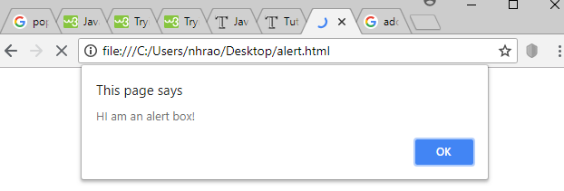
1.Alert Box
  An alert box is often used if you want to make sure information comes through to the user.
  When an alert box pops up, the user will have to click "OK" to proceed.
<script>
alert("HI am an alert box!")
</script>

Slide 34
2. Confirm Box
  A confirm box is often used if you want the user to verify or accept something.
  When a confirm box pops up, the user will have to click either "OK" or "Cancel" to proceed.
  If the user clicks "OK", the box returns true.
  If the user clicks "Cancel", the box returns false.

Slide 35
Example
<script>
var x=window.confirm("Press a Button");
if(x)
document.writeln("You Pressed Ok Button")
else
document.writeln("You Pressed Cancel Button")
</script>

Slide 36
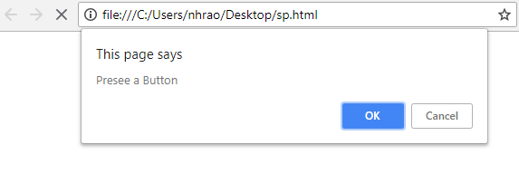
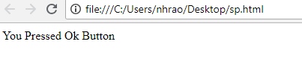
output

Slide 37
3. Prompt Box
  A prompt box is often used if you want the user to input a value before entering a page.
  When a prompt box pops up, the user will have to click either "OK" or "Cancel" to proceed after entering an input value.
  If the user clicks "OK“, the box returns the input value. If the user clicks "Cancel“, the box returns null.

Slide 38
Example
<script>
var name=window.prompt("Enter your Name");
document.writeln("GoodMorning Mr ."+name)
</script>

Slide 39
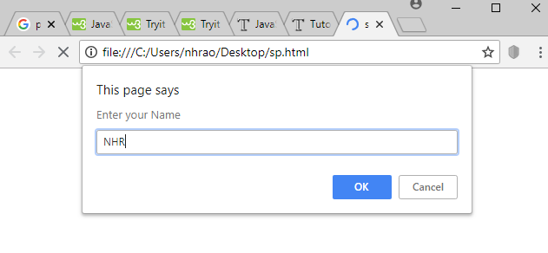
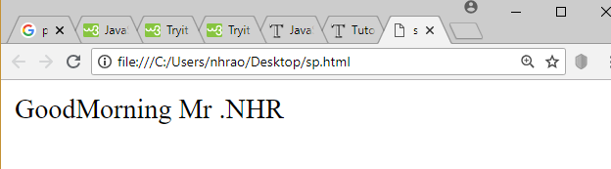
output

Slide 40
Prompt Box When Reading Integer Numbers
<script>
var n1=parseInt(window.prompt("Enter First Number"));
var n2=parseInt(prompt("Enter Second Number"));
var result=n1+n2;
alert("The Result is: "+result);
</script>

Slide 41
JavaScript If-else
The JavaScript if-else statement is used to execute the code whether condition is true or false. There are three forms of if statement in JavaScript.
If Statement
If else statement
if else if statement

Slide 42
JavaScript If statement
It evaluates the content only if expression is true.
The signature of JavaScript if statement is given below.
if(expression){
//content to be evaluated
}
<script>
var a=20;
if(a>10){
document.write("value of a is greater than 10");
}
</script

Slide 43
JavaScript If...else Statement
It evaluates the content whether condition is true of false.
The syntax of JavaScript if-else statement is given below.
if(expression){
//content to be evaluated if condition is true
}
else{
//content to be evaluated if condition is false
}

Slide 44
Example(Even or Odd)
<script>
var a=20;
if(a%2==0){
document.write("a is even number");
}
else{
document.write("a is odd number");
}
</script>

Slide 45
JavaScript If...else if statement
It evaluates the content only if expression is true from several expressions.
The signature of JavaScript if else if statement is given below.
if(expression1){
//content to be evaluated if expression1 is true
}
else if(expression2){
//content to be evaluated if expression2 is true
}
else if(expression3){
//content to be evaluated if expression3 is true
}
else{
//content to be evaluated if no expression is true
}

Slide 46
Example
<script>
var a=20;
if(a==10){
document.write("a is equal to 10");
}
else if(a==15){
document.write("a is equal to 15");
}
else if(a==20){
document.write("a is equal to 20");
}
else{
document.write("a is not equal to 10, 15 or 20");
}
</script>

Slide 47
JavaScript Switch
The JavaScript switch statement
is used to execute one code
from multiple expressions.
It is just like else if statement.
But it is convenient than
if..else..if because it can be
used with numbers, characters etc.
switch(expression){
case value1:
code to be executed;
break;
case value2:
code to be executed;
break;
......
default:
code to be executed if above values are not matched;
}

Slide 48
Example
<script>
var grade='B';
var result;
switch(grade){
case 'A':
result="A Grade";
break;
case 'B':
result="B Grade";
break;
case 'C':
result="C Grade";
break;
default:
result="No Grade";
}
document.write(result);
</script>

Slide 49
JavaScript Loops
The JavaScript loops are used to iterate the piece of code using for, while, do while or for-in loops.
There are four types of loops in JavaScript.
for loop
while loop
do-while loop
for-in loop(It makes the code compact. It is mostly used in array.)

Slide 50
1) JavaScript For loop
The JavaScript for loop iterates the elements for the fixed number of times.
It should be used if number of iteration is known.
The syntax of for loop is given below.
for (initialization; condition; increment)
{
code to be executed
}

Slide 51
Example
<script>
for (i=1; i<=5; i++)
{
document.write(i + "<br/>")
}
</script>
Output:
1
2
3
4
5

Slide 52
2) JavaScript while loop
The JavaScript while loop iterates the elements for the infinite number of times.
It should be used if number of iteration is not known.
The syntax of while loop is given below.
while (condition)
{
code to be executed
}

Slide 53
Example
<script>
var i=11;
while (i<=15)
{
document.write(i + "<br/>");
i++;
}
</script>
Output:
11
12
13
14
15

Slide 54
3) JavaScript do while loop
The JavaScript do while loop iterates the elements for the infinite number of times like while loop.
But, code is executed at least once whether condition is true or false.
The syntax of do while loop is given below.
do{
code to be executed
}while (condition);

Slide 55
Example
<script>
var i=21;
do{
document.write(i + "<br/>");
i++;
}while (i<=25);
</script>
Output:
21
22
23
24
25

Slide 56
JavaScript Functions
JavaScript functions are used to perform operations. We can call JavaScript function many times to reuse the code.
There are mainly two advantages of JavaScript functions.
Code reusability: We can call a function several times so it save coding.
Less coding: It makes our program compact. We don’t need to write many lines of code each time to perform a common task.

Slide 57
Types of Functions
Predefined functions or Global functions
User defined functions

Slide 58
Predefined functions or Global functions
isFinite()
isNaN()
parseInt()
parseFloat()
Eval()
Escape()
Unescape()

Slide 59
JavaScript User defined Function Syntax
The syntax of declaring function is given below.
function functionName([arg1, arg2, ...argN]){
//code to be executed
}
JavaScript Functions can have 0 or more arguments.

Slide 60
JavaScript Function Example
JavaScript that does not has arguments.
<script>
function msg(){
alert("hello! this is message");
}
</script>
<input type="button" onclick="msg()" value="call function"/>

Slide 61
JavaScript Function Arguments
<script>
function getcube(number){
alert(number*number*number);
}
</script>
<form>
<input type="button" value="click"
onclick="getcube(4)"/>
</form>

Slide 62
Function with Return Value
<script>
function getInfo(){
return "hello Mr. Rakesh How r u?";
}
</script>
<script>
document.write(getInfo());
</script>

