Slide 1
JavaScript: Objects
Outline
12.1 Introduction
12.2 Thinking About Objects
12.3 Math Object
12.4 String Object
12.4.1 Fundamentals of Characters and Strings
12.4.2 Methods of the String Object
12.4.3 Character-Processing Methods
12.4.4 Searching Methods
12.4.5 Splitting Strings and Obtaining Substrings
12.4.6 XHTML Markup Methods
12.5 Date Object
12.6 Boolean and Number Objects
12.7 document Object
12.8 window Object
12.9 Using Cookies
12.10 Final JavaScript Example
12.11 Web Resources

Slide 2
12.1 Introduction
Use JavaScript to manipulate every element of XHTML document from a script
Reference for several of JavaScript’s built-in objects
Demonstrates the capabilities

Slide 3
12.2 Thinking About Objects
Objects
  Attributes
  Behaviors
  Encapsulate data and methods
  Property of information hiding
  Details hidden within the objects themselves

Slide 4
12.3 Math Object
Allow the programmer to perform many common mathematical calculations

Slide 5
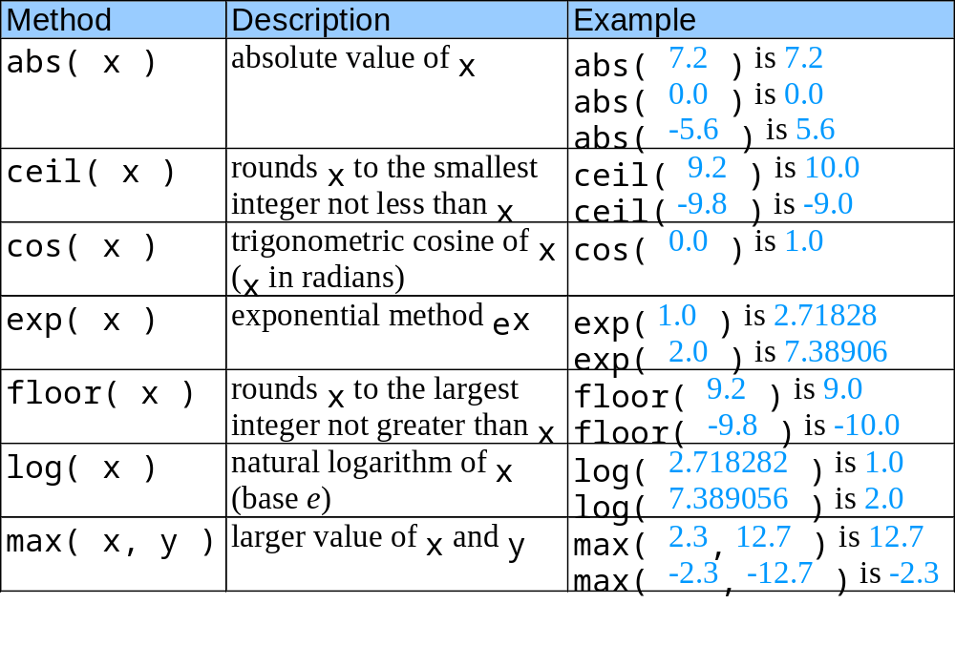
12.3 Math Object
Fig. 12.1 Math object methods.

Slide 6
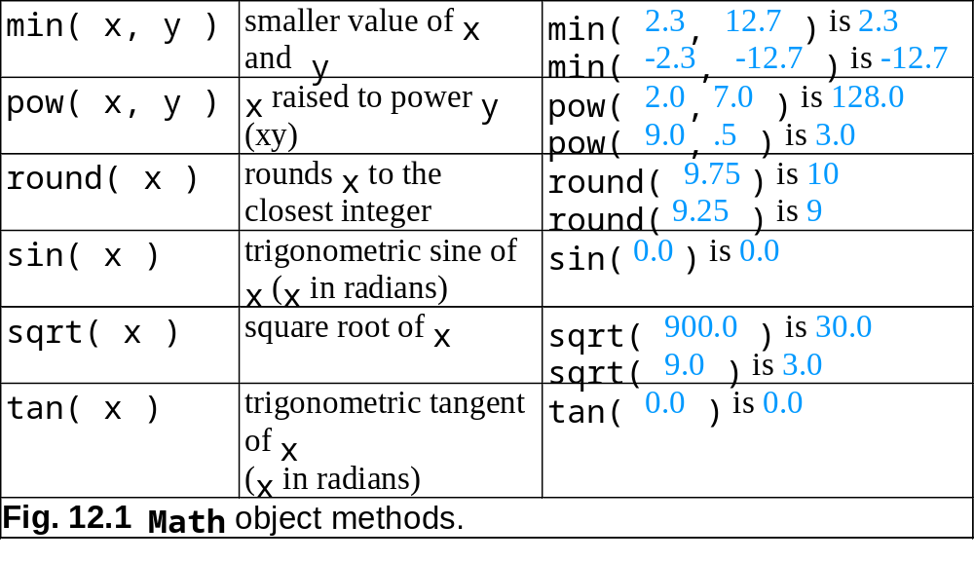
12.3 Math Object

Slide 7
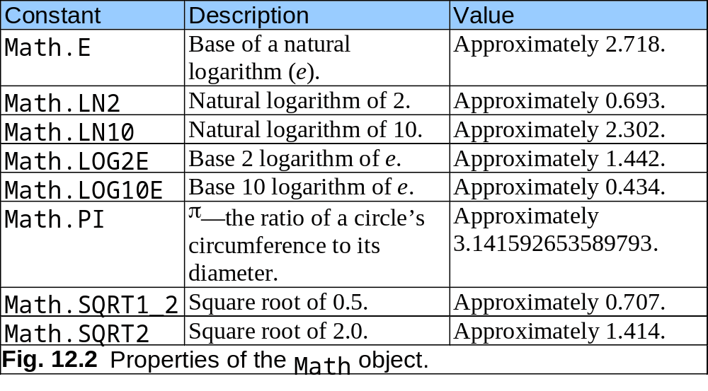
12.3 Math Object

Slide 8
12.4 String Object
JavaScript’s string and character-processing capabilities
Appropriate for processing names, addresses, credit card information, etc.

Slide 9
12.4.1 Fundamentals of Characters and Strings
Characters
  Fundamental building blocks of JavaScript programs
String
  Series of characters treated as a single unit

Slide 10
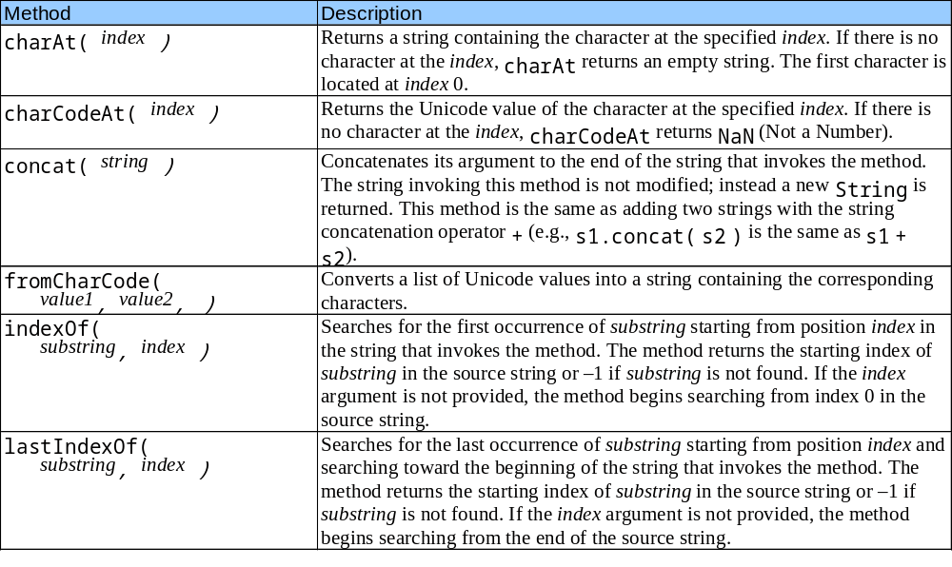
12.4.2 Methods of the String Object
Fig. 12.3 String object methods.

Slide 11
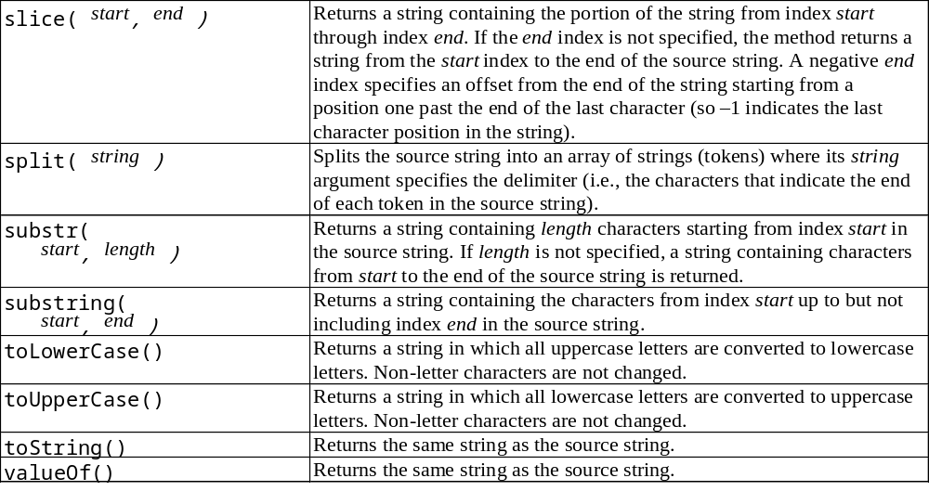
12.4.2 Methods of the String Object
Fig. 12.3 String object methods.

Slide 12
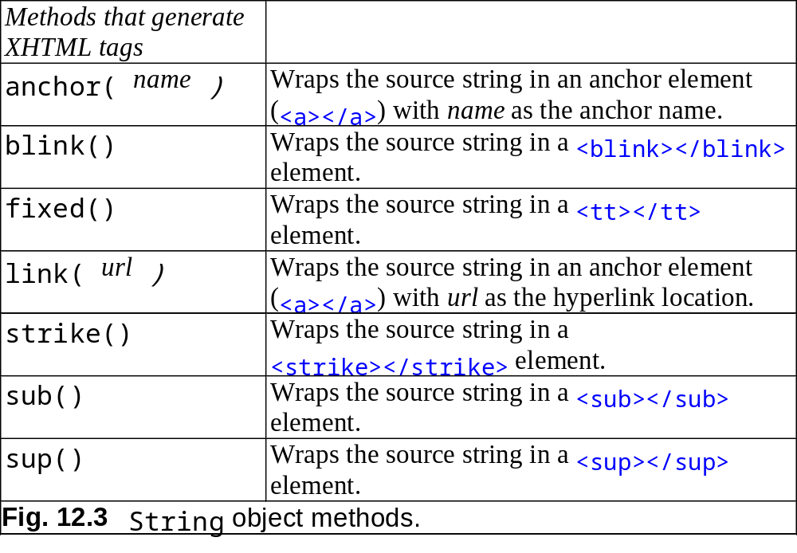
12.4.2 Methods of the String Object

Slide 13
12.4.3 Character Processing Methods
charAt
  Returns the character at specific position
charCodeAt
  Returns Unicode value of the character at specific position
fromCharCode
  Returns string created from series of Unicode values
toLowerCase
  Returns lowercase version of string
toUpperCase
  Returns uppercase version of string

Slide 14
12.4.6 XHTML Markup Methods
Anchor
  <a name = “top”> Anchor </a>
Blink
  <blink> blinking text </blink>
Fixed
  <tt> monospaced text </tt>
Strike
  <strike> strike out text </strike>
Subscript
  <sub> subscript </sub>
Superscript
  <sup> superscript </sup>

Slide 15
12.5 Date Object
Provides methods for date and time manipulations

Slide 16
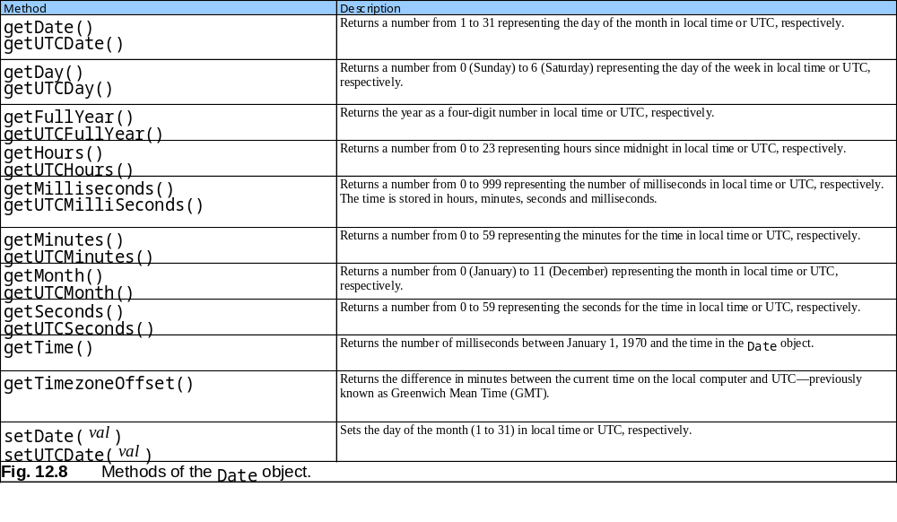
12.5 Date Object

Slide 17
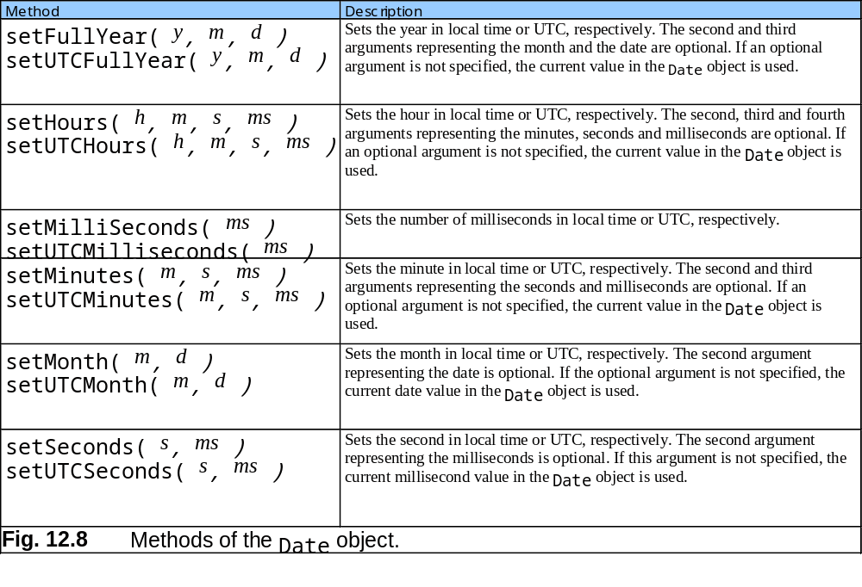
12.5 Date Object

Slide 18
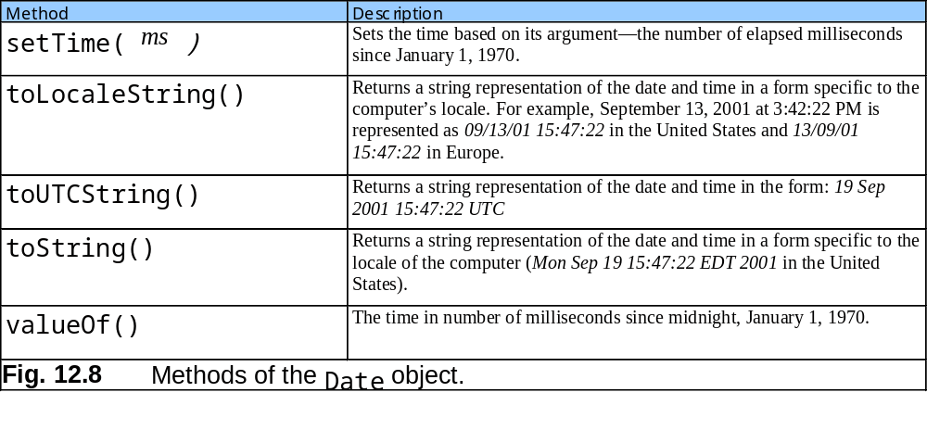
12.5 Date Object

Slide 19
12.6 Boolean and Number Objects
Object wrappers for boolean true/false values and numbers

Slide 20
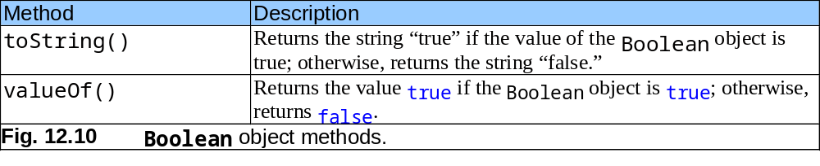
12.6 Boolean and Number Objects

Slide 21
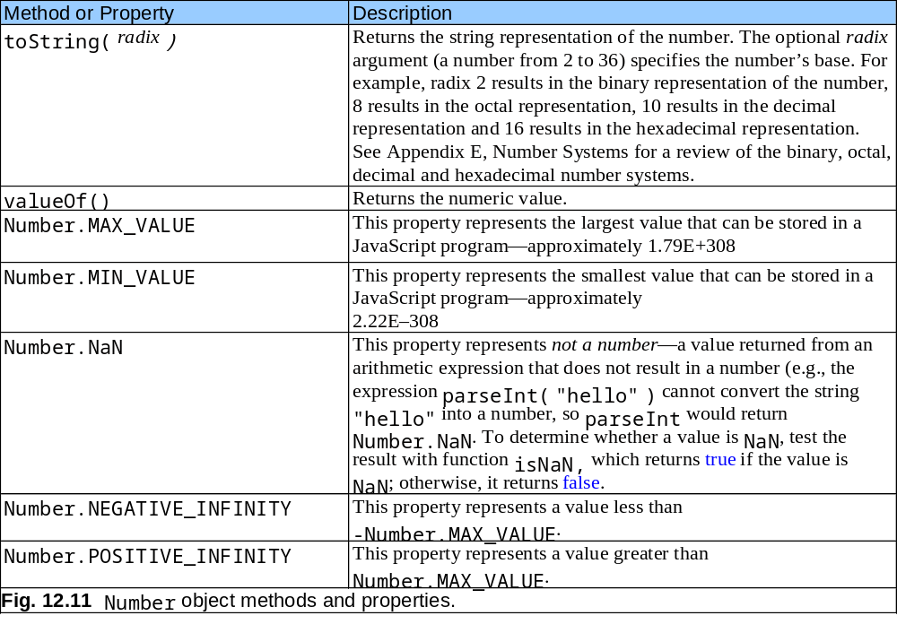
12.6 Boolean and Number Objects

Slide 22
12.7 document Object
Manipulate document that is currently visible in the browser window

Slide 23
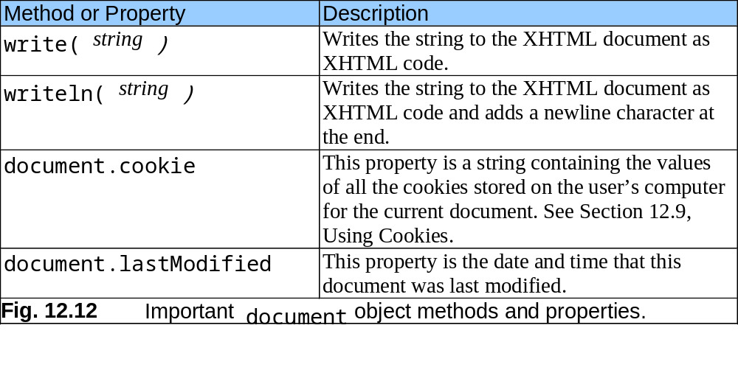
12.7 document Object

Slide 24
12.8 window Object
Provides methods for manipulating browser window

Slide 25
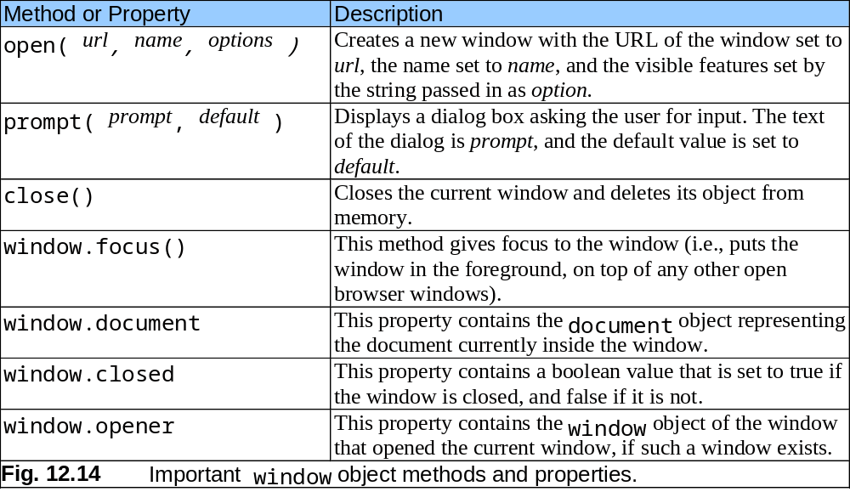
12.8 window Object

