Slide 1
How to work with List Styles in PPT
Satya Komatineni
V 2.0 (6/19/2025) [v1.0, 10/30/2024]
Location
https://github.com/SatyaKomatineni/articles-repo/blob/master/architecture/styling-lists-in-powerpoint.pptx

Slide 2
Table of Contents
Pages
Problem
How do I control spacing in lists?
3
Final Answer
Use lists in layouts
Use multiple master layouts
5
TOC
Notes
And
Recommendation
Detailed notes
Detailed answers
Detailed Recommendation
6 - 15
Testing
Of Lists
Pages to test the ideas
Layout list vs a list on a page
Copy vs copy of a copy
16 - 20

Slide 3
Problem/Goals
My Use of PPT
In my work as an architect, I use PPT a lot
My usage is basic, and the goal is not graphics, like a sales presentation
I use lot of lists (Mostly numbered)
I often keep these lists in a template page for cut/paste.
My problem: Spacing between numbers and items
The default spacing in these lists between numbers and text is either too narrow or too wide
Also, spacing between lines
I get a lot of surprises, when for level 2 and level 3s
It was hard for me to control that spacing
Goal
Figure out how to control spacing for all levels (1 to 5) in a list
Reuse the lists once their spacing is configured
Make those lists available for copy and paste
Solution
See in the Findings section how to style spacing
Use layouts to control most lists
Use custom text box lists (copy/paste) as a secondary option

Slide 4
Final Answer
Uses the Non-Title-Master master
Uses a “separator” layout

Slide 5
Design Master Layouts : Empty page layout
Lay outs
Pages
Content Pages
layout
Content Page: Title + Main content list
Empty page: Only Title
Two list page: Title + Main list + side list
Black list page: Title + Main content list in black color
Title + List layout
Master layouts
Title + Image + List layout
Title + empty page
Non-Content Pages
Layout
Title page
Various separator Pages
Title Page layout
Appendix/separator layout

Slide 6
Notes and Findings
Uses the Non-Title-Master master
Uses a “separator” layout

Slide 7
Global Notes: Content Page layout: Title + Main content List
Not all lists are the same!!
Two kinds
Layout lists: Lists defined on layout pages as “place holders”
Text box lists: Any text in a text box that is formatted as a list
Text box lists cannot be styled
You have to use master pages to style “layout lists”
Master layouts
Different from their children
Children cannot have other children
The order of children is not important
There are more “Place holders” possible on child layouts
The place holders are fixed on the master layout
You can have more than 1 master layout
Changing the layout of a content page with a “layout list” will make that list either a default list format or a format in line with a destination list format

Slide 8
Layout lists and Text box lists: Content Page layout: Title + Main content List
Complicated stuff
Text box lists are different from those inherited from layouts (layout lists) !
Text box lists
No way to pre-style the text box list styles for the necessary control.
Use a preconfigured lists on a page of your liking to replicate them (Not that easy)
Layout lists
They are defined on the slide layouts
Spacing between numbers and text controlled by Ruler (and tedious)
Space between the outer box and numbers is hard to control. See how to do this on a dedicated page for this topic. (Shape for padding left and top, and Paragraph for moving bullets to the right)
Few basics (font, spacing between lines) you can control from each page
A separate style page is needed if you want different looking styled lists
Layout lists copy behavior
The layout-lists keep their formatting and take on the destination theme.
If there is equivalent list on the target page, they take on a default bulleted list

Slide 9
Styling a layout list
Start with a place holder for a list in the style page
This place holder is called “Text” by the way
You will see 5 levels of bullets
Space between the numbers and the left outer box is tricky: 2 Controls
Padding: Use the “list box” format shape menu for: Left and Top margins of the shape
Indent: Use paragraph menu to control space between border and numbers or bullets (highlight whole list – Does not work for more than 1 level)
You are not done yet
Between Bullets and Text
First: Stay with the 5 levels and don’t add any more for this exercise
Use the ruler to adjust each level the left spacing for a) number and b) text
Do this for all 5
Here or on the Target page
Space between multiple lines of the list: Use Paragraph. You can do this on the target page.
Fonts/colors etc: You can do this on the target page as well

Slide 10
Paragraph Controls: The left side Indent
They apply to each line (that is a paragraph) in the bulleted list
Indent: Where the lines start on the left corresponding to the padding of the shape
Special: None, All lines honor the left indent
Special: First line: A special left indent for the first line
Special: Hanging: First line stays at the left indent, rest of the lines follow this
Again Note: This “in each bulleted line”. Does not apply to the other lines
Recommendation
Use left indent
Use special to None

Slide 11
Paragraph Controls: The left side Indent Full explanation
The ruler and the left indent does the same thing
There are 2 positions
Of the number or bullet
Text
What is first line and what is hanging on a list line
Number is the first line
Text is the hanging (rest of the lines)
Indenting: Before text + Hanging
Move the number by “before text”
Move the text by “hanging” further to the right (relative)
Only one selection is active
None, First line, Hanging
Only ONE of them can be active

Slide 12
Paragraph Controls: The left side Indent: Enter and Tab nudge
Problem
Changing the left indent on the whole list will move child levels also to the same indent as the parent
You don’t want that
How to
Start with 1 level in the layout list
Adjust spaces for line 1
Fix its “shape” left padding
Fix its left paragraph indent
Adjust the ruler as needed
Then enter and tab from the first line to create the second level and so on
Second level space adjustments
Shape left, and paragraph left are preserved
Adjust the ruler for level 2
Enter and tab for level 3
Repeat this for all levels
Mainly the Ruler, rest are honored
So, use the tab work around

Slide 13
Paragraph Controls: The spacing options
They apply to each line (that is a paragraph) in the bulleted list
Not between the bullets!!
Very tricky!!
Before and after refers to each line inside ONE bullet
Line spacing (single, double, etc) is for lines inside a paragraph
Before and after is outside the paragraph
So, if both are in play and if the line is a single line they add up
For single line bullets, the “double spacing” inadvertently acts like as if it is applied to multiple bullets.
Advice
For spacing between the boundary and the list use the “shape” controls not paragraph
Use before and after for better control when the list has bullets that are multi line
For single line ones you can get away with line spacing

Slide 14
Place Holders and Layouts: : Content Page layout: Title + Main content List
Insert Place holders are not available on Master layout, but only on child layouts.
Master layout has a fixed number of insertable layouts like title, footer, page etc. These can be turned on or off. That’s it.

Slide 15
Multiple Master Layouts
Say, most pages want a divider line between title and the content. Say these are 100 pages.
So you do that....
Now you want a page that doesn't have that title
Say these are 10 pages
These pages cannot use a layout from the other master because they will get the line a the top!
So you need to create another master layout without that line!
Now you have 2 masters!
there may be other ways to do it, but this is one way!

Slide 16
A separate master for non-content pages
May be a good idea to use a separate master for non content pages
Title page
Separator page
This one typically misses the a) page title b) horizontal line at the top etc.
Any drawings or images you place on a master cannot be removed from children!!

Slide 17
Demonstrating the 2nd Master Style
Uses the Non-Title-Master master
Uses a “separator” layout

Slide 18
Recommendation

Slide 19
Guidance: Design of layouts for lists: Primary and Secondary Options
3 sister layout pages
Extending a common content layout
Can inherit
Content with 1 list
Have pages use one of these layouts
Content with 2 lists
Content layout
Content with 3 lists
1
Style:
Spacing
Fonts
Color
A page with many “simple” text box lists to copy if needed
Style these lists in layouts
2
Cannot inherit

Slide 20
Testing of List Behavior

Slide 21
A Simple List layout: black-list-layout
Heading 1 [Black color]
L2
L2
L3
L3
L2
Heading 1
Etc.
Layout list
Two
Different
Things
A simple example of using a layout list
The space, font, etc are configured on the layout page (master pages)
Changing that definition will change this list above.
Note: Those lists are different from this list here (inside this text box)
Just a text box list

Slide 22
Layout lists: Using 2 layout lists on a page
Heading 1 [Colorful one]
L2
L2
L3
L3
L2
Heading 1
Etc.
These two boxes are on the style page
See “two-list-content-style” in master pages view
The left one follows that color font scheme as defined in the master style.
We can call these “layout lists”
See “how to style layout lists” for more info
This is a copy of the list
It seem to work sometime and sometime not (retaining its formatting)
On the same page seem to work but there is a hesitation being able to update it
On a new page the top list loses its formatting whereas this list (copy of copy) seem to retain.

Slide 23
Combined lists: A layout without any layout-lists
Heading 1 [Colorful one]
L2
L2
L3
L3
L2
Heading 1
Etc.
Heading 1 [Black color]
L2
L2
L3
L3
L2
Heading 1
Etc.
Copying the “layout lists” on to new page with a different layout does not retain their formatting
They don’t retain the original formatting
They fall back to the “list” as known to this page and its layout page ☹
Or they fall back to the default of a “bulleted list”

Slide 24
Combined lists: style empty
Testing
Hello
Test a copy of the layout list
A direct copy doesn’t retain its format
Whereas a copy of copy seem to keep its formatting
Just a text box list
Copy-of-a-copy of a layout list from another page

Slide 25
Testing: works
Level 1
Level 2
Level 3
Level 2, item 2
Level2 item 1
Level 2 item 2
Level 2, item 3
One
two
Level 1 item 2
Another
Another
One
Two
another

Slide 26
Appendix

Slide 27
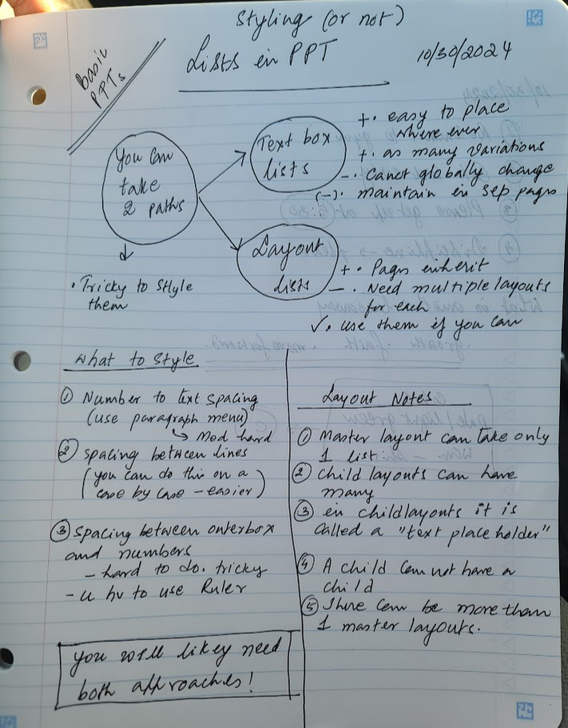
Quick Summary

