Slide 1
How to work with List Styles in PPT
Satya Komatineni
10/30/2024
Version 1.0
Location
https://github.com/SatyaKomatineni/articles-repo/blob/master/architecture/styling-lists-in-powerpoint.pptx

Slide 2
Problem/Goals
My Use of PPT
As an architect, I use PPT a lot
My usage is very basic, and the goal is not graphics or “wow-ing” someone like a sales presentation
I use lot of lists (Mostly numbered)
I often keep these lists in a template page and copy over
My problem: Spacing between numbers and items
The default spacing in these lists are either too narrow or too wide
I get lot of surprises especially when I move into level 2 and level 3s
When I try to control that spacing it was hard for me to figure out
Goal
Figure out how to control spacing for all levels (1 to 5) in a list
Reuse the lists once their spacing is configured
Make those lists available for copy and paste as needed
Solution
See in the Findings section how to style spacing
Use layouts control most lists
Use custom text box lists as a secondary option

Slide 3
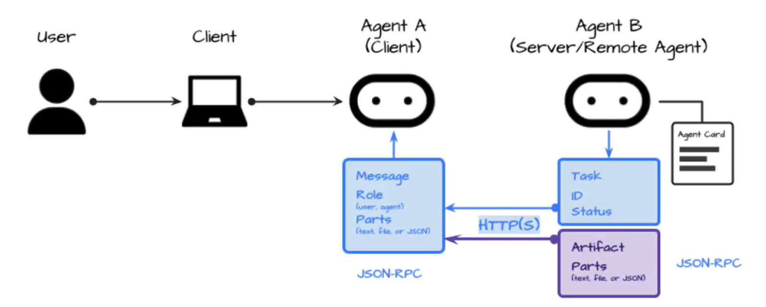
Quick Summary

Slide 4
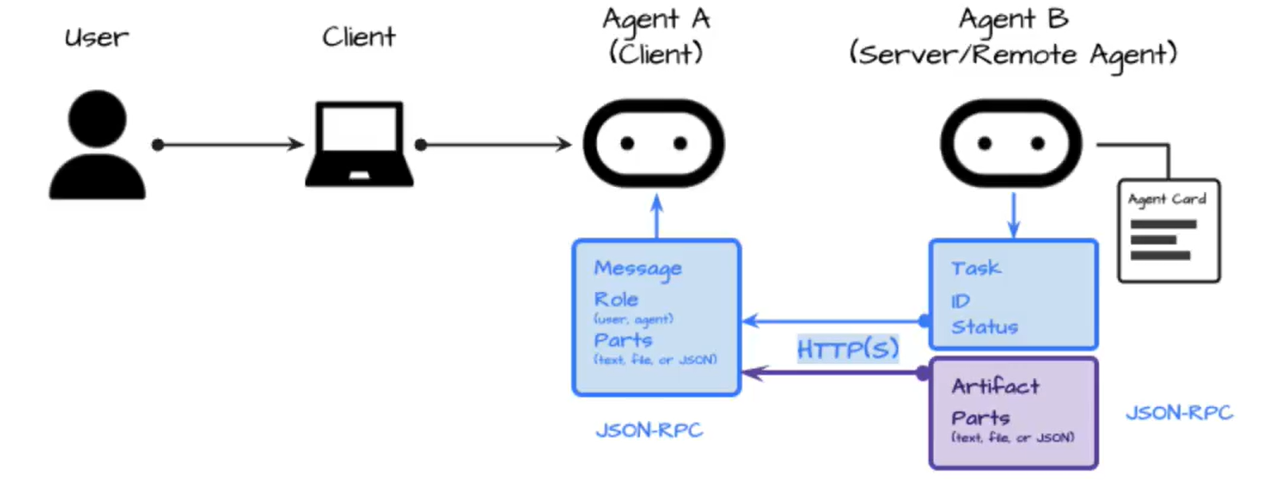
Approach/Table of Contents

Slide 5

Approach/Table of Contents

Slide 6
Testing of List Behavior

Slide 7
A Simple List layout: black-list-layout
Heading 1 [Black color]
L2
L2
L3
L3
L2
Heading 1
Etc.
Layout list
Two
Different
Things
A simple example of using a layout list
The space, font, etc are configured on the layout page (master pages)
Changing that definition will change this list above.
Note: Those lists are different from this list here (inside this text box)
Just a text box list

Slide 8
Layout lists: Using 2 layout lists on a page
Heading 1 [Colorful one]
L2
L2
L3
L3
L2
Heading 1
Etc.
These two boxes are on the style page
See “two-list-content-style” in master pages view
The left one follows that color font scheme as defined in the master style.
We can call these “layout lists”
See “how to style layout lists” for more info
This is a copy of the list
It seem to work sometime and sometime not (retaining its formatting)
On the same page seem to work but there is a hesitation being able to update it
On a new page the top list loses its formatting whereas this list (copy of copy) seem to retain.

Slide 9
Combined lists: A layout without any layout-lists
Heading 1 [Colorful one]
L2
L2
L3
L3
L2
Heading 1
Etc.
Heading 1 [Black color]
L2
L2
L3
L3
L2
Heading 1
Etc.
Copying the “layout lists” on to new page with a different layout does not retain their formatting
They don’t retain the original formatting
They fall back to the “list” as known to this page and its layout page ☹
Or they fall back to the default of a “bulleted list”

Slide 10
Combined lists: style empty
Testing
Hello
Test a copy of the layout list
A direct copy doesn’t retain its format
Whereas a copy of copy seem to keep its formatting
Just a text box list
Copy-of-a-copy of a layout list from another page

Slide 11
Notes and Findings

Slide 12
Global Notes
Not all lists are the same!!
Two kinds
Layout lists: Lists defined on layout pages as “place holders”
Text box lists: Any text in a text box that is formatted as a list
Text box lists cannot be styled
You have to use master pages to style “layout lists”
Master layouts
Different from their children
Children cannot have other children
The order of children is not important
There are more Place holders possible on child layouts
The place holders are fixed on the master layout
You can have more than 1 master layout
Changing the layout of a content page with a “layout list” will make that list either a default list format or a format in line with a destination list format

Slide 13
Layout lists and Text box lists
Complicated stuff
Text box lists are different from those inherited from layouts!
Text box lists
No way to pre-style the text box list styles.
Use a preconfigured lists on a page of your liking to replicate them (Not that easy)
Layout lists
They are defined on the slide layouts
Spacing between numbers and text controlled by “paragraph” menu
Space between the outer box and numbers is hard to control. See how to do this on a dedicated page for this topic.
Few basics (font, spacing between lines) you can control from each page
A separate style page is needed if you want different looking styled lists
Layout lists copy behavior
The layout-lists keep their formatting and take on the destination theme.
If there is equivalent list on the target page, they take on a default bulleted list

Slide 14
Styling a layout list
Start with a place holder for a list in the style page
This place holder is called “Text” by the way
You will see 5 levels of bullets
Use paragraph menu to control space between numbers or bullets and text
Space between the numbers and the left outer box is tricky
Use the “list box” format shape menu to remove the “left hand spacing from text”.
You are not done yet
Left side space control
First: Stay with the 5 levels and don’t add any more for this exercise
Use the ruler to adjust each level the left spacing for a) number and b) text
Do this for all 5
You are now done.

Slide 15
Place Holders and Layouts
Insert Place holders are not available on Master layout, but only on child layouts.
Master layout has a fixed number of insertable layouts like title, footer, page etc. These can be turned on or off. That’s it.

Slide 16
A separate master for non-content pages
May be a good idea to use a separate master for non content pages
Title page
Separator page
This one typically misses the a) page title b) horizontal line at the top etc.
Any drawings or images you place on a master cannot be removed from children!!

Slide 17
Recommendation

Slide 18
Guidance: Design of layouts for lists: Primary and Secondary Options
3 sister layout pages
Extending a common content layout
Can inherit
Content with 1 list
Have pages use one of these layouts
Content with 2 lists
Content layout
Content with 3 lists
1
Style:
Spacing
Fonts
Color
A page with many “simple” text box lists to copy if needed
Style these lists in layouts
2
Cannot inherit

