Slide 1
A Testbed for Applied GenAI - Developing a large Expertise -
Satya Komatineni
6/16/25, Version 1.0 (Started 6/16/25)
Location: …tbd

Slide 2
Goals
Define a strategic development goal
Define a tactical development goal
Gain Expertise in Applied GenAI
Provide a continuous work stream
Aim to provide a set of consistent tasks
Define a “why”

Slide 3
Strategic work: Why

Slide 4
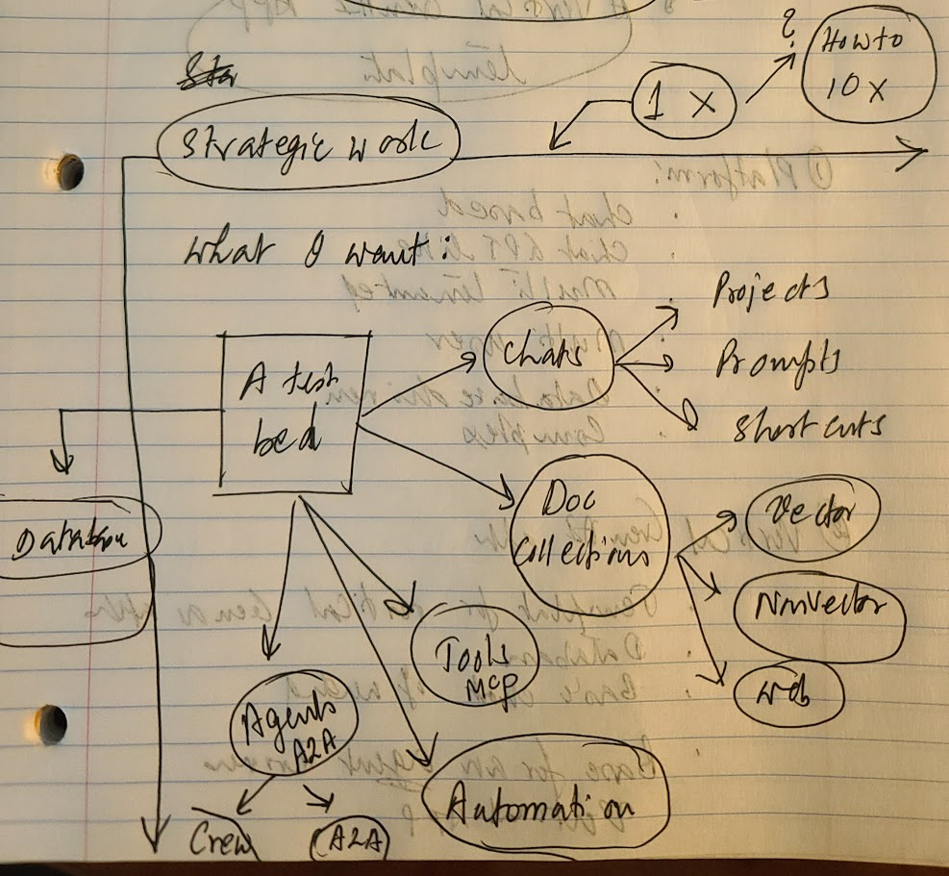
Strategic Vision
A ux chat (Ex: Assistant-ui)
A DB to support it
Projects
Prompts
Prompt Shortcuts
Document collections
MCP Tools
A2A via Crew AI
Automation via A2A

Slide 5
Strategic work: Local
Notes/Technologies
A ux chat (Ex: Assistant-ui or CopilotKit with AG UI)
A DB to support it
Projects
Prompts
Prompt Shortcuts
Document collections
MCP Tools
A2A via Crew AI
Automation via A2A
Local app, no web or user management
Assistant-ui
Copilot-kit
AG-UI
CrewAI
Google A2A

Slide 6
Strategic work: Platform
Notes/Technologies
Multi-user
Mulit-tenanted
Web based deployment
Mobile – Responsive UX version
Mobile – Native using Google Flutter
Devops
Google Cloud
React stack from Copilotkit or Assistant Ux
Flutter

Slide 7
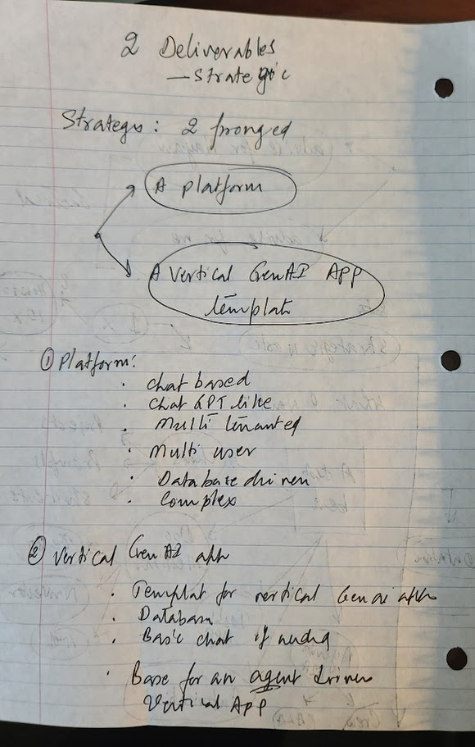
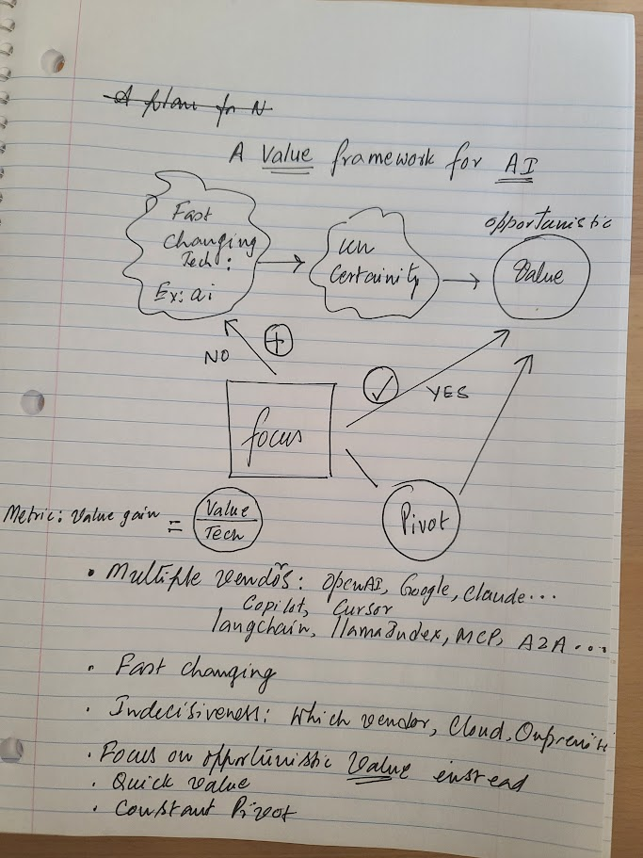
Strategic work

