Slide 1
React in Pics
Satya Komatineni
V 1.x (8/16/2025) [8/16/2025]
Location
https://github.com/SatyaKomatineni/articles-repo/tbd

Slide 2
Styling Appendix

Slide 3
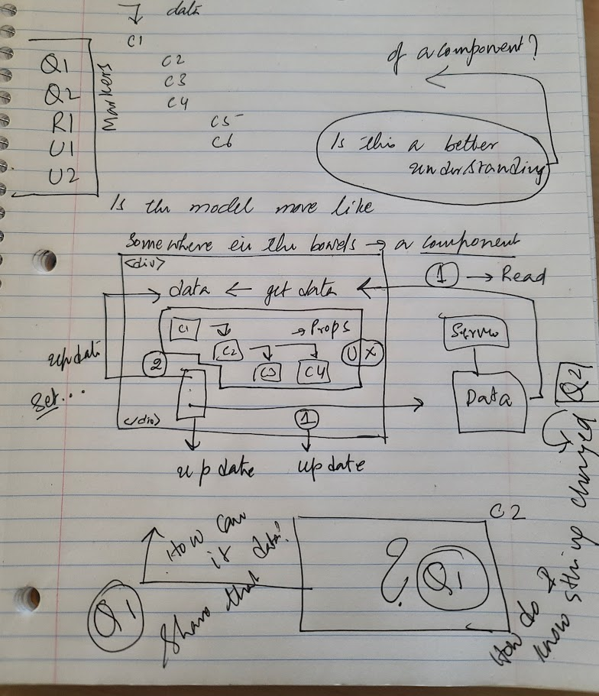
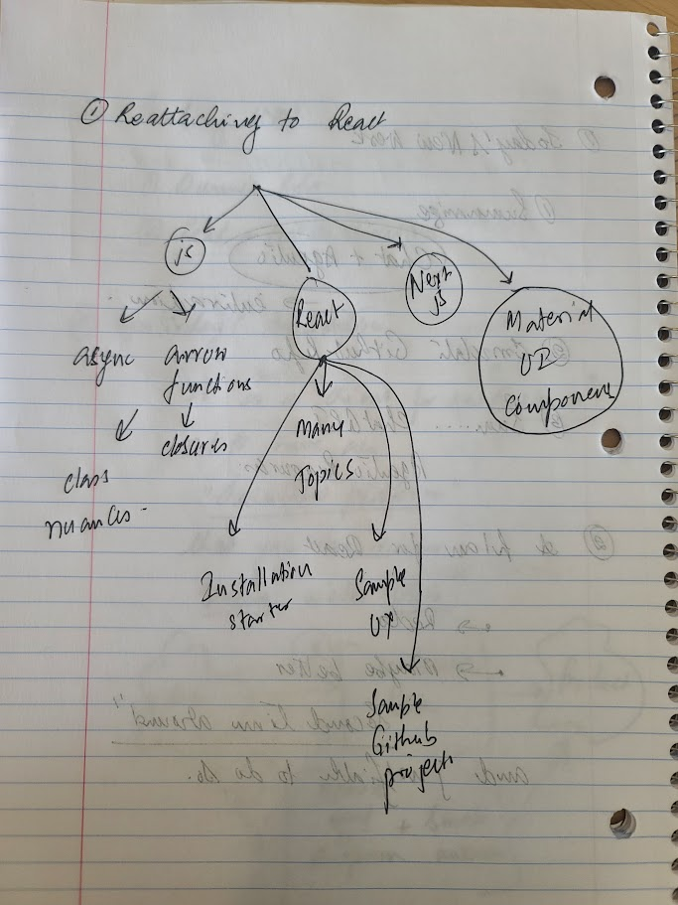
Drawings

Slide 4
Problem/Goals
My Use of PPT
In my work as an architect, I use PPT a lot
My usage is basic, and the goal is not graphics, like a sales presentation
I use lot of lists (Mostly numbered)
I often keep these lists in a template page for cut/paste.
My problem: Spacing between numbers and items
The default spacing in these lists between numbers and text is either too narrow or too wide
Also, spacing between lines
I get a lot of surprises, when for level 2 and level 3s
It was hard for me to control that spacing
Goal
Figure out how to control spacing for all levels (1 to 5) in a list
Reuse the lists once their spacing is configured
Make those lists available for copy and paste
Solution
See in the Findings section how to style spacing
Use layouts to control most lists
Use custom text box lists (copy/paste) as a secondary option

Slide 5
Don’t delete this page: Available Layouts
Content Master: heading, top line, footer
Default: Title + Main list
Empty page: No body, full access
Figure + Annotation
Non Content Master
Title page
Separator page

Slide 6
Paragraph Controls: The left side Indent
They apply to each line (that is a paragraph) in the bulleted list
Indent: Where the lines start on the left corresponding to the padding of the shape
Special: None, All lines honor the left indent
Special: First line: A special left indent for the first line
Special: Hanging: First line stays at the left indent, rest of the lines follow this
Again Note: This “in each bulleted line”. Does not apply to the other lines
Recommendation
Use left indent
Use special to None

Slide 7
Paragraph Controls: The spacing options
They apply to each line (that is a paragraph) in the bulleted list
Not between the bullets!!
Very tricky!!
Before and after refers to each line inside ONE bullet
Line spacing (single, double, etc) is for lines inside a paragraph
Before and after is outside the paragraph
So, if both are in play and if the line is a single line they add up
For single line bullets, the “double spacing” inadvertently acts like as if it is applied to multiple bullets.
Advice
For spacing between the boundary and the list use the “shape” controls not paragraph
Use before and after for better control when the list has bullets that are multi line
For single line ones you can get away with line spacing

