Slide 1
Claude Execution Architecture & Resources
Satya Komatineni
V 1.x (12/29/2025) [12/29/2025]
Location
https://github.com/SatyaKomatineni/articles-repo/templates

Slide 2
Index
Claude Execution Architecture for the Enterprise
Claude Product Dimensions
Claude Capability Map
Claude Documentation/website roadmap
Opportunities

Slide 3
Claude Execution Architecture

Slide 4
What is Claude Execution Architecture?
Dilemma
Challenges
Quick Summary
Where does Claude run custom code like MCPs, Skills, Agents etc?
When the sources or targets (end points) are cloud based and public like MS 365, gmail, Google Drive it is easy to imagine Claude will connect to them from Claude cloud.
What happens when the end points are inside an enterprise?
How does Claude deployment and execution architecture look like for an Enterprise?
Does that change with each mode: Consumer, Enterprise, Claude.ai, Claude Code, Claude Desktop?
Enterprise documentation is sparse.
Execution architecture is very unclear from Anthropic docs
No diagrams especially
I have searched developer docs, supporting docs, blogs etc. (See other sources I had searched later in the deck)
There is some level of enterprise docs in the “support” collection
For enterprise end points they are defined in the cloud
These end points include remoted MCP endpoints, connectors etc.
Skills also follow the same pattern (in the cloud)
The on-premise connectors are reached through oauth and https.
For claude desktop and claude code, there are some provisions to run them on premise directly
Local MCP servers are targeted for Claude Desktop and runs on the local computer using local computers resources
Likely the same with Claude Code
Both Claude Code and Desktop can use the Remote MCP servers or skills

Slide 5
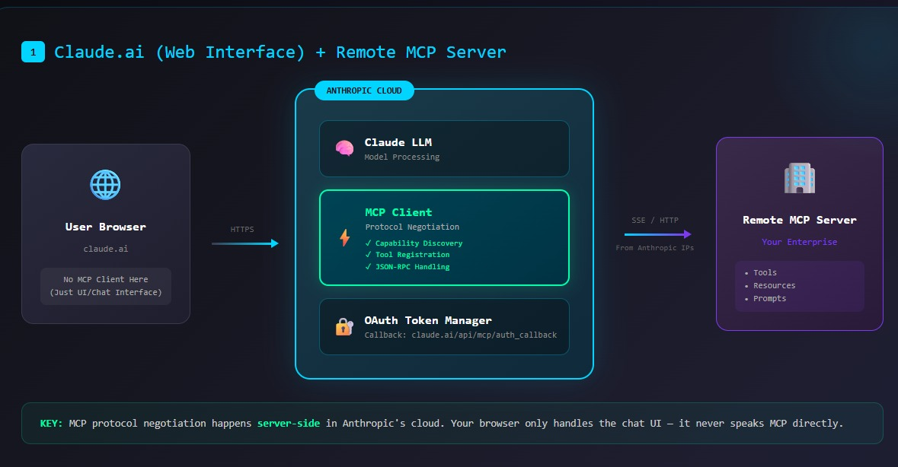
1 / 4

Slide 6
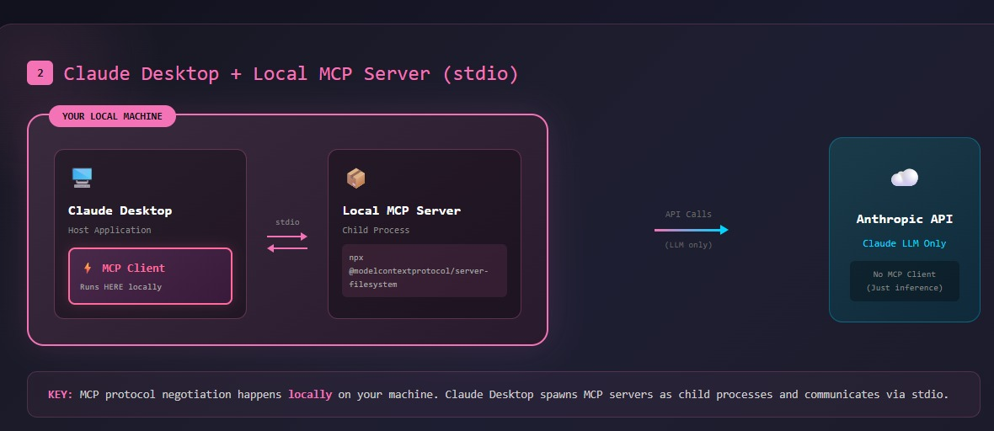
2 / 4

Slide 7
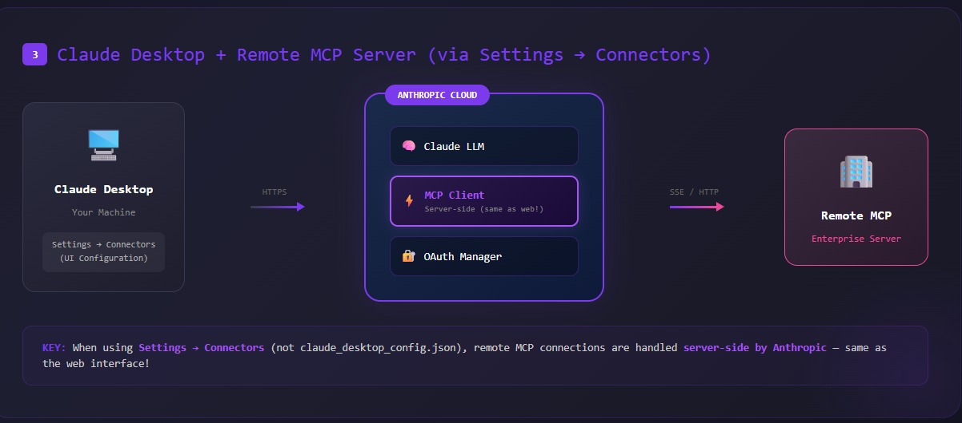
3 / 4

Slide 8
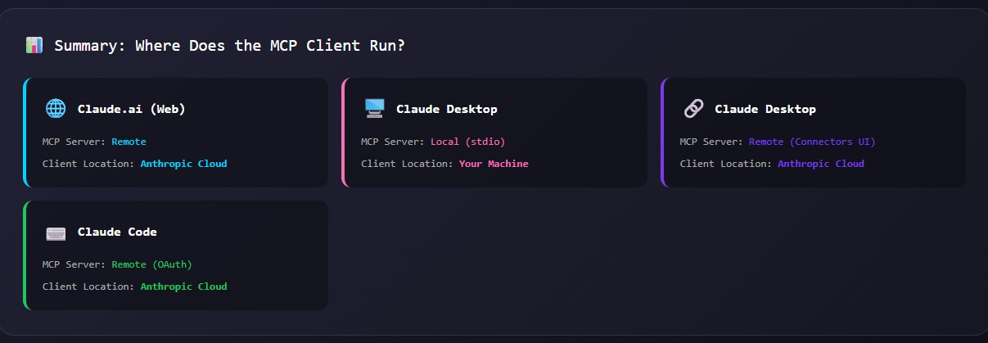
4 / 4

Slide 9
Understanding Claude

Slide 10
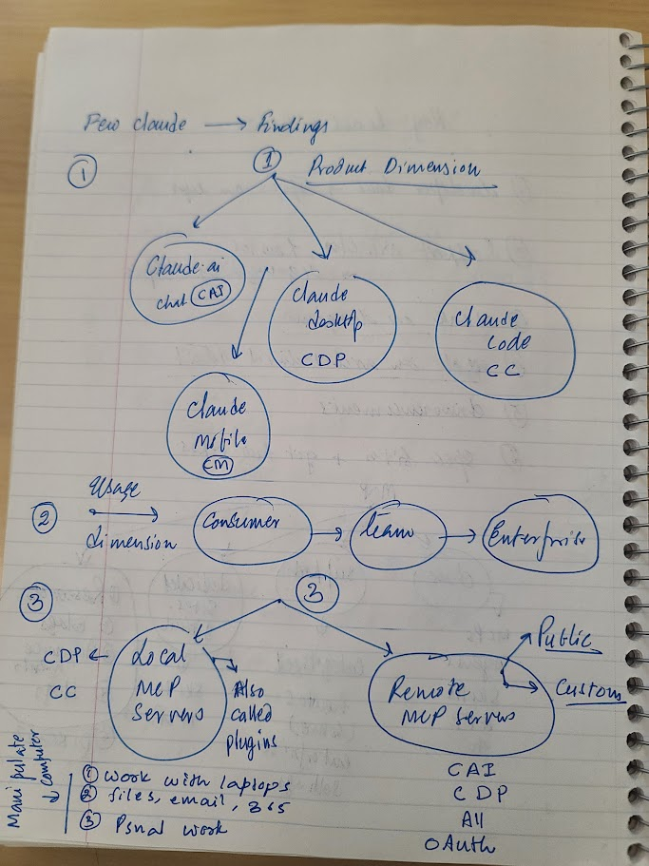
Claude Product Dimensions
What
Claude.ai (website) – CAI
Claude Desktop – CDP
Claude Code - CC
Consumer/Team/Enterprise
MCP Dimension
Each product CAI, CC, CDP available for Consumer, Team, and Enterprise
Local MCP Servers – for CDP and CC
:Work with laptops,
: files,
: emails 365 etc.
Remote MCP Servers
: Public servers for SP, Box, etc
: Custom MCP servers for Enterprises
: CAI, CDP
: All use oauth and run from cloud
To explore more
Use public MCP servers in Claude Desktop and experiment
Experiment with Skills in Pro version

Slide 11
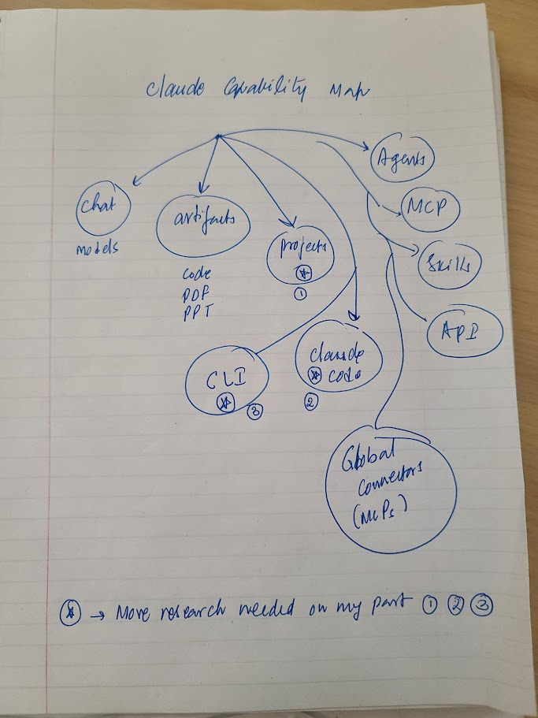
Claude Capability Map
What
Understand full capabilities of Claude
List them
Capabilities: Its affordances for Consumer and Enterprise
Chat: web, mobile
Artifacts: Code, PDF, PPT
Projects
CLI
Claude Code
Global Connectors
MCP
Skills
Agents
API
To explore more
CLI
Skills
Using Global Connectors
Claude code

Slide 12
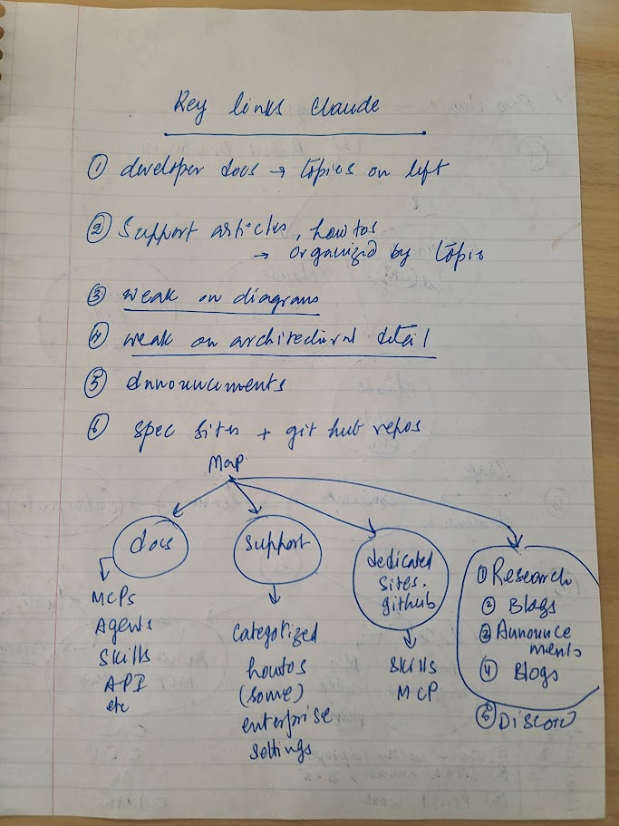
Claude Document Roadmap
What
What you fill find at their site
What is the documentation structure of Claude
Website organization
Developer docs – by left naviation
Support docs – by category
Dedicated sites – MCP, Skills
Research
Blogs
Announcements
Discord
Enterprise Resources
To explore more
What additional resources I have missed?
List Enterprise Resources
Weak on architecture
Weak on diagrams

Slide 13
Opportunities

Slide 14
Opportunities
Experiment with Skills in Claude.ai
Experiment with Skills in Claude desktop
Use CDP Projects and Document creation more (.md, word, excel, ppt)
Oauth and MCP
See if “English” Agents can work in Claude (no code)
Explore public skills and MCP servers
Claude Mobile
Automate IG image generation through Claude Mobile

Slide 15
Styling Notes for this Deck

Slide 16
Don’t delete this page: Available Layouts
Content Master: heading, top line, footer
  Default: Title + Main list
  Empty page: No body, full access
  Figure + Annotation
Non Content Master
  Title page
  Separator page

Slide 17
Paragraph Controls: The left side Indent
They apply to each line (that is a paragraph) in the bulleted list
Indent: Where the lines start on the left corresponding to the padding of the shape
Special: None, All lines honor the left indent
Special: First line: A special left indent for the first line
Special: Hanging: First line stays at the left indent, rest of the lines follow this
Again Note: This “in each bulleted line”. Does not apply to the other lines
Recommendation
  Use left indent
  Use special to None

Slide 18
Paragraph Controls: The spacing options
They apply to each line (that is a paragraph) in the bulleted list
Not between the bullets!!
Very tricky!!
Before and after refers to each line inside ONE bullet
Line spacing (single, double, etc) is for lines inside a paragraph
Before and after is outside the paragraph
So, if both are in play and if the line is a single line they add up
For single line bullets, the “double spacing” inadvertently acts like as if it is applied to multiple bullets.
Advice
  For spacing between the boundary and the list use the “shape” controls not paragraph
  Use before and after for better control when the list has bullets that are multi line
  For single line ones you can get away with line spacing

