Slide 1
MCP Protocol Architecture
Where the MCP Client Lives: Claude.ai vs Claude Desktop
Claude Enterprise Integration Guide

Slide 2
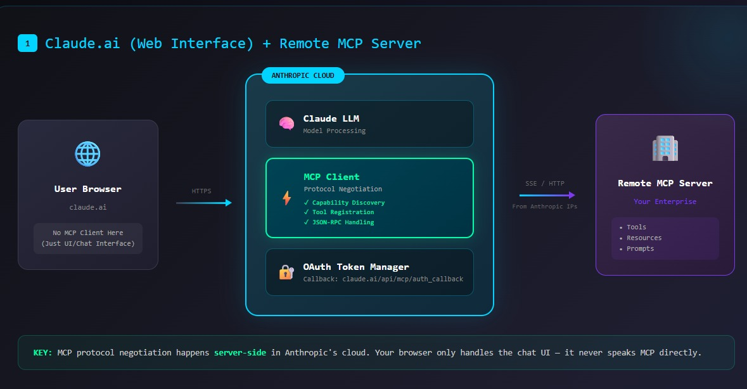
1 / 4

Slide 3
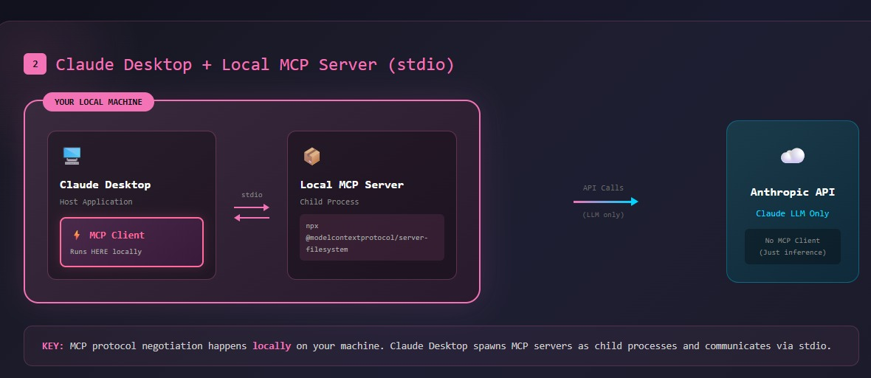
2 / 4

Slide 4
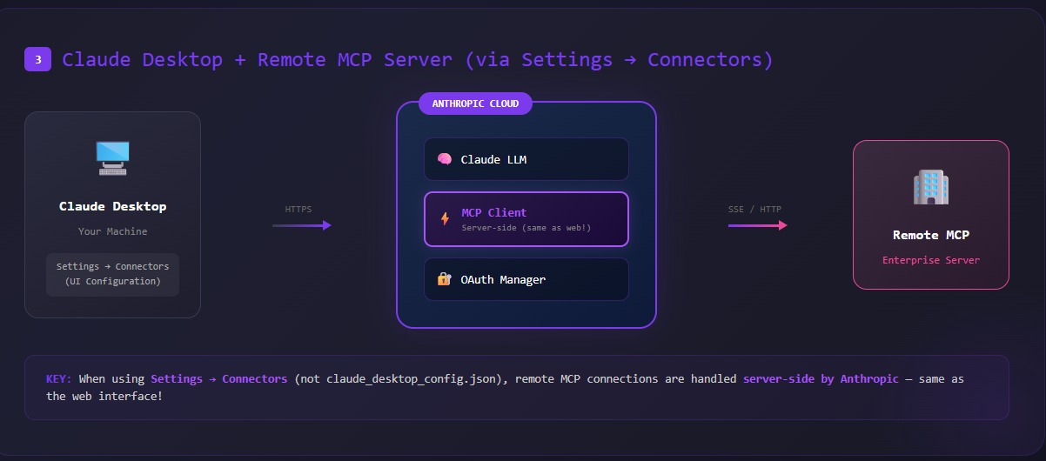
3 / 4

Slide 5
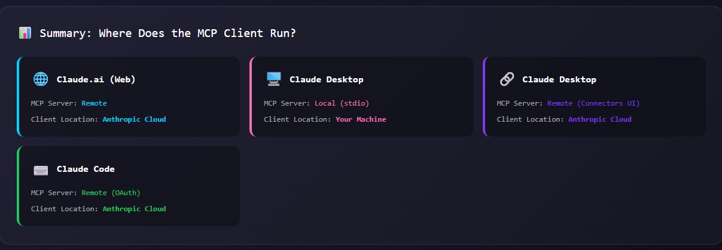
4 / 4

