Slide 1
UI
(Browser)
APIs
(Web Server)
DB
(Database Server)
Your Computer,
Laptop,
Mobile
Big Machine 1
-
Text files,
Business logic
Big Machine 2
-
Database files
Program
Return a file
APIs
Incoming
Calls
Each – A call to a function
Read from a database
Collection of Functions
Send an email

Slide 2

Transactional DB
UI
APIs
Transactional Tables
Users
Transactional DB with Reporting
Transactional Tables
PowerBI
Users
Roll up Tables
Aggregate Tables
Materialized Views
Developers

Slide 3
Transactional DB
Transactional Tables
Replicate using native DB
Transactional Tables
PowerBI
Users
Roll up Tables
Aggregate Tables
Materialized Views
Developers
Replicated DB with Reporting

Slide 4
Transactional DB
Transactional Tables
Replicate using CDC
Transactional Tables
And, or New Schema
Roll up Tables
Aggregate Tables
PowerBI
Users
Materialized Views
Developers
Replicated DB with Reporting

Slide 5
Transactional DB
Transactional Tables
Logstash
Kibana
Users
Planned Elastic documents
indexed
Developers
Elasticsearch Schema
ADX
Ingestion
Storage
Use
Data Factory
Event Grids
Kafka
Files
Etc.
Clustered
ADLS
Queries
Analysis
Reporting
Dashboarding

Slide 6
LangChain Vector Embedding Interfaces
Embedding Interface
(Embeddings)
:
Embed_documents
Embed_query
Trained Embedding Model
Of your
Choice
4
“Ask the World”
Extend
1
Call: URL
Embed_query
2
Custom Embedding
Output Vectors
Embed_documents
5
“Hell World”
Vector1 : [1, 2, 3, 4, 5, 6, 7, ….]
Vector2 : [1, 2, 3, 4, 5, 6, 7, ….]
…..
Vector_n : [1, 2, 3, 4, 5, 6, 7, ….]
“Hell World”
“Hell World”
3

Slide 7

5
Get Paid
Payer
Pay Rest
3
PBM
Pay (portion)
4
Pharmacy
Pay
2
Wholesaler
Manufacturer
Coupons
1

Slide 8

Running a Short-Term Project with MS Teams
Sr Leadership
1
Execute A Project
Enterprise Architects
2
Create a Team
Add members
Domain Team 1
MS Team
(Private)
Interact
Domain Team 1
3
3
1 Channel
Files
PPT, Docx, XLS,
Directories
One Note
Instructions
Documentation
Pointers to files
Tables
Interact
7
6
Search Keys
Main
Chat
Leadership
Chat 1
Dedicated
Chat 1
Dedicated
Chat 2
4
5

Slide 9
MS Copilot Wave 2: Birds eye view of Features
Pages
(Biz)
Chat
Web Search
Work/Your
Data Search
Agents
(Custom GPTs)
With your
Or
Company data
Or
APIs
CoPilot
Wave 2
Word
OneNote
Edge
PPT
Etc.
Inline
Office
Interaction
Excel
With
Python

Slide 10
Extracting English from Python files
Github and ChatGPT Canvas
Public URL 1
Crew AI Agents
.py file
In github
ChatGPT
with
Canvas
Agentic English
.md file
In github
Prompt/Rules
.md file
In github
Public URL 2

Slide 11
Non-Virtual Environments
Share libs
Sub dir
Project 1
Sub dir
Sub dir
lib
lib
Global
Python
Installation
Project 2
Sub dir
Sub dir
lib
Sub dir
Share libs
lib
Sub dir
Hundreds of libs
Project 3
Sub dir
Share libs
Sub dir

Slide 12
Example of Virtual Environment
Share libs
Sub dir
Project 1
Sub dir
Sub dir
lib
lib
Global
Python
Installation
Project 2
Sub dir
Sub dir
lib
Sub dir
Share libs
lib
Hundreds of shared libs
Loosley coupled
Dedicated Sub dir
.venv
Project 3
python
Sub dir
lib
Sub dir
A project under virtual environment
Dedicated libs
Sub dir
lib
lib
Hundreds of
Dedicated
libs

Slide 13
Uv Features in pictures
Install Python
Install libs
Uv
(Executable)
Run .py scripts
Manage Projects
Run public probrams
With temp installs
(uvx)
Idea: uv <run-any-thing-you-want>

Slide 14


Ask “UV” to do all things Python
Uv run
UV
As an Agent
a.py
No activation necessary
Creates .venv automatically
Uv
(Executable)
Some-lib
Do all things
Python
Uv pip install
Manage
Sub dir
.venv
Programmer
Project
Sub dir
python
Sub dir
lib
Sub dir
lib
pyproject.toml
lib
Uv.lock
Hundreds of
Dedicated
libs

Slide 15
Reimagine!
Applied GenAI
- Horizontal -
Agentic Chat
Slack/Teams
CoPilot/Cursor
MCP Server
MCP Server
MCP Server
MCP Server
Enterprise

Slide 16
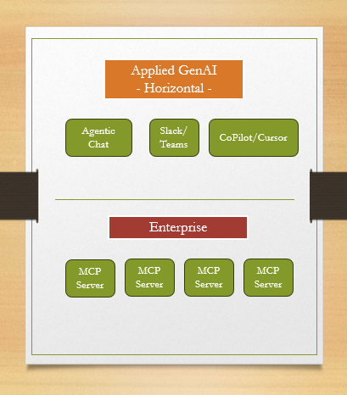

Slide 17
