Slide 1
A Testbed for Applied GenAI - Developing a large Expertise -
Satya Komatineni
6/21/25, Version 1.0 (Started 6/16/25)
Location: /articles-repo/architecture/
Applied GenAI Starter Notes for Advanced Developers

Slide 2
Goals
Define a strategic development goal
Define a tactical development goal
Gain Expertise in Applied GenAI
Provide a continuous work stream
Aim to provide a set of consistent tasks
Define a “why”

Slide 3
Why: When I have this?
Quickly test ideas
Enable smart people to be productive.
Remove impedance
Move value through vibe coding
Have productivity to developers (vibe coding) and users (via prompts)
A Team platform
Teach others to reach this goal in order to gain velocity
Trunk-and-leaf architecture to extend and enable new functionality
How to add leaves
How to add branches or trunks
A daily-use-tool-framework-platform for developers as well
Architecture easy to understand and update

Slide 4
What to watch out for
Focus on the simplest road first
For example, focus on what is easy and readily available, such as text vs voice and video
Bring innovation to that “simple” work to have a platform that can mine/cultivate value
Take the “basic” not the complex, and make it valuable
AVOID COMPLEXITY (intentionally)

Slide 5
How: The Approach Guidelines
Negotiating between Vision and Development expertise and prowess
Developers may come and go!
The Pillar need: There needs to be “ONE” developer that knows this, in and out, at all times and be part of the central team that doesn’t waver. Preferably more than one.
Framework team and an implementation team: Aspire Model.
Non-core contributing framework (Trunk-leaf architecture)
Enabled for vibe coding
Content as code
New functionality without deployment

Slide 6
Approaches for Team Cross Pollination
How do you share work
How do you bring others to contribute to the output??
How do mentees teach mentors?
Lot of TBDs here
Follow Book writing example
Explore the idea
Write sample code in github
Write the article in github with Sample code as the anchor
Have the mentor as the reviewer
Allows for large teams to collaborate
Have an integrator that is the PILLAR to bring it along
Conduct hands on coaching
Consider following a Development sabbatical model
Show how Trunk-leaf architecture can be put to action
Everything you discover, on a daily basis, publish in github!! Small or big!

Slide 7
Strategic work - The Why via What -

Slide 8
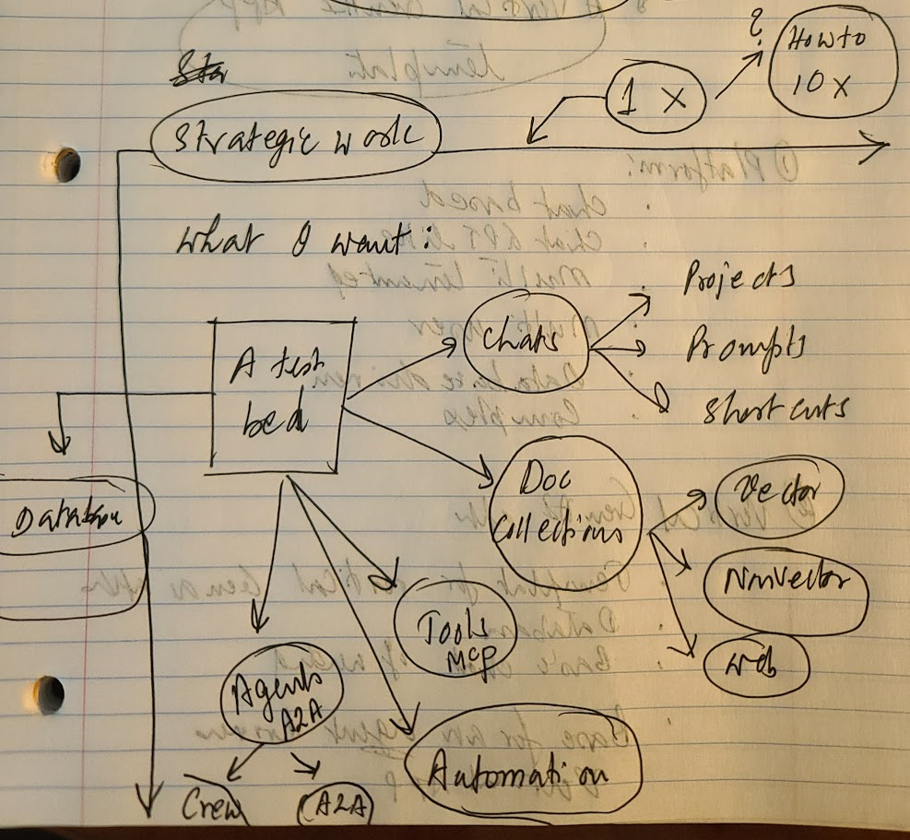
Strategic Vision
A ux chat (Ex: Assistant-ui)
A DB to support it
Projects
Prompts
Prompt Shortcuts
Document collections
MCP Tools
Automation with Agents (Crew)
A2A via Crew AI
Automation via A2A

Slide 9
Strategic work: Local
Notes/Technologies
A ux chat (Ex: Assistant-ui or CopilotKit with AG UI)
A DB to support it
Projects
Prompts
Prompt Shortcuts
Document collections
MCP Tools
A2A via Crew AI
Automation via A2A
Local app, no web or user management
Assistant-ui
Copilot-kit
AG-UI
CrewAI
Google A2A

Slide 10
Strategic work: Platform
Notes/Technologies
Multi-user
Mulit-tenanted
Web based deployment
Mobile – Responsive UX version
Mobile – Native using Google Flutter
Devops
Google Cloud
React stack from Copilotkit or Assistant Ux
Flutter

Slide 11
Tactical work - Vertical Templates for Application -

Slide 12
Tactical App Template
Notes/Technologies
Assistant-ui chat
LLM integration
MCP Tools integration
Vector integration with MCP tools
Agentic Sockets implementation for MCP and Agents
CrewAI integration
Few CrewAI apps
Assistant UI
MCP
CrewAI
Follow Cross-Pollination slide for collaboration notes
Use Duane’s assistant-ui repo as a starting point

Slide 13
A Value Framework for Applied GenAI

Slide 14
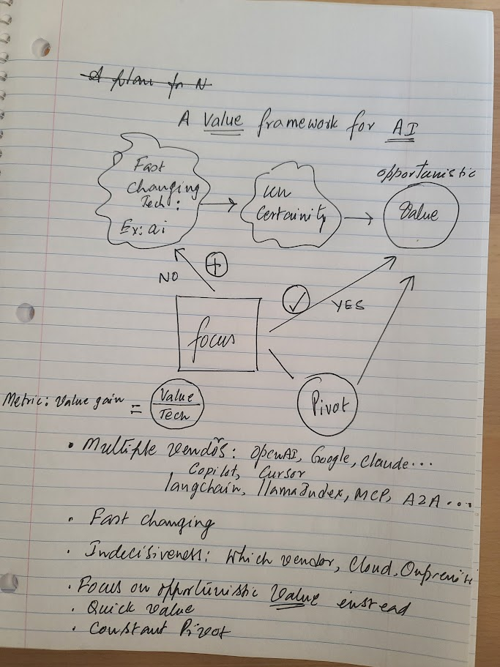
Thought

Slide 15
Challenges and Necessities….
Multiple vendors: OpenAI, MS Copilot, Aws Bedrock, Google…etc
Multiple libraries: LangChain, Llama Index, Assistant UI, CopilotKit, CrewAI, MCP, A2A
Changing fast, really fast
Indecisiveness: Which vendor to choose, which library to choose?
May be….
So…..
Focus on opportunistic value?
Quick Value: Value Today
Constant Pivot Architectures: Innovation (as early as) tomorrow
Hybrid Approaches: Both Vendors and on Premise…with “Value” at the center

Slide 16
Key References

Slide 17
Key References: Libraries and Companies
# | Dt | Item | Description
1 | 6/21/25 | LangChain
 |  | Llama index
 |  | Hugging face
 |  | OpenAI
 |  | Assistant UI
 |  | Chroma DB
 |  | Crew AI
 |  | Google ADK
 |  | Google A2A

Slide 18
Key References: Concepts
# | Dt | Item | Description
1 | 6/21/25 | Prompts
 |  | Agentic: Function Calling
 |  | ReACT
 |  | Vector RAG: Chunking, Embedding, Retrieval
 |  | LangGraph
 |  | Protocol: MCP
 |  | Agents/CrewAI
 |  | Protocol: A2A

Slide 19
Key References: Coding
# | Dt | Item | Description
1 | 6/21/25 | Github Copilot
 |  | Cursor
 |  | Anthropic
 |  | OpenAI Canvas
 |  | OpenAI Codex
 |  | Perplexity
 |  | Windsurf
 |  | Vercel
 |  | Replit

Slide 20
Appendix

Slide 21
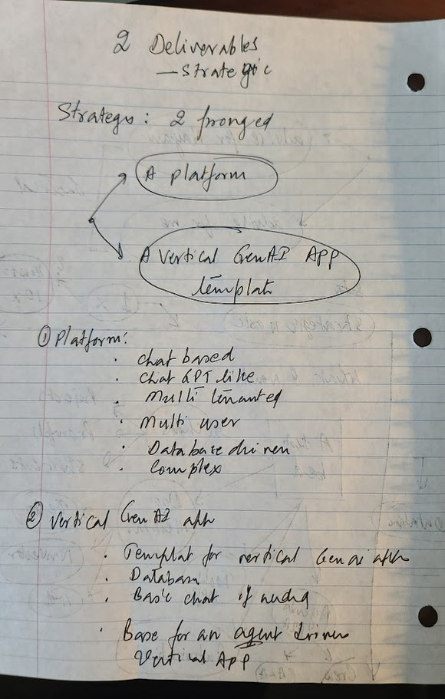
Strategic work

